Slide 1
Various Topics Related to FEB
Liang Han, Ge Jin
University of Science and Technology of China
Dec.21,2013

Slide 2
NSW sTGC Readout Electronics（1/16）

Slide 3
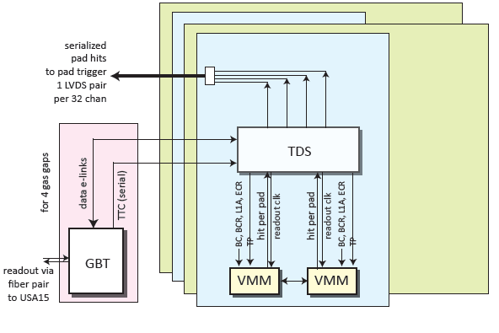
FE Boards
Two kinds of FE boards:
128 channel for PAD and Wires, Total of FE boards for Pad and wires: 24×16 ×2=768
512 channel for strips, Total of FE Boards for strip: 24×16 ×2=768
V. Polychronakos Muon Week 16-20 September 2013
3

Slide 4
Signal Generator & Mini FEB
USTC are going to develop two kinds of boards
Mini FEB
Signal Generator
The output of Signal Generator will feed charge to the input of Mini FE Board by the zebra connector.

Slide 5
Functions of Signal Generator
Functions:.
Same signals for all output;
Random signals to simulate TGC strip output;
64 strip output + 64 pad output
Zebra Conn 64
strip0
FPGA
XC6VLX240T
Driver
strip63
To FEB
Zebra Conn 64
strip64
strip128
USTC
5

Slide 6

Mini FE Board
Strip0
Zebra Conn 64
VMM2
GBT
FPGA
XC6VLX240T
E-Link
Strip63
out
Pad trig
Strip64
Zebra Conn 64
in
Strip trig in
VMM2
Ethernet
PC
Strip128
At first Ethernet will be used to read out data and configure VMM
Then develop E-link firmware to connect GBT
USTC
6

Slide 7
Diagram of FPGA Fireware for PCB test

Slide 8
Diagram of FPGA firmware for TDS test

Slide 9
Purposes of Development of Mini FEB
University of Science and Technology of China
9
FEB PCB Test
Analog performances of PCB: impedance of input, matching, shape of signal, noise on PCB, protection circuit, test input
Zebra performances: type, size, resistance, capacitance, crosstalk, mounting on PCB
Power, GND
VMM Understanding
Configuration of VMM, BC clock, TTC
Read out data from VMM
Consistency and crosstalk between channels
TDS Emulation
Pad trigger
Strip trigger logic emulation

Slide 10
Zebra Connector
Type?
Pitch number: for 64/128/512 channels?
Size: Height, length, width
How to mount zebra on PCB?
Vendor?
Crosstalk
Impedance, capacity: is it changed in different temperature?
Working life?
Absolute maximum ratings: voltage, temperature
How to feed in signal? 1 signal+1 ground per channel from sTGC to VMM

Slide 11
Questions about VMM2
How many tests have been done for VMM1
Protection circuit, if it is needed to design on PCB again?
Analog Input via zebra connector?
Matching in input stage?
What kinds of tests for VMM2 will be done in BNL?
Specification of VMM2
How to consider the pin map of VMM during designing VMM?
Output of VMM2 connect to V6 FPGA directly?
Grounding: analog GND and digital GND in VMM2, How to deal with GND on PCB.
Differences between VMM2 and VMM3: func, size, package

Slide 12
Schedule of Mini FE Board
USTC
12

Slide 13
Thank You!

Slide 14
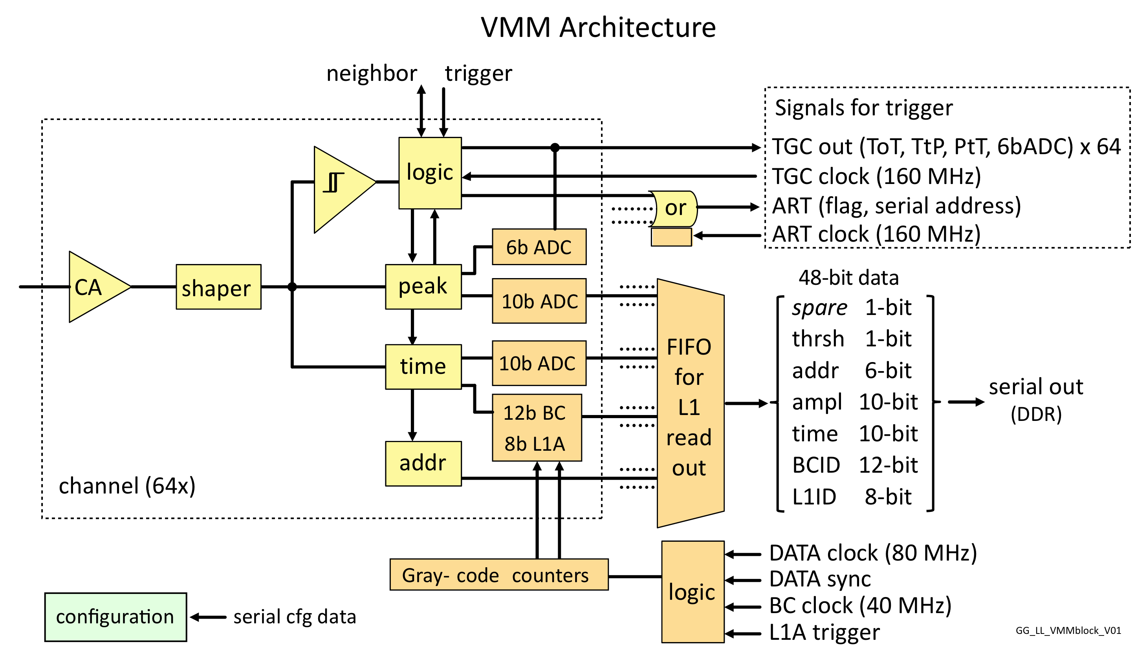
The Second version of the ASIC (VMM2)
Fixes issues (mostly minor) of the first version
Includes 10-bit digitizers for amplitude and timing (200 ns)
Includes a 6-bit Amplitude digitizer at ~40 ns conversion time
Includes 4 word buffer, simultaneous read/write, can continuously be read out at both phases of 200 MHz clock in DDR mode → 800 Mbps
G. De Geronimo, BNL Instr. Div.
IBM 8RF 130 nm CMOS process, 1.2 V 9.1 x 9.1 mm2, ~6.5 mW/channel

Slide 15
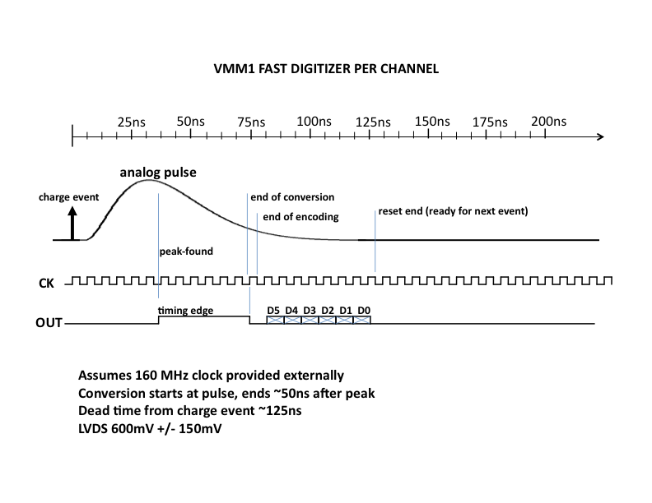
Trigger Feature 2- Prompt 6-bit amplitude per Channel

Slide 16
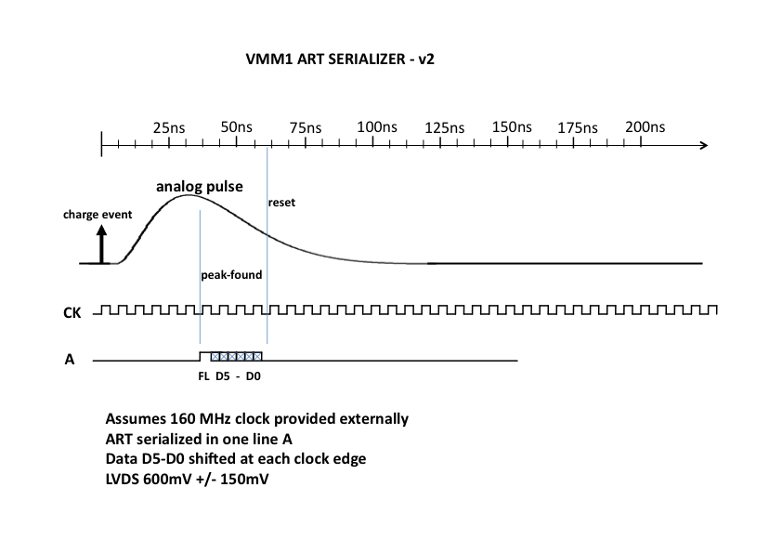
Trigger Feature 1- Address in Real Time (ART)
At every bunch crossing ART provides the 6-bit address of the channel with the earliest signal above threshold
Can be used as a fast OR

Slide 17
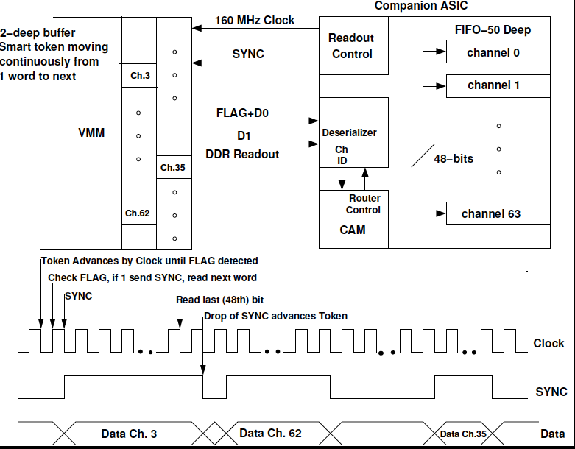
VMM2 Readout
(May be modified in final version)
4-deep buffer
200 MHz Clock
Uses both phases
Effectively 800 Mbps

