Slide 1
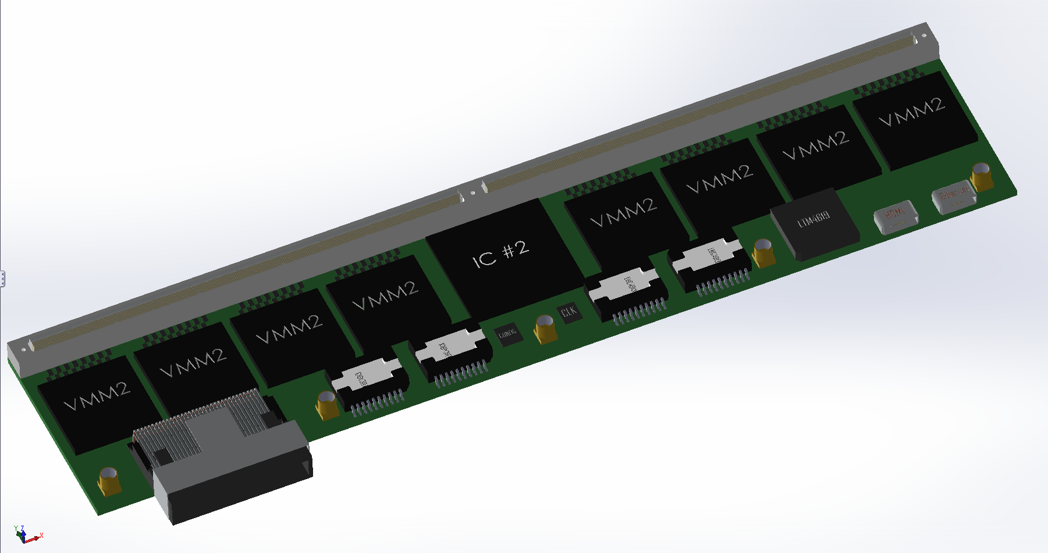
MMFE-8
SolidWorks layout
FPGA

Slide 2
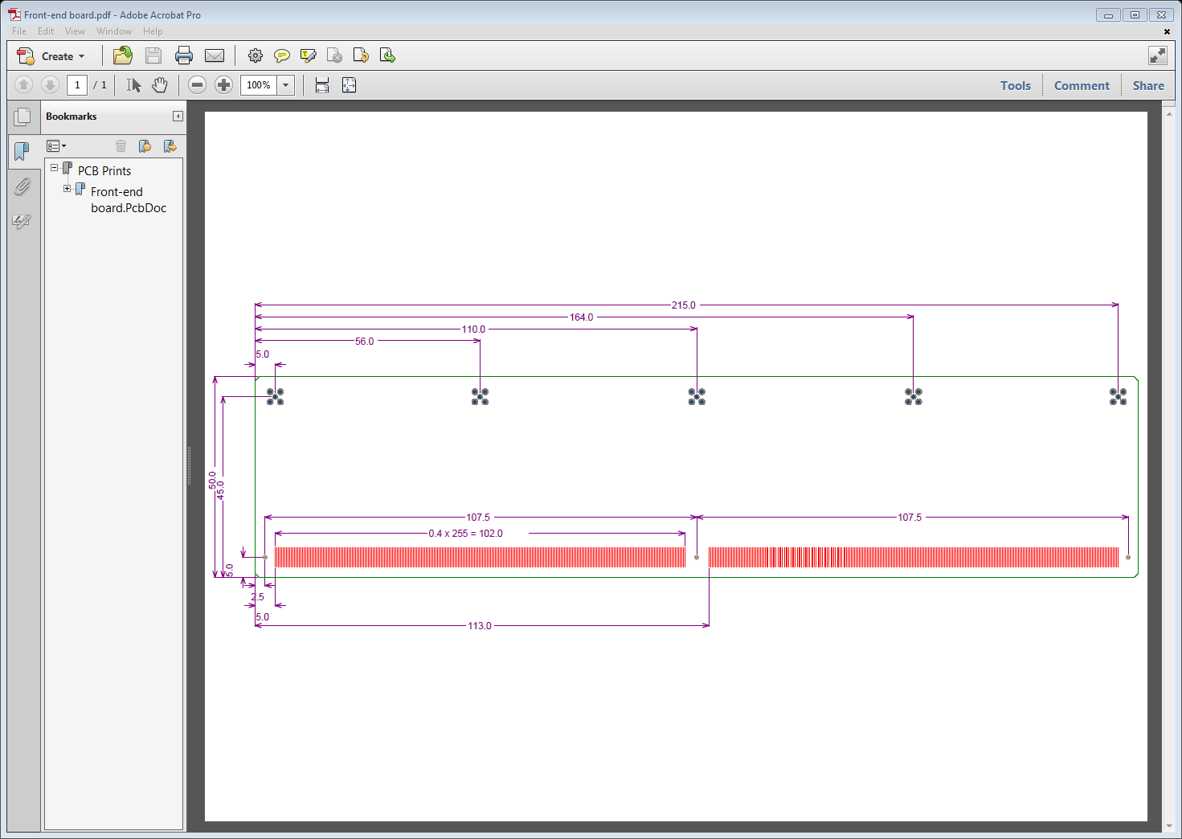
MMFE-8 PCB

Slide 3
MMFE_8 w/ FPGA
Block Diagram
Local
OSC
Config
Flash
Config
JTAG
10
SPI MOSI to VMM2_1 CONFIG + CLK
Artix XC7A200T-2FBG676Cv
8
SPI MISO from VMM2
74
TTC, CTRL, Status Clk
4
L1 Sync, L1 Clk
24
ADC
2
ART Clk
64 Sig In
SPI CFG
BCnt + Ctrl
L1 Accept
ACLK
2
TRIG/ADDR: 16
Dual Zebra + Protection
VMM2_1
SPI CFG
BCnt + Ctrl
L1 Accept
ACLK
6
D0, D1, STATUS: 48
64 Sig In
2
VMM2_2
SPI CFG
BCnt + Ctrl
L1 Accept
ACLK
6
Protection
64 Sig In
2
uHDMI
SRS
VMM2_3
SPI CFG
BCnt + Ctrl
L1 Accept
ACLK
6
64 Sig In
2
GbE
PHY
uHDMI
GbE
VMM2_4
SPI CFG
BCnt + Ctrl
L1 Accept
ACLK
6
64 Sig In
2
VMM2_5
uHDMI
GBT
SPI CFG
BCnt + Ctrl
L1 Accept
ACLK
6
64 Sig In
2
VMM2_6
SPI CFG
BCnt + Ctrl
L1 Accept
ACLK
6
miniSAS 8i
64 Sig In
2
VMM2_7
SPI CFG
BCnt + Ctrl
L1 Accept
ACLK
6
64 Sig In
2
VMM2_8
6
VMM 1.2 VDC_Analog
VMM 1.2 VDC_Digital
FPGA 1.8/1.2/1.0 VDC
24 VDC

Slide 4
MMFE-8
Input
  2 x 256 channel Zebra connectors (Ruter Elastomer)
  Compatible with sTGC
  24V Power connector TBD
Input / Output
  JTAG for FPGA Configuration
  ≤ 68pin miniSAS 8i I/O (e-link)
  μHDMI for SRS (still TBD with Sorin)
  μHDMI for future dual GBT or dual e-link
  μHDMI for ethernet

Slide 5
I/O Connections between
FPGA and VMMs
Configuration (3 pairs)
  Configuration clock (potential multidrop)
  di and d0
ART Data (2 pairs)
  ART clock (potential multidrop)
  ART data to ART ASIC
L1 Data (4 pairs)
  L1 Data clock (potential multidrop)
  SYNCH
  L1 Data (d0 and d1)
TTC (5 pairs)
  BC clock (phase adjusted) (potential multidrop)
  L1A (potential multidrop)
  BCR (potential multidrop)
  FER (potential multidrop)
  CAL
Control (2 pairs)
  WEN and ENA
Status (2 pairs)
  VMM status
  Status clock (potential multidrop)
Implies Worst Case
18 x 8 = 144 pairs (288 pins)
for FPGA
Implies Best Case
10 x 8 + 8 - 8 = 88 pairs (160 pins)
for FPGA (pairs + MD – ART)

Slide 6
Connections between
FPGA and MMFE-8 I/O
SRS uHDMI (need Sorin’s input) (4 pairs)
  4 undefined pairs
GbE uHDMI (4 pairs)
  4 pairs from PHY (need magnetics and adapter)
  14 pins to PHY from FPGA
GTB uHDMI (3 pairs)
  2, 3, or 4 pairs depending on application (single, dual, GTB or e-link)
miniSAS 8i (24 pairs)
  Configuration, Control and Status (3 pair e-link)
    Configuration (encoded)
    WEN and ENA (encoded)
    Status (encoded)
  TTC (3 pair e-link)
    BC clock (phase adjusted e-link clk)
    L1A (encoded)
    BCR (encoded)
    FER (encoded)
    CAL (encoded)
    JTAG (encoded)
  L1 Data (3 pair e-link)
  ART data (8 + 1 =9 pairs)
JTAG(4 pins)
sTGC needs? TTP signals are currently left open…
Implies
36 pairs (72 pins)
For FPGA
Implies
18 pairs (36 pins)
For miniSAS 8i

Slide 7
FPGA Choice

Slide 8
FPGA Choice

Slide 9
FPGA Choice

Slide 10
FPGA Choice
Design files exist for S6 and K7 (Arizona) and A7 (Weizmann)
Vivado can be used with *7 FPGA’s
Zynq has ARM capability (easier testing via C?)
S6 needs fewer voltages
A7, K7, Z7 have ADC capabilities
Chose XC7A200T-2FBG676C
  Best known architecture and tools
  3 rail power solution
  No bank restrictions
  Has MB solution available
  Nearly identical dev board and IP
  Good chance of Rad Hard acceptance
  Comparable cost $250
  Comparable size 729mm
  Comparable power ~600mW quiescent

Slide 11
FPGA Power Estimate
Xilinx Power Management Solutions Guide from Analog Devices
1V -- ICCINT=3.15A; ICCBRAM=.100A?; IMGT_AVCC=.511A =>3.66A
1.2V -- ICCIO=0.1A; IMGT_AVTT=0.36A; ICCO=.511A => .971A
1.8V – ICCAUX=0.32A
Next: XPE Power Estimation—Use Cases for Artix-7/Kintex-7

Slide 12
VMM Power Estimate
VMM requires separate Analog 1.2V supply, 8mW/ch * 64 = 512mW => 427mA.
VMM requires separate Digital 1.2V supply, 10mW/pr * 18 = 180mW => 150mA.
8 VMM’s require Ivmma = 3.4A; Ivmmd = 1.2A

Slide 13
Power Solution
1 x LTM4619
  Drop 24Vin to 1.8Va for Vvmma
  Drop 24Vin to 1.8Vd for Vvmmd
  Use 1.8Vd for 1.8Vfpga
2 x 8 LT3080
  Drop 1.8Va to 1.2Va for Vvmma
  Drop 1.8Vd to 1.2Vd for Vvmmd
  Awaiting Gianluigi’s feedback
1 x LTM4619
  Drop 24Vin to 1.2Vfpga
  Drop 24Vin to 1.0Vfpga
Utilize additional LTM4619 if required.
LTM4619 and LT3080 have successful Rad Hard history.
Use Chip Inductors liberally to separate power inputs, permit direct current measurement.
Use Bulk and Bypass Caps Liberally to reduce supply noise.

Slide 14
Analog Input Considerations:
Impedance
Kapton Thickness | 0.06 | mm | 2.36 | mil
Er Kapton | 3.4
Honeycomb Thickness | 9 | mm | 354.33 | mil
Er Argon - CO2 | 1
Trace Width | 0.3 | mm | 11.81 | mil
Trace Pitch | 0.45 | mm | 17.72 | mil
MM Impedance Calc
Single Ended Microstrip |  |  |  | Differential Microstrip
Target Impedance |  | 13 |  |  | 26 | 26
Model Impedance | 13.12 | 14.04 |  | 26.22 | 28.03 | 24.07
Trace width | 11.81 | 13.50 |  | 11.81 | 13.50 | 11.81
Dielectric Er | 3.4 | 4.3 |  | 3.4 | 4.3 | 4.3
Dielectric height | 2.36 | 3.00 |  | 2.36 | 3.00 | 2.36
Trace thickness | 0.7 | 1.4 |  | 0.7 | 1.4 | 0.7
Differential Spacing |  |  |  | 17.72 | 17.72 | 17.72

Slide 15
Analog Input Considerations:
Protection:
NUP4114 is the current protection device in use.
  ESD Rating for contact is +/- 8 KV
  Capacitance is 1 - 0.3pf
New proposed ESD7008 has:
  Same manufacturer
  Lower capacitance 0.2pf
  Higher ESD Rating for contact +/- 15 KV
  Comparable cost per channel
  Slightly larger packaging (to dissipate energy)
  Bidirectional capability
Testing leakage current now…

Slide 16
Analog / Digital Design Considerations
Analog Power should not overlap Digital ground planes, and vice versa.
Analog length matching is not important, however impedance matching is.
Digital length and impedance matching is important, within pairs, and within clock domains.
Distributed clocks such as ART to VMM should be the same distance from the FPGA.

Slide 17
Configuration
Startup FPGA configuration should be stored in the config flash, This will speed up startup.
A Golden config should be kept in flash, to speed recovery.
VMM config should be stored in flash.
Flash can be configured via JTAG.
A serial number can be stored in the flash.

Slide 18
ADC
ADC is built into the FPGA.
  32 Channels
  12bit
  1MHz
  0-1V
3 ADC lines can be provided to each VMM from the FPGA, for cal and diagnostics.
ADC also monitors Power and Temp.

Slide 19
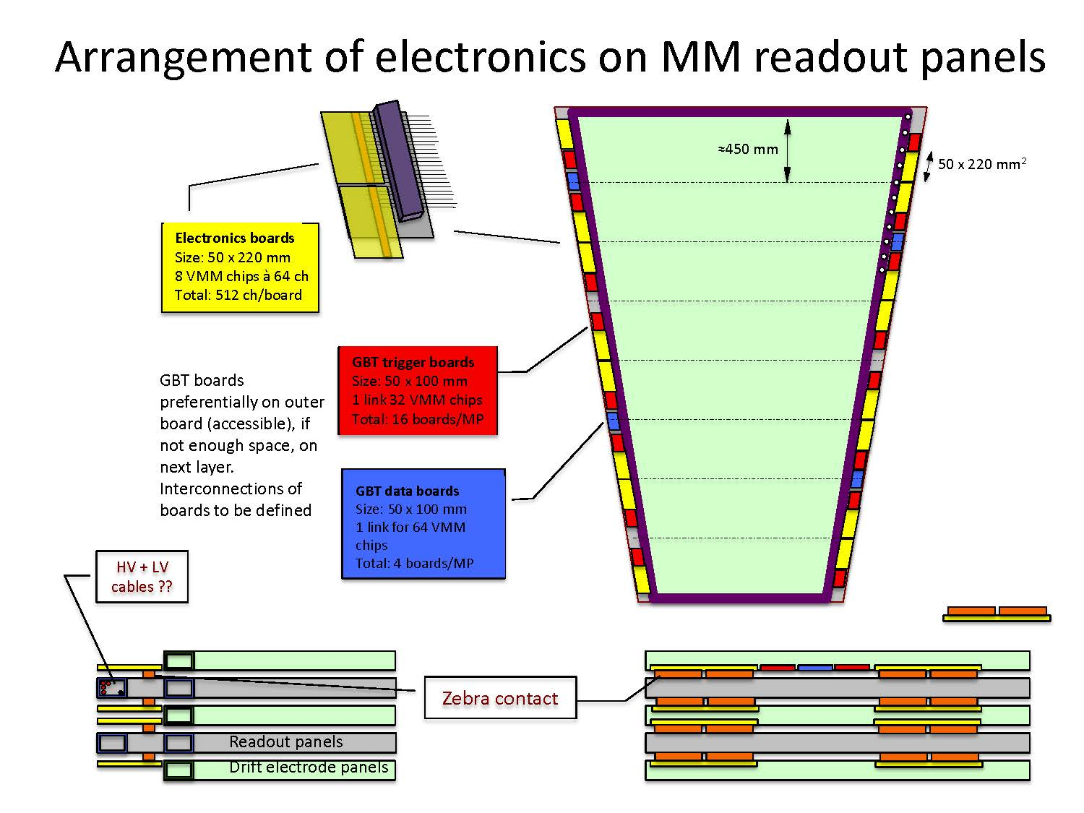

Slide 24
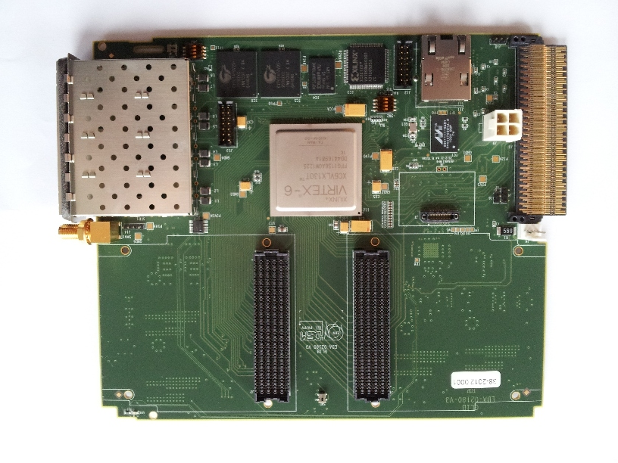
Readout of MMFE-8
The Spartan 6 on the S6-FMC
is used to translate voltage
levels to/from VMM
Custom
S6-FMC
GbE out
(UDP
packets)
Or Versa-
Link
(Custom
packets)
4 x MMFE-8,
each containing
8 VMM ASICs
4 x miniSAS
cables (32 ART,
3+ E-Link each)
GbE out
(UDP
packets) to MATLAB
The Virtex 6 contains
transfer logic to configure
and readout the VMM
PCIe out
packets to Chassis

Slide 25
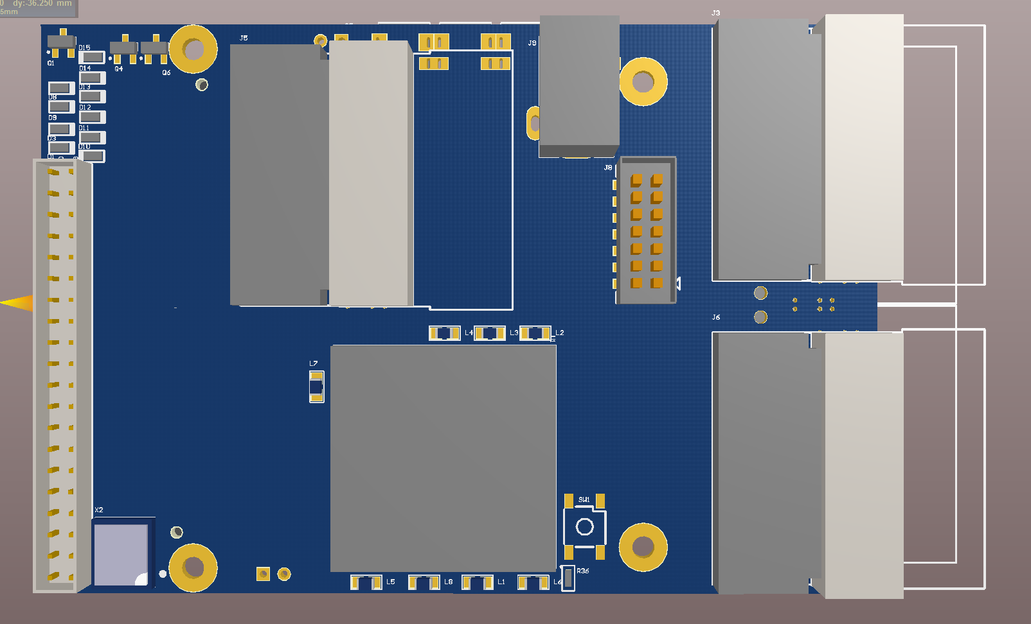
Readout of MMFE-8
The Spartan 6 on the S6-FMC
is used to translate voltage
levels to/from VMM
GbE out
(UDP
packets)
Or Versa-
Link
(Custom
packets)
4 x MMFE-8,
each containing
8 VMM ASICs
4 x miniSAS
cables (32 ART,
3+ E-Link each)
GbE out
(UDP
packets) to MATLAB
The Virtex 6 contains
transfer logic to configure
and readout the VMM
PCIe out
packets to Chassis

