Slide 1
Mini MMFE
Miniature MicroMegas Front End Board

Slide 2
Block Diagram
Analog Input Connector
Lemo
Analog Out
64x analog in
Not used
Protection
Networks
VMM1
TTP/TOT
64x analog in
ART
Readout
Digital I/O Connectors
VDDD
VDD
VDDP

Slide 3
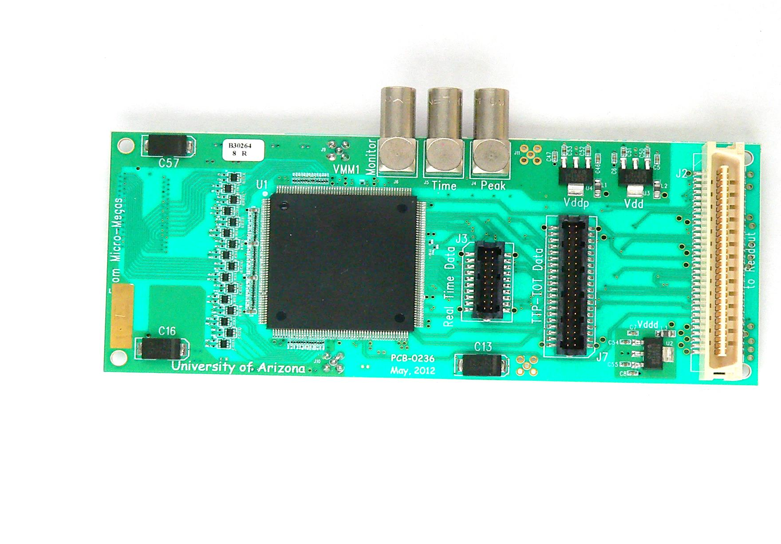
Mini MMFE

Slide 4
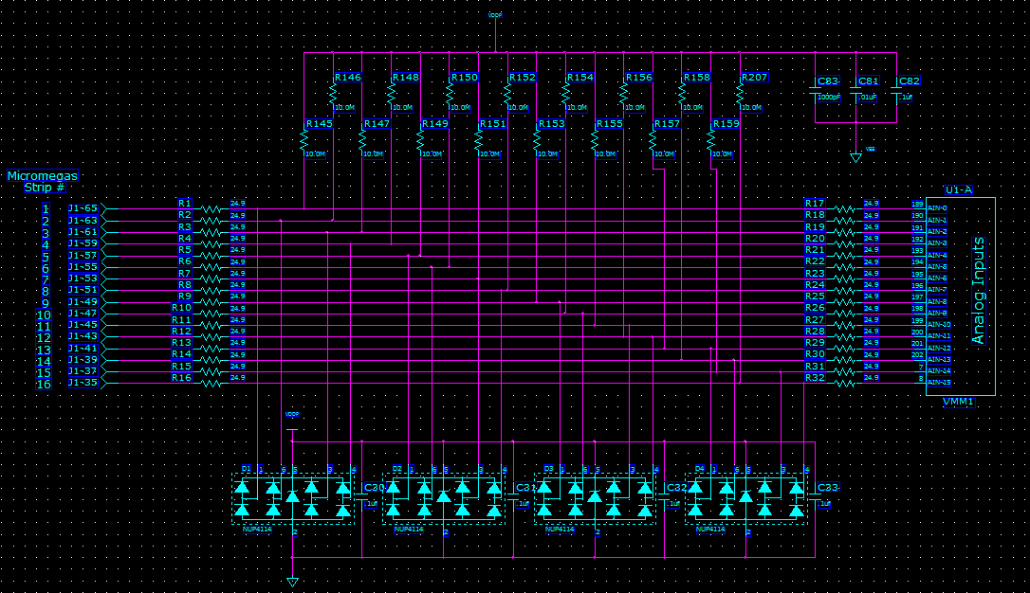
Analog Inputs

Slide 5
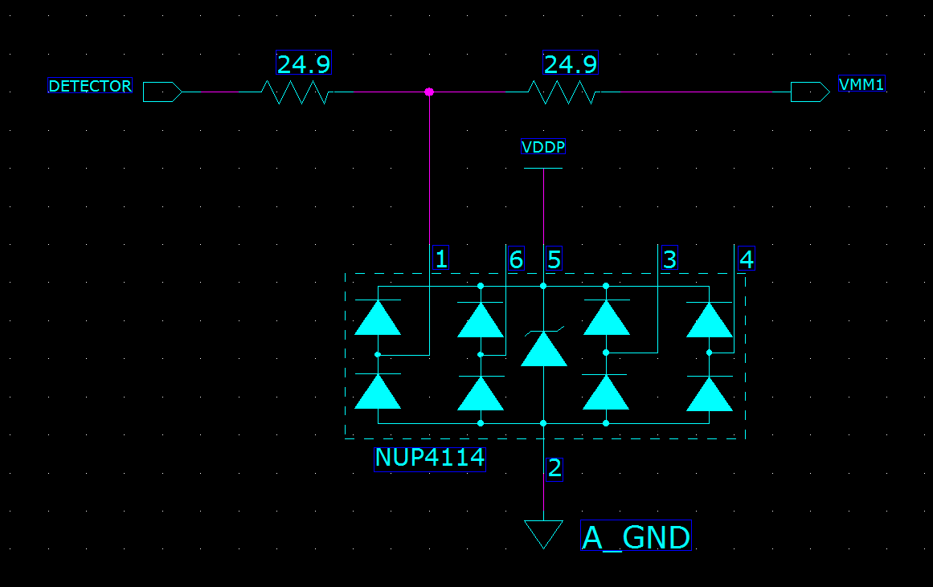
Protection Network

Slide 6
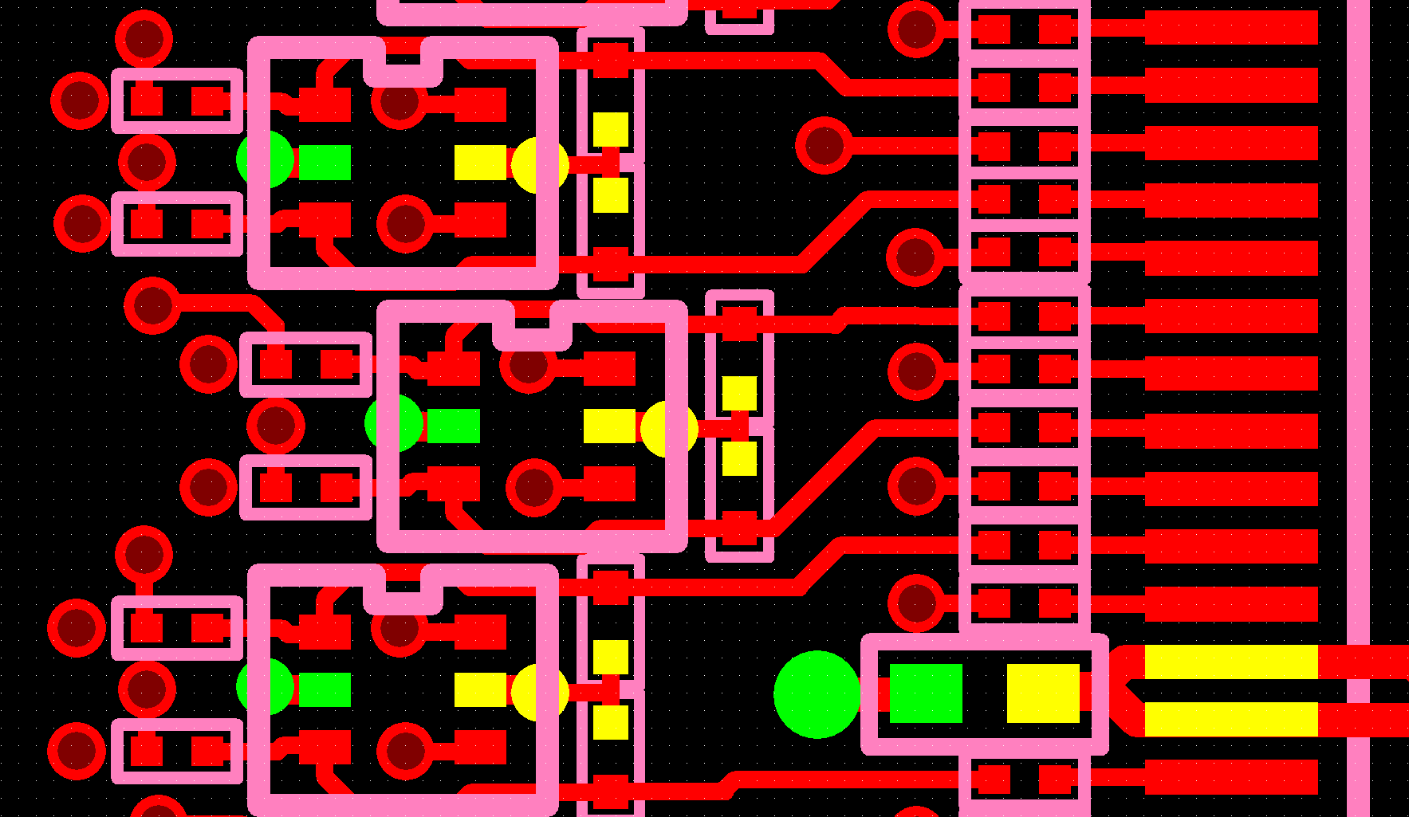
Protection Network Layout
Connect Vcc and GND pins directly to a plane and keep traces short

Slide 7
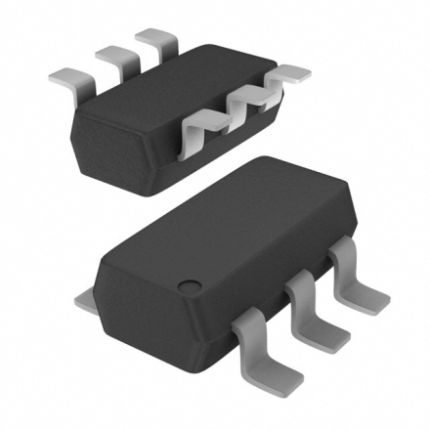
NUP4114
Leakage Current < 1pA @1.2V
< 1 pF Junction capacitance
Response Time is Typically < 1.0 ns
Stand−off Voltage: 5.5 V
Cost $0.10 in large quantity

Slide 8
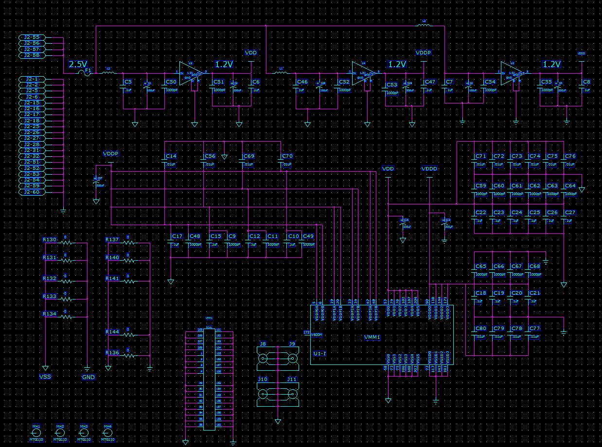
Regulators

Slide 9
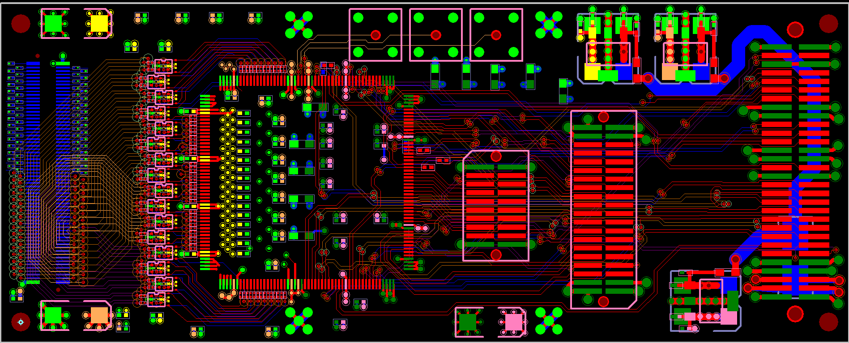
All Layers

Slide 10
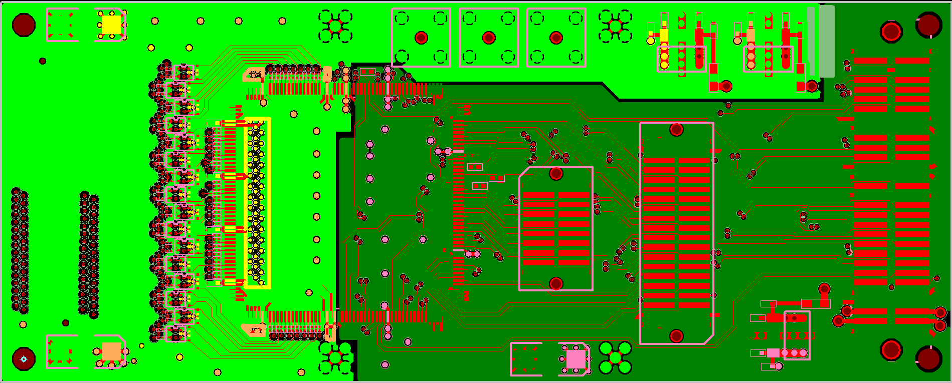
Power and ground planes
Planes join here
Analog
Digital

Slide 11
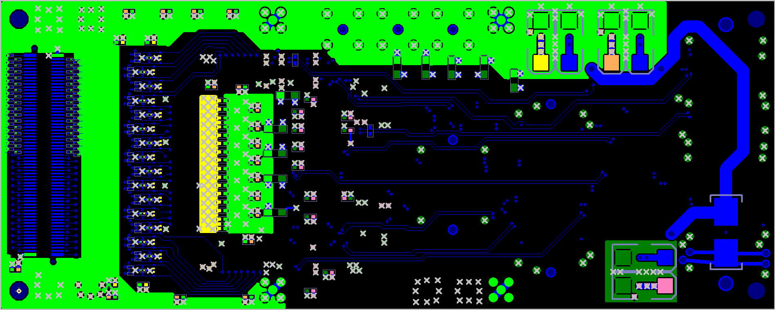
Bottom Layer

Slide 12
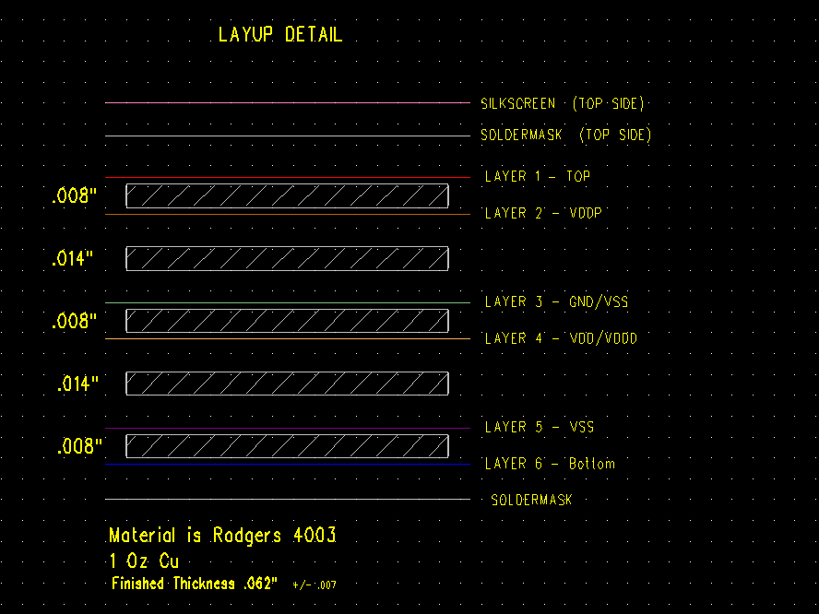

Slide 13
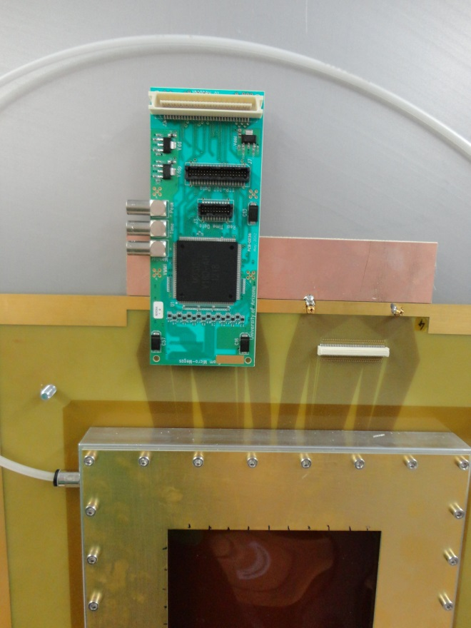
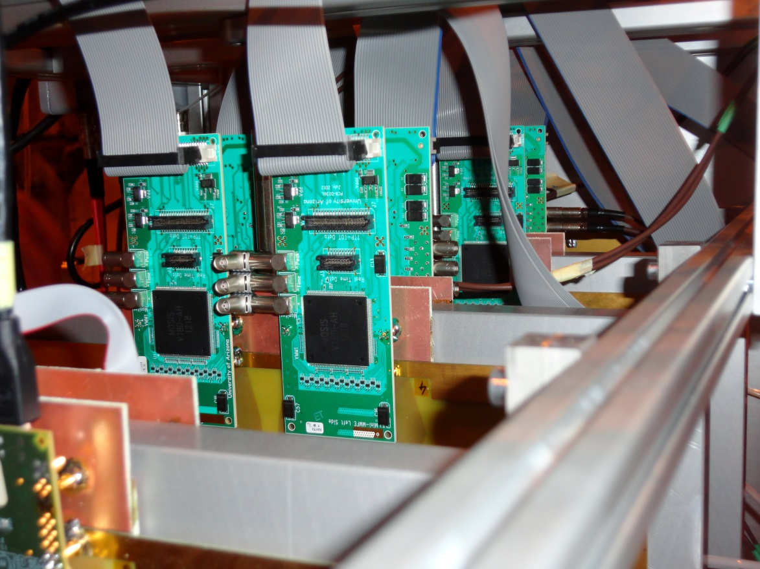
Mini MMFE in use
Photos by:

Slide 14
Mini MMFE-2

Slide 15
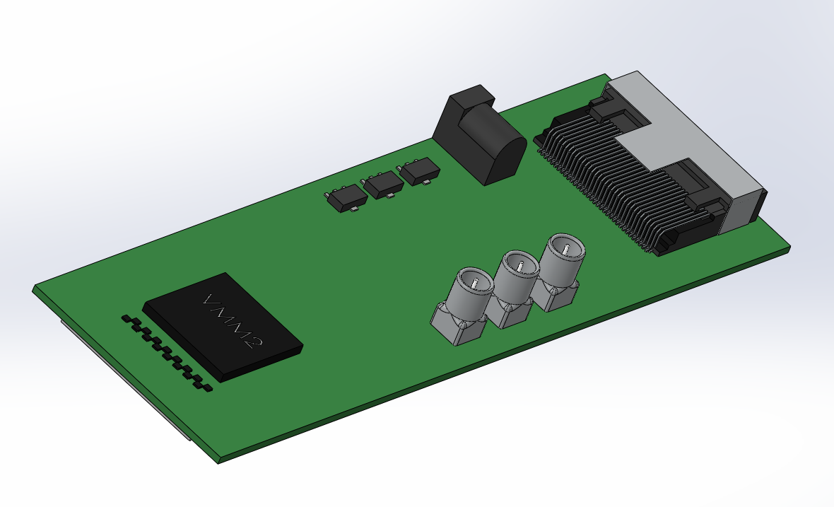
Mini MMFE-2
Drawn by Karen Palmer

Slide 16
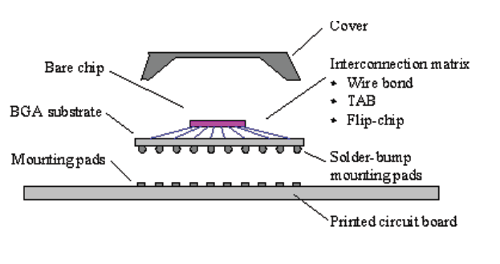
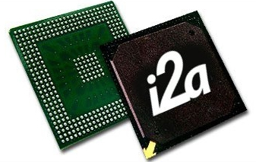
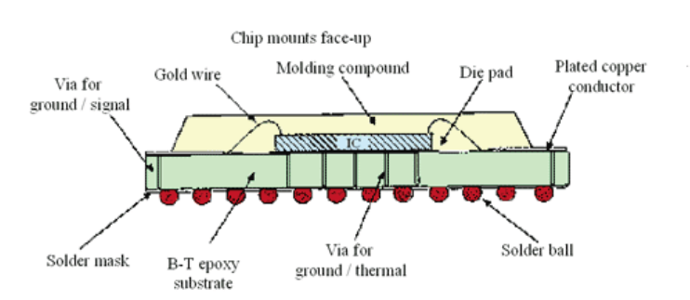
BGA package in a nutshell

Slide 17
Mini MMFE-2
WIP, Pin out and power consumption unknown
VMM2 will be in a 22x22mm BGA Package
8 layer board?
Use a lower noise regulator ( LT1763) and fewer bypass Caps.
Mini SAS connector for digital I/O.

