Slide 1
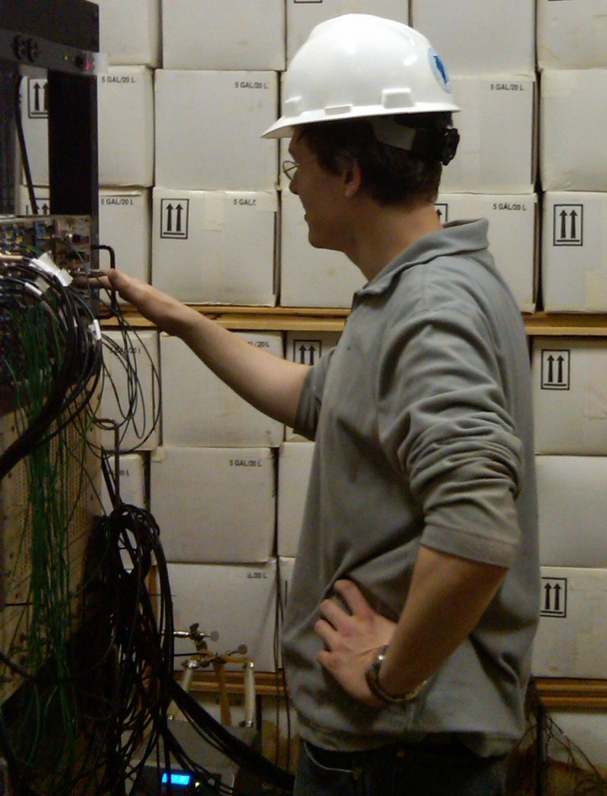

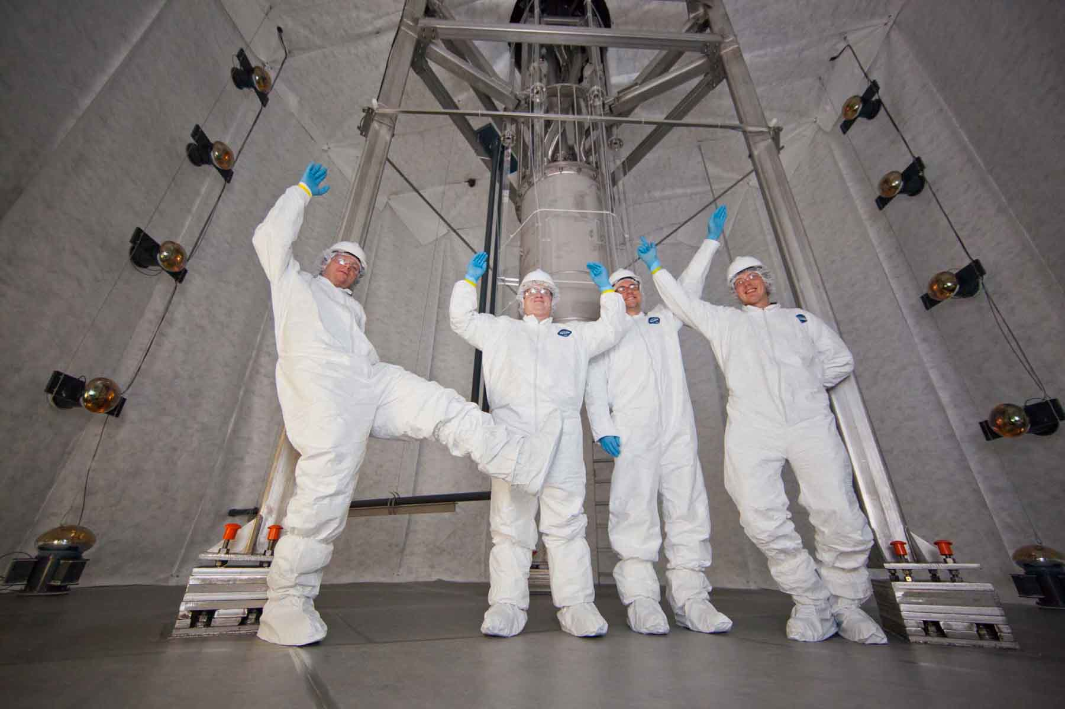
The Riddle of the Invisible Universe
A journey from the sewers of Chicago to the Black Hills
Matthew Szydagis
University of California, Davis
University of Arizona 02/26/14

Slide 2
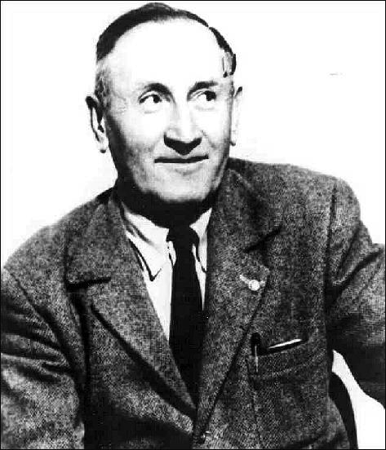
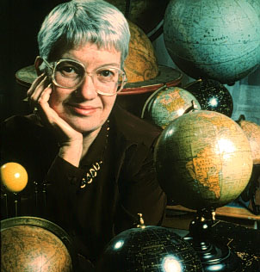
Historical Perspective
In 1933 Swiss astronomer Fritz Zwicky discovered that there was “insufficient” luminous matter in the stars of the Coma cluster
Conclusion based on looking at the kinetic energies of galaxies
Coined the term “dark matter”
In 1950 American astronomer Vera Rubin found a new piece of the puzzle: intragalactic rotation curves
Today - wealth of indirect evidence, but conclusive detection elusive
Fritz Zwicky
Vera Rubin

Slide 3
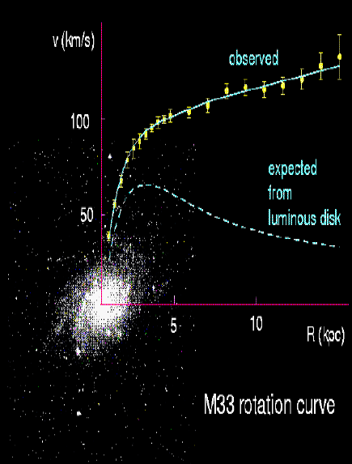
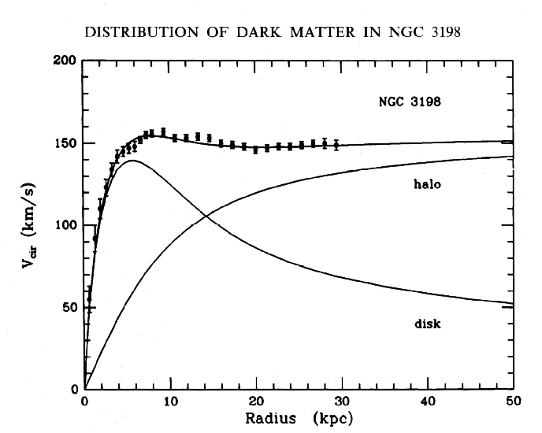
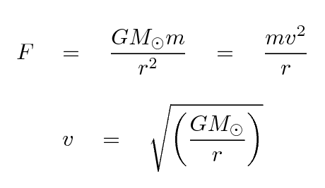
Rotation Curves
Galactic rotation curves consistently exhibit unexpected behavior
Intragalactic rotational velocities gravitationally consistent with there being more matter than is visible in the stars
U. of Sheffield
Notre Dame

Slide 4
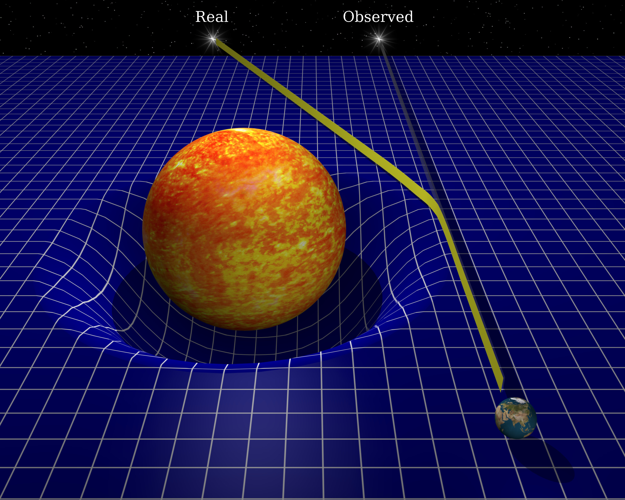
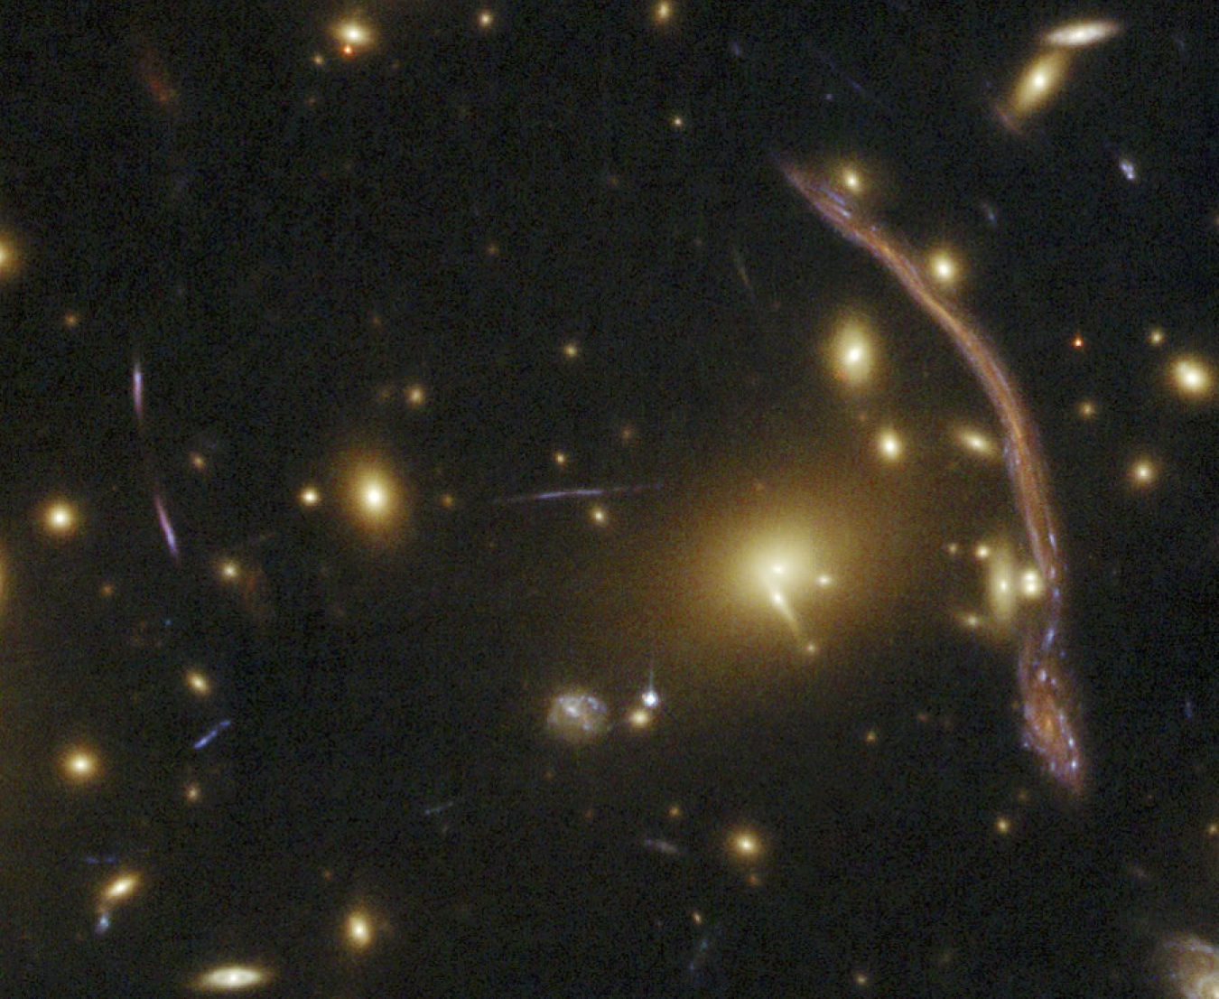
Gravitational Lensing
Gravitational distortion of light by matter enables a calculation of the mass of the matter doing the distorting
Predicted by Einstein (general relativity) and first hint observed during a solar eclipse in 1919, but not as a galactic-scale lens until 1979
Gravitational lensing studies concur with the rotation curves
Bell Labs
R. Dalsanto
NASA

Slide 5
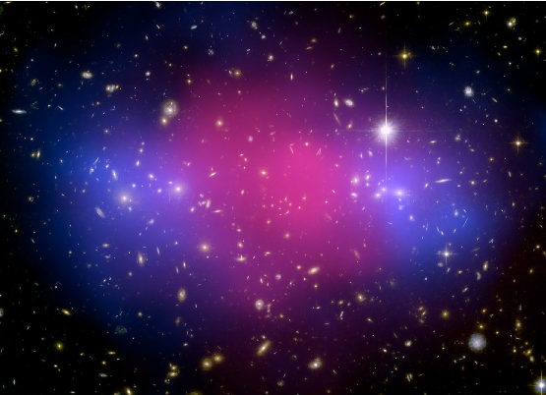
Baby Bullet Cluster
Hot x-ray emitting gas in red superimposed on image
Probable dark matter in blue (mapped via gravitational lensing study)
Galaxies collided but dark matter evaded
> 1 Gpc away!
Clowe et al., 2006

Slide 6
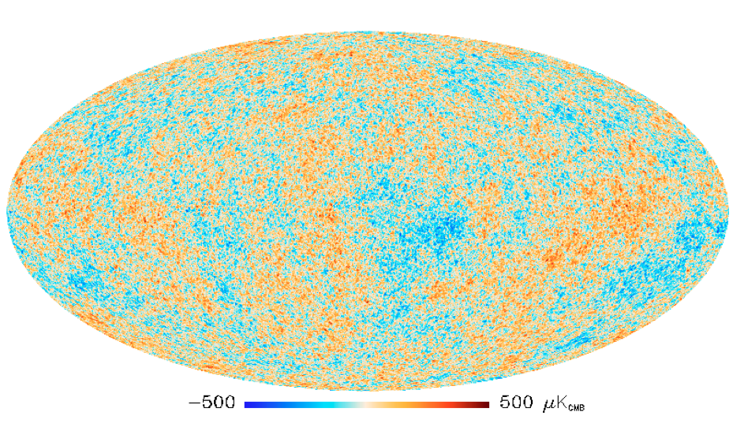
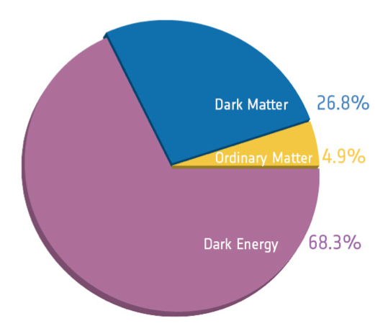
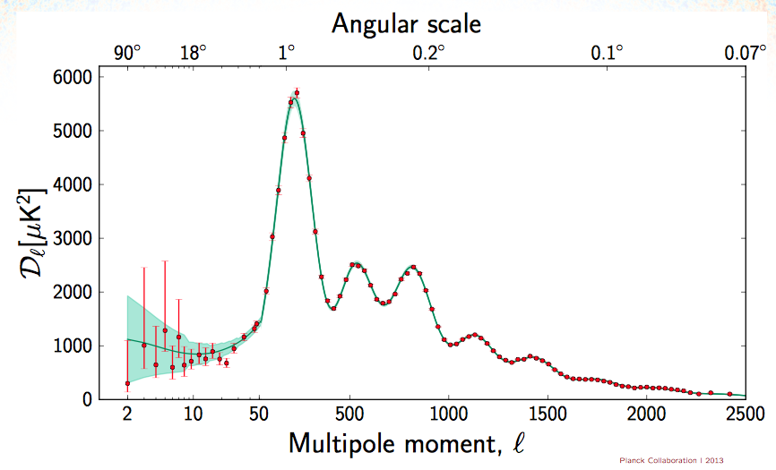
Cosmic Microwave Background
CMB is an “echo”: snapshot from 370,000 years after Big Bang, when photons and the plasma decoupled
CMB favors model where 27% of energy content of universe is in matter, but non-baryonic particles
  Best fit for explaining the angular power spectrum of the temperature anisotropy
Planck collaboration 2013
Not a proton, a neutron, or a related particle
Standard Cosmological Model

Slide 7
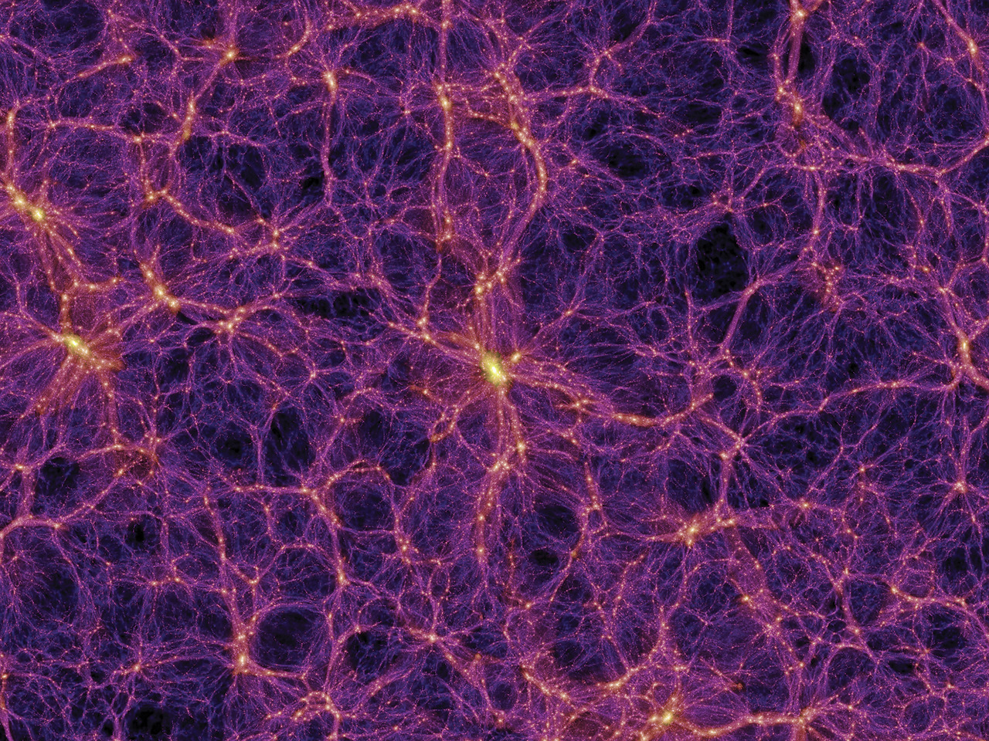
Large-Scale Structure
  Observations (baryon acoustic oscillation, galaxy clusters) and simulations agree well when the presence of *cold* (non-relativistic) dark matter assumed
  Need dark matter to interact weakly (as in rarely -- not necessarily via the weak force), mainly gravitationally
Springel et al., 2006

Slide 8
Strategies for Detection
Indirect detection of dark matter (DM) self-annihilation into Standard Model (SM) particles (γ’s or ν’s)
Direct detection
Production of dark matter particles from the high-energy collisions of a particle accelerator (LHC)
?
M. Woods

Slide 9
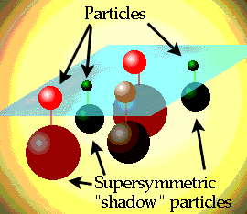
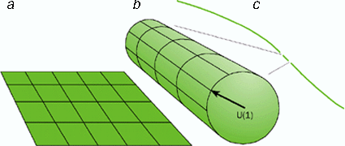
Candidate Particles
The WIMP, or, the Weakly Interacting Massive Particle = vanilla candidate
But, no Standard Model particle has all its traits
  Cold/non-relativistic (so, must be heavy)
  Can’t be baryons (would result in disagreement with CMB measurements)
  Interacts very “weakly”
  Stable, or very long-lived
Supersymmetry or Kaluza-Klein theory (higher dimensions) => WIMPs
fermions and bosons
FNAL
sfermions and
bosinos
EXTRA DIMENSIONS?
© Dirk Laureyssens, 2002/2003

Slide 10
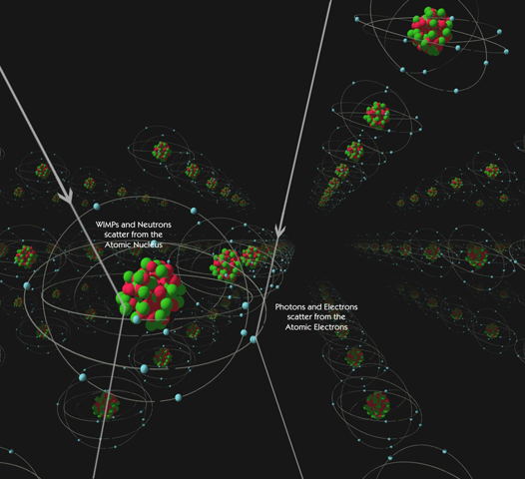
Direct Detection Method
Most searches are geared toward finding WIMPs, in a model-independent fashion
In most WIMP models, WIMP-nucleon scattering cross-section is dominant
Experiments deployed underground, because depth reduces cosmic ray background
M. Attisha
Two signals: nuclear recoil and electron recoil
Low-energy nuclear recoils (NR) are expected from WIMPs, and electron recoils (ER) constitute background (BG) one must avoid misidentifying as NR

Slide 11
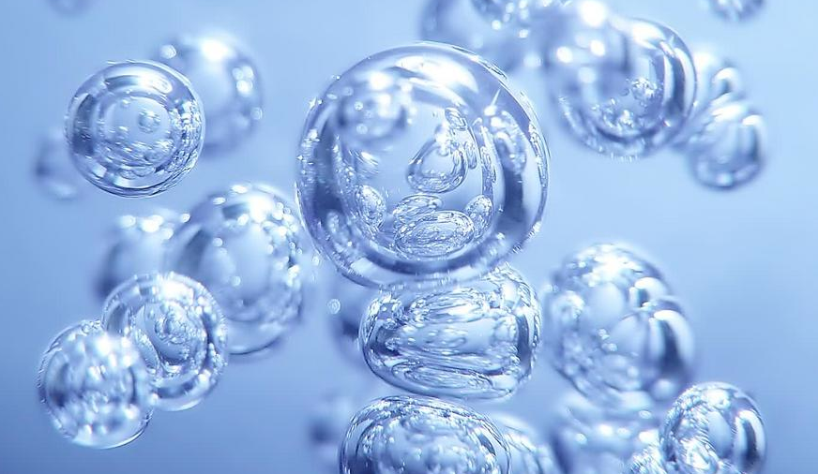
Response of a Detector
Atoms can be excited and scintillate and/or be fully ionized by NR/ER
Recoils can also cause lattice vibrations
Recoiling species can boil superheated liquids
Robust searches combine two methods
Given rare interaction, figure of merit = target mass X exposure
light from de-excitation (scintillation)
charge from ionization
phonons
heat
bubbles

Slide 12


Slide 13
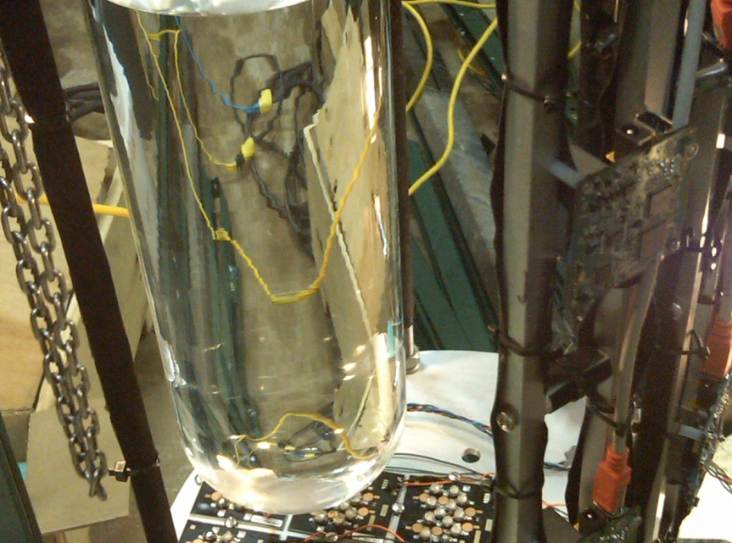
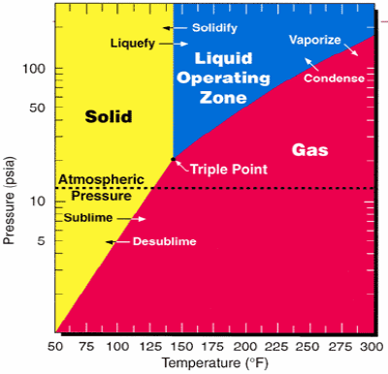
My History in Dark Matter
Chicagoland Observatory for Underground Particle Physics (COUPP) bubble chamber
Metastable fluid, in liquid phase below vapor pressure
Innovative 15 kg windowless chamber deployed in Chicago water pollution alleviation tunnel, for my Ph.D. thesis
Showed Rn alphas “louder” vis-à-vis neutrons (WIMP-like) using piezo microphones

Slide 14
Technology Contrast
COUPP (now PICO) is blind to ER BGs to better than 1 part in 10¹⁰, but event energy unknown
  Latter issue overcome with operating pressure or temperature sweep: energy, dE/dx thresholds change
  But, only one channel with which to study signal
Xenon detector like LUX (Large Underground Xenon) misidentifies ER as NR with a 1 in 10²-10³ chance and is cryogenic and expensive, but *has* event energy reconstruction
  Mis-ID issue surmountable with low-BG construction
  High density of liquid xenon provides excellent self-shielding of not only alphas, but gammas as well
Xenon-based experiments (XENON, ZEPLIN, LUX) leading the field for better part of a decade now

Slide 15
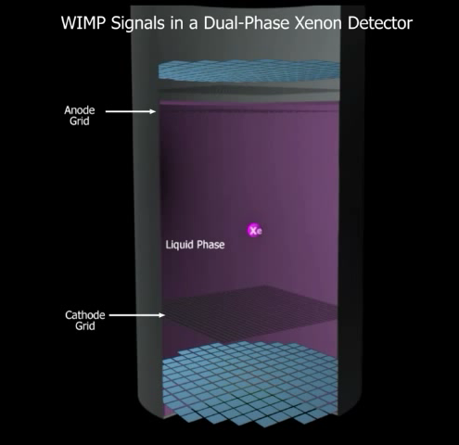
How LUX Works
A two-phase xenon detector, an example of a time-projection chamber (TPC), with 122 PMTs (photomultiplier tubes), which convert photons into photo-electrons (phe)
S1 (primary) and S2 (secondary) scintillation, the latter from charge
Fiducialization and multiple-scattering rejection powerful: WIMPs will exclusively lead to single scatters
XY positions from top light pattern
1:1 detector
48 cm max drift length

Slide 16
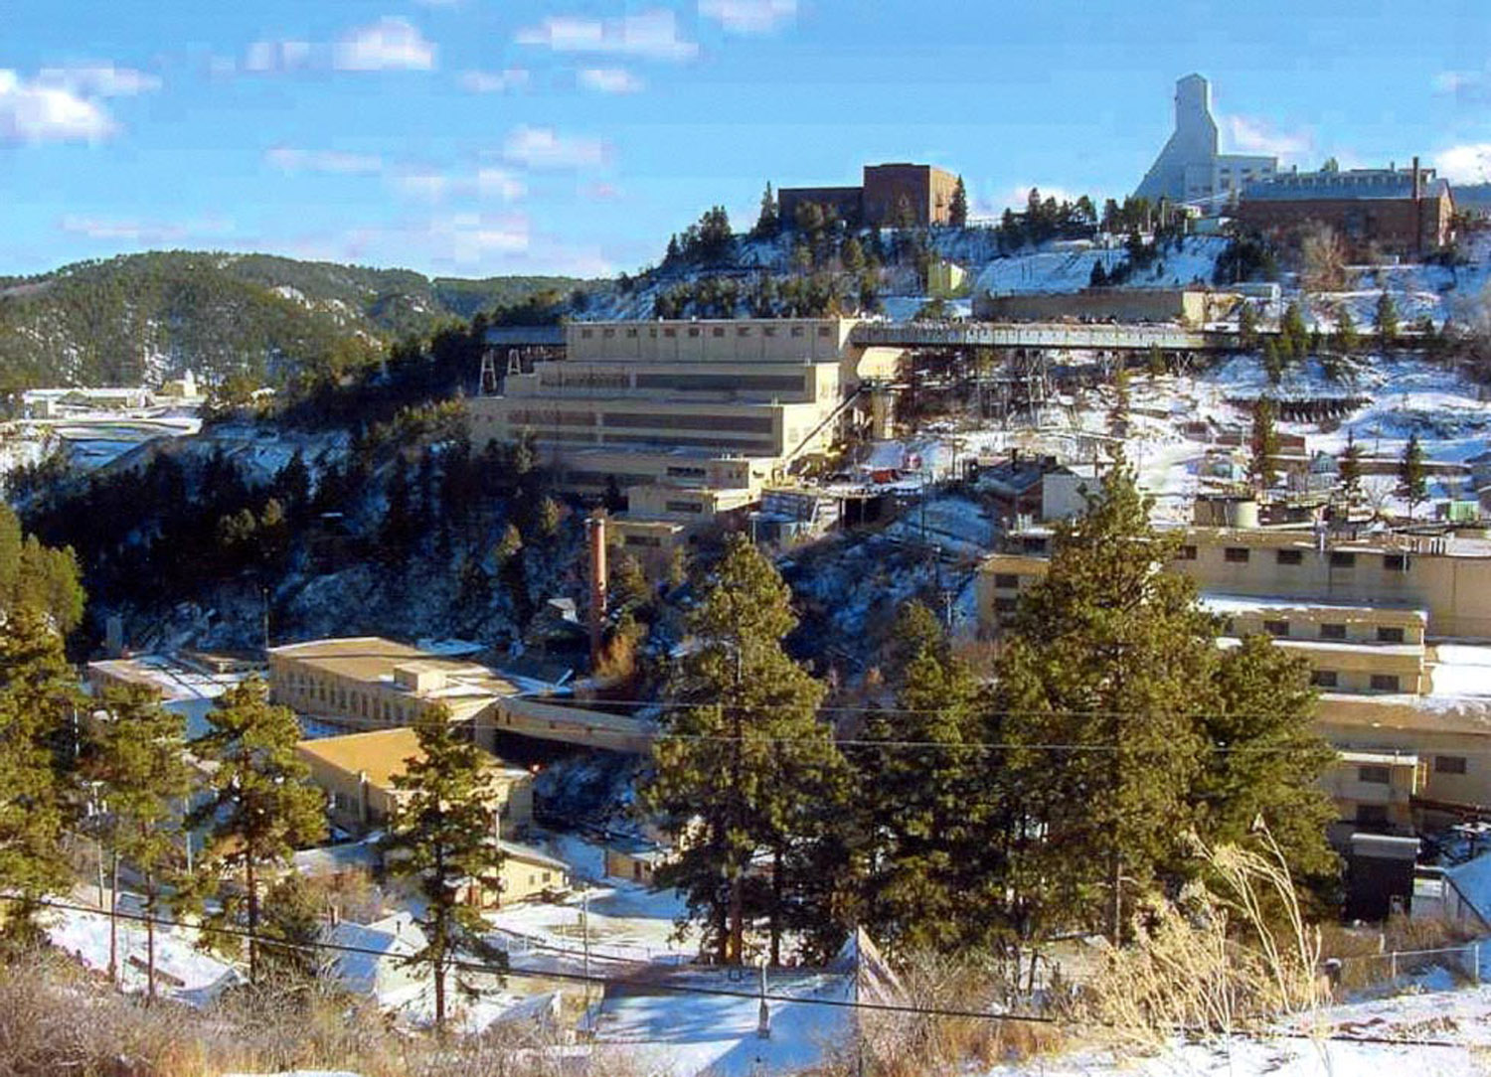
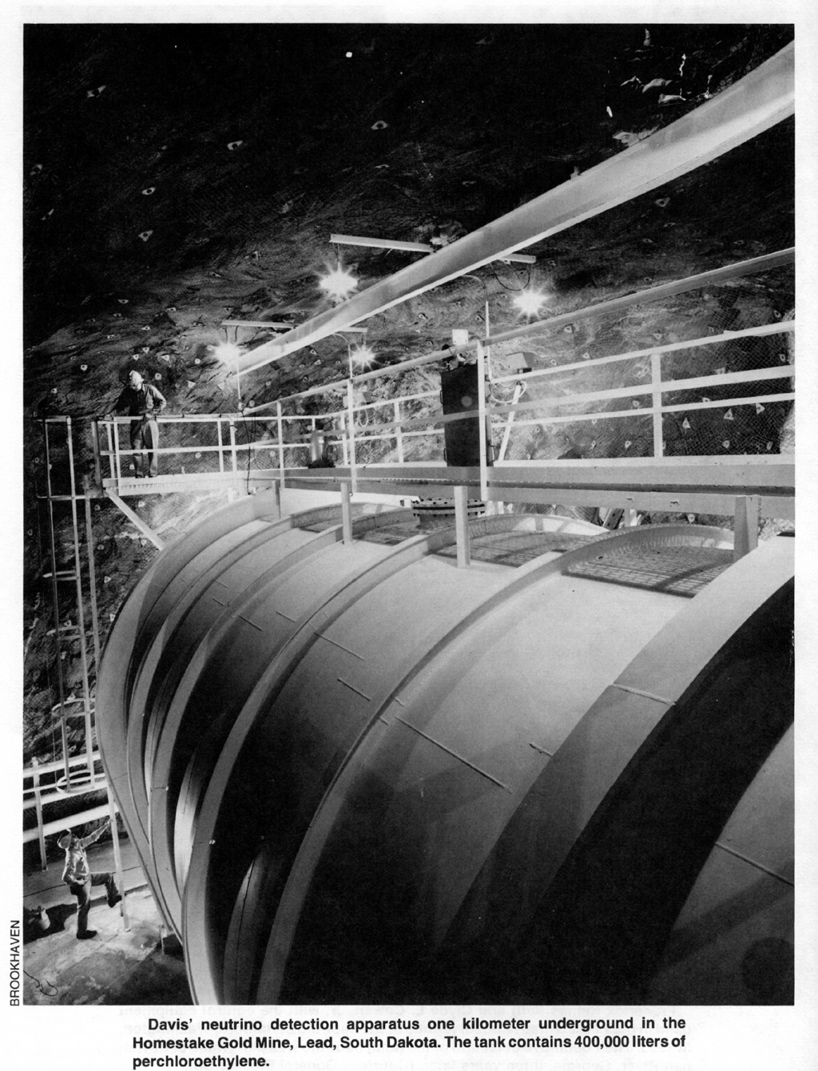
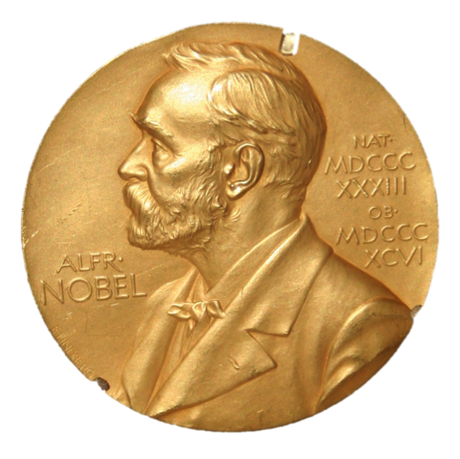

Underground at Sanford Lab
4850’ depth (4300 m.w.e. or “meters of water equivalent”) at the Sanford Underground Research Facility (SURF) in Lead, South Dakota, the former site of the Homestake Au mine
LUX experiment is installed in the Davis cavern, once home to the Nobel prize-winning Homestake Solar Neutrino Experiment, which first observed solar neutrinos, and hint they oscillate

Slide 17
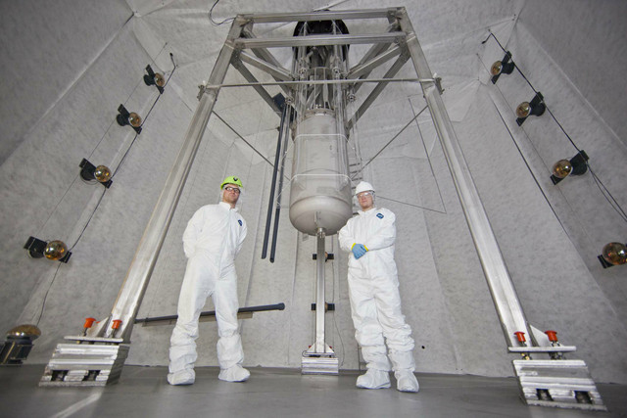
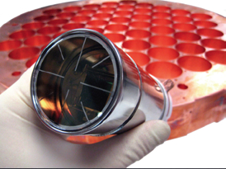
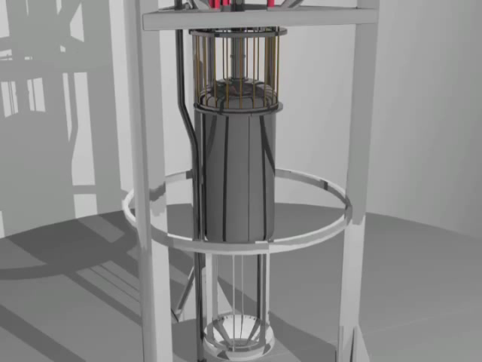
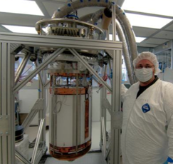
Detector Deployment
Backgrounds reduced (~ 1 mile underground!) further by presence of the water tank, where cosmic-ray muons produce Cerenkov light
low background Ti cryostat
370 kg gross/250 active/118 fiducial Xe inside
PMTs and support structure UC Davis responsibilities
Photo credit: Matt Kapust
Animation: Harvard-Smithsonian Center for Astrophysics, Annenberg Media

Slide 18
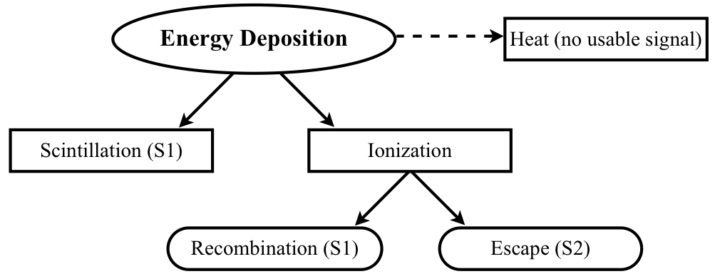
Noble Element Physics
Energy deposited in 3 channels; “heat,” prominent for NR, reduces light (S1) and charge (S2) compared to ER
Excitation and recombination lead to S1, while escaping ionization electrons lead to S2
Scintillation comes from decaying molecules, not atoms (excitons and ions form dimers). Not absorbed before detected: therefore Xe, Ar, etc. transparent to own light
This physics is described in
M. Szydagis et al., JINST 8 (2013) C10003. arXiv:1307.6601
M. Szydagis et al., JINST 6 (2011) P10002. arXiv:1106.1613
Division differs for NR, ER

Slide 19

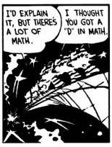
Physics Handled by
Noble Element Simulation Technique is a data-driven model explaining the scintillation and ionization yields of noble elements as a function of particle type, electric field, and dE/dx or energy
Provides a full-fledged, predictive simulation with
  Mean yields: light and charge
  Energy resolution: key in discriminating backgrounds
  Pulse shapes: both S1 and S2
Canon of existing data on noble liquids and gases combed at UC Davis and all physics learned combined, filling a hole in the dark matter field
Simulations critical for understanding any detector (lesson from collider physics: Higgs discovery)
I will pass over the technical details of the microphysics in NEST and cut to the chase

Slide 20
ER and NR Band Calibrations
Ratio: charge (via S2) / light (S1) forms the heart of the NR vs. ER ID
Separation of NR from ER improves at the lowest energies

Slide 21
Pulse Classification Efficiency
Excellent agreement was observed when assuming NEST light yield and deriving NR efficiency, compared with ER (tritium)
Efficiency for finding single-scatter events (1 S1 and 1 S2) as a function of S1 size, the driver of efficiency
o AmBe neutron calibration data (left)
– Parameterized NEST-only simulation without event classification efficiency applied, in order to derive it
gray histogram & red (fit) efficiency from AmBe (right)
LUXSim full NR simulation processed like real data, flat in energy, with the efficiency organically included
Tritium-based efficiency

Slide 22
LUX: WIMP Search Result
S1 range for analysis [2,30] phe is ~3–25 keV (NR)
Lowest noble threshold. Still very efficient there
Total number events: 160 in 85.3 live-days X 118 kg
Distribution of events completely consistent with ER in log(S2/S1) space and with 3D BG distribution
0.64 ± 0.16 ER BG events expected for this exposure, which is > 10,000 kg-days, below NR band centroid
Upper end avoids 5 keV ¹²⁷Xe ER

Slide 23
WIMP Dark Matter Limit
Result accepted for publication in Phys. Rev. Lett.
Edelweiss II
CDMS II Ge
ZEPLIN III
XENON100 (2011), 100 live days
Some claims of discovery…
XENON100 (2012), 225 live days
LUX (2013), 85 live days
PLR (Profile Likelihood Ratio) limit calculation accounts not only for S1 and S2 distributions, but also 3D BG distribution. Relatively new to the dark matter community
LUX ±1σ on expected sensitivity

Slide 24
Low-Mass WIMP Region
CDMS II Ge
DAMA/LIBRA Favored
CRESST Favored
CoGeNT Favored
LUX (2013)
CDMS II Si Favored
S2-only analysis can push this even further down, to an ultra-low threshold ~1 keVnr
This effort is being spearheaded by UC Davis
XENON100 (2012)
New calibration data (DD n gun) suggest we can lower this - see arXiv:1402.3731 and ref. therein

Slide 25
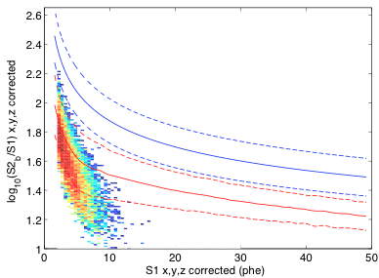
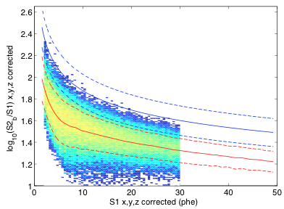
Sensitivity at Different Masses
Signal model samples for different WIMP masses, which have unique (falling exponential) recoil spectra
Lower-mass WIMPs not only produce less energetic recoils but appear lower in log(S2/S1) space: detections would be from upward fluctuations in S1, making them even further away from the ER band
8.6 GeV WIMP
Probability Density Function (PDF)
1,000 GeV WIMP

Slide 26
A Bright Future Anticipated
And this is only the “spin-independent” exclusion plot. More analyses possible (spin-dependent proton and neutron, non-WIMPs, etc.)
LUX, 85 live days
LUX, 300 live days
Coming: LZ ~1,000 times more sensitive than 1st LUX result

Slide 27
LZ = LUX + ZEPLIN
Building on experiences gained in both programs, this proposed new project will utilize the LUX infrastructure at SURF. Same principles as in LUX but mounting a bigger, better system now:
Improved shielding: LUX water shield and an added liquid scintillator active veto, to work in concert with an instrumented “skin” region of peripheral Xe as yet another veto.
New PMTs: with an even lower natural radioactivity than in LUX.
Innovation in cryogenics: Xe liquefaction and purification systems made external, in a unique design.
DAQ: Fully digital, deadtime-less data acquisition & trigger system.
Robust simulation package: with NEST, inherited from LUX (LUXSim). Lends a high degree of confidence to our understanding of the projected performance of LZ

Slide 28
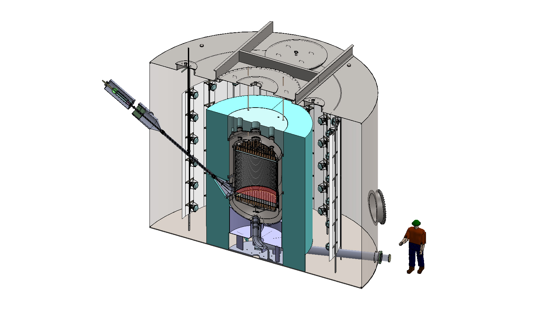
Next-Generation Detector
Active Xe
volume
High Voltage Feedthrough
A two-phase Xe TPC with ~7 tons in the active volume, of which ~6 tons fiducial
Three layers of shield/veto: Xe “skin,” liquid scintillator, instrumented water tank (same one as for LUX)
Highly reflective PTFE walls
inside
8” PMTs
Water
Liquid scintillator
Heat Exchanger Conduit
The engineering design is at an advanced stage.

Slide 29
Background Simulations
Low, conservative baseline S1 photon detection efficiency assumed
The final BG rate down at 0.7 events per year, driven by ν’s from sun (can’t avoid)
Gammas
Neutrons
DRU (differential rate units) is counts/keV-kg-day
Bigger than LUX, so more Xe --> more self-shielding, leading to a very quiet center

Slide 30
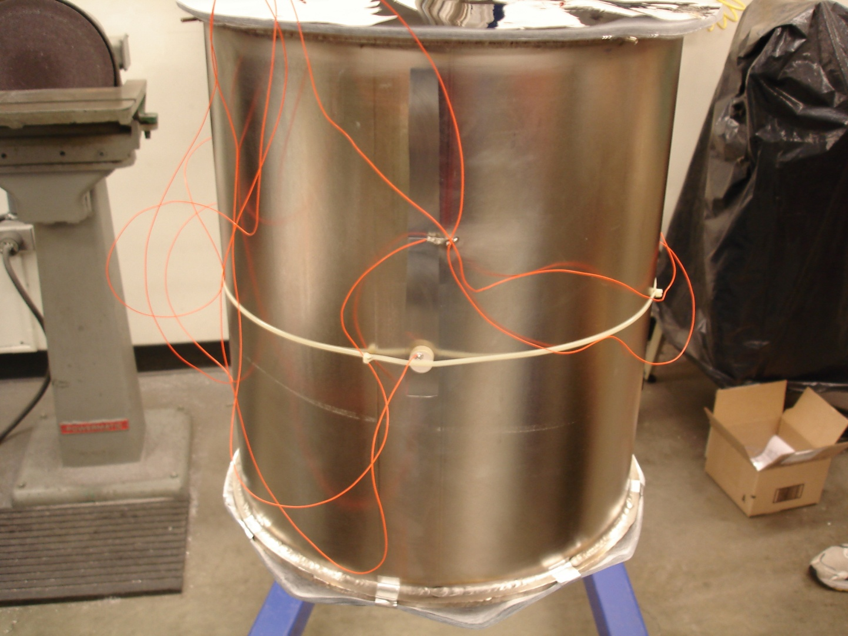
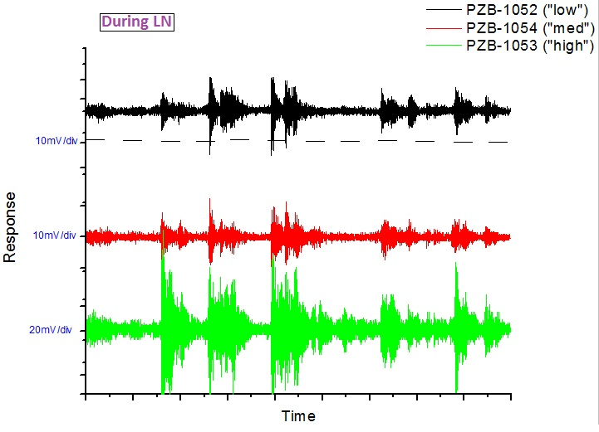
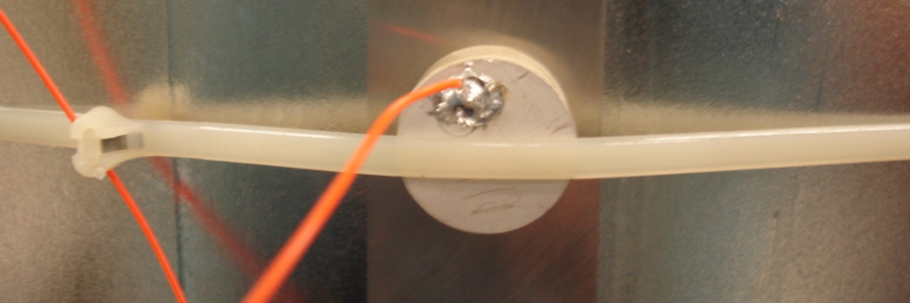
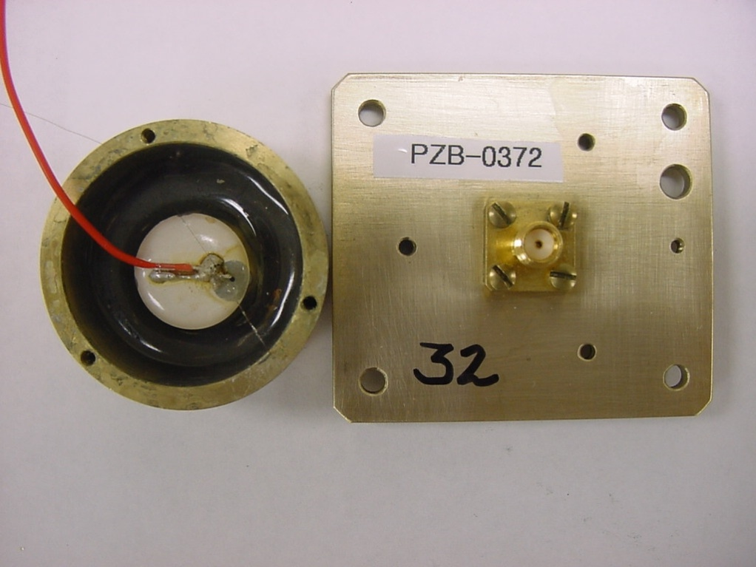

An Aside: Piezo Microphones
Bringing COUPP experience to LZ, to listen for bubbling
Bubbles can disrupt photon propagation, electric field (sparking), and the liquid surface (→ S2 size problems)
A new type of veto, providing a leg up over competition

Slide 31
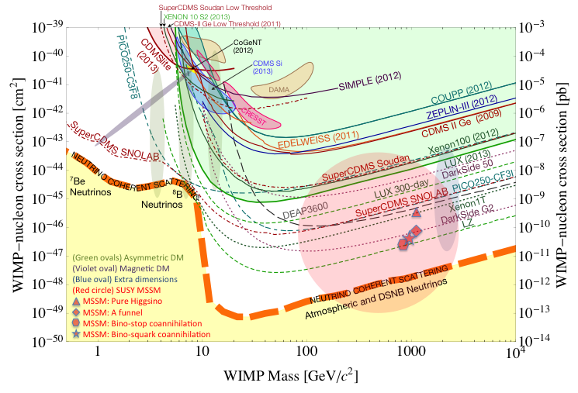
LZ: The Ultimate Experiment
Will provide an endpoint to the direct WIMP detection saga…
“Down-select” coming!
LZ, 1000 days X 5600 kg
2017 turn-on
Conventional wisdom: Direct searches are over once they hit the “neutrino floor”
SNOWMASS

Slide 32
A New Approach
There is still a lot of parameter space, especially at sub-GeV WIMP masses, where the thresholds of Xe-TPC-based experiments force an inevitable turn-up in limits
Larger detectors must have greater turn-up: cannot push reflectivity and purity much more
Probably no $$ for another step past 7-ton LZ. Need to built smarter, not bigger/costlier. Lack of discovery does not mean stop looking. There is cause for optimism!
S2-only can take you only so far: discrimination is lost, so how can a conclusive discovery be made?
Low-mass WIMP controversy is not likely to go away any time soon, even if experiments like LUX appear to rule such a WIMP out. Must consider concordance of others (CoGeNT, CDMS, CRESST, DAMA)

Slide 33
Xenon Bubble Chamber
Turns the “disadvantage” of Xe into an advantage: decreasing NR S1+S2 means more energy into heat
And heat means bubbles, in a superheated system
In theory, no limit to energy threshold: keep lowering pressure and raising temperature – at cost of ER misidentification, but starting at orders of magnitude better than LUX or any existing experiment as it is
Anti-correlated!

Slide 34
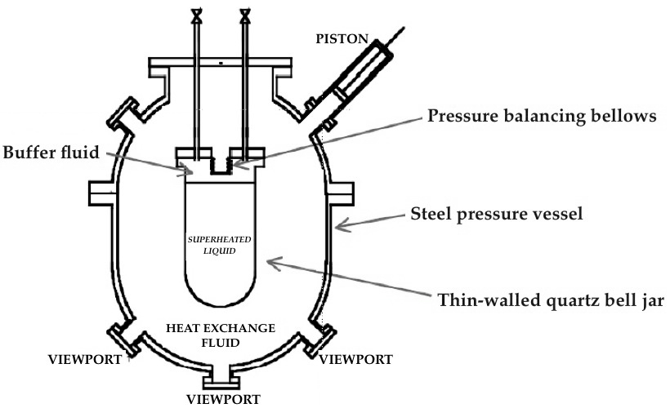
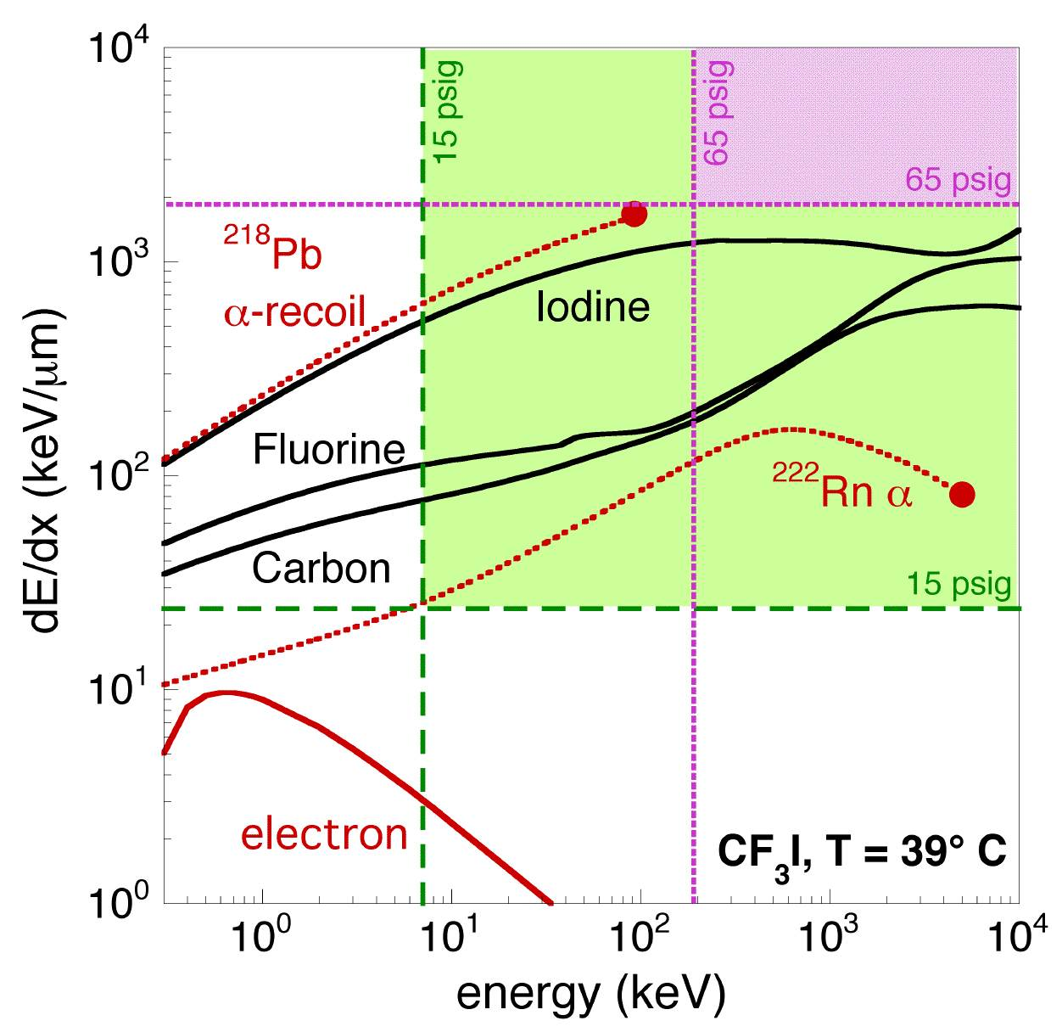
More Advantages
Xe could be first of many liquid noble chambers
With electric field, potential for an unprecedented three dimensions of discrimination – S1, S2, bubbles (S2 + bubbles at low energy) – or four if you count acoustic (andγ’s may sound different)
Directionality achieved at high degree of superheat, and energy reconstructable from scintillation

Slide 35
CONCLUSIONS
Dark matter is probably there, and there is a fairly agnostic way to directly look for one candidate, WIMPs, by waiting for nuclear recoils to produce a signal
LUX has one of the highest exposures and lowest energy thresholds, and currently has the most stringent limit on the WIMP-nucleon spin-independent cross-section, across a wide range of WIMP masses
Result still in conflict with low-mass WIMP interpretations of other data. More data to come!
With a scale-up from LUX, LZ holds the promise to be the best second-generation (DOE G2) experiment
A xenon bubble chamber may spell the death knell for low-mass WIMPs, or discover them

Slide 36
Thank You

Slide 37
backup

Slide 38
Philosophy of Dark Matter
The evidence points to a significant non-baryonic (would otherwise interact more often), non-relativistic component of the matter in our Universe (85%): a key part in what is now the standard cosmological model
But is dark matter the new aether or phlogiston? Removable by Occam’s Razor? Is relativity wrong? Postulating a new particle does explain our observations well and fits into our quantum paradigm
What good would its discovery do? Besides expanding the frontiers of human knowledge?
The last time a new form of matter was theorized, then found (antimatter) it was “useless” for decades but today maps cancerous tumors (PET scan)

Slide 39
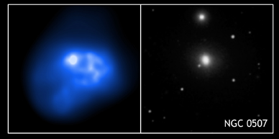
Where is the Mass?
Chandra X-ray Observatory
X-rays are in left pane and optical at right. What is binding the gases in place to make those x-rays, considerably outside of the visible elliptical galaxy?

Slide 40
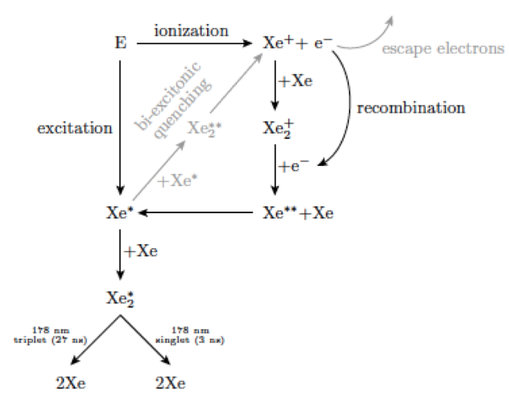
Xe Dimer Formation
Aprile 2012

Slide 41
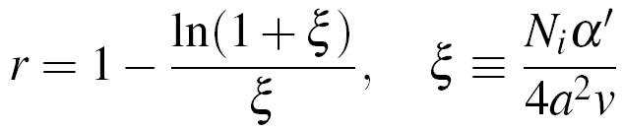
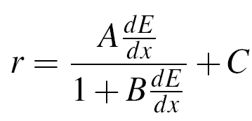
Basic Principles of NEST
The work function for creating an S1 photon or S2 electron does not depend on the interacting particle or its energy, but differences in yields are caused by the field, energy, and particle-dependent recombination probability of ionization electrons
Recombination model is different for “short” tracks (<O(10) keV) and “long” tracks: using Thomas-Imel box (TIB) and Doke-Birks approaches respectively
This probability is what causes non-linear yields per unit of energy: twice the energy does not necessarily translate into twice the signal, in either channel
Thomas-Imel uses only total deposited energy, via the number of ions
By contrast, Doke-Birks relies on the energy loss

Slide 42
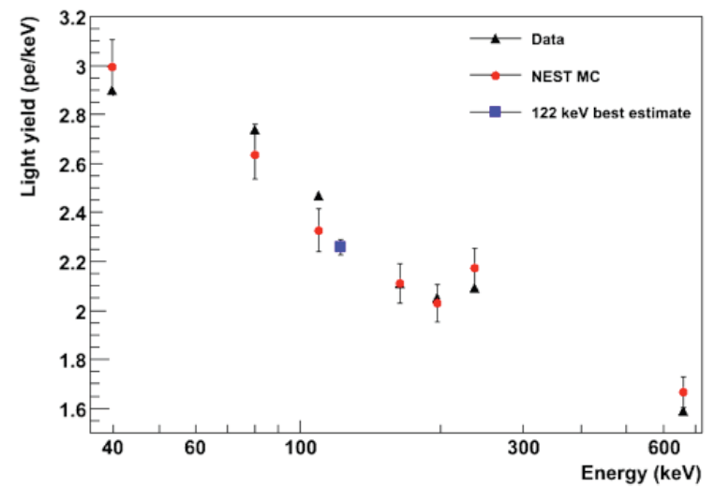
A New Industry Standard
XENON100 collaboration
Aprile 2012
(Monte Carlo simulation)
⁵⁷Co 122 keV gamma ray, reference point for reduction in S1 (NR vs. ER)
No ⁵⁷Co calibration, so NEST was key for XENON, a direct competitor of LUX

Slide 43
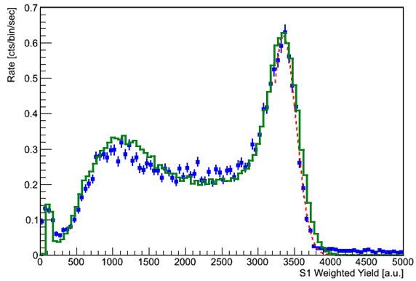
Backbone of LUX Result
arXiv:1210.4569
LUX 1st run data
Gaussian fit
LUXSim* +NEST
First time simulated resolution fits data, from first principles
¹³⁷Cs
*D.S. Akerib et al., Nucl. Inst. and Methods A675, 63 (2011). arXiv:1111.2074

Slide 44
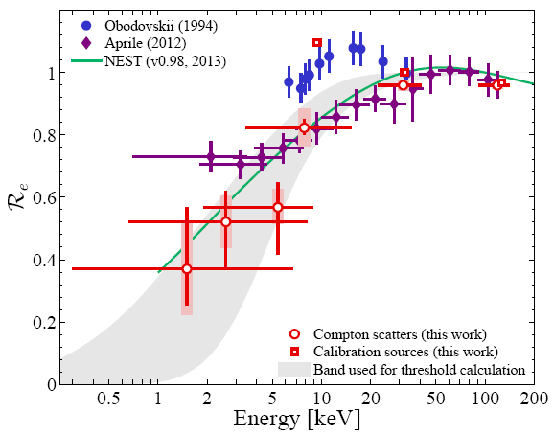
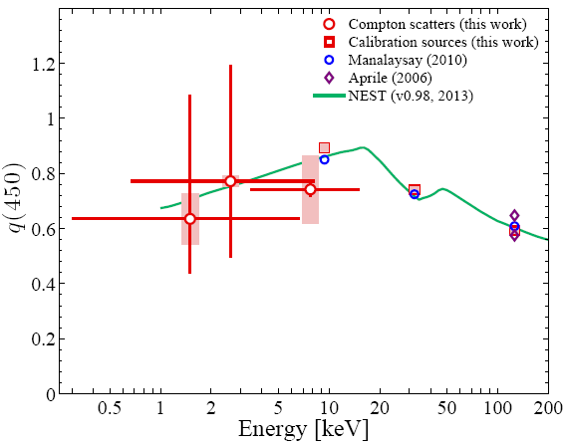
ER Scintillation Yield
Zero field
Non-zero field
arXiv:1303.6891
arXiv:1303.6891
K-edge (as in NaI[Tl])
As the energy increases dE/dx decreases, thus recombination decreases: less light, at expense of more charge (Doke-Birks)
At low energy recombination increases with increasing energy, leading to more scintillation light per unit of energy (TIB)

Slide 45
NR Scintillation Yield
Modeled using NEST for absolute yield and optical model for light collection
Conservative, but also predictive, and matches the LUX data very well
No need to use the ⁵⁷Co zero-field reference point anymore (its gamma can’t penetrate modern large detectors anyway)
LUX assumed no signal generated below 3 keVnr, lowest data point

Slide 46
NR Ionization Yield
3.0 keVnr cut-off as with light (LUX)
XENON100 (730 V/cm)
LUX (181 V/cm)

Slide 47
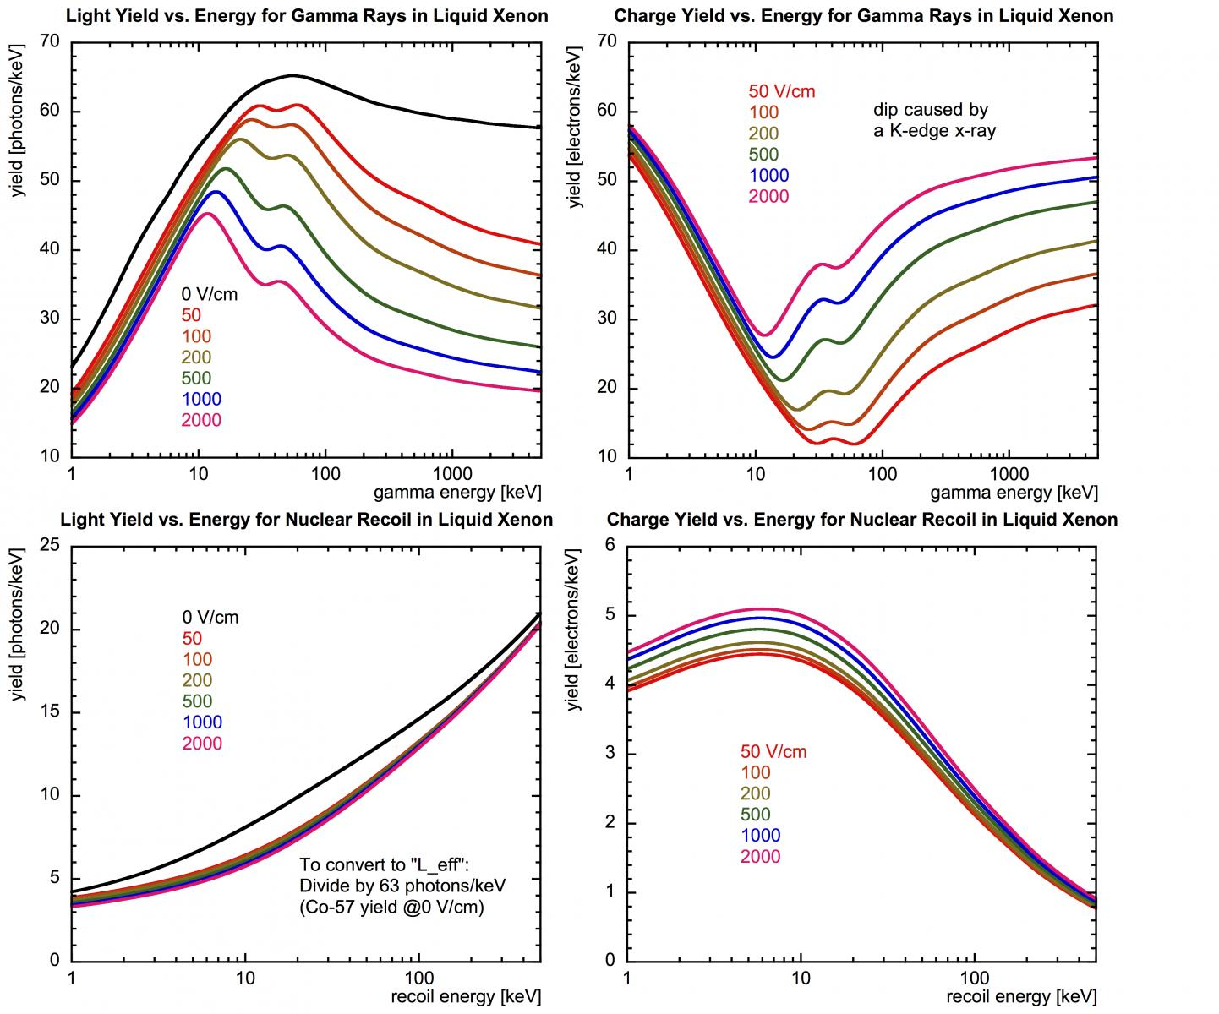

Slide 48
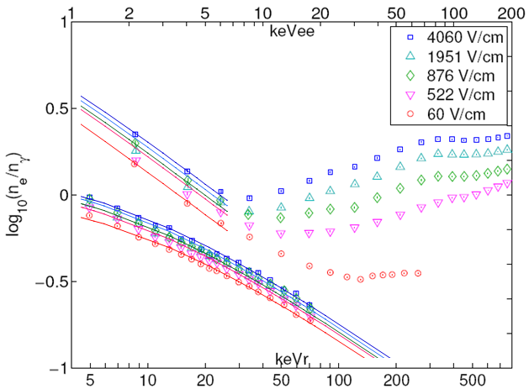
Electric Field Dependence
Data presented in terms of log(n_{e}/n_{γ}), converted from log(S2/S1), but keVee scale is (n_{e}+n_{γ}) 13.7x10⁻³ keV and so can easily extract n_{γ} and n_{e} alone and get their field dependencies
AmBe and ²⁵²Cf sources, not a known-angle neutron scattering measurement, but important thing is *relative* yield was established
Approximate analysis region for LUX here
ER (above)
NEST (lines)
NR (below)
Dahl 2009
(high energy Doke-Birks region not plotted, only TIB)

Slide 49
NR Calibration MC Vetting
Both single-scatter (WIMP-like) and full AmBe simulations use NEST, but AmBe sim includes ER component (Compton scatters) + neutron-X event (multiple-scatter, single-ionization) contamination
Mean
of NR band
Neutron-only effects shifting band mean and width in well-understood fashion, inapplicable to WIMP scattering. When they’re included, there’s agreement with data
Width

Slide 50

Energy Scale
W_{LXe} = 13.7 +/- 0.2 eV
Energy is a linear combination of the number of primary photons n_{γ} and electrons n_{e} generated
Photons created by original energy deposition (S1) or by electrons (S2), but “photo-electrons” (pe or phe) detected in PMTs, via the photoelectric effect
S1 photons equal to S1 phe (XYZ-corrected using 10⁶+ ^{83m}Kr events) divided by detection efficiency (light collection x PMT QE), and S2 e⁻ count is S2 phe (XYZ-corrected) divided by the product of extraction efficiency and the number of phe per e⁻
Scale calibrated using Xe activation lines, ^{83m}Kr, and tritium. L is “Lindhard factor” (L=1 for ER)

Slide 51
Light Collection
Field-shaping rings, and spaces between PMTs all covered with Teflon/PTFE (measurements imply that it is >95% reflective)
14% efficiency for the detection of a primary scintillation photon at the PMTs after its journey
  From center of detector
  Varies from 11—17% between top and bottom
  Mapped out with ^{83m}Kr
  Total internal reflection causes most light to be in bottom PMT array
  Cross checked: different sources and methods

Slide 52

Breaking Down Efficiencies
3 keVnr (MC truth)
S1 area ~ 2.0 phe
Efficiency falls at high energy: due to S1 max (30 phe).
Prior to the analysis cuts: (2-fold PMT coincidence)
S1 pulse identification
S2 pulse identification
Concurrent identification
Including analysis cuts:
S1>2 phe, S2>200 phe
(same as slide 26 purple triangles except vs. energy)

Slide 53
ER Leakage into NR Band
Leakage based on σ from Gaussian fits to binned ER band
Raw leakage (just counting events): it is mostly consistent
Mean leakage 0.4 ± 0.1% (2 – 30 phe S1 region) accepting all ER events below power law fit to the NR Gaussian mean in slices
Not used directly in LUX limit calculation, which is a PLR (Profile Likelihood Ratio) not cut and count, but illustrates separation

Slide 54

Backgrounds
3.6 ± 0.2 x 10⁻³ counts per keV-kg-day (DRU) in energy, volume regions of interest
Getting better: cosmogenics from surface run decaying
BG data
LUXSim

Slide 55


Background Cooling Off
Quiet detector with < 2 events/day in the energy and volume regions of interest, getting quieter as cosmogenic activity (activated Xe) cools
Fiducial volume indicted by dashed edges. Energy regime: < 5 keVee
log₁₀ of data rate in
[evts/keVee/kg/day]
118.3 ± 6.5 kg
3.6 ± 0.2 mDRUee
(0.5 cosmogenic)
R < 18 cm
Z = 7 – 47 cm

Slide 56
Full Background Model
(larger volume, 225 kg, so the high-energy peaks prominent)
(PMT saturation causes a peak misalignment at higher energies)
Data spectrum
Can not be well-fitted assuming equilibrium AND maintaining a good fit across positions in detector at both higher and lower energies. Location of contamination could be culprit BUT ²²⁸Ac is a small contributor to low-E ER BGs, so overestimate has a small effect.
Simulation

Slide 57
Summary of Effect of Cuts
Non-blind analysis, but cuts are very simple

Slide 58

What a Typical Event is Like
1.5 keVee (electron-equivalent reconstructed energy) event
Look at all the white space! Not much noise. (The front-end electronics were a UC Davis responsibility.)

Slide 59



Position Reconstruction
XY reconstruction of events near anode resolves wires every 5 mm
Iterative approach used to optimize resolution currently* while a neutral network is under development
^{83m}Kr events map out the XYZ dependence of S1 and S2 signals
*V. Solovov et al., IEEE Trans. Nucl. Sci., 59 (2012)

Slide 60
Cut-and-Count Cross-Check
The PLR is well bounded by the 0 and 1 BG event cases, but lies closer to 0 BG, as one should expect
1 BG event case: 0.64 event expectation (Feldman-Cousins)
PLR takes likelihood of an event being NR into account instead of making a binary decision
LUX (2013)
1 BG event
cut and count
0 BG events

Slide 61
LZ BGs & Discrimination
NR due to neutrons from detector structures such as PMTs, Titanium cryostat, etc. are sub-dominant to leakage from ER.
Goal for Krypton: < 0.02 ppt. This will represent ~0.1 times solar pp rate. Best production level obtained by LUX ~0.2 ppt, which would be equal to the pp rate. However, LZ is confident about achieving purity close to the goal level.
Goal for Radon in LXe: < 0.6 mBq. Tight control in assembly.
Discrimination: > 99.5% (~700 V/cm at nominal operating voltage of 100 kV) for < 30 keVnr (> 99.8% at > 1 kV/cm)
~ 50% NR acceptance, increasing to near-100% at < 10 GeV
For a total exposure of 1000 days and a 5.6 ton fiducial mass: < 2 BG events, including the coherentνscattering

Slide 62


Optimization of the Baseline
A 1300 km baseline is a pragmatic way to get a comprehensive scientific program that covers both MH and CP violation
Normal hierarchy assumed for these example plots, and 5 years of neutrino running coupled with 5 years of anti-neutrino running
Fraction of δ_{CP} parameter space covered. Muon neutrinos oscillate and appear as electron neutrinos, observed by their electrons

Slide 63


ν_{e} Appearance Oscillogram
First and third columns (orange-red plots): neutrino oscillations vs. energy and baseline for neutrinos (top) and anti-neutrinos (bottom), for δ_{CP} = 0
Second and fourth columns: neutrino oscillations as a function of energy, for different values of δ_{CP}, with the θ₁₂ contribution (solar) plotted in yellow

Slide 64
WIMPs & Neutrinos as Sisters
Conventional wisdom: Direct searches are over once they hit the “neutrino floor” (orange dashes, p. 31)
But, one individual’s background is another’s signal!
Neutrinos are intimately tied to fundamental physics, and not just via solar neutrinos or coherent scattering. Unlike WIMPs, already discovered, but in a sense “invisible” too (weakly interacting)
Even if WIMPs are discovered, neutrino physics still offers great parallel experimental opportunities. And if not, it can easily become a full-time endeavor

Slide 65

Introduction to LBNE
Long Baseline Neutrino Experiment
700–2300 kW, 80–120 GeV proton beam that leads to a muon neutrino beam, starting from Fermilab
35 kT liquid argon TPC at SURF
Muon neutrinos oscillate and appear as electron neutrinos, observed by their electrons
Sandbox Studio, Chicago

Slide 66


Physics Motivations
Although LBNE is still far in the future, with a turn-on in the 2020s, the physics it offers is much broader in scope than in WIMP searches
Neutrinos have mass, and oscillate between different types. The flavor eigenstates are not the same as the three mass ones, however
But what order is their mass hierarchy (MH)? Two heavy neutrinos and one light, or vice versa? After nearly 60 years, new questions emerge

Slide 67



Further Questions
Doν’s violate CP (charge-parity): do anti-neutrino oscillations differ?
Are there “sterile neutrinos” into which the known neutrinos can oscillate (dark matter candidate)?
Bonus question: Does the proton decay? Half-life=?
An underground, high-mass LAr target would also enable atmospheric and astrophysical neutrino studies (latter: supernova neutrino bursts)

Slide 68

Liquid Argon Far Detector
Scintillation is in the extreme UV and thus difficult to detect, so it must first be made visible, with a wavelength-shifter (WLS)
Light determines time of event, as detected by silicon photomultipliers (SiPM’s)
Electric field drifts the liberated electrons, which constitute the primary means of calorimetry and particle ID (no gas stage as in LUX/LZ)
Great tracking, like a “digital bubble chamber”
wire planes
ArgoNeuT
drift field
ionization electrons
incoming particle
energy deposition
ultraviolet scintillation photons
TPB WLS
SiPM
acrylic light guide

Slide 69

Energy Reconstruction
Combining light with charge lets you empirically reduce the effects of the recombination fluctuations and the energy loss to scintillation, where ~half the energy goes
Anti-correlation proven in both argon and xenon, but need great light collection to capitalize on it. Have been pursuing this as co-convener of LBNE sims group

Slide 70

e⁻/γ Separation
Must detect electrons from a neutrino interaction (such as ν_{e} + n -> p⁺ + e⁻) but discriminate against gamma-ray background
Issue similar to ER/NR discrimination in xenon
Electrons and gammas have different charge yields, and we can simulate that: gammas will pair produce and the resulting lower-energy e⁻, e⁺ have a bit different dE/dx
My interest was to adapt NEST for argon to address this critical issue
Electrons
Gammas
(same E: 0.5 GeV)

Slide 71

Model Building with Data
R is the electron escape probability, so it is a useful simultaneous measure of both the charge and light yields
NEST does argon, and does high energies too: dE/dx is the key
But, the particle type matters, not just dE/dx, because of stochastic variation in the secondary track history, in steps
Data: Amoruso et al., 2003

