Slide 1
Zebra connectors
Karen Palmer
Sarah Jones

Slide 2
Companies
Company | Price/100 connectors ($) | Additional Charges ($) | Estimated Delivery | notes
Fujipoly | < 17.13* | 588 → prototype tooling 1650 → production tooling | > 2 weeks | 30 um diameter copper wire
Ruter | 2.40 | 50 → shipping | 2-3 weeks** | 30 um diameter copper wire - 100 um pitch
Z-Axis | 16.00 | 450 → one-time setup | 4 weeks*** | 50 um diameter copper wire - 110 um pitch
* FujiPoly’s quote was for 75 connectors
** includes getting through UA procedures
*** estimated delivery to UA
Most charges expected to decrease with a larger order

Slide 3
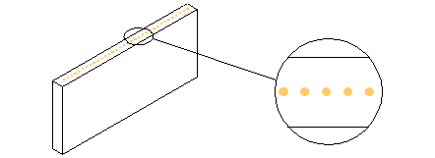
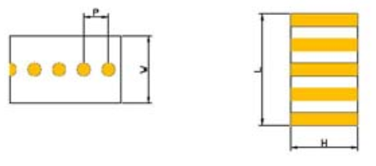
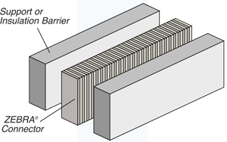
Types of connectors
FujiPoly has two types of connectors we are interested in:
FG-S → wires are embedded in the silicone
D-type → wires are wound around 3 sides of connector
Multiple materials: Gold, Silver, Carbon
Ruter and Z-axis offer gold connectors in “FG-S” style

Slide 4
Details on companies availability
All companies were given relatively the same dimension specifications
Some companies do custom dimensions and designs
Typically there is a min/max dimension range for these companies
FujiPoly issues:
**dimensions were set by their “type” of connector
Series 8000C (D-type)
Prototyping tool: for 75 connectors, would have to purchase another if dimensions changed
they are not currently manufacturing FG-S unfortunately
Min order amount → $250
Ruter and Z-axis dimensions:
height = 6.5 +- 0.2 mm
length = 103 mm
width = 3 mm
wire pitch = 100 um
wire width = 30 um
FujiPoly dimensions:
height = 6.5 +- 0.1 mm
length = 103.9 +- 0.4 mm
width = 2.99 +- 0.13 mm
wire pitch = ~152 um**
wire width = ~ 70 um **

Slide 5
Testing System
Connector is too short:
Far left pad never connects.
Testing is done in 8 sets of 31 1KΩ resistors.

Slide 6
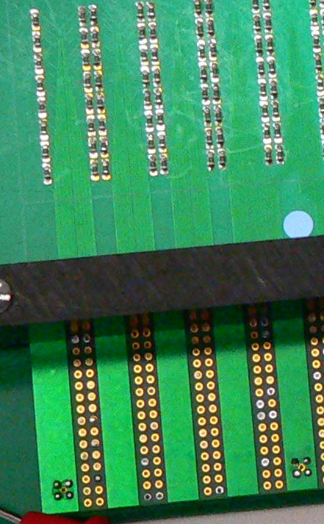
Testing System
Detail

Slide 7
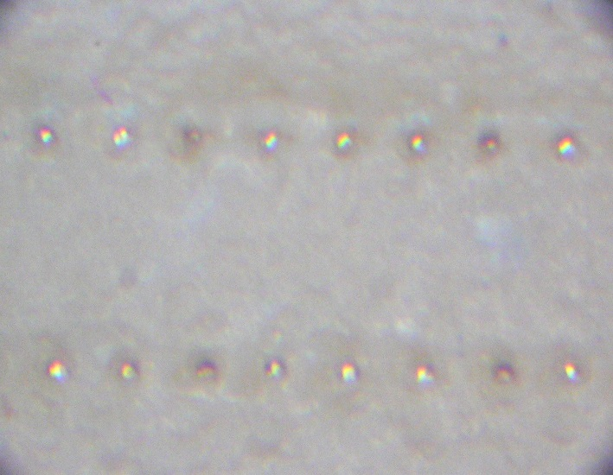
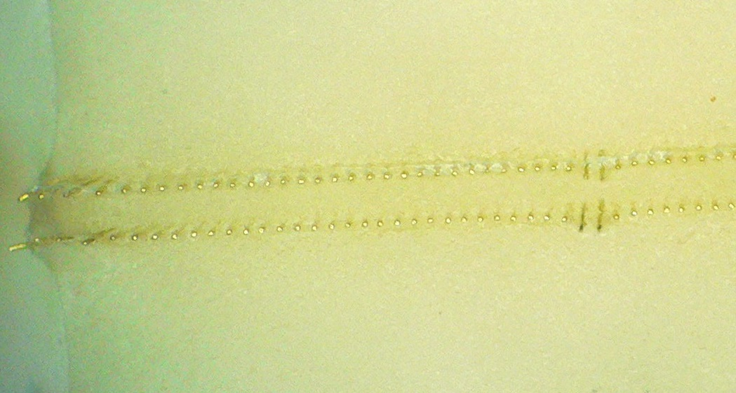
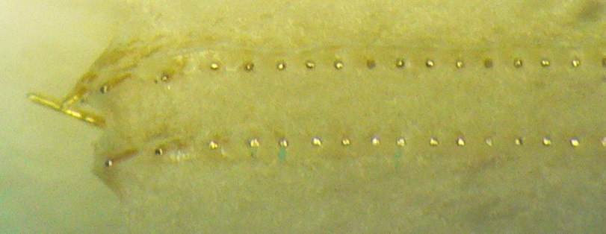
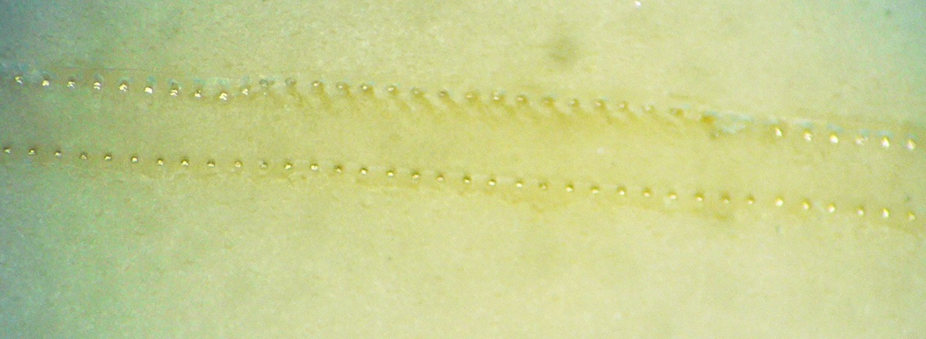
Examples of Flaws in Ruter
Good Connector
Flaws in Fujipoly

Slide 8
Machining: cost prohibitive
Sample quotes for professional machine shops
CustomPart.net
Part Quantity | 4700
Workpiece: | Rectangular bar
Price per bar | $17.48
Total Material Cost: | $30,347.90
First Cut
Material: | ABS Black
Shipping: | 3 business days (no expedite charge)
Quantity: | 1
Cost: | $ 164.00
Hourly Rates:
 | http://www.eng-tips.com
$30 - $40 |  |  |  | Very Small (no overhead shop)
$60 - $80 |  |  |  | Standard shop w/ overhead and inspection
$150 - $200 |  |  |  | Large shop and machinery
$25-50 |  |  | http://www.practicalmachinist.com
$40-150 |  |  | http://www.cnczone.com
$85 |  |  | http://www.sandsmachine.com

Slide 9
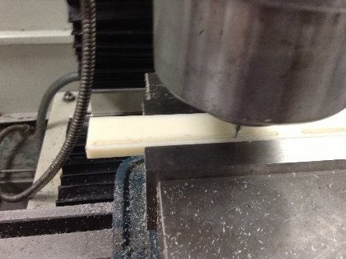
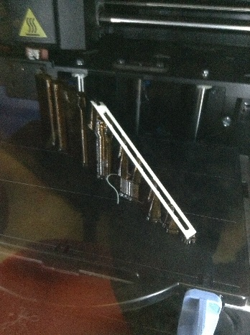
In-house Machine Shop
In-house CNC Machining
ABS plastic not rigid
Master Machinist on campus
G-10 plastic is rigid
labor cost for 1 holder: $200
3-D Printing
There are limited options for plastic material
Small printer: one holder may be done at a time
Dissolving support material takes several hours
Final product is flimsier than ABS holder

Slide 10
Injection Molding
Company | Price | Mold | notes
Protomold | $ 10,870.75 | $ 2,580.00 | 4700 parts; mold price includes $500 setup charge + 25 samples
QuickParts | $ 12,745.00 | $ 5,545.00 | 5000 parts; mold price includes 25 samples
RedEye | $ 11,532.00 | $ 8,900.00 | 5000 parts; Sept 28 (quote valid for 2 weeks)
Plastikos | N/A | N/A | Aug 28-29: company specializes in smaller parts. CAD drawing sent, no response from company after that.
Protomold is interested in our business
They have continued to make contact
They have kept our records while we finish designing

Slide 11
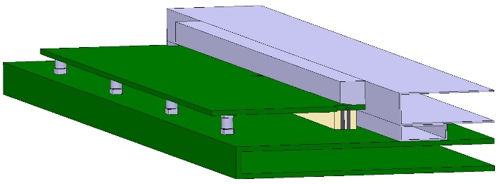
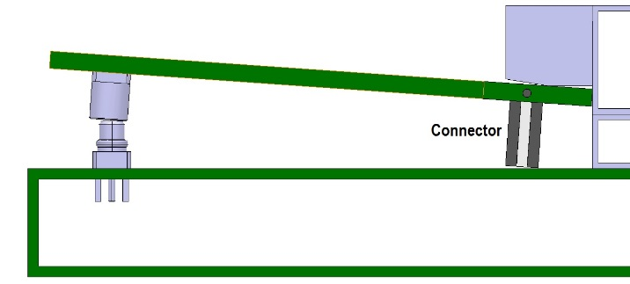
Concerns
Companies have varying pricing
This has shown up in the quality control!
Ruter connectors have little better than 50% success rate in testing
Fujipoly cost and communication issues
Longer connectors are needed
A re-design of the holder may be required
Significant compression is necessary for connection

