Slide 1

managed by Brookhaven Science Associates
for the U.S. Department of Energy
VMM1
Front-end ASIC for charge-interpolating micro-pattern gas detectors
Gianluigi De Geronimo
Instrumentation Division, BNL
April 2012

Slide 2

Targeted architecture
64 channels, adj. polarity, adj. gain (0.11 to 2 pC), adj. peaktime (25-200 ns) note: interest in 5 pC
peak detection (10-bit) and time detection (1.5 ns)
real-time first address
sub-threshold neighbor acquisition (channel or chip)
10-bit single-trigger ADCs
derandomizing buffer for continuous operation
integrated threshold and pulse generators
monitors, channel mask, temperature sensor, 600mV-LVDS interface
~ 5 mW per channel, CMOS 130 nm

Slide 3
Initial architecture ( first prototype )
64 channels, integrates almost all of the critical functions
MUX replaces ADCs and FIFO
external trigger replaces TAC stop
ADC architecture being in a separate project
includes direct ToT (time-over-threshold) or TtP (time-to-peak) on 16 channels (0-7 and 56-63)
note: interest in PdT (peak-discharge-to-threshold)

Slide 4
Operation and functions
  Functions
  common
      temperature monitor
      pulse generator (10-bit adjustable amplitude)
      coarse threshold (10-bit adjustable)
      self-reset option
      analog monitors
          analog, trim thresholds, BGR, DACs, temp.
        analog buffers
    analog section
      charge amplifier (200pF), high-order DDF shaper
      adjustable polarity (negative, positive)
      gain: 0.5, 1, 3, 9 mV/fC (2, 1, 0.33, 0.11 pC)
      peaktime: 25, 50, 100, 200 ns
      test capacitor 1.2pF, channel mask
  discriminator
      trimmer (4-bit adjustable, 1mV)
      sub-hysteresis pulse processing option
      neighbor logic on channels and chips (ch0, ch63)
  peak detector multiphase
    time detector
      TAC ramp (selectable 100, 200, 500, 1000 ns)
      start at peak-found
      stop selectable (ena-low or stp-low)
  ART
      address of the first event in real time
      selectable at first threshold or at first peak
      self-resets in 40ns
      fflag indicates event
      address available at fa0-fa5
  timing per channel
      available for channels 0-7 and 56-63
      selectable between ToT and TtP
  readout
      flag at first peak indicates events to readout
      sparse with smart token passing (skips empty chan.)
      amplitude available at pdo
      timing available at tdo
      address available at a0-a5
    Modes of operation
  acquisition: events are detected and processed (amplitude and timing)
      charge amplification, discrimination, peak- and time-detection
      address in real time (ART) of the first event
      direct timing (ToT or TtP) per channel for channels 0-7 and 56-63
  readout: sparse mode with smart token passing (amplitude, timing, addr.)
  configuration: access to global and channel registers

Slide 5
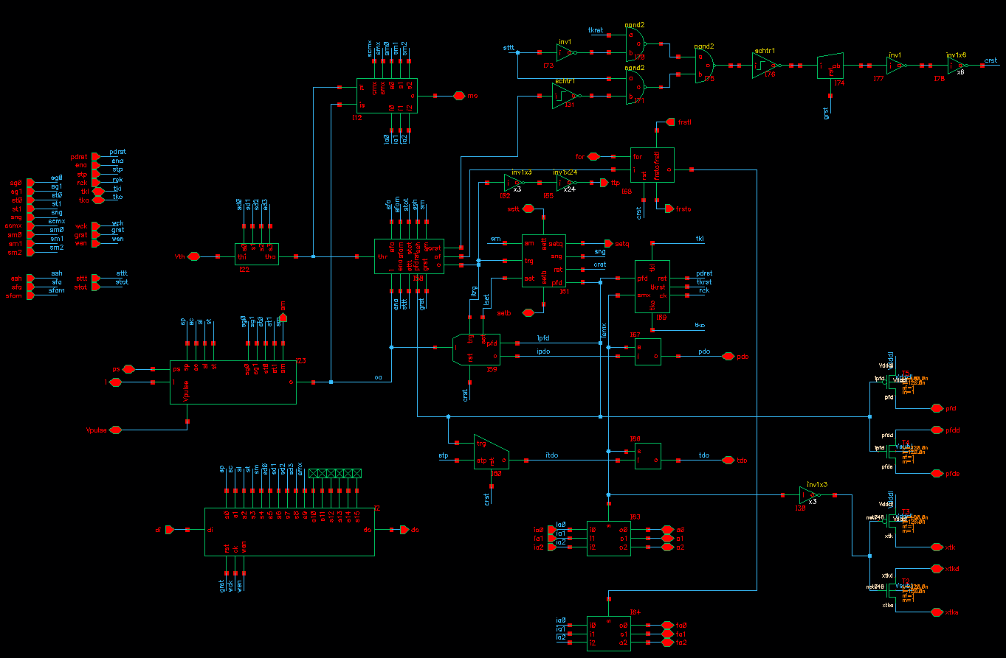
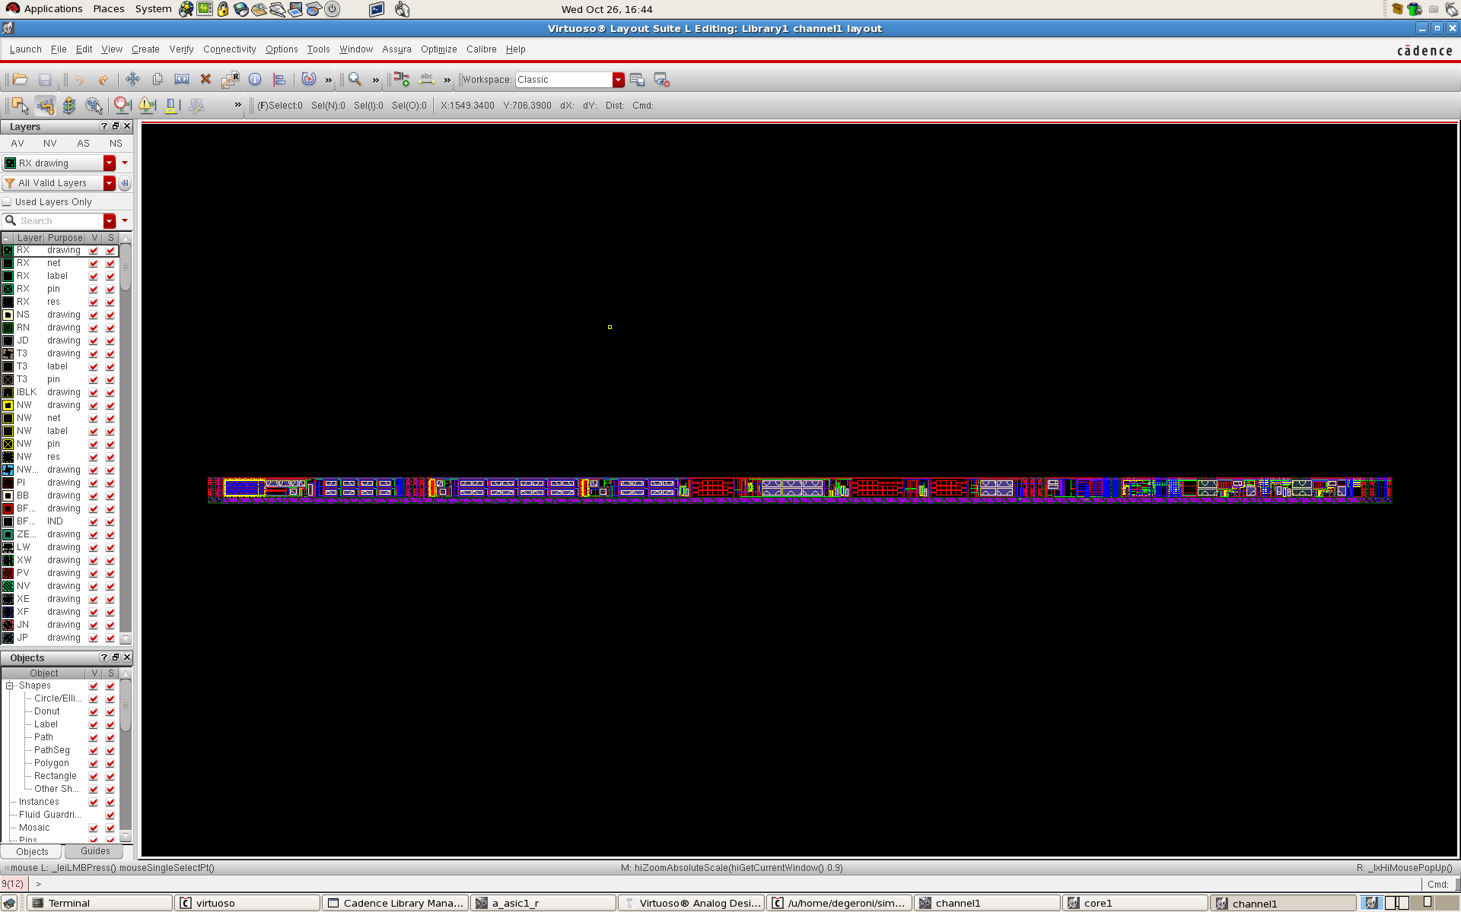
Channel
monitor
ART
trim
discrim.
neigh
token
PD
analog
TD
regist.
size 4.7 mm x 100 µm
power dissipation ~ 4mW at 25 ns peaktime

Slide 6
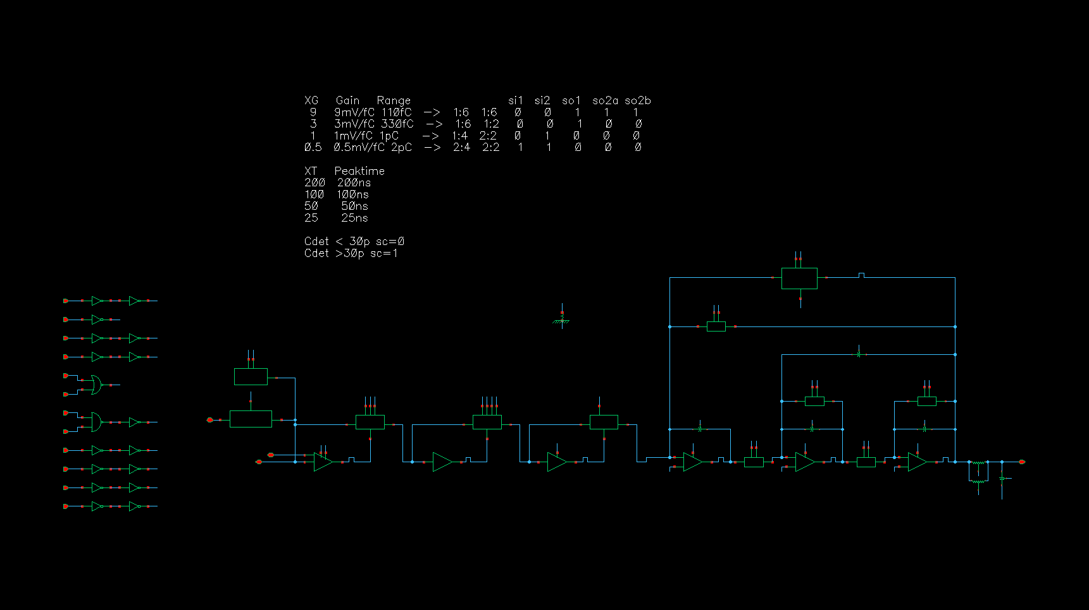
Analog section
baseline stabilizer
charge amplifier
polarity
DDF shaper
charge amplifier
  two stages, continuous reset, adjustable gain: 0.5, 1, 3, 9 mV/fC (2, 1, 0.33, 011 pC)
  optimized for C_{DET} = 200 pF, can operate with C_{DET} = 1pF - 400pF
  input MOSFET: NMOS W/L ≈ 10mm/180nm, I_{D} ≈ 1.65mA, P_{D} ≈ 2mW, C_{G} ≈ 18pF, g_{m} ≈ 38mS
shaper
  3^{dr} order, complex-conjugate poles, delayed-dissipative feedback (DDF)
  adjustable peaking time: 25, 50, 100, 200 ns
baseline stabilizer (BLH)

Slide 7
Analog section - simulations 1/2
Target resolution < 5,000 e⁻ at 200 pF, 25 ns

Slide 8
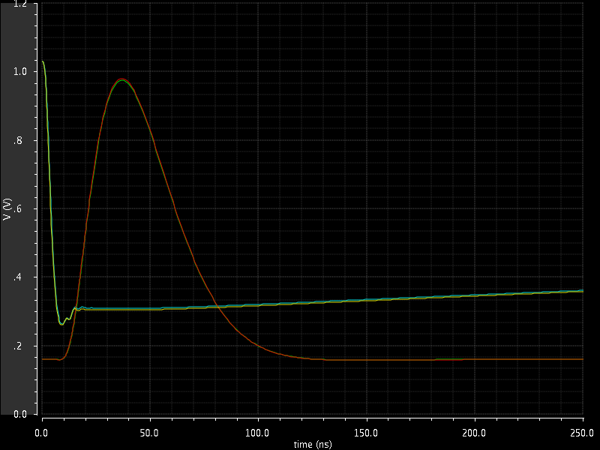
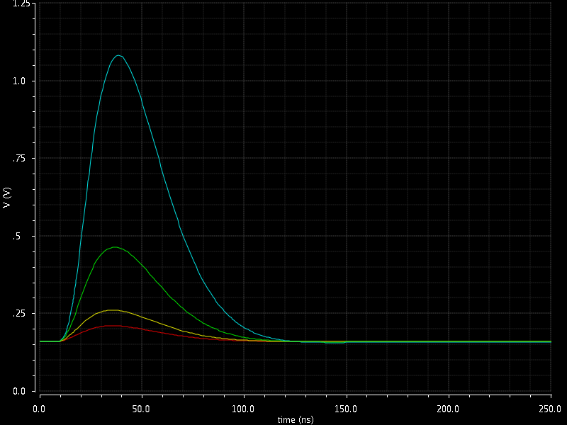
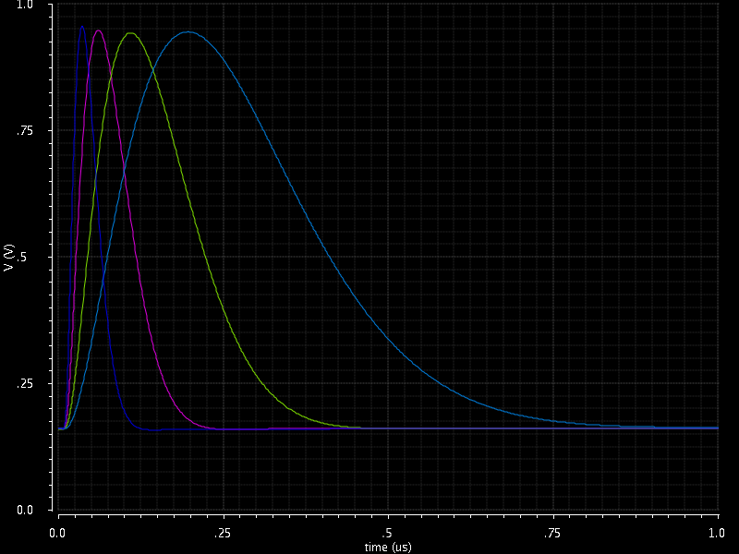
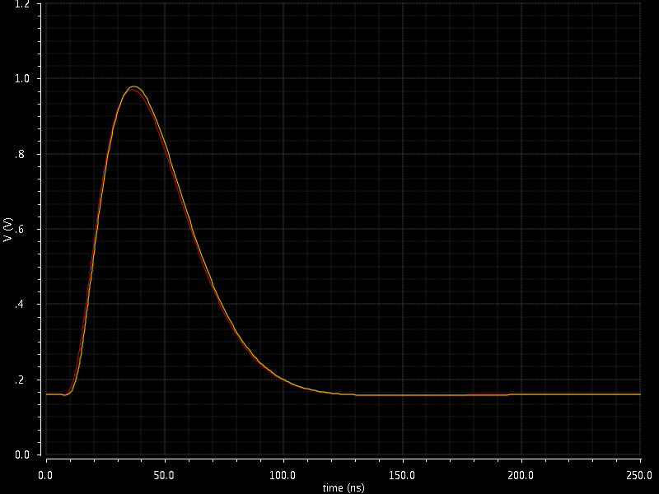
Analog section - simulations 2/2
without and with RC parasitics
shaper output
adjustable gain
Q=100fC
charge amplifier output
Q=800fC, G=1mV/fC, C_{DET}=200pF
adjustable peaktime
adjustable polarity
Q=800fC
Q=800fC

Slide 9
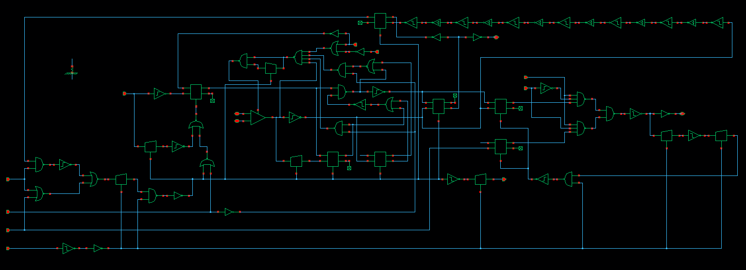
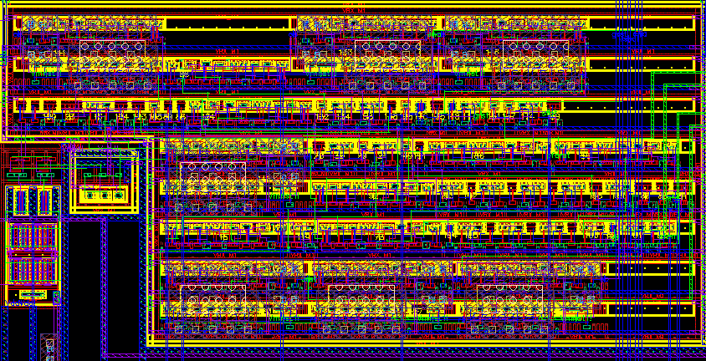
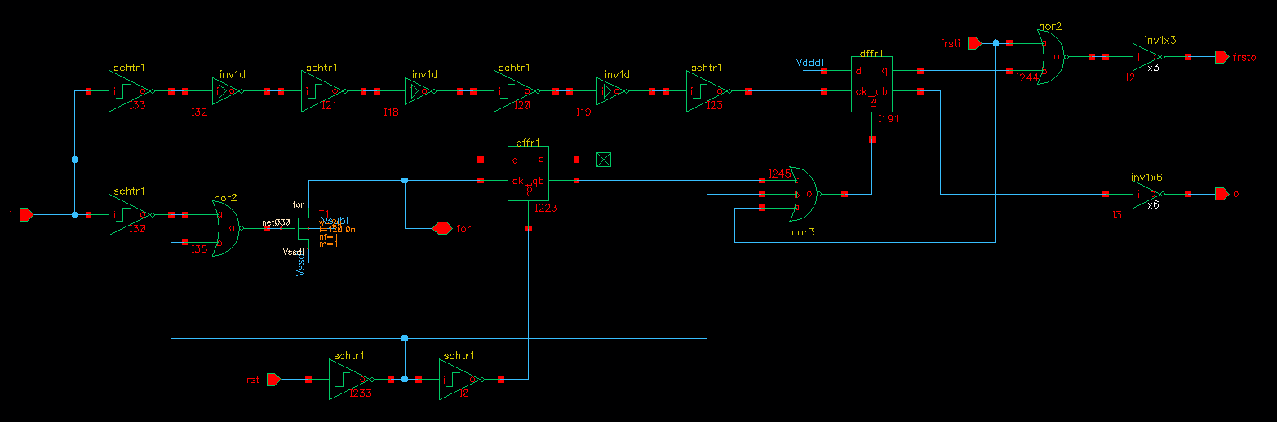
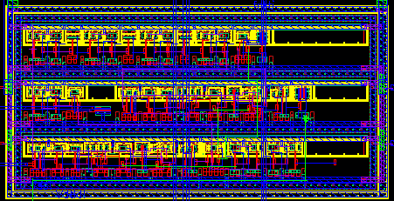
Discriminator and ART
Discriminator
hyst. ctrl loop
comparator
size 130 µm x 70 µm
comparator hysteresis (positive feedback) ~ 20mV
comparator response ~ 1ns
hysteresis control loop reduces effective hysteresis to 1 mV
can detect events down to 2 mV (signal dynamic range ~ 500)
ART
fast OR node
size 50 µm x 25 µm
ART (Address in Real Time) provides address first event
uses fast OR, multiplexed twice (x 8 and x 8)
response 2 ns
within 2 ns, lowest order channel wins

Slide 10
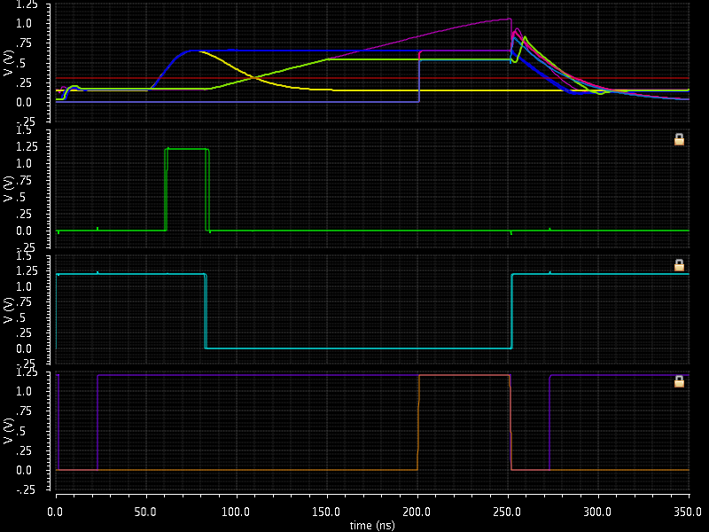
Peak and time detectors - simulations
without and with RC parasitics
ramp
pdo
threshold
pulse
tdo
threshold
peak found
token
reset
TAC stop signal at 150ns (not visible); timing at peak found (low time walk)

Slide 11
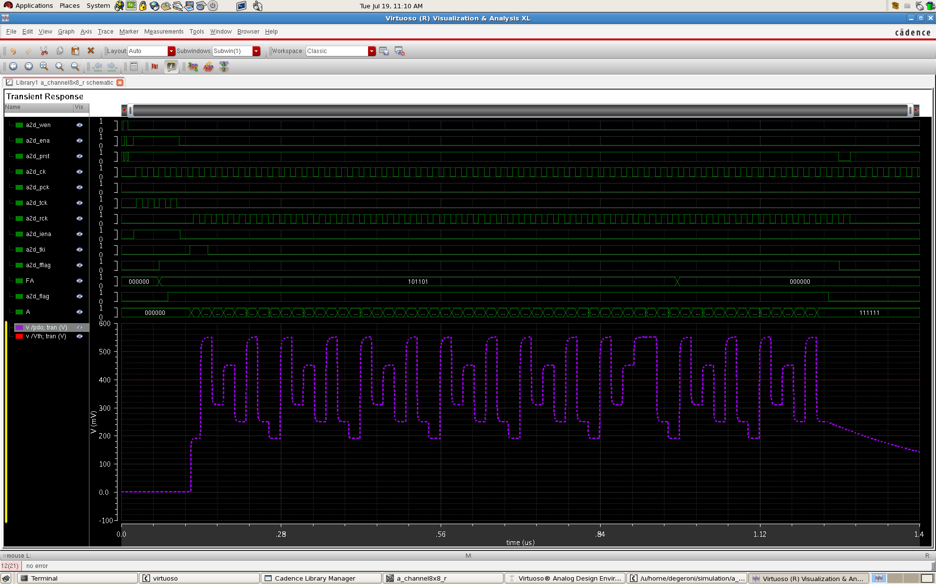
Readout - simulations 1/2
wen
ena
rst
ck
pulser ck
timing ck (for counter)
readout ck
internal enable
token input
ART flag
ART address
flag
address
threshold
PDO
ART at threshold (selectable), flag at peak

Slide 12
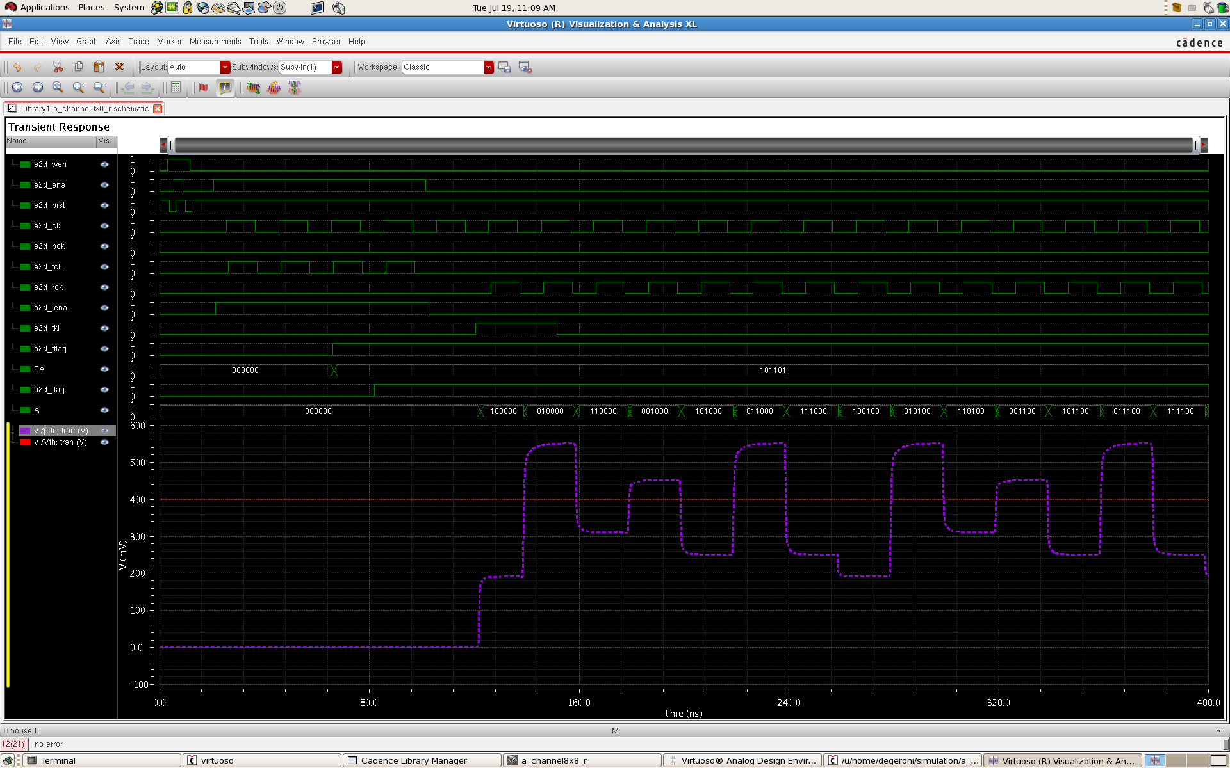
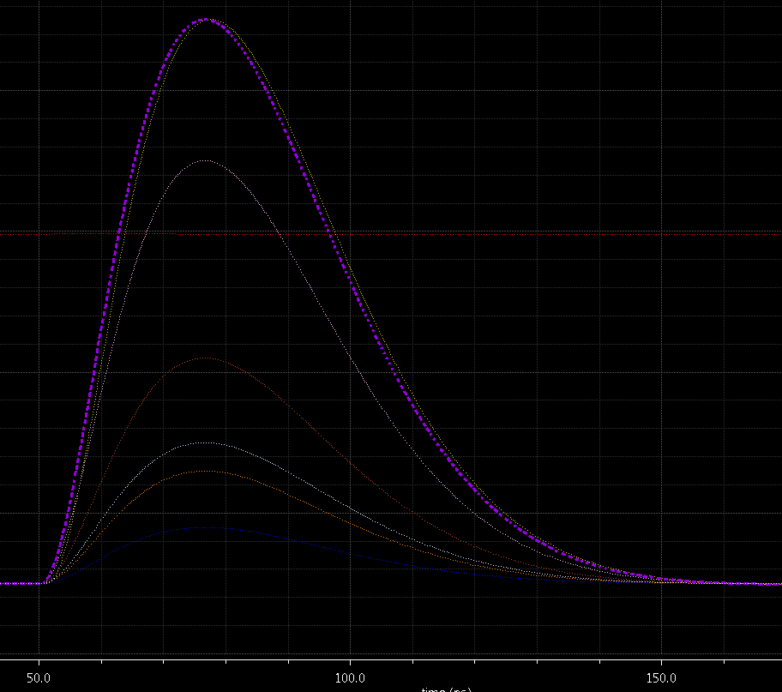
Readout - simulations 2/2
wen
ena
rst
ck
pulser ck
timing ck
readout ck
internal enable
token input
ART flag
ART address
flag
address
45
1 2 3 4 5 6 7 9 10 11 12 13 14 15
threshold
PDO
channels 2, 4, 6, 10, 12, 14 exceed threshold; neighbors are collected
channel 45 hits 2 ns earlier than others (ART)

Slide 13
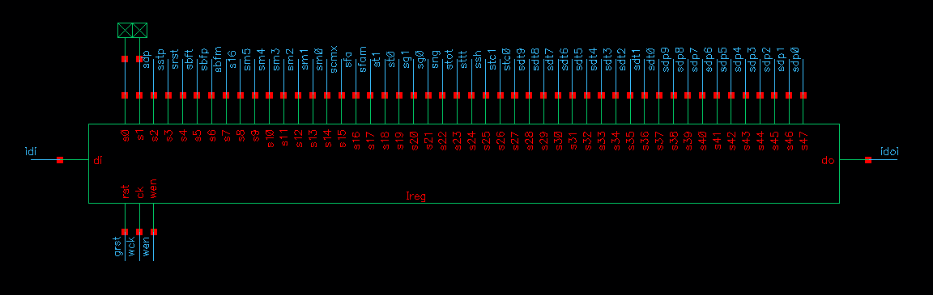
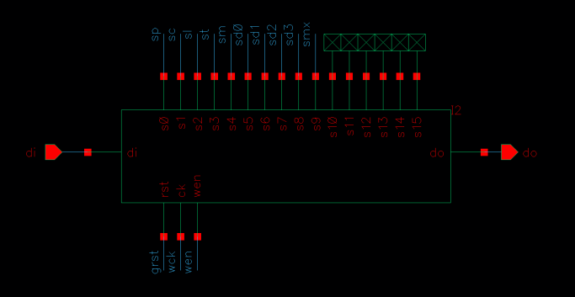
Registers
    Common bits
    sg0,sg1: gain (0.5, 1, 3, 9 mV/fC)(2, 1, 0.33, 0.11 pC)
    st0,st1: peaktime (25, 50, 100, 200 ns)
    sng: neighbor (channel and chip) triggering enable
    stc0,stc1: TAC slope (125, 250, 500, 1000 ns)
    sdp: disable-at-peak
    scmx, sm0-sm5: monitor multiplexing
    sfa, sfam: ART enable and mode (peak, threshold)
    sbfm,sbfp,sbft: buffers enable (mo, pdo, tdo)
    sstp: TAC stop setting (ena-low or stp-low)
    ssh: sub-hysteresis discrimination enable
    sttt,stot: timing outputs enable and mode (ToT or TtP)
    s16: makes ch 7 neighbor to ch 56
    srst: self reset enable (40ns after flag)
    sdt0-sdt9: coarse threshold DAC
    sdp0-sdp9: test pulse DAC
    Channel bits
  sp: charge polarity
  sc: large input capacitance mode (C_{DET}>30pF)
  sl: leakage generator enable
  st: test capacitor enable
  sm: mask enable
  sd0-sd3: trim threshold DAC
  smx: mux monitor mode (analog or trim threshold)

Slide 14
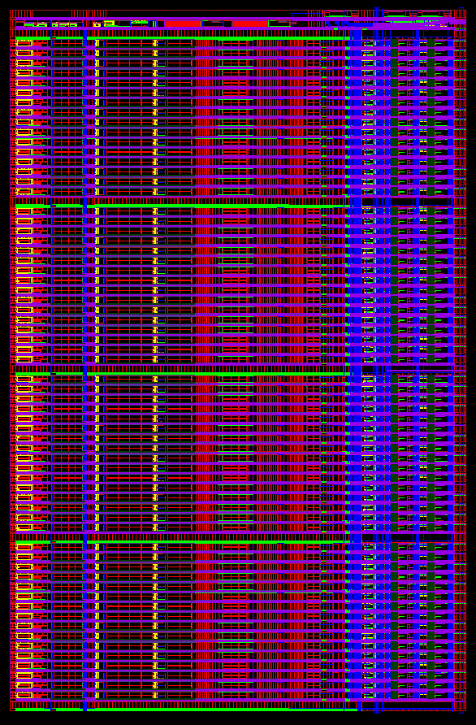
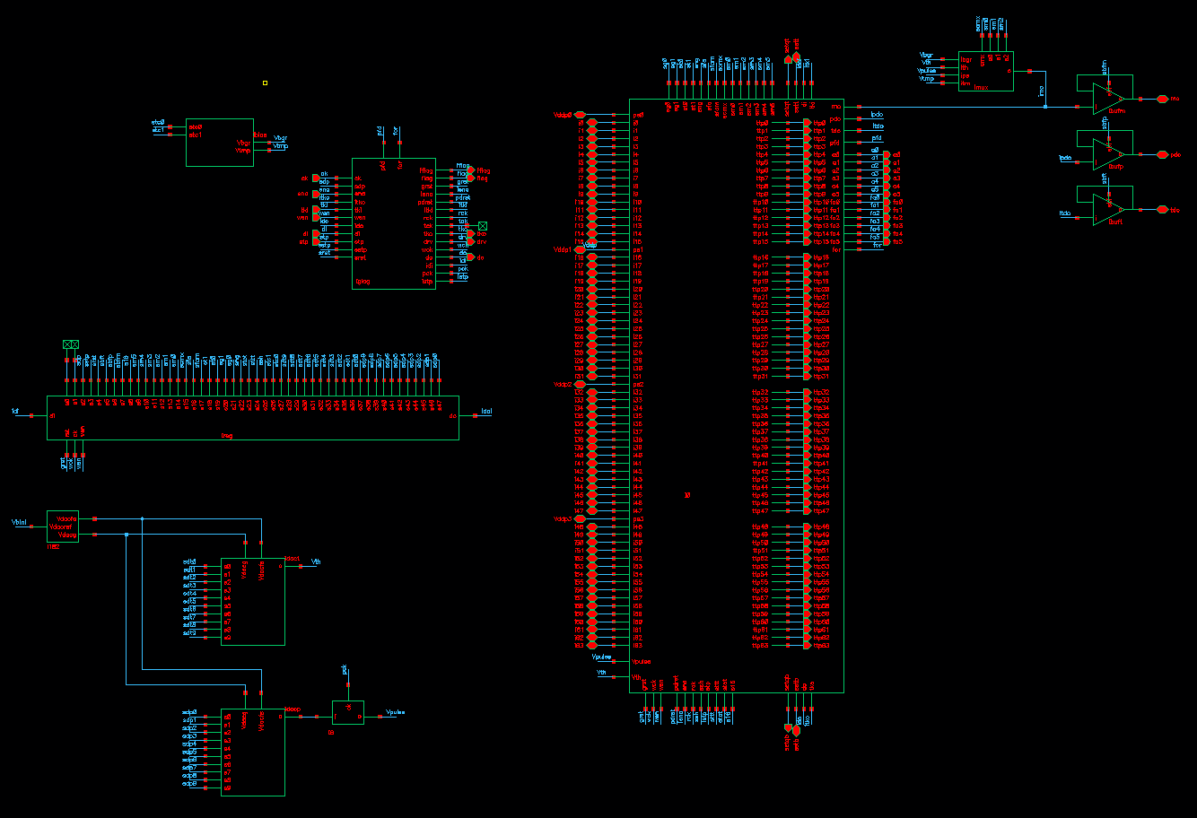
Core
bias, BGR, temp. sensor
monitor
pdo
tdo
addr
control
logic
buffers
64
channels
64 inputs
common registers
threshold DAC
pulser
pulser DAC
size 4.7 mm x 7.1 mm
five banks of MOSCAP filters on bias lines
power dissipation ~ 300 mW

Slide 15
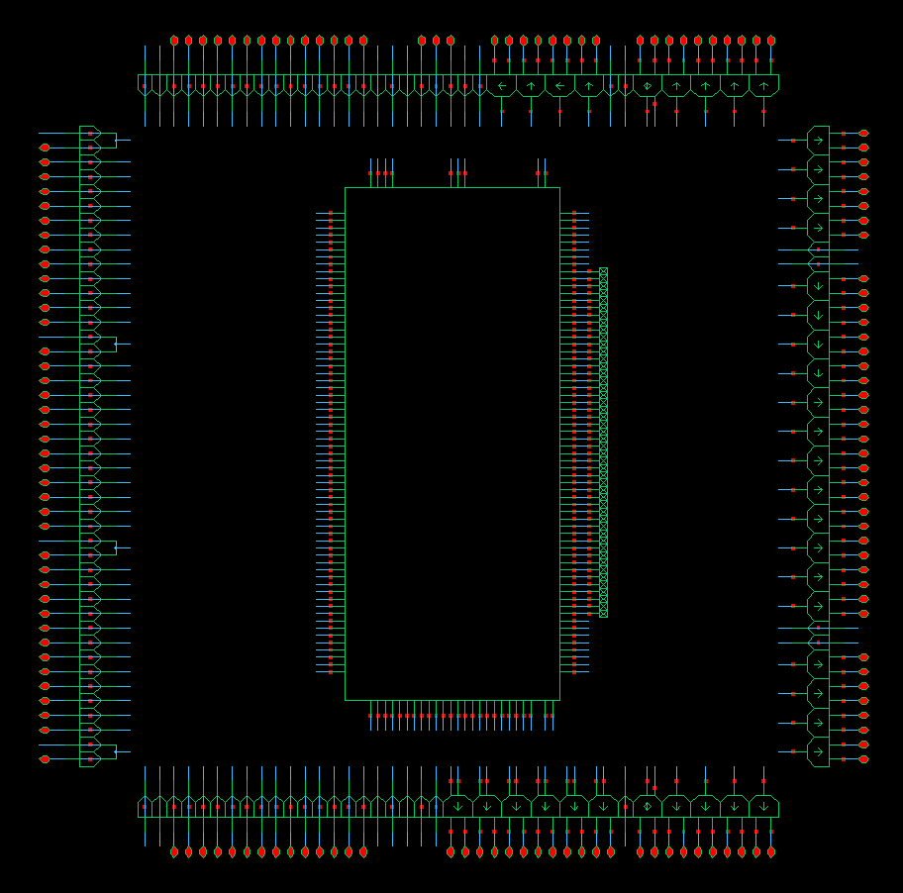
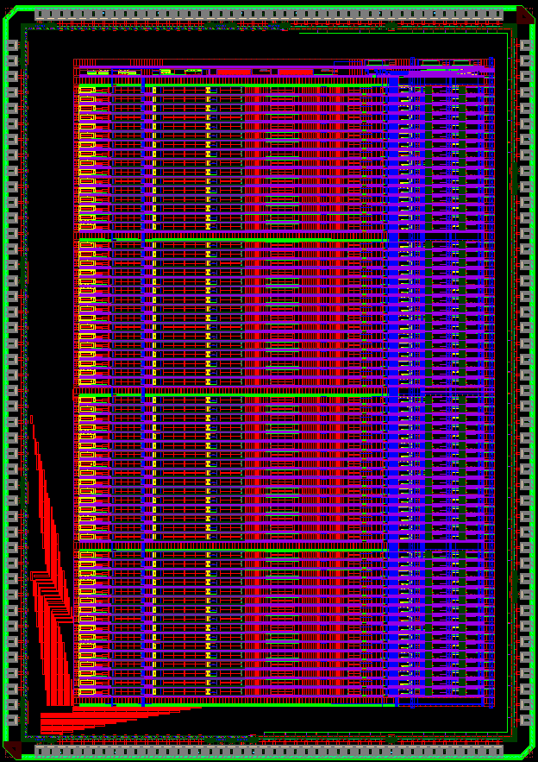
Top level
LVDS IOs
CORE
size 5.9 mm x 8.4 mm

Slide 16
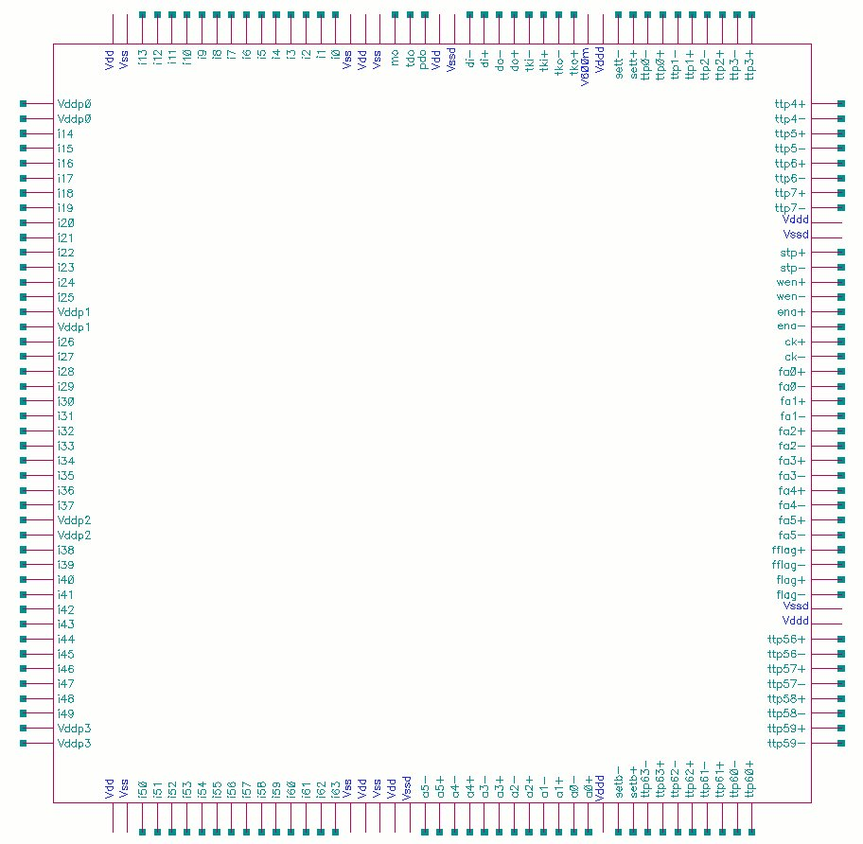
Pinout
  Pinout
  176 pins (44 each side)
  Vdd,Vss: analog supplies 1.2V and grounds 0V
  Vddd, Vssd: digital supplies 1.2V and grounds 0V
  Vddp0-Vddp3: charge amplifier supplies 1.2V
  V600m: reference for LVDS 600mV
  i0-i63: analog inputs, ESD protected
  mo: monitor multiplexed analog output
  pdo: peak detector multiplexed analog output
  tdo: time detector multiplexed analog output
  flag: event indicator
  a0-a5: multiplexed address, tristated (driven with token)
  ttp0-ttp7 and ttp56-ttp63: ToT or TtP
  fflag: ART event indicator
  fa0-fa5: ART address output
  stp: timing stop
  sett, setb: ch0, ch63 neighbor chip triggers (bi-directional)
  ena: acquisition enable
      ena high, wen low: acquisition mode
      ena low, wen low: readout mode
      ena pulse, wen high: global reset
  wen: configuration enable
      wen high: configuration mode
      wen pulse: acquisition reset
  ck: clock
      in acquisition mode ck is counter clock
      in readout mode ck is readout clock
      in configuration mode ck is writein clock
  tki, tko: token input and output (3/2 clock wider)
  di, do: data configuration input and output (1/2 clock shifted)
      in acquisition mode di is pulser clock

Slide 17

Schedule and status
 | scheduled | completed
Analog section | Jan 2011 | February 2011
Peak/time section | March | April
Common circuitry | April | May
Digital sections | May | July
Physical layout | July | October
Fabrication | September | Queued for November 7th
technology IBM 8RF CMOS 130 nm
size 5.9 mm x 8.4 mm (~50mm²)
pads count 176, package LQFP 176 ?

Slide 18
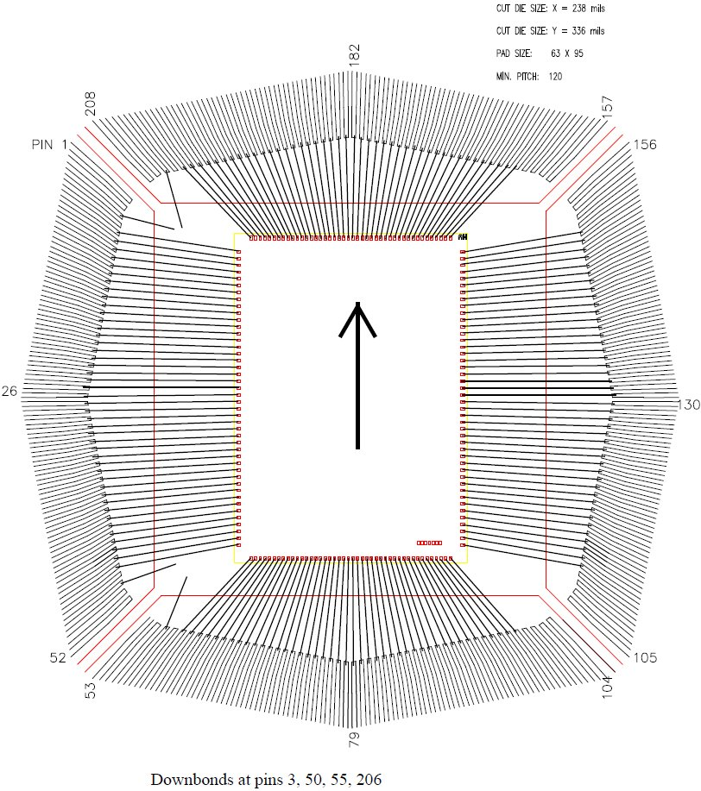
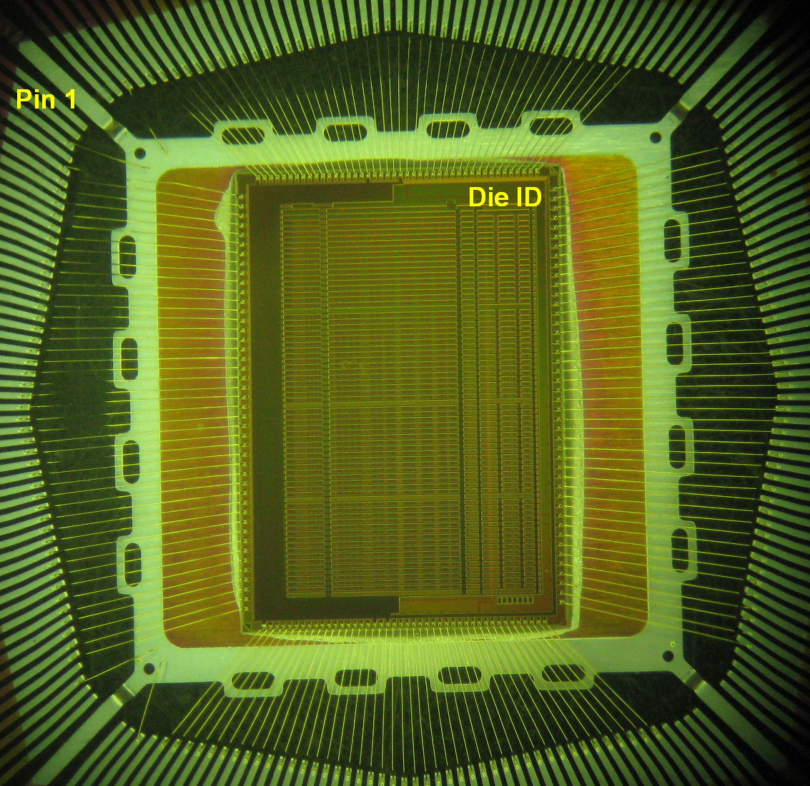
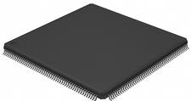
Schedule and status: update March 2012
Packaged in LQFP208 (instead of LQFP 176)
Received from MOSIS 3/7/2012
Test board fabricated 3/22/2012
Test board assembled 3/29/2012
DAQ development in progress

Slide 19
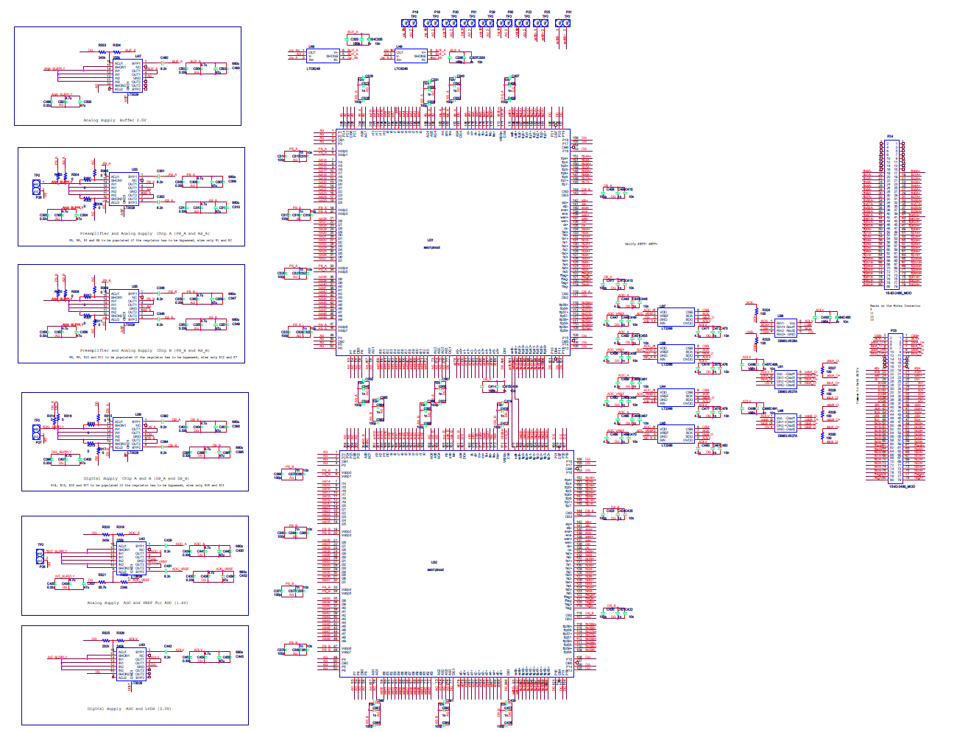
Status as of April 2nd, 2012 - Test Board

Slide 20
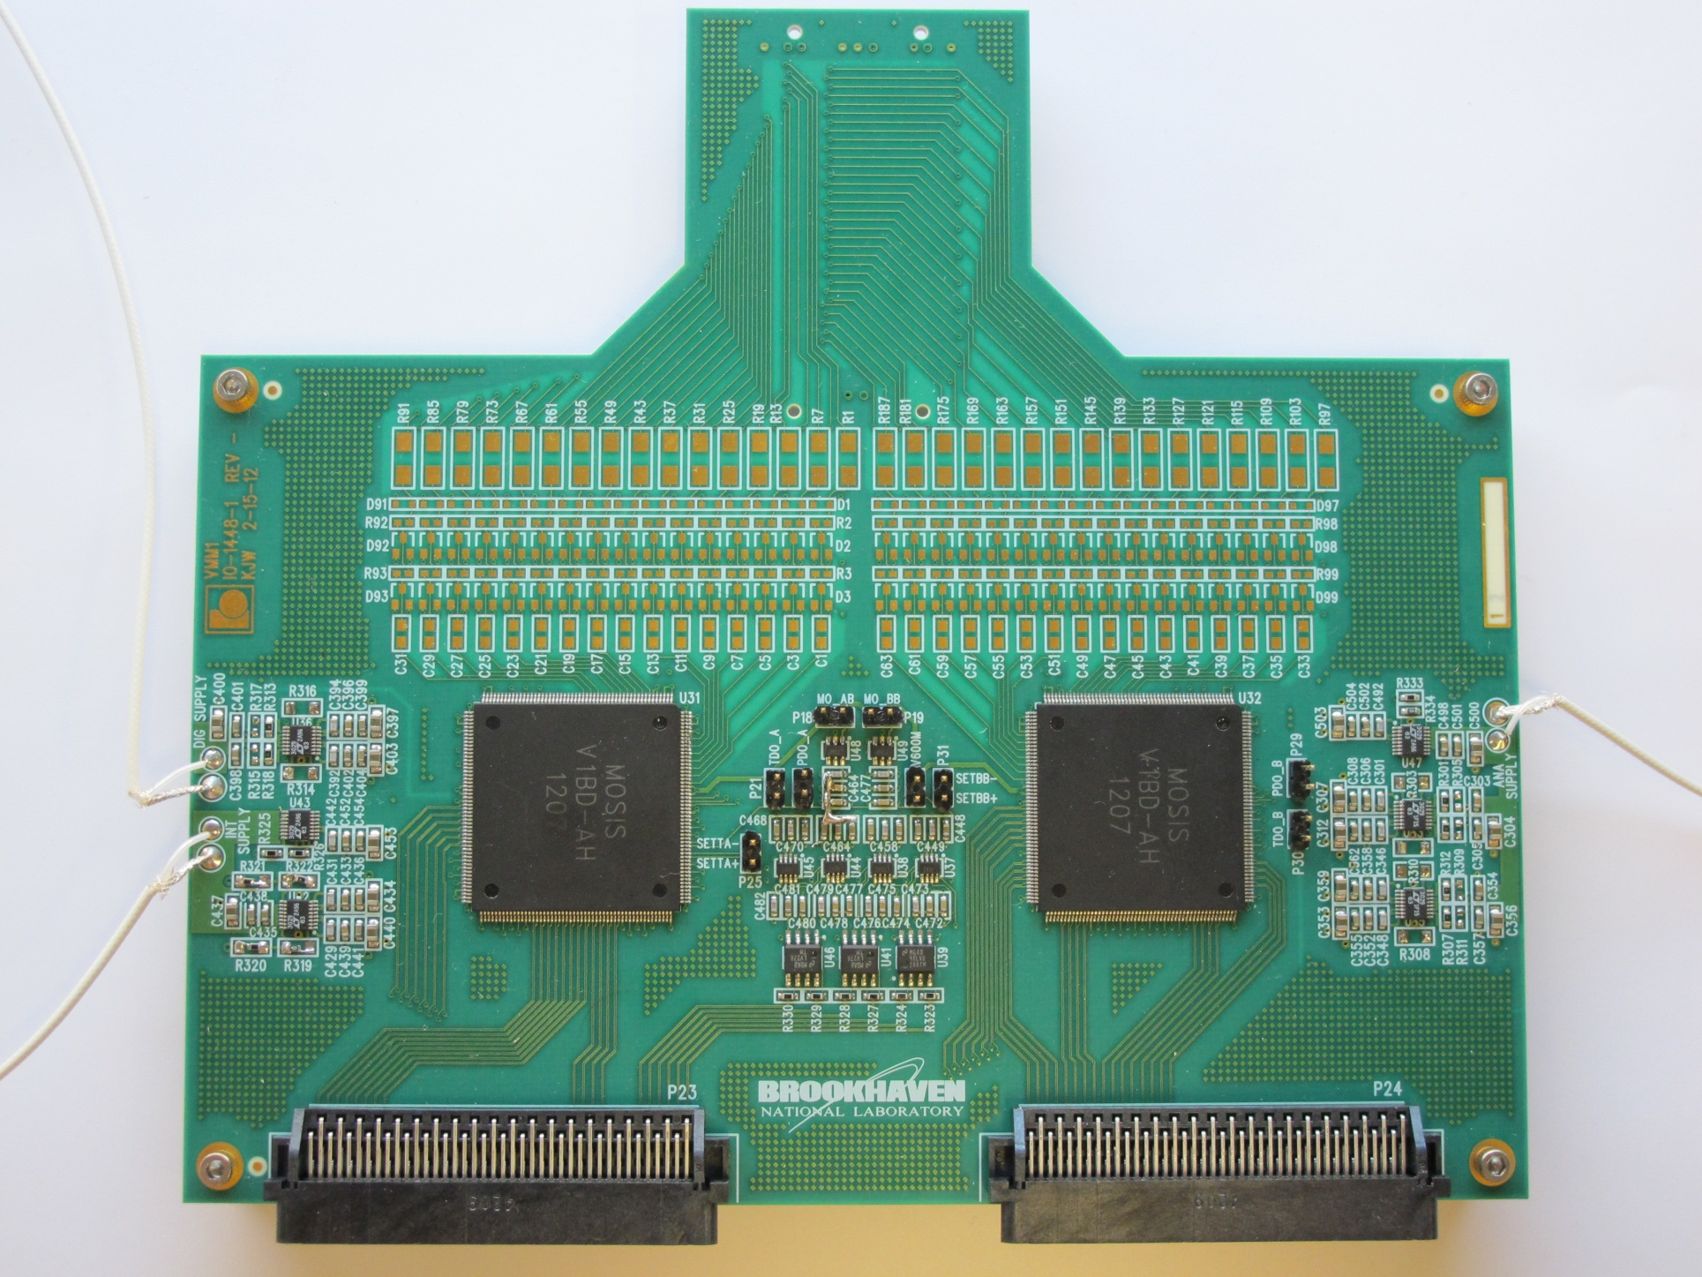
Status as of April 2nd, 2012 - Test Board

Slide 21
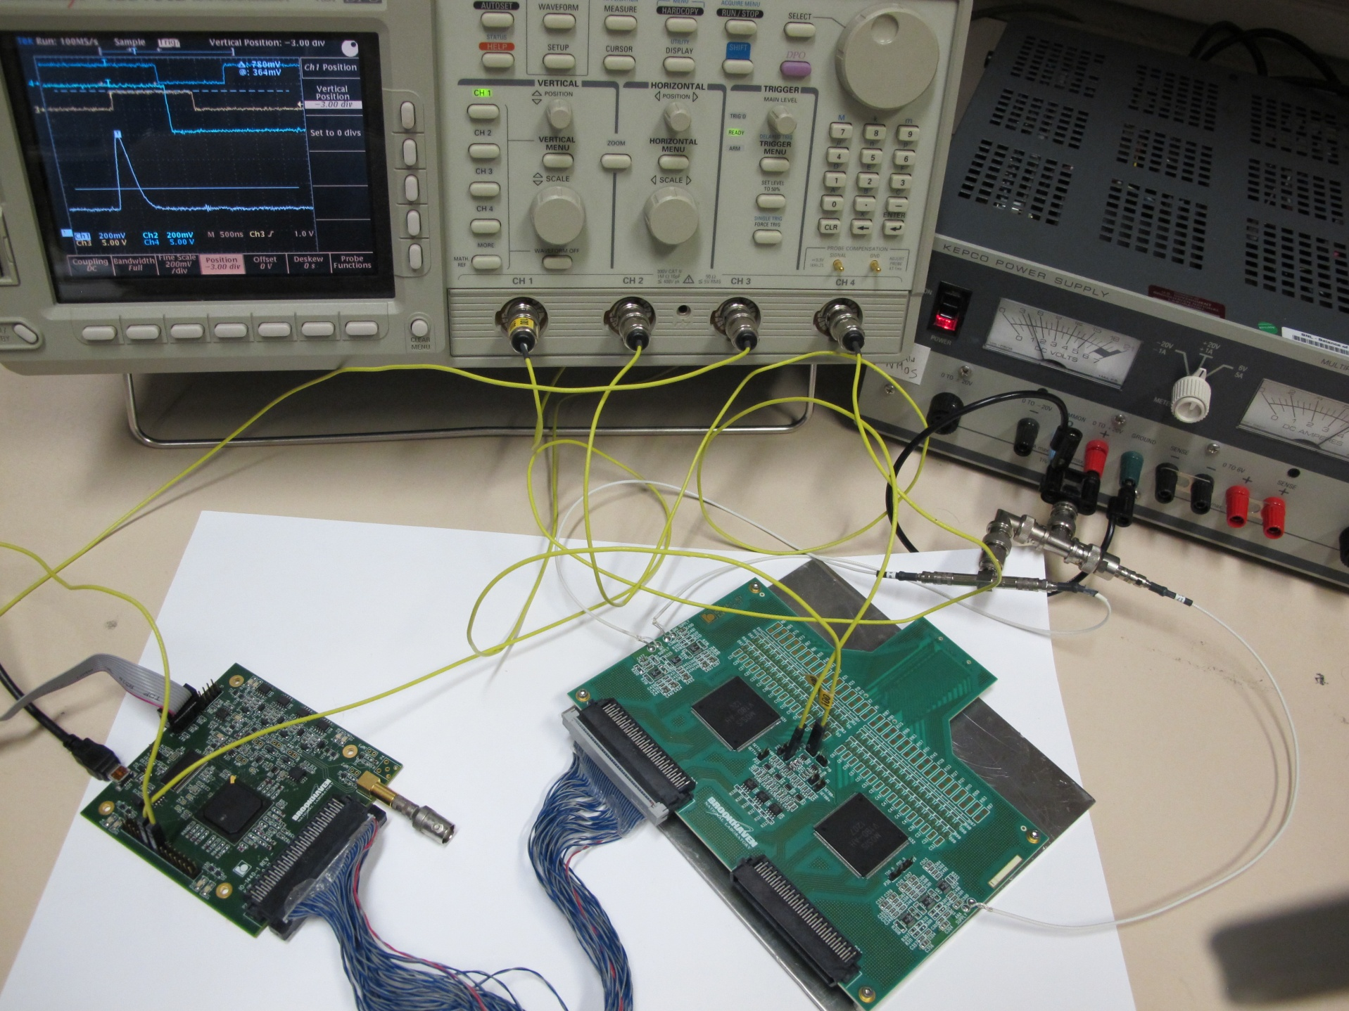
Status as of April 2nd, 2012 - Test System

Slide 22
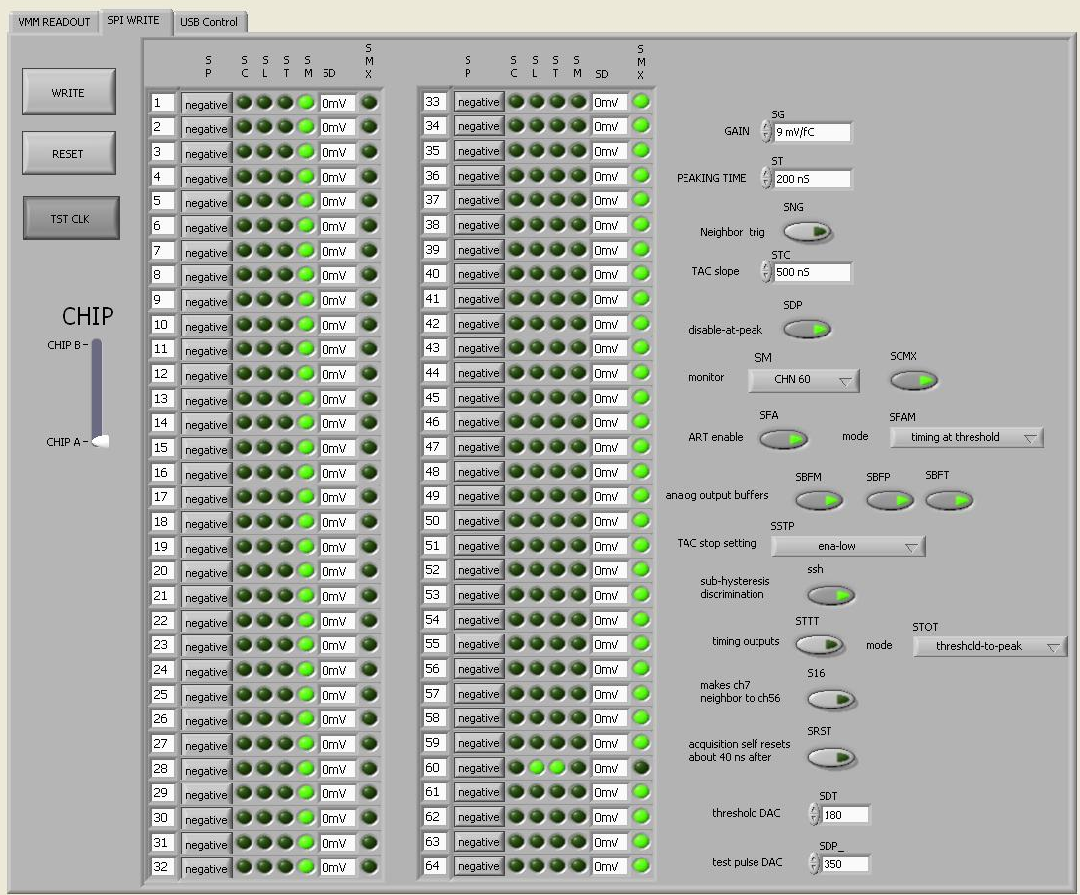
Status as of April 2nd, 2012 - Interface

Slide 23
Preliminary results as of April 2nd, 2012 - Pulse Response
Input charge ~90 fC
pktime 25, 50, 100, 200 ns
Input charge ~90 fC
gain 0.5, 1, 3, 9 mV/fC
Measured output noise at 9mV/fC
peaktime outnoise enc
25, 50, 100, 200 ns 0.49, 0.81, 1.16, 1.52 mV 340, 560, 800, 1050

Slide 24
Preliminary results as of April 2nd, 2012 - Peak Detection
EN
CK
FL
FL
PDO
PDO

Slide 25
Preliminary results as of April 2nd, 2012 - Timing Detection
CK
CK
FL
FL
TDO
ramp 125ns
TDO
ramp 1us

Slide 26
Preliminary results as of April 2nd, 2012 - Neighboring
CK
neigh chip
FL
PDO
neigh channel

Slide 27
Preliminary results as of April 2nd, 2012 - Fast Flag
ART at threshold
ART at peak
FL
FL

Slide 28
Preliminary results as of April 2nd, 2012 - Timing Outputs 1/2
ART at peak
ART at peak
FL
FL
ToT
TtP

Slide 29
Preliminary results as of April 2nd, 2012 - Timing Outputs 2/2
ART at peak
ART at peak
FL
FL
ToT
TtP

Slide 30
Preliminary results as of April 2nd, 2012 - Summary
Most relevant issues so far:
  large leakage from input protection increases noise (~400e⁻) and disables positive charge front-end circuit (needs external current compensation, e.g. resistor)
  self-reset function does not reset discriminator
  analog pulse shows some digital pick-up
  mixed signal issues to be investigated

Slide 31
Backup slides

Slide 32
Delayed dissipative feedback (DDF)
Classical
DDF equal DR
DDF equal C
G. De Geronimo et al., Ieee TNS 58 (2011)

Slide 33
Peak detector - classical configuration
detects and holds peak without external trigger
provides accurate timing signal (peak found, z-cross on derivative)
low accuracy (op-amp offset, CMRR)
poor drive capability
Notes:
Back-up

Slide 34
Peak detector - multiphase
1 - Track (< threshold)
• Analog output is tracked at hold capacitor
• M_{P} and M_{N} are both enabled
2 - Peak-detect (> threshold)
• Pulse is tracked and peak is held
• Only M_{P} is enabled
• Comparator is used as peak-found
3 - Read (at peak-found)
• Amplifier re-configured as buffer
• High drive capability
• Amplifier offsets is canceled
• Enables rail-to-rail operation
• Accurate timing
• Some pile-up rejection

Slide 35
Peak detector - multiphase
Chip 1 – negative offset
Chip 2 – positive offset

Slide 36
Peak detector - timing function
Compare timing at threshold crossing with timing at peak
Threshold crossing Peak detection
output slope normalized to unit charge
Time-walk strongly dependent on amplitude
Time-walk almost independent of amplitude
(equivalent to zero crossing on differential)
Notes:
Back-up

Slide 37
Peak detector - timing function
Compare timing at threshold crossing with timing at peak

Slide 38
Shaper coefficients for amplitude and timing resolution

