Slide 1
MMFE-8 Status at Arizona
Kenneth Johns, Charlie Armijo,
Will DeCook, Andy Dowd, Kade Gigliotti
Bill Hart, Sarah Jones
University of Arizona

Slide 2
Hardware

Slide 3
MMFE-8 Status
We have 7 boards
4 with eight VMM
2 of these were re-worked at Sigmatron to add additional VMM
Poor workmanship / poor quality control, flux was not cleaned from boards. One board had missing parts, other had damaged parts. However these are the “best” boards.
2 of these were re-worked at Advanced Assembly to add additional VMM
Good workmanship, no damage, very clean.
If we had a factory acceptance test we would be able to reject the failed builds before delivery
2 with two VMM, one of which is modified for Ethernet power supply testing
Nice boards for testing since we have access to VMM pads
1 with no VMM

Slide 4
MMFE-8 Status
Two boards (the best ones) are being left at CERN for use
Strongly suggest using good ESD handling procedures since we only have four fully populated boards

Slide 5
MMFE-8 with Eight VMM

Slide 6
Testing
Many voltage measurements
Present functional test is to use an FPGA state machine to global reset, configure, configure, enter acquisition mode, send CKTP and CKTK and readout data with CKDT
Success is defined as reasonable data observed on data0 and data1 with oscilloscope

Slide 7
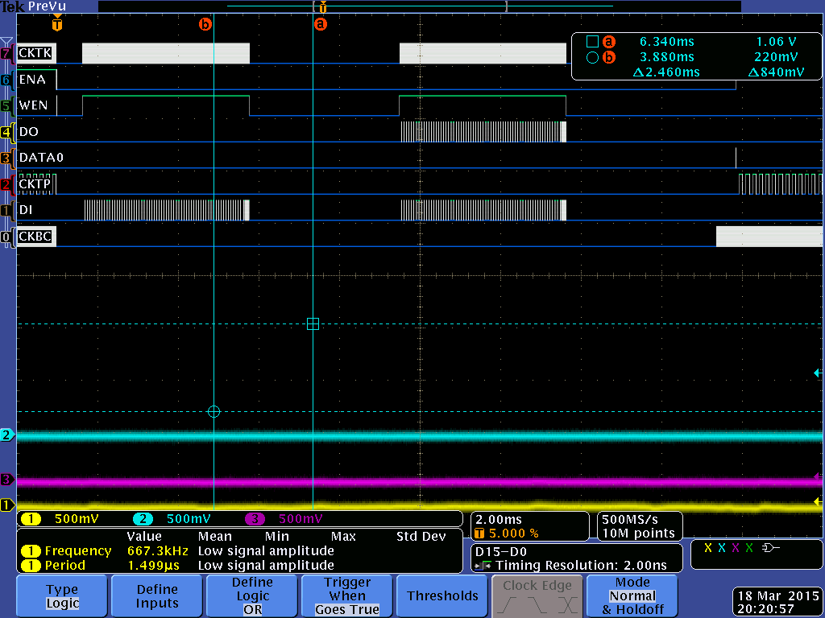
State Machine Tests
Using state machine, VMM configuration OK

Slide 8
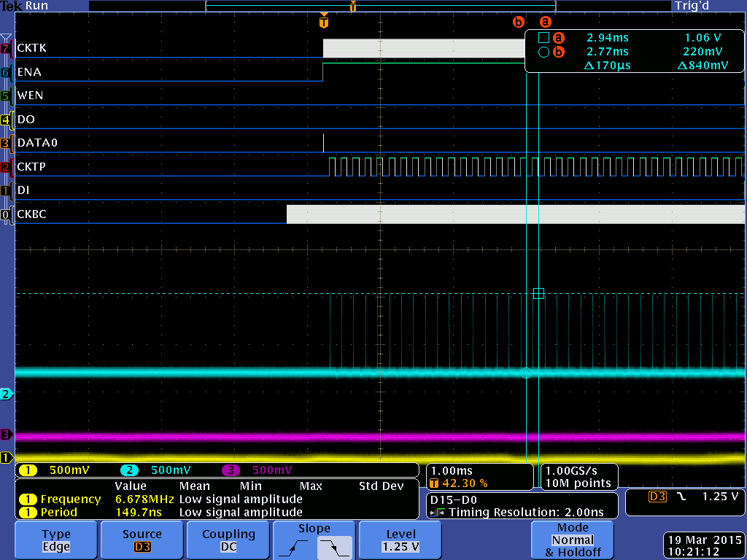
State Machine Tests
Using state machine, MO output and data0 in response to CKTK and CKTP

Slide 9
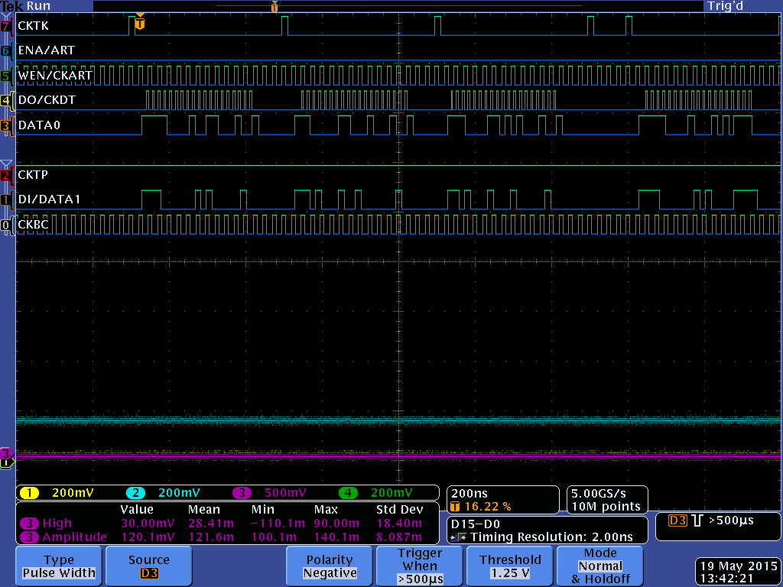
State Machine Tests
CKDT “readout”

Slide 10
Results
Of the 4 eight VMM MMFE boards
Board 1, SN 0001
Passes testing on VMM 1 - 6,
VMM 7 shows a short between Vdd and AGND.
Power to VMM 7 has been temporarily removed so the remainder of the board’s VMM can be utilized.
VMM 8 exhibits signs of an open pin on CKBC or CKTP.
Board 2, SN 0003
Passes testing on VMM 1, and 3 - 8
VMM 2 exhibits signs of an open pin on CKBC or CKTP. This can be temporarily fixed by flexing the board, or squeezing the SE corner of the VMM.
Board 3, SN 0004
Passes testing on VMM 1 – 3, and 5 - 8
VMM 4 exhibits signs of an open pin on CKBC or CKTP. This can be temporarily fixed by squeezing the SE corner of the VMM. So far this has been a one time fix.
Board 4, SN 0005
Passes testing on VMM 1 – 2, 4, and 6 - 8
VMM 3 exhibits signs of an open pin on CKBC or CKTP.
VMM 5 exhibits signs of an open pin on CKBC or CKTP. This can be temporarily fixed by squeezing the SE corner of the VMM. So far this has been a one time fix.

Slide 11
Problems and Issues
We raised the DCDC converter voltage supplying the LDO’s to the VMM Vddp and Vdd, to resolve LDO dropout during VMM global reset and configuration
We verified this works for simultaneous global reset of all VMM
We verified this works with all clocks being driven
Ground offsets (affecting LDO operation, and possibly differential signal bias) due to high DCR inductors resolved by replacing ground inductors with 0 ohm resistors.
Low voltage issues (possibly affecting differential signal bias), mainly associated with large DCR inductors
Replaced some inductors with smaller DCR inductors
Optimization still to be done, propose replacing all inductors with new type
Note: Inductors were changed at last minute due to test failure of previous selection
Timing issues with VMM
VMM is sensitive to clock widths, edge alignment, and synchronization with other clocks and signals
This seems to correspond with observed data “features”
Unclear if we have optimal timing yet and more consideration of clocks needs to taken in the firmware

Slide 12
Problems and Issues
Rework issues on all boards
We are just dealing with it
Noise on the enet 2V5 line
Perhaps this limits our Ethernet speed
Additional capacitance did allow increase of Ethernet speed
Noise source is from PHY, as well as from DCDC and FPGA.
No noise on the VMM lines
No evidence of noise on analog inputs.
Analog supplies show good noise isolation even with poor orientation of the DCDC.
Some noise on digital lines but well below signal amplitudes.
No evidence of problems but not extensively studied.
Random noise seems to be low (< 1 mV limit of scope)

Slide 13
Schedule
Two boards (50%) are being released to CERN after demo
Firmware/software updates will be distributed later
New assembly of 5 MMFE boards with eight VMM
On hold until we converge on optimum component values
Hopefully will place order in the next couple of weeks
If boards test successful, assembly will be given to NTUA for assembly production of N boards with eight VMM
Next six-eight weeks?
Start new design with VMM3 + FEAST + Enet fixes
End-June
Start new design with VMM3 + FEAST + SCA + ROC??
End-July

Slide 14
VMM Count (may be old)
Available 94
78 (BNL) + 4 (AZ) + 12 (CERN)
Need 163
3 (Mini-1 w FEAST)
5x8 (40) (new assembly with optimized component values)
15x8 (120) NTUA

Slide 15
Other Considerations
Budget is a constant concern (Kotcher, Bensinger)
More difficult to take on extra projects (e.g. mini-1 with VMM3)
Proposed VMM3 packaging potentially increases cost and board complexity
Labor
Beginning to lose grad students to Run 2 Physics
Several partial FTE students working during the summer but they are just ramping up now

Slide 16
Firmware

Slide 17
Firmware – What Exists
Ethernet communication @ 10 Mbps with registers and FIFO’s on A7 via host PC
And eight VMM configuration via GUI
State machine that does global reset, configure, acquisition reset and CKDT readout into FIFO (for internal pulser)
One VMM readout into FIFO and subsequent readout into host PC via UDP packets
One VMM readout using leaky bucket
Eight FIFO into one FIFO readout using leaky buckets
Both leaky bucket projects are untested

Slide 18
Firmware – What Exists
User reset and start data acquisition via GUI
In testing currently
XADC readout of multiplexed PDO and other analog data (baselines, not pulses)
In testing currently
BCID capture using external trigger
Untested, needed for leaky bucket
With few exceptions (MB), HDL code is functional but not elegantly written

Slide 19
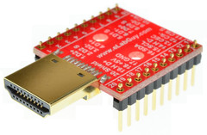
Firmware – What Does Not Exist
Eight VMM readout
As mentioned, in progress
Extensive testing to find dark corners in logic or timing
Readout in response to external triggers
As mentioned, firmware in progress via HDMI but Lorne Levinson is suggesting alternatives
Any testing with multiple MMFE-8

Slide 20
Host PC Software
MMFE8 connected to Linux SL6 via LAN.
GTK Python 2.6/2.7 GUI used for configuration.
GUI configuration tab similar to BNL LabView.
Configuration via UDP packets to MicroBlaze on Artix7.
Data can be received in UDP packets from A7 FIFO.
Size of packets limited because of sparse A7 RAM.
Data automatically loaded into file on PC.
PyRoot used to display data, including per channel.

Slide 21
Ethernet
Ethernet has been operational for many weeks however the speed is limited to 10 Mbps
Our best guess is the magnetics or noise in the Ethernet circuitry but we have put this investigation aside until more pressing problems are resolved

Slide 22
Conclusions
Status of the MMFE-8 was presented
Two boards are now at CERN
A fairly complete firmware/software system for benchtop testing seems realizable within the next month
Work remains to evolve this into a system for MM factories and test beams (and very unclear where the labor will come from)

