Slide 1
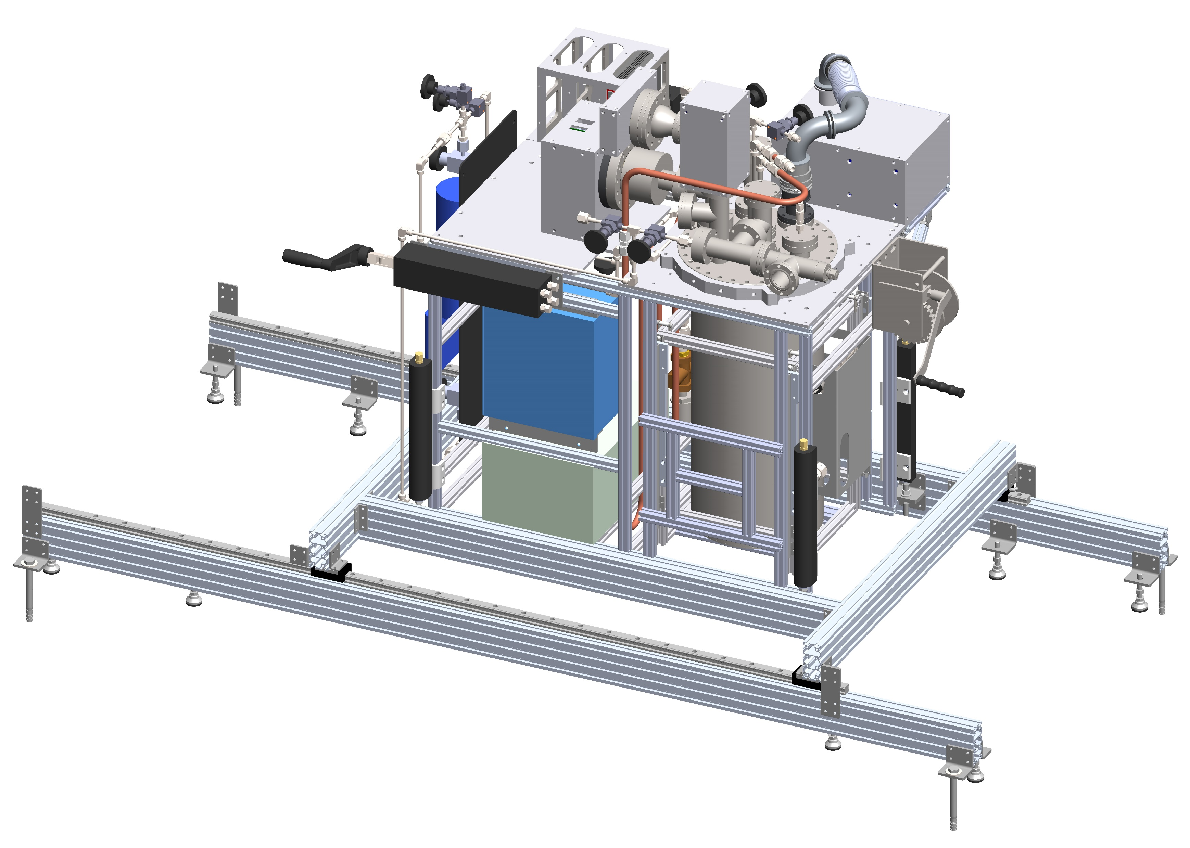
Various FCalPulse Updates
March 25, 2021
Robert Walker

Slide 2
Status of Parts
Ordered
Source Press (Ordered 3/16, URIC, expected next week)
SCal modules (Ordered 3/23, URIC, 3-4 weeks)
Scintillator Acrylic (Cookies and Light Guides) (Ordered 3/24, URIC, 2 weeks)
Scintillators (Order confirmed 3/22, Elgen Technologies, 4-5 weeks)
Yet to Order
Faraday Cages
HV, FAMP/Signal, Cryostat Monitoring (Early next week)

Slide 3
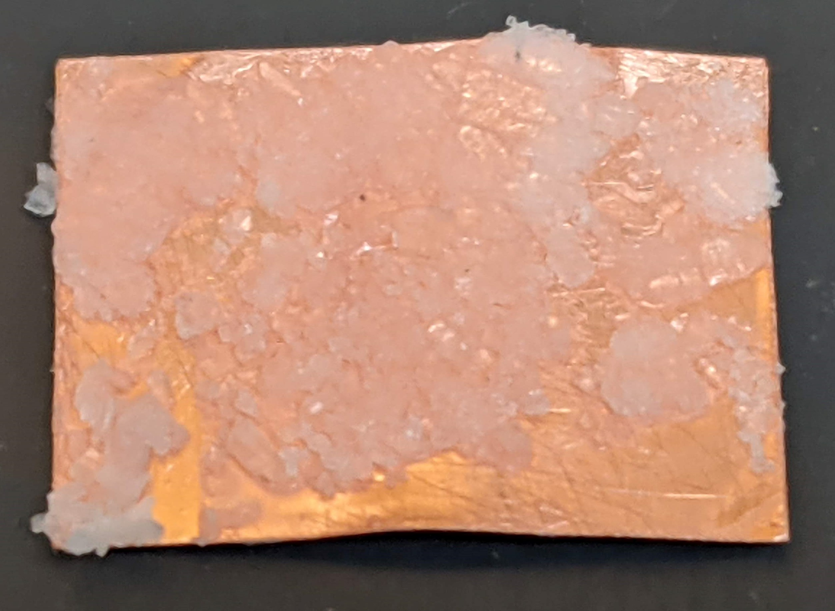
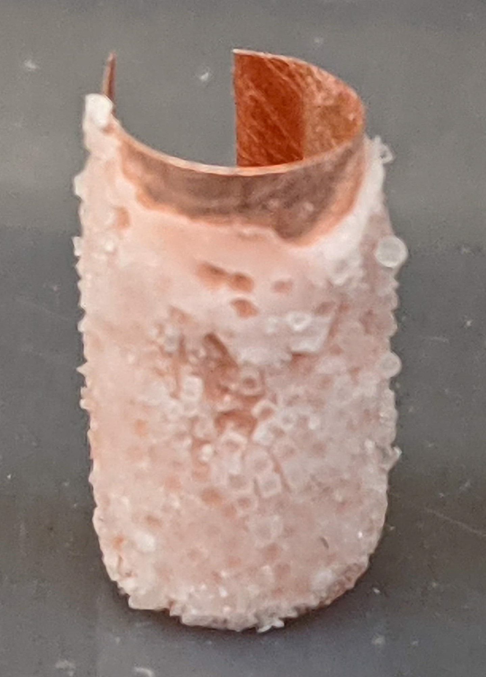
Strontium Chloride Copper Foil Study
Began testing salt behaviors with Elmer’s glue.
NaCl (Morton’s Iodized Salt and Sea Salt)
Added to glue it binds and dries much quicker.
H₂O must be added to “sort of” work.
Tested different order of adding materials.
Trial pressed between two Al blocks.
Managed to get one foil rolled.
Scuffing foil with sandpaper is necessary for better bonding.
Overall takeaway of NaCl with Elmer’s Glue:
Not easy to work with.
Uniform distribution will be hard to achieve.

Slide 4
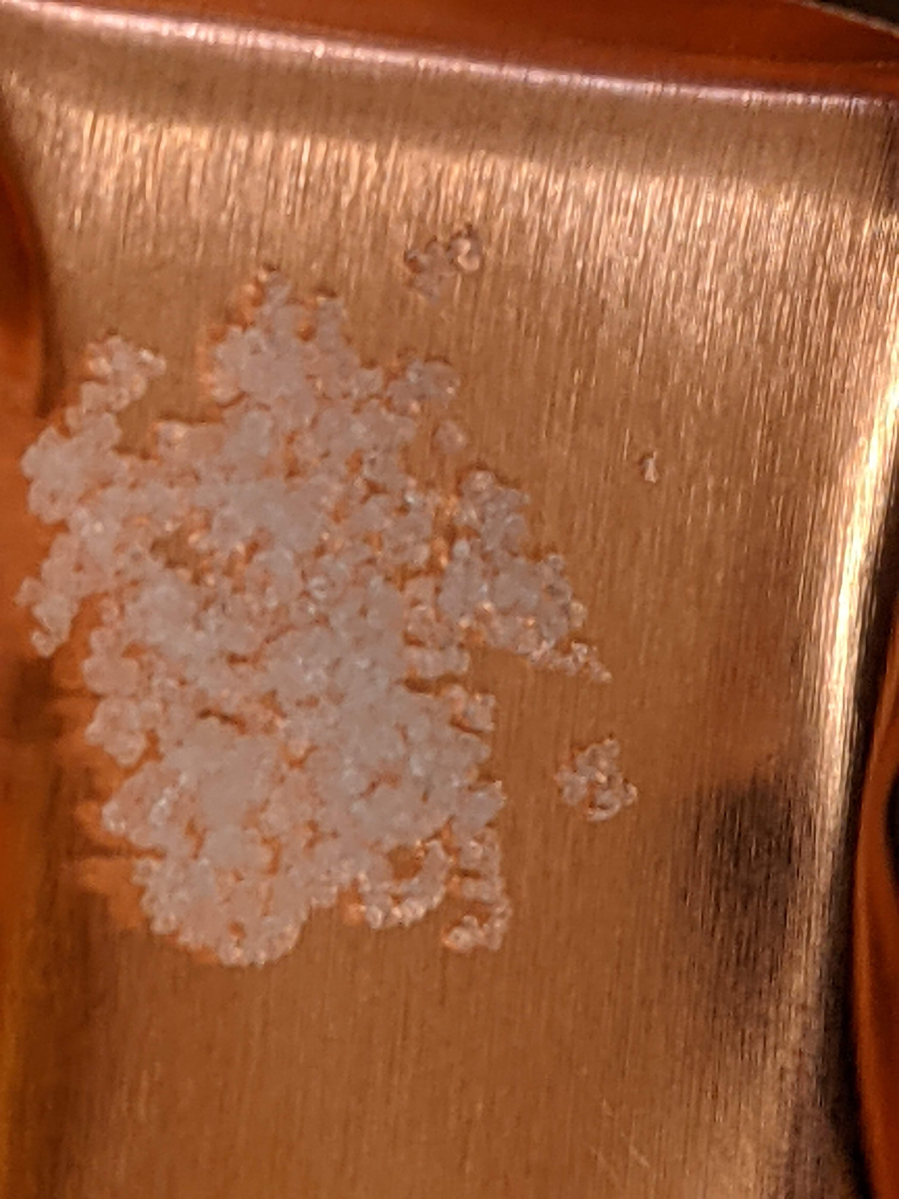
Strontium Chloride Copper Foil Study
Actual source material is SrCl₂
We have SrCl₂ 6H₂O (Strontium Chloride Hexahydrate)
Mixing with Elmer’s glue:
Opposite of table salt, makes glue thinner.
Belief is that the glue breaks the water bonds with the Strontium Chloride (Not a Chemist)
Takes longer to set.
One mixture was still wet 4 hours after mixing.
Ratio of glue to salt will be important to figure out.

Slide 5
Strontium Chloride Copper Foil Study
Next Steps:
Acquire scale to accurately measure glue and salt amounts.
Find best/easiest mixture to work with using estimated volume of Strontium Chloride for source strength.
Different glues have been ordered.
Work better/worse?
Is a layer of material (Kapton, Copper, etc.) needed to encapsulate the source?
Test with press
Develop procedure to create source.
Process for mixing, spreading, pressing.
Working time (time to make source, roll, and install in holder).

