Slide 1
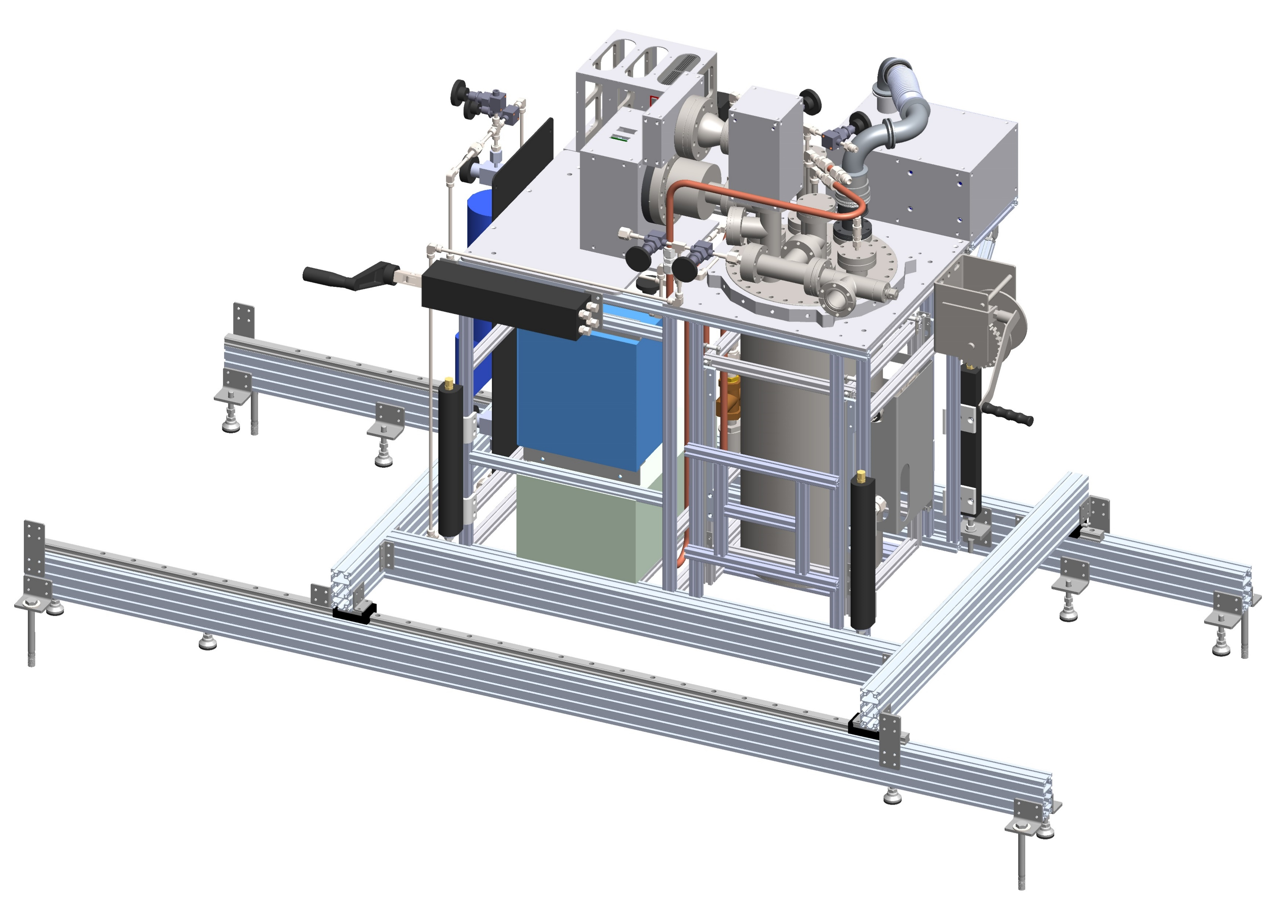
Source Foil R&D Updates
April 8, 2021
Robert Walker

Slide 2
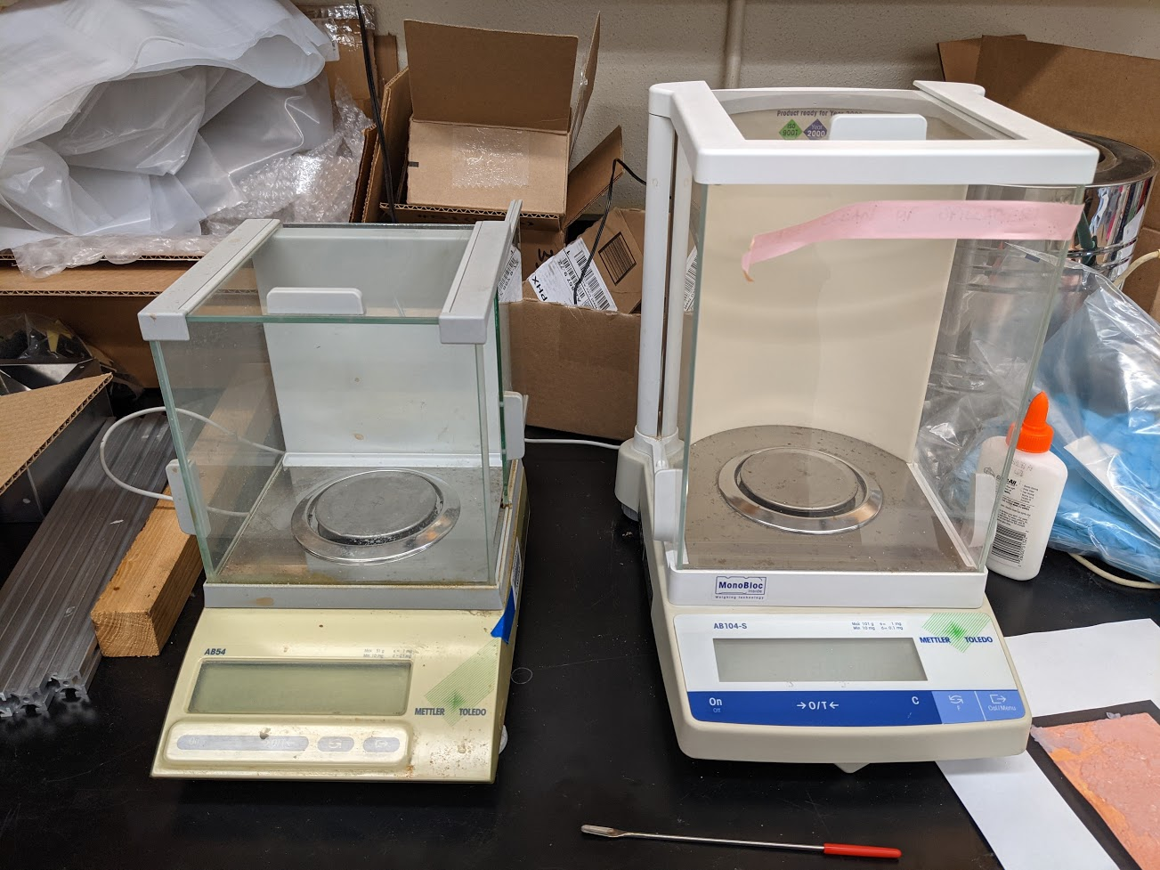
Updates
Press side piece remade, fitted, and assembled.
Much better fit.
Acquired (borrowed) two scales.
Both have precision 0.0001g
Started work to find the best salt/glue/water ratio.
Started development of a procedure for producing thin deposit of SrCl₂.

Slide 3
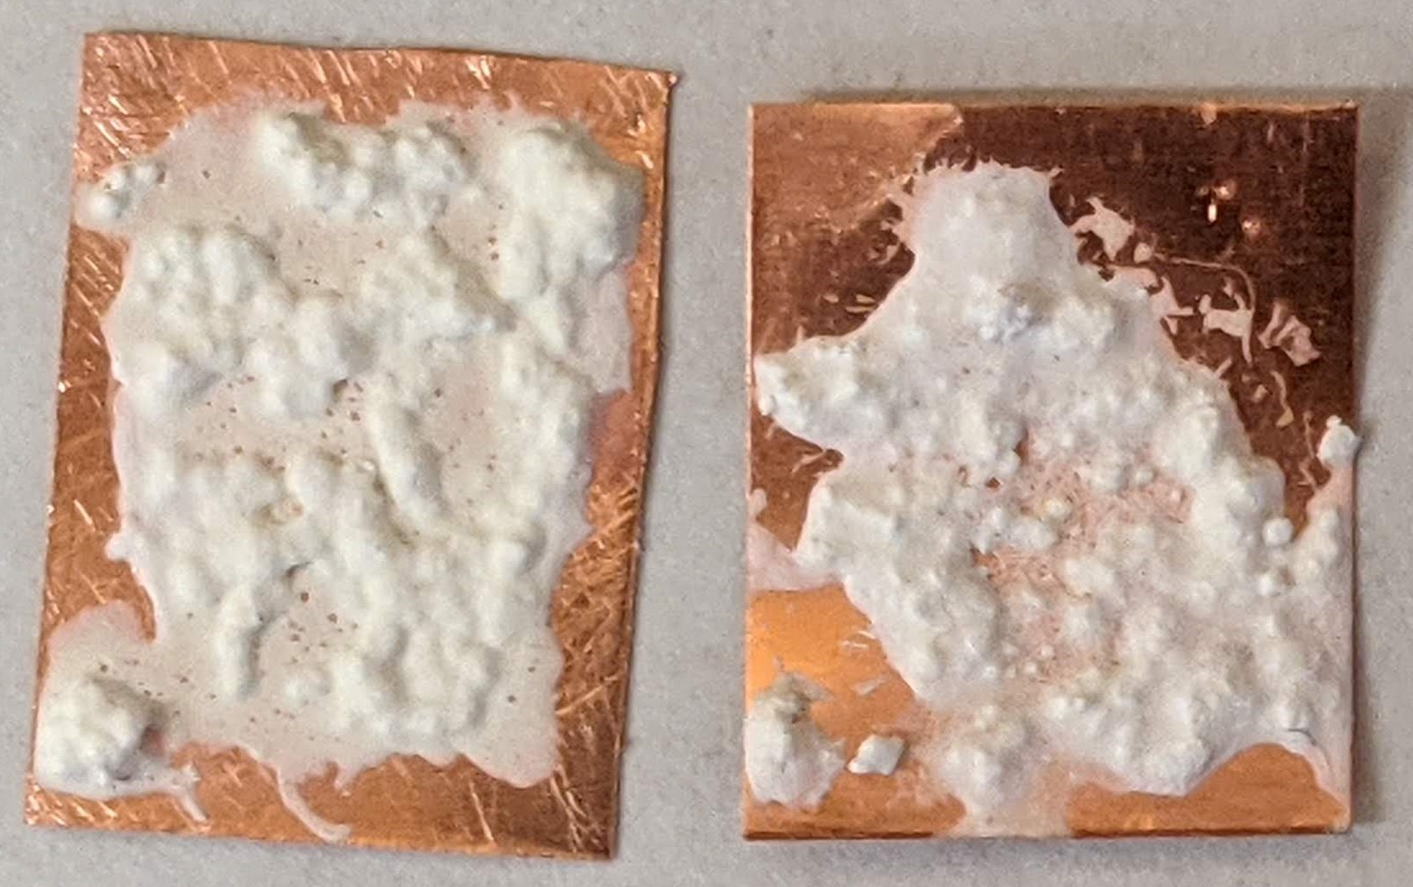
Mixture Ratio
Glue needs to be water based.
Strontium salt is water soluble; cyanoacrylates or epoxies will not work.
Elmer’s glue - Polyvinyl acetate
Glue alone is not enough.
Salts do not dissolve completely.

Slide 4
Mixture Ratio continued.
Mixture requirements:
Dissolve salt completely (or almost completely)
Thin enough to spread evenly
Not so thin it flows.
Ratio: 1 part salt : $\sim 2/3$ part glue : $≤1/4$ part water (by weight)

Slide 5
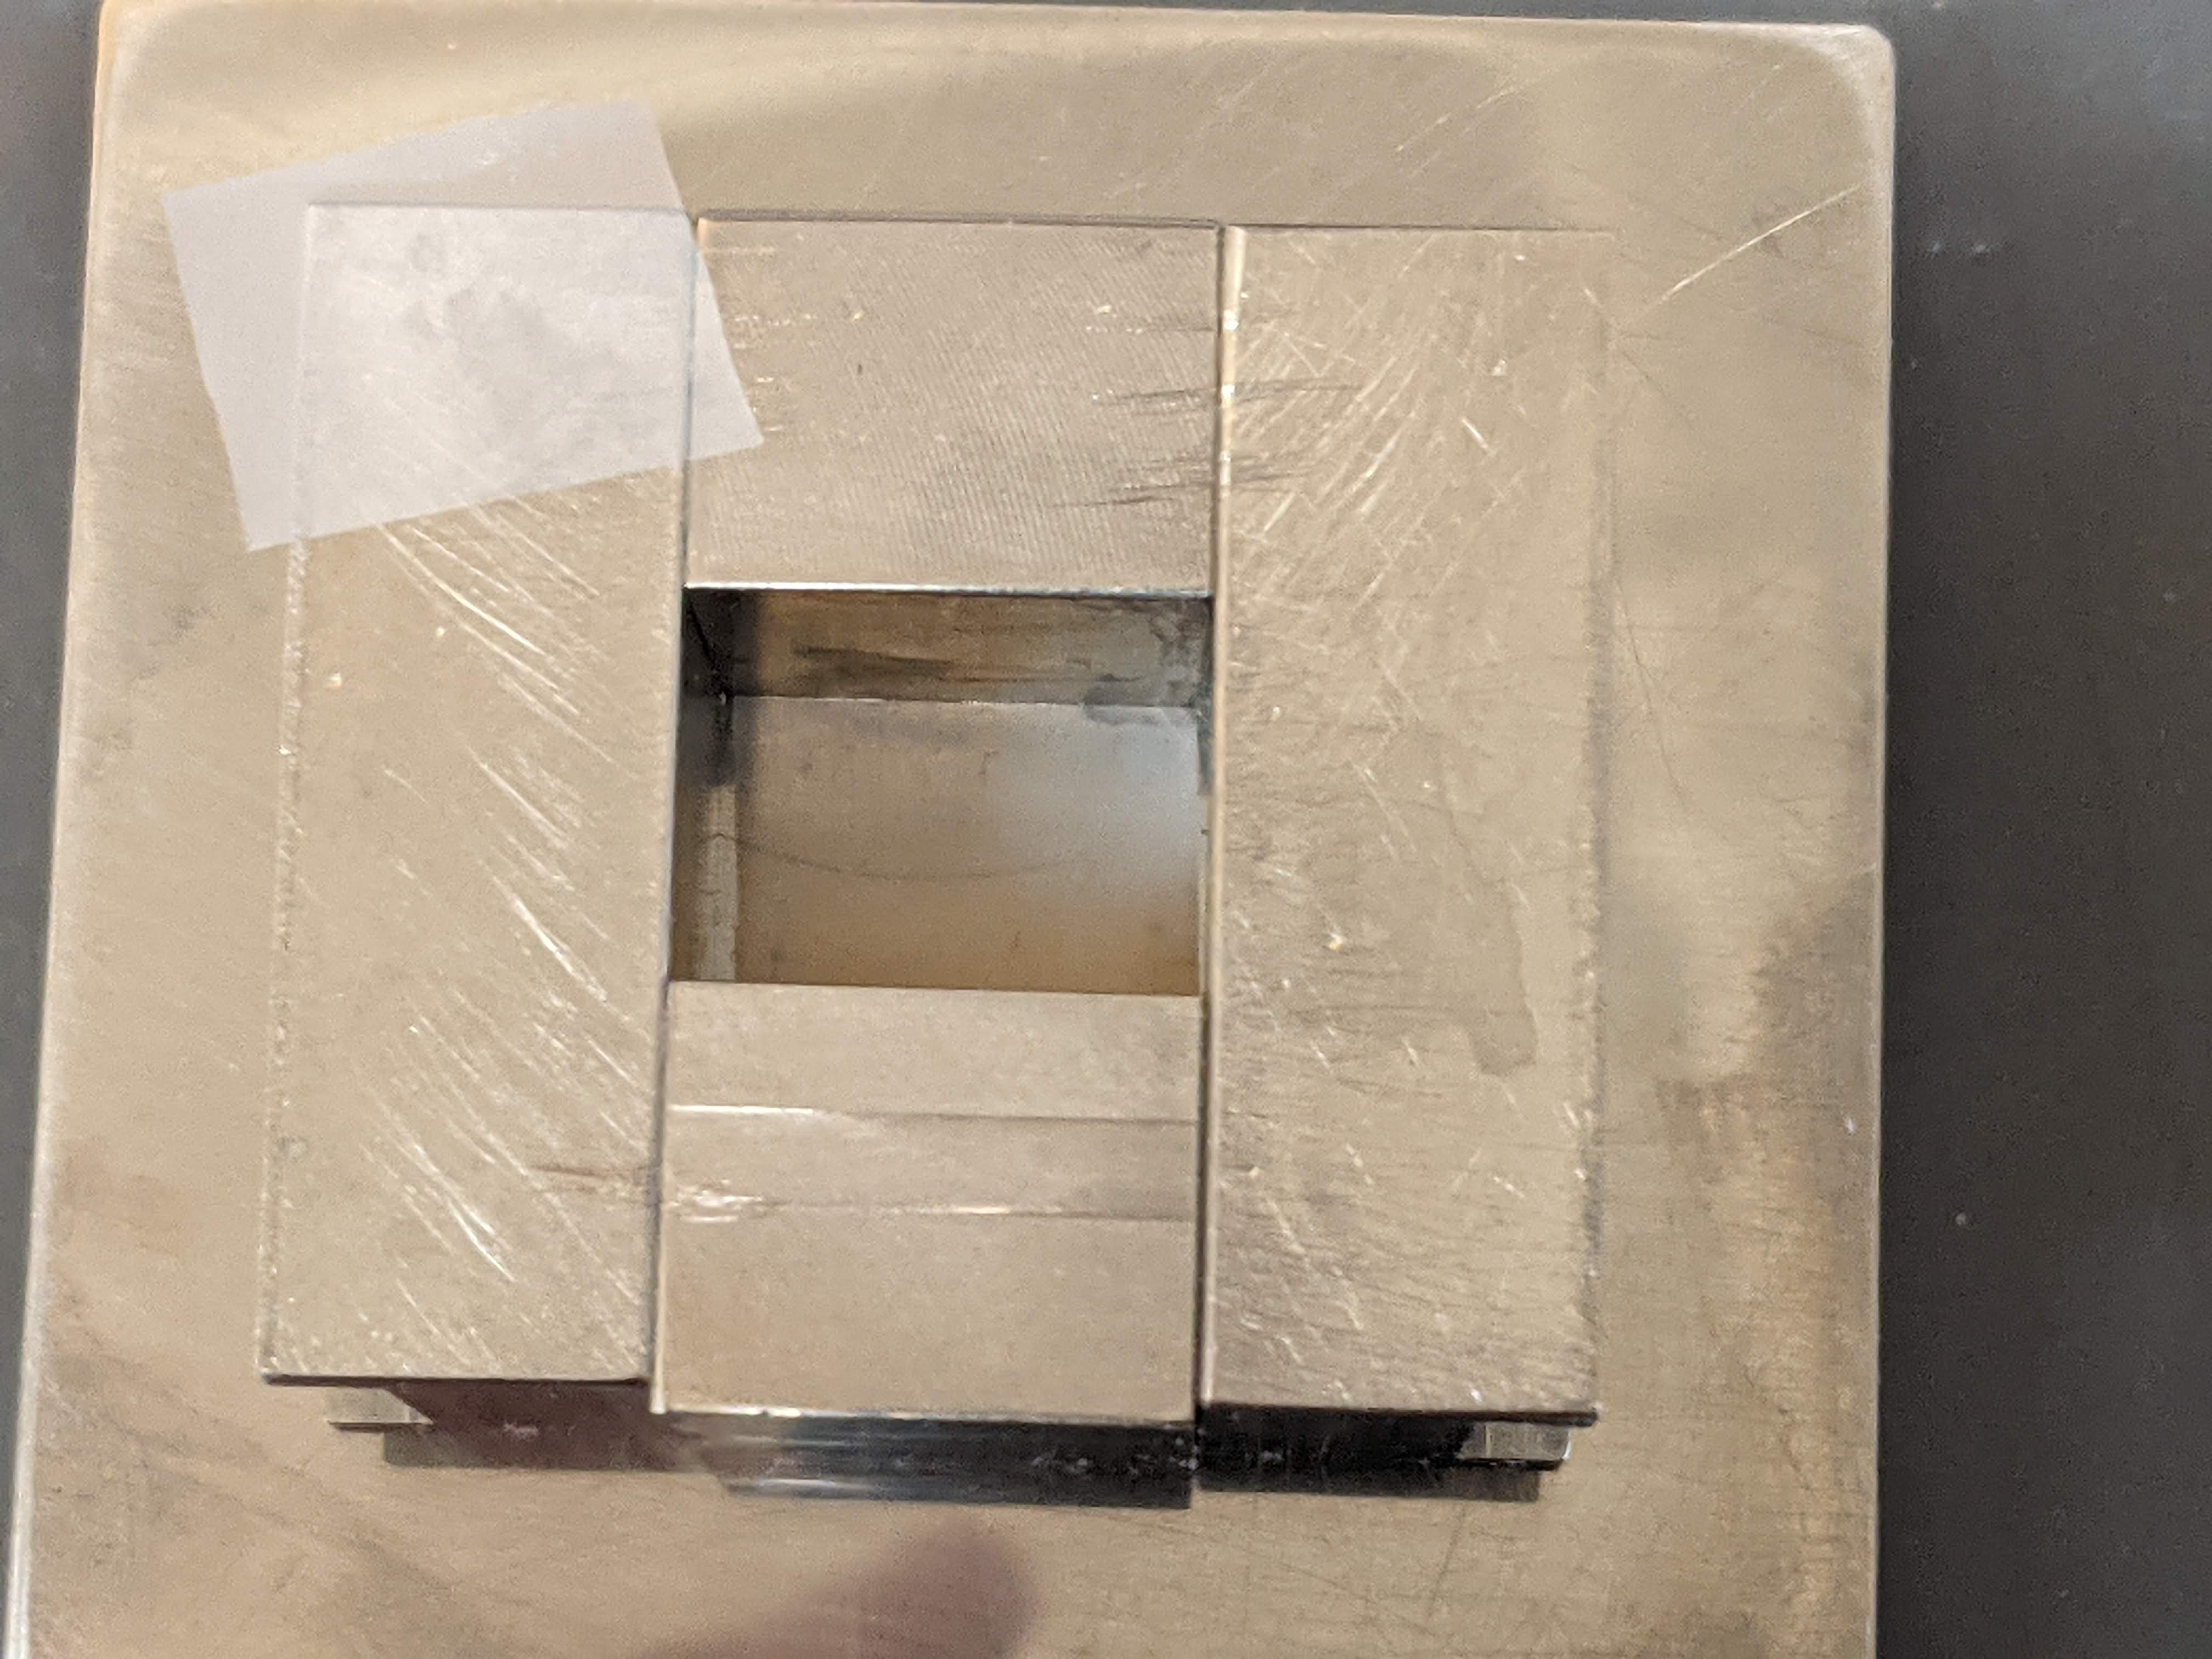
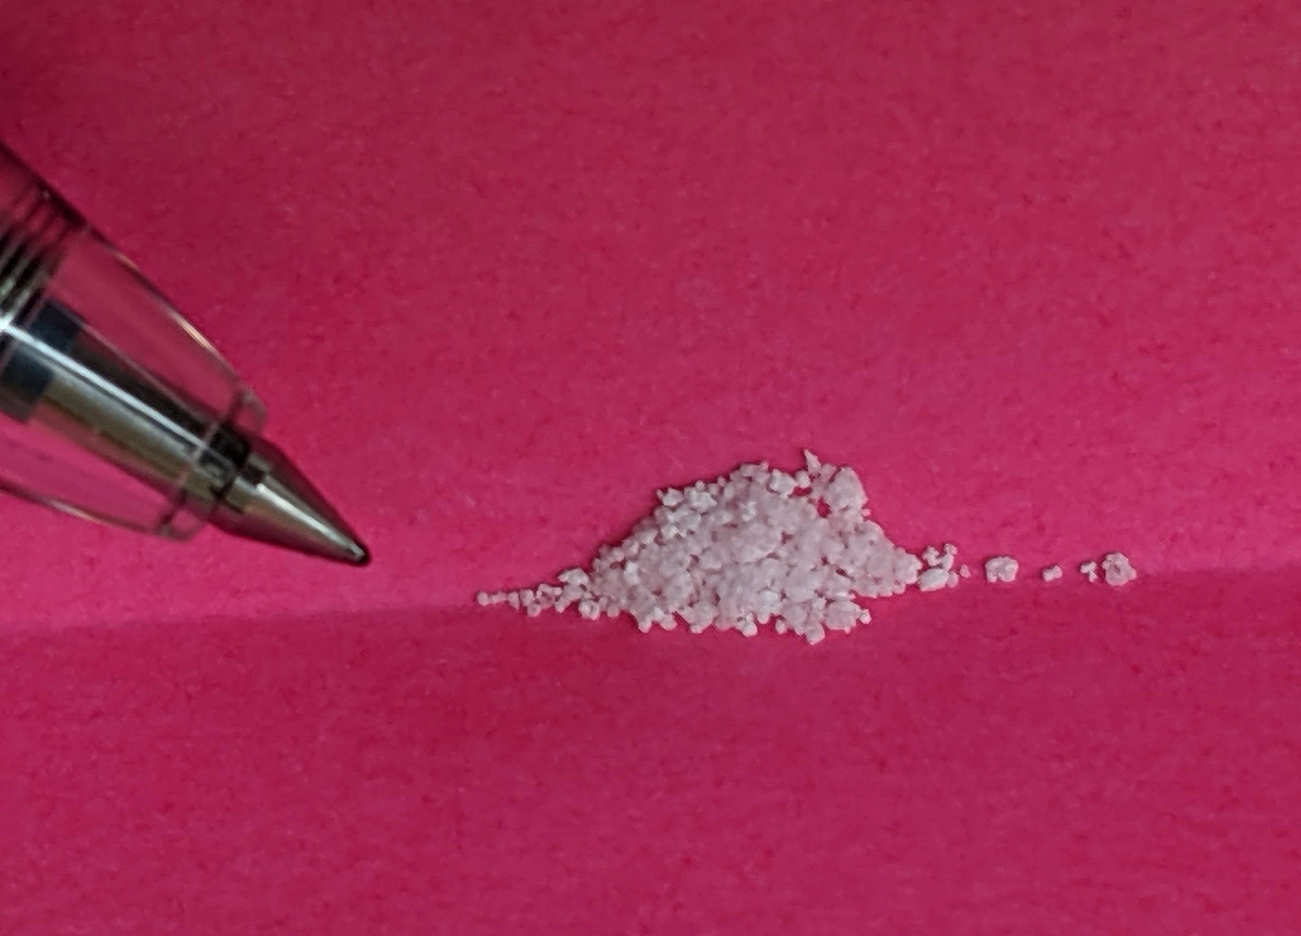
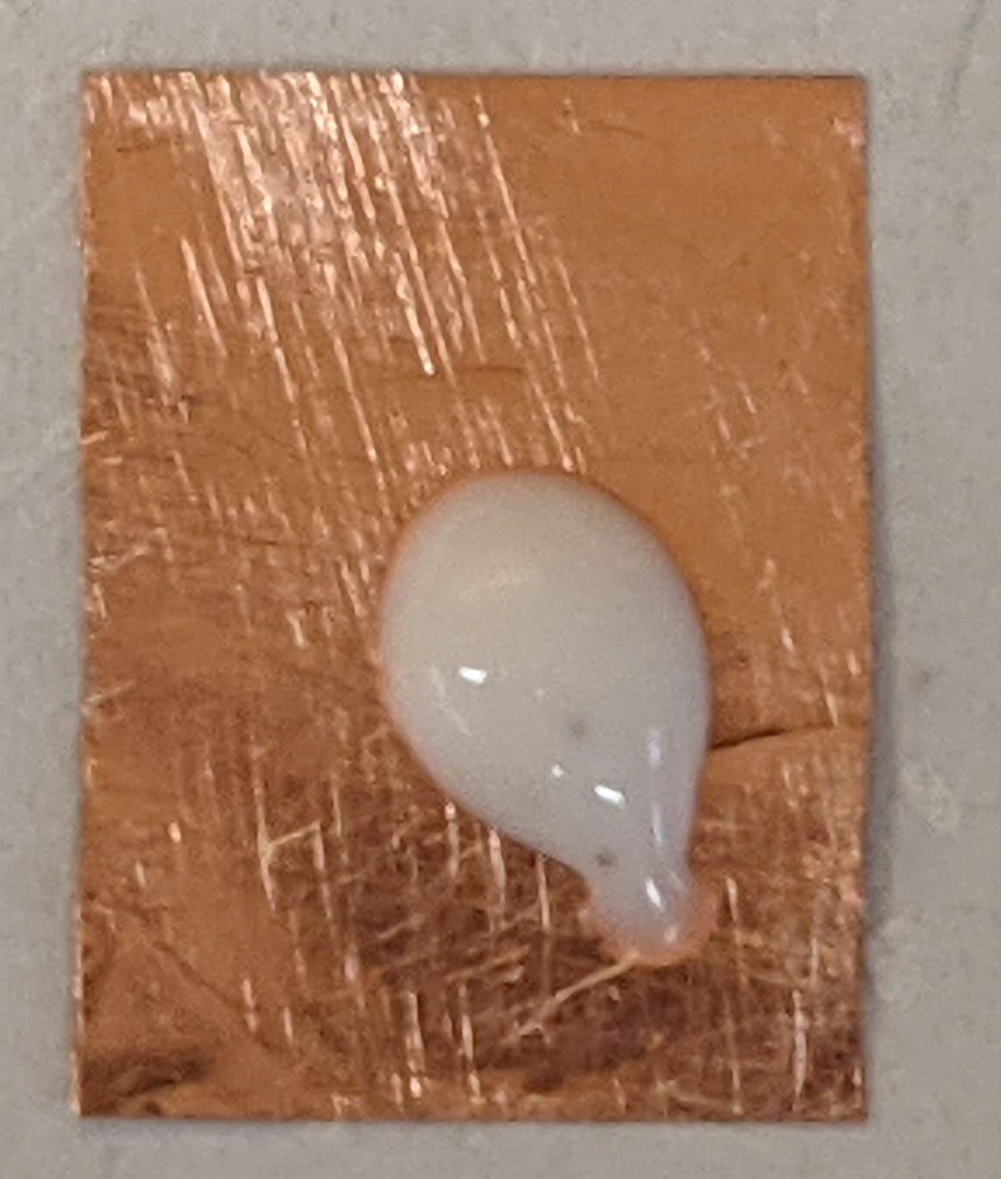
Deposition Procedure (so far)
Prepare press
Teflon sheet (25micron) placed as a bottom layer.
Have Teflon sheet prepared for top layer.
Measure out salt.
Measure out glue.

Slide 6
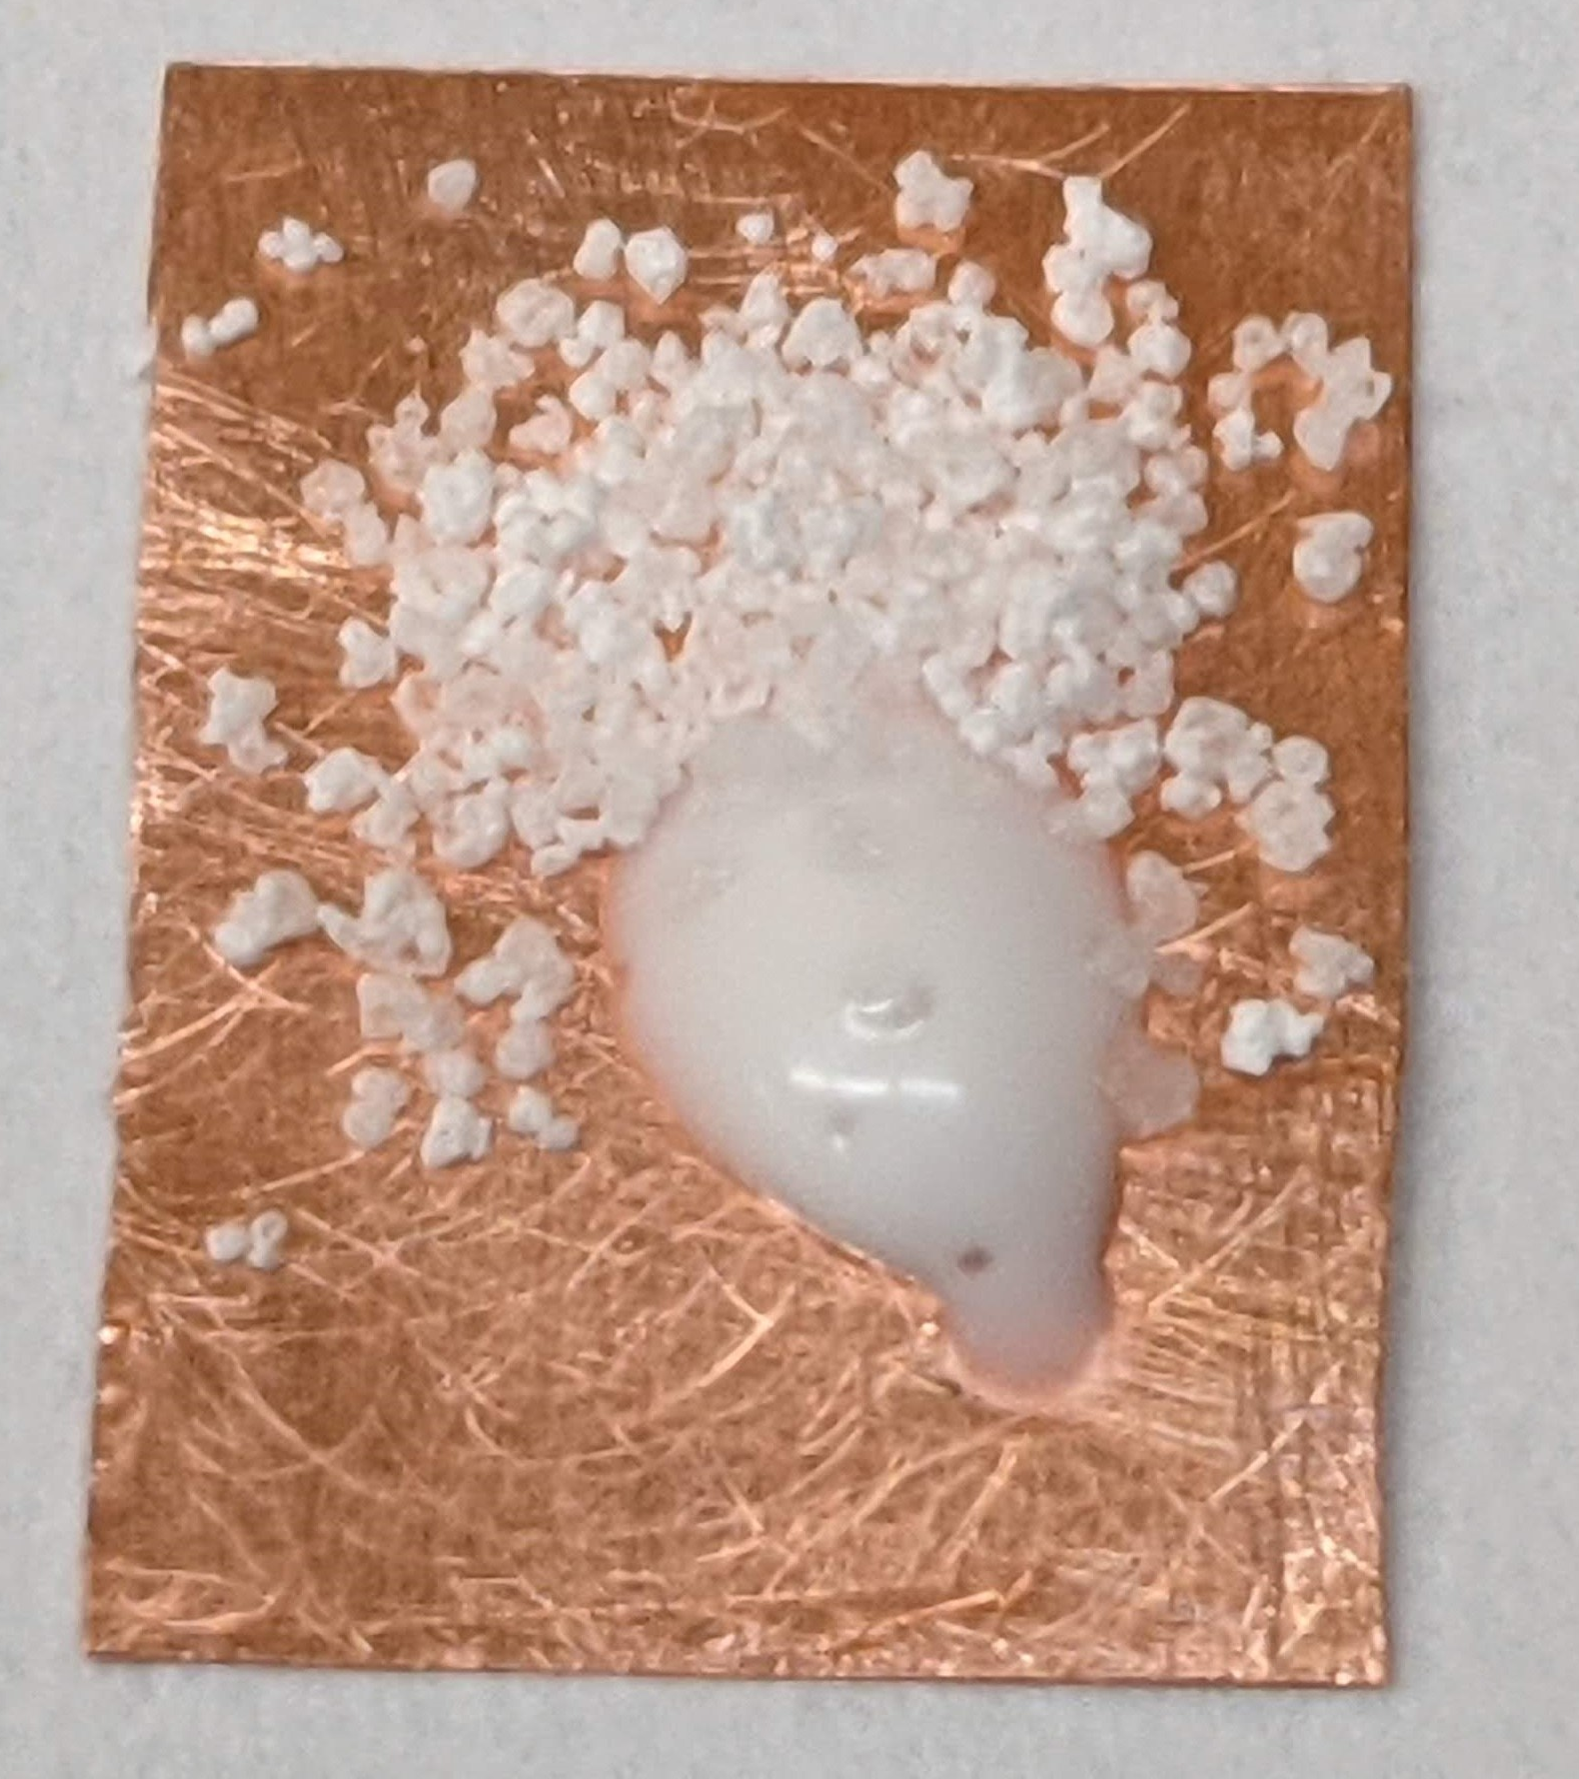
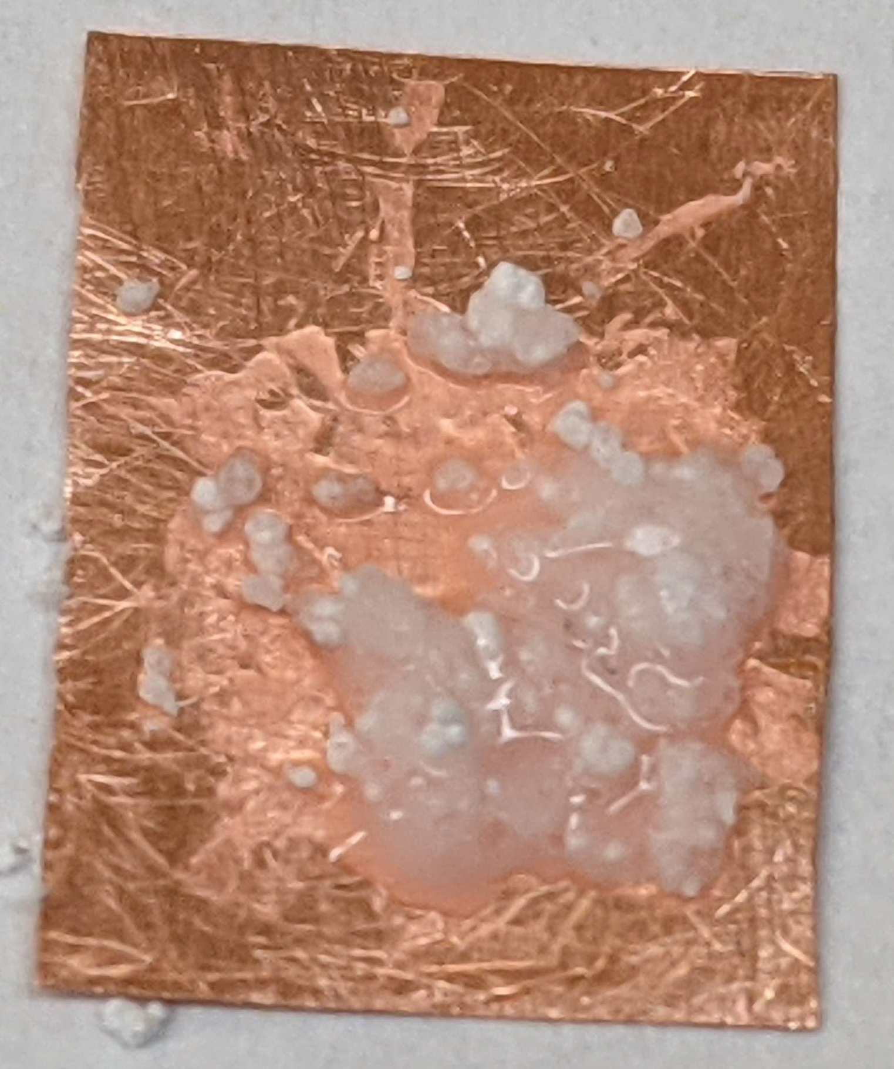
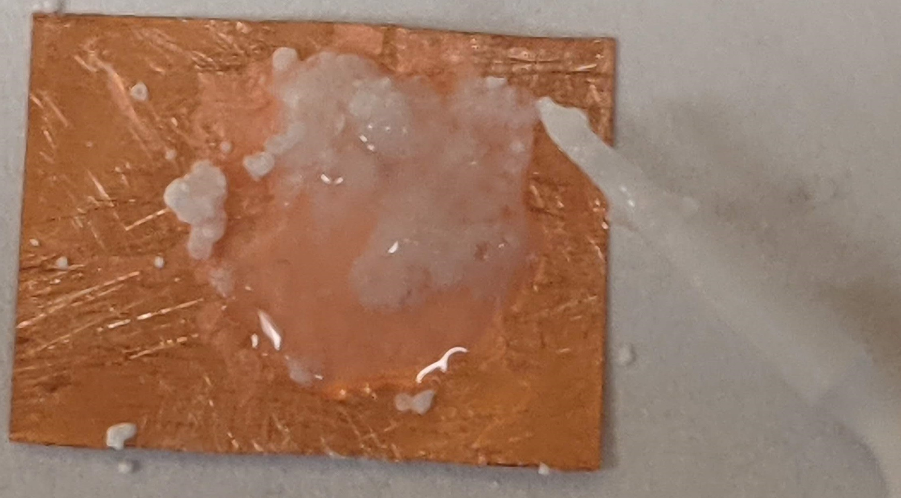
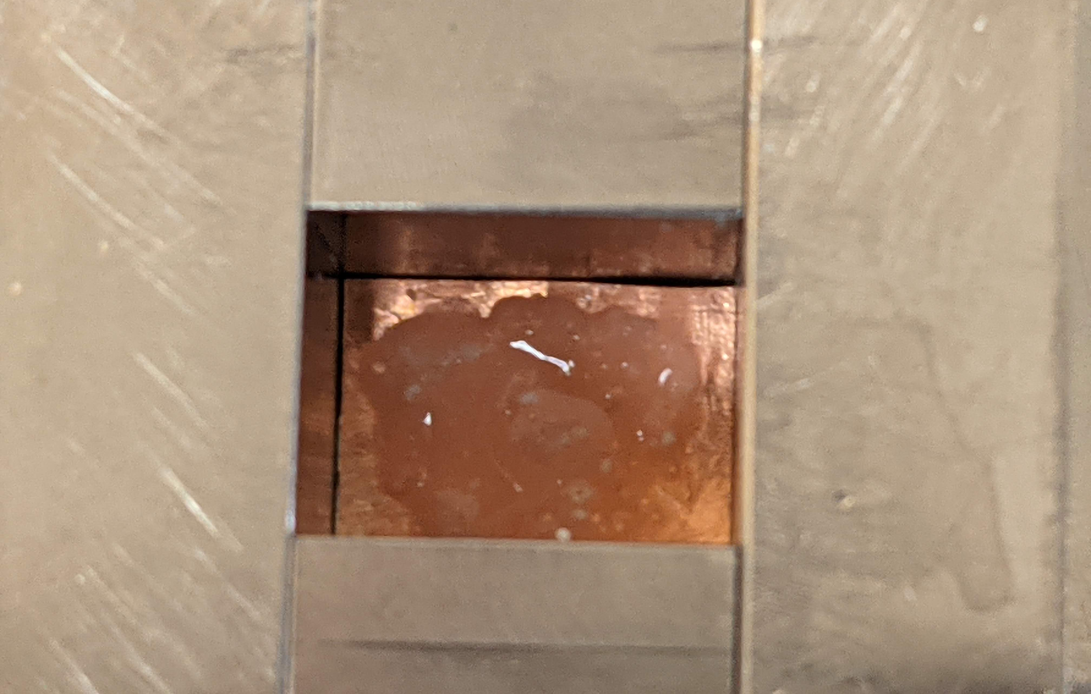
Deposition Procedure continued.
Add salt to glue.
Mix.
Add water to mixture.
Mix until dissolved.
Spread mixture around foil.
Place in the press, glue side up.

Slide 7
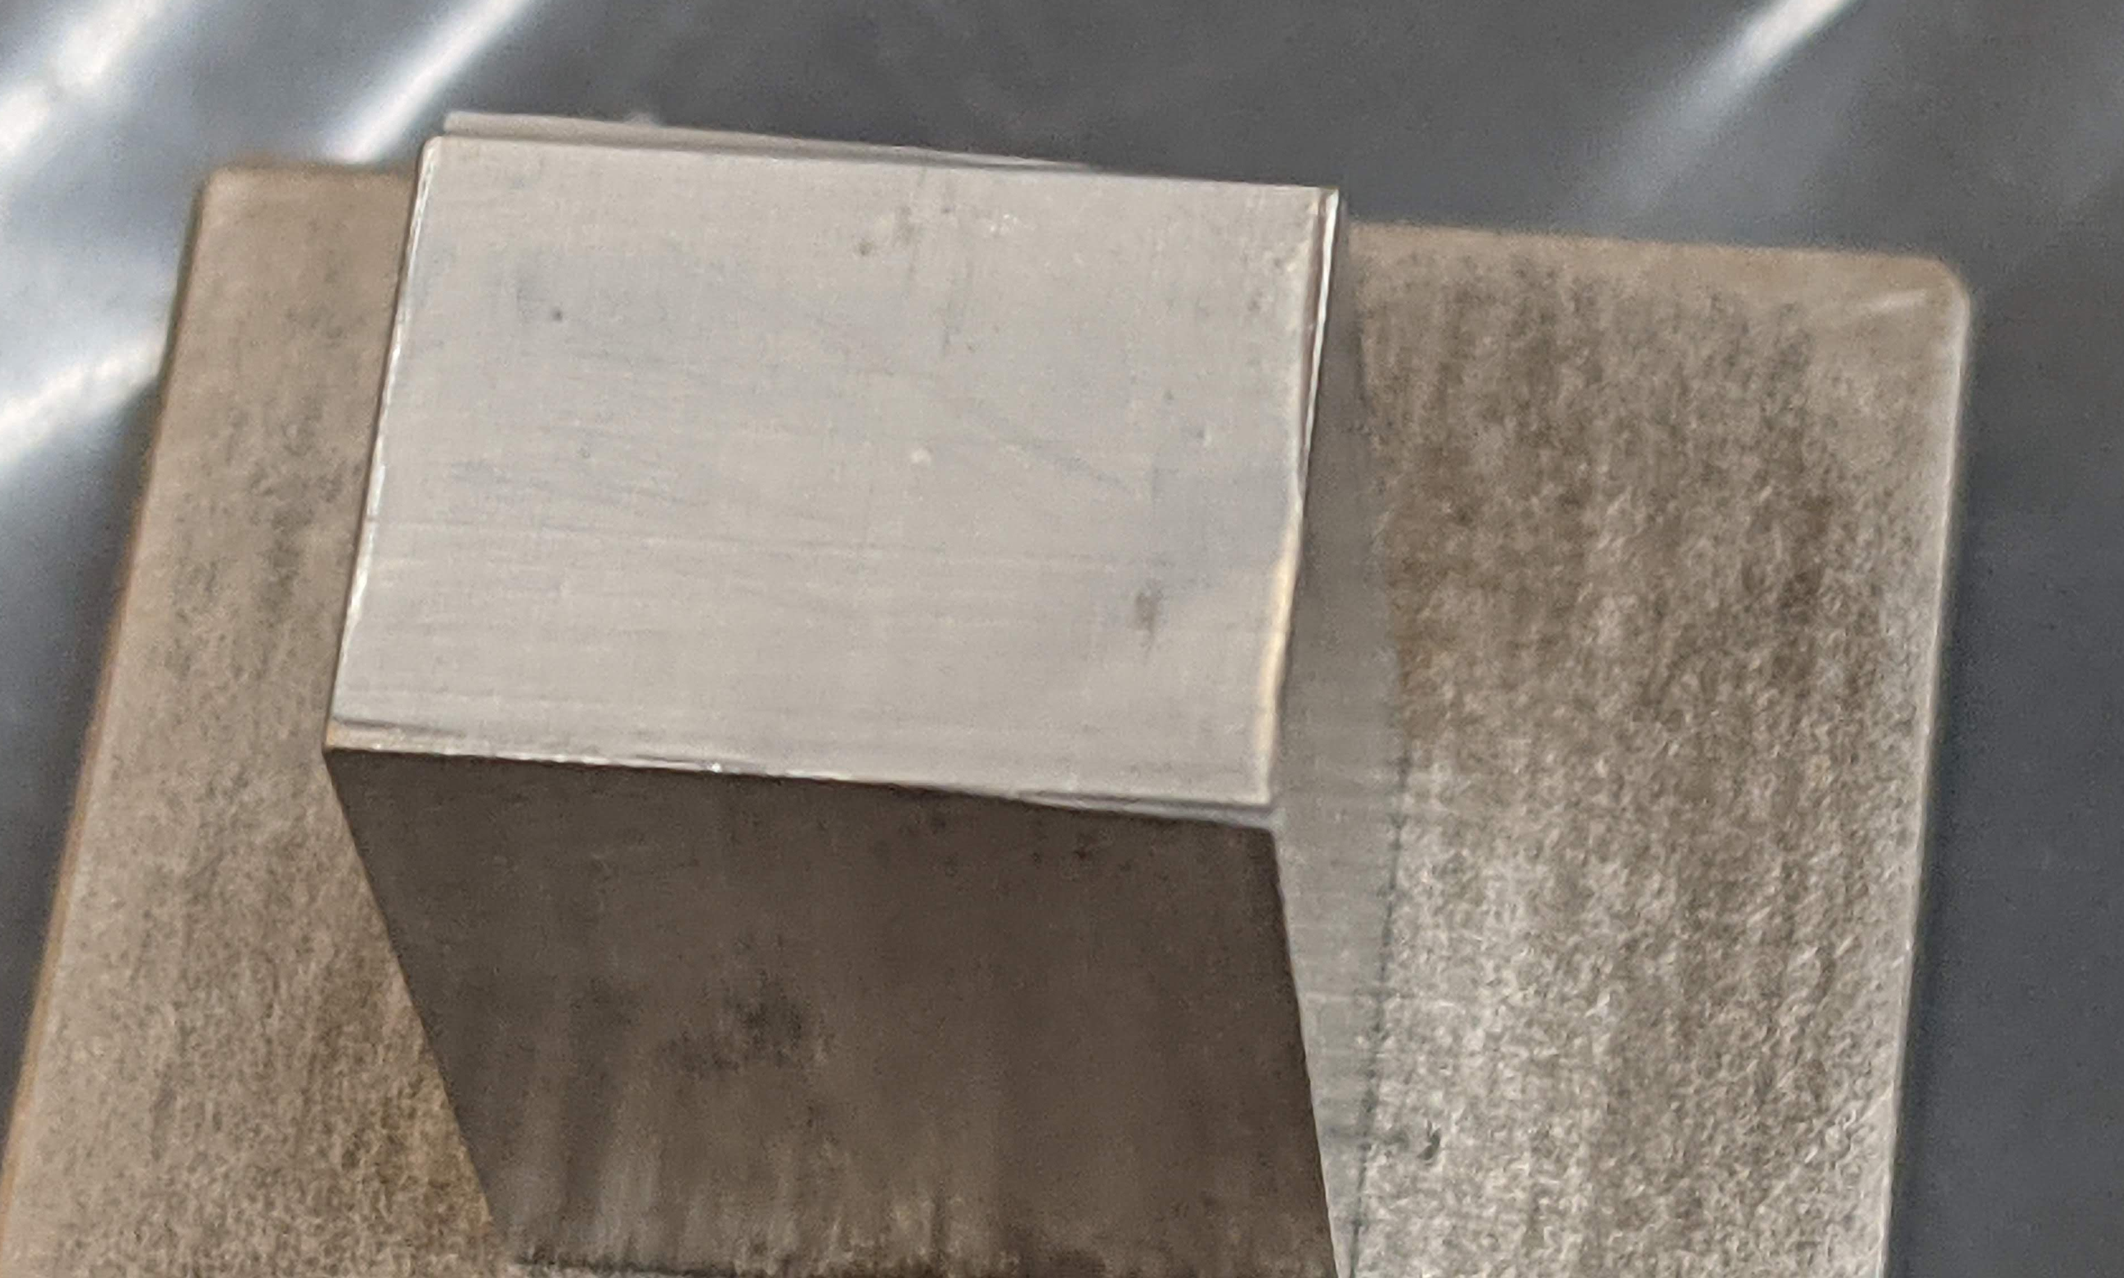
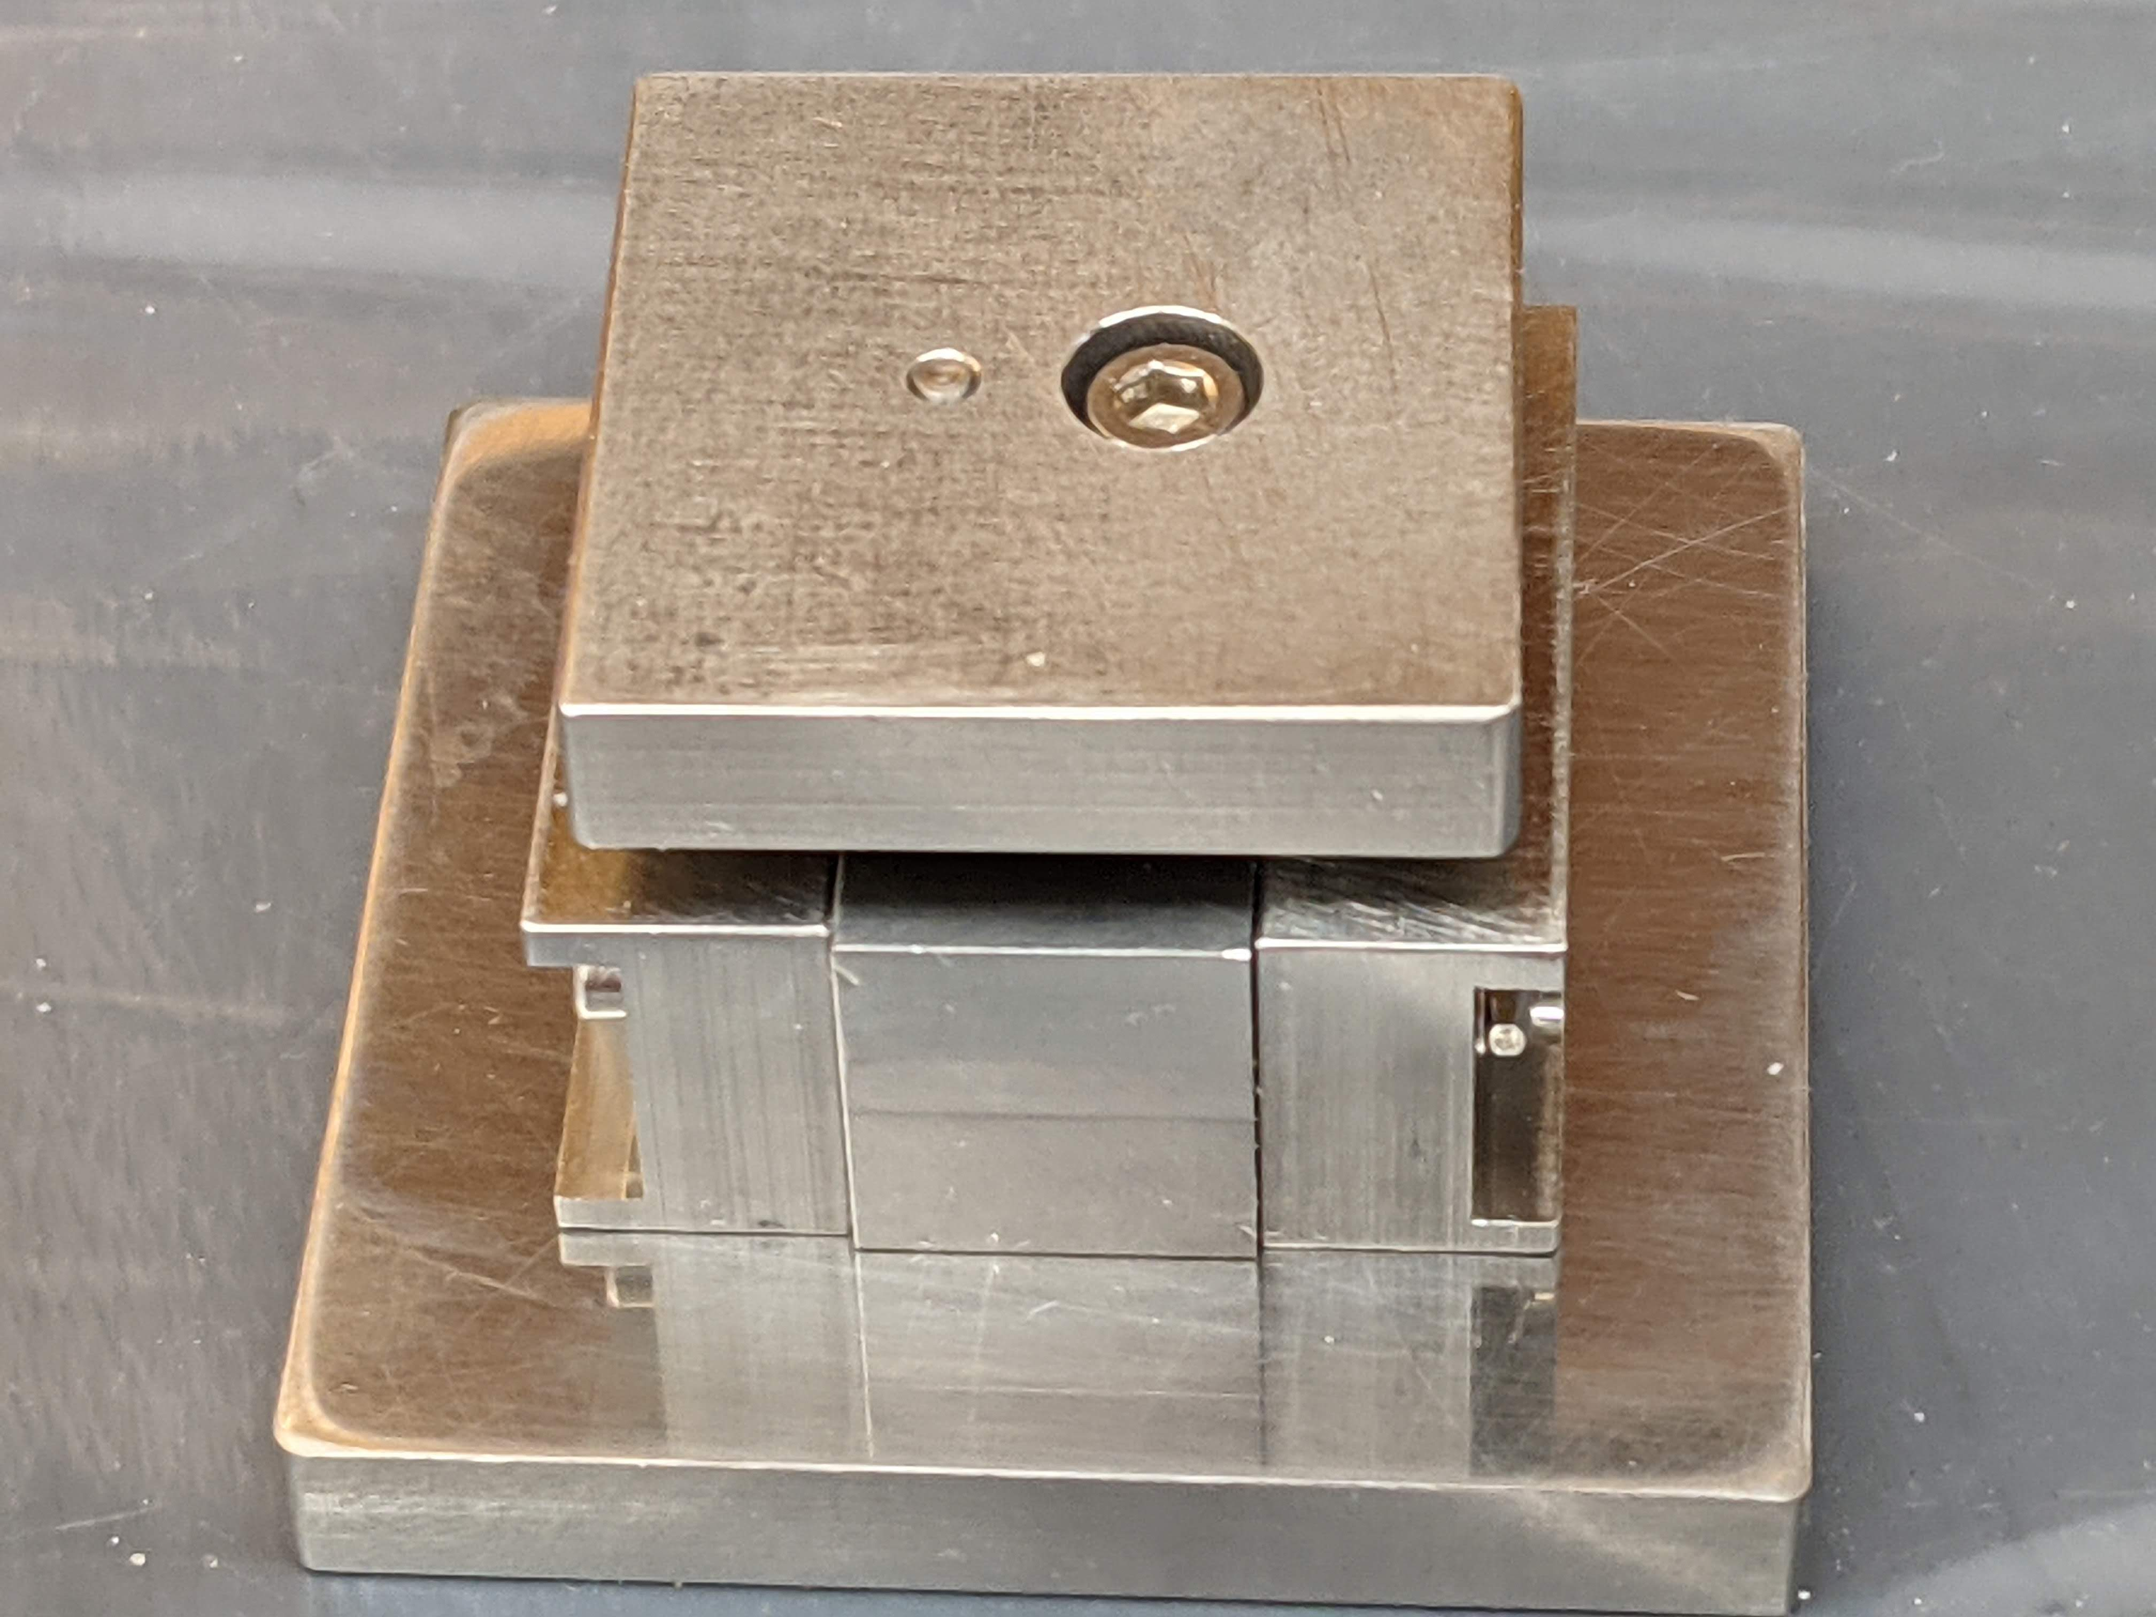
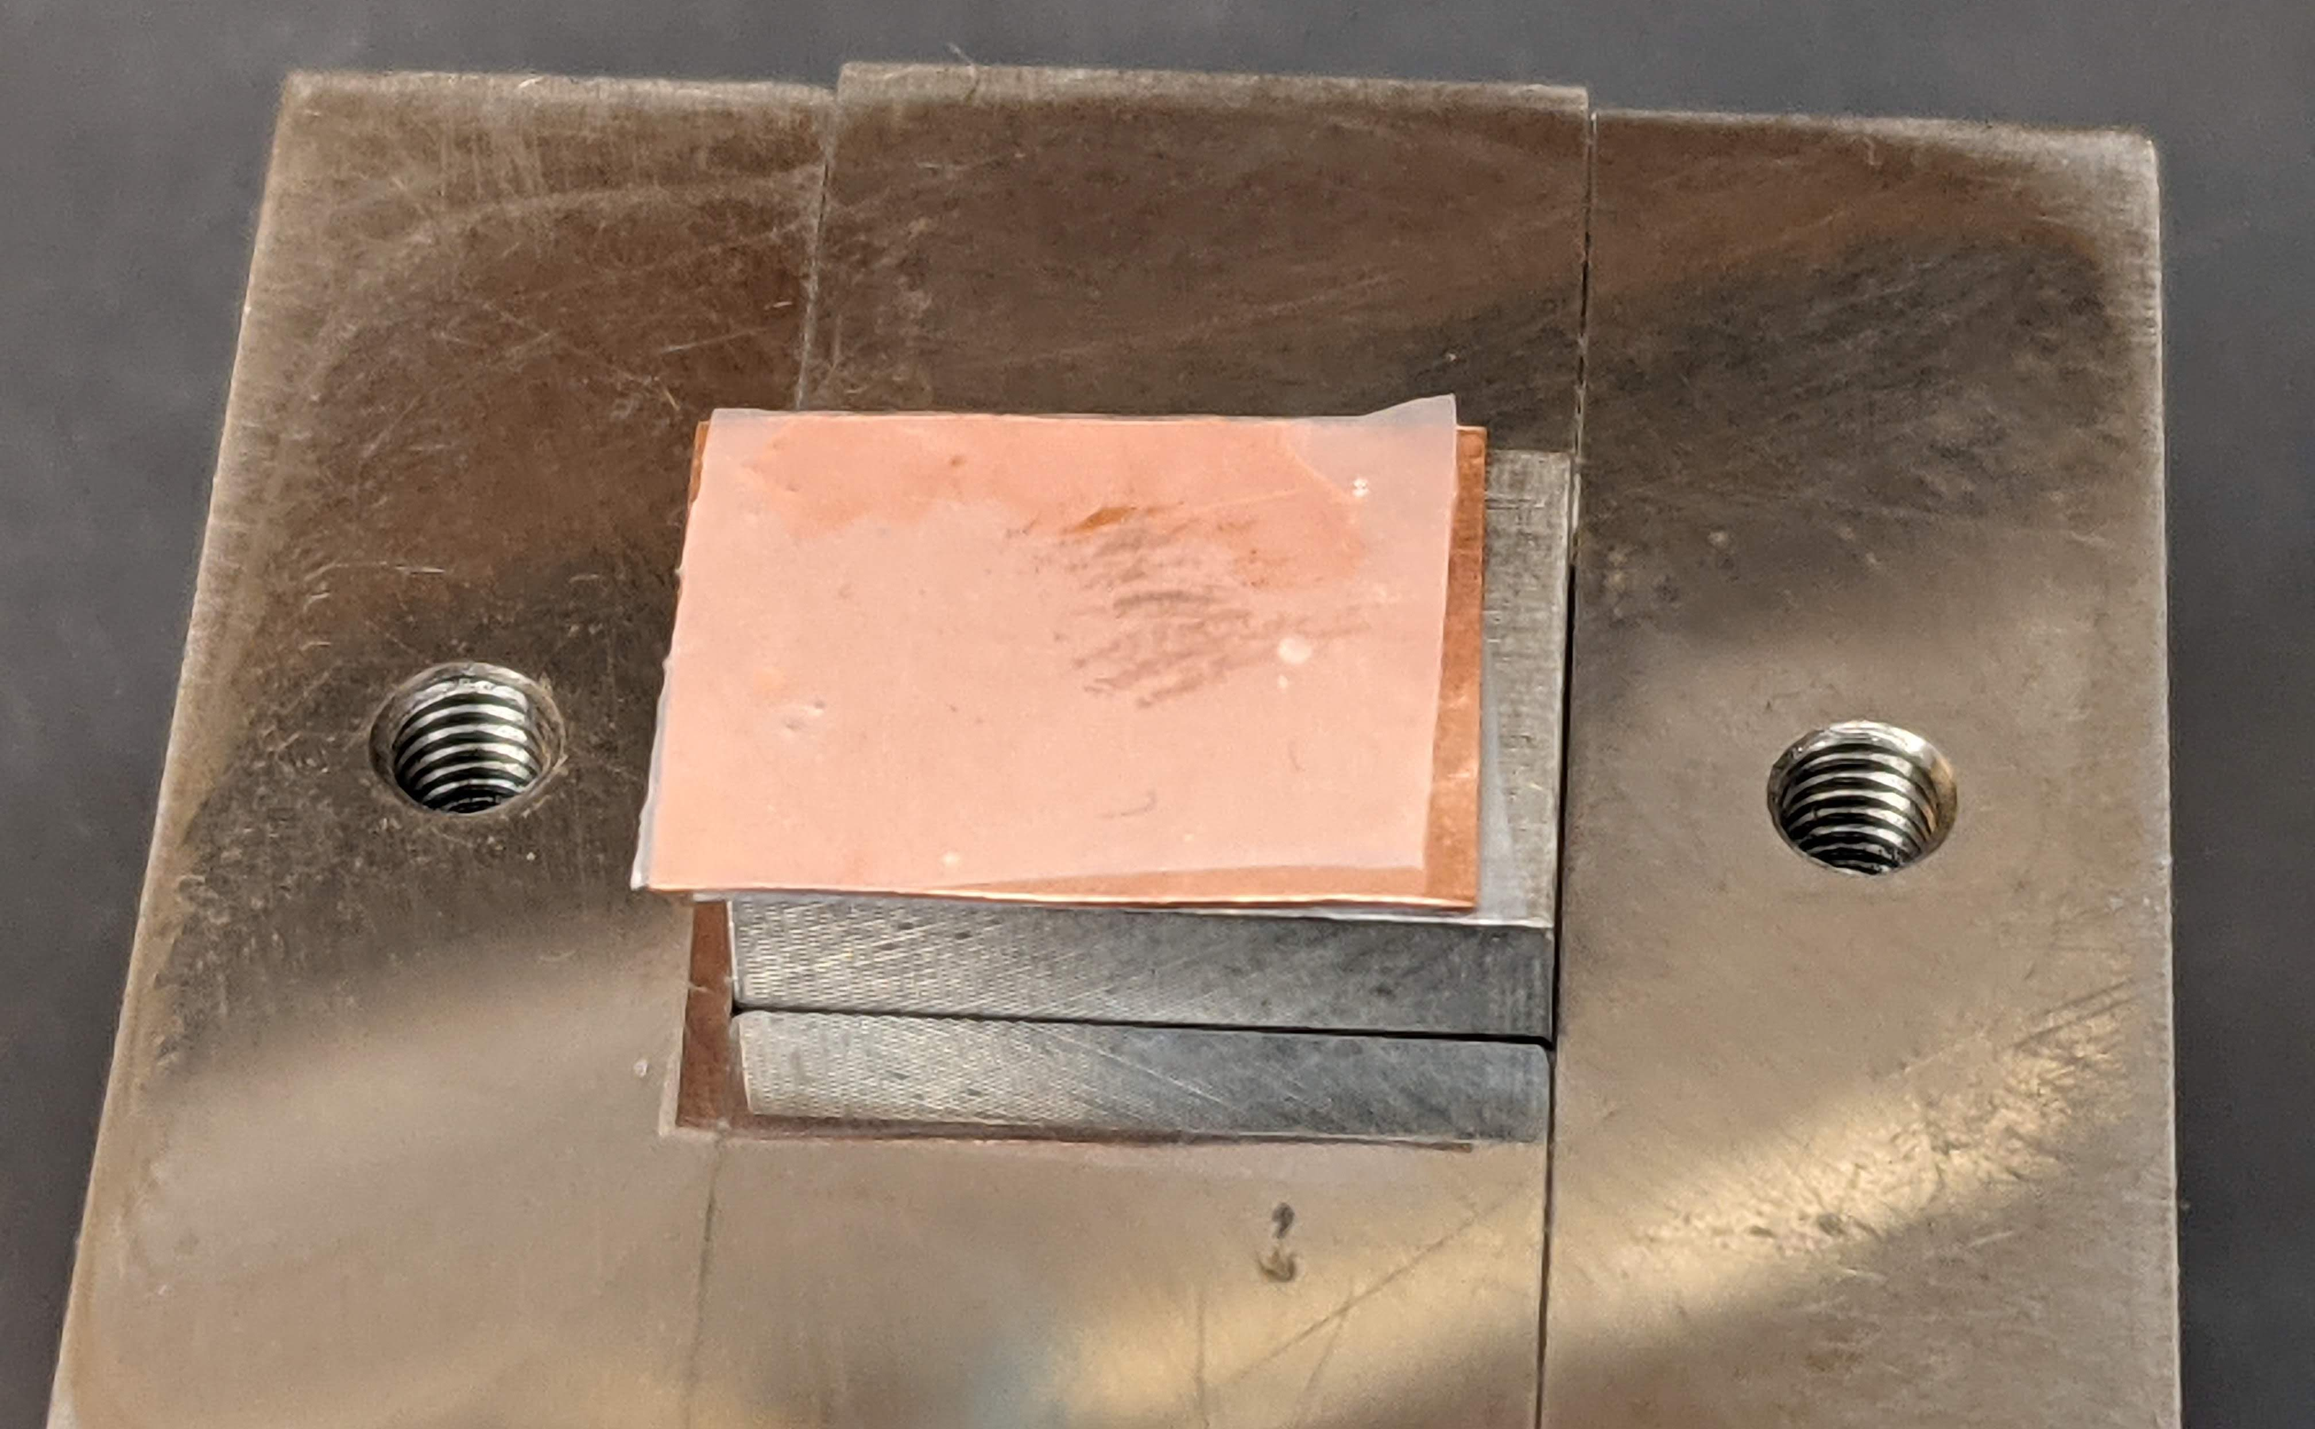
Deposition Procedure continued.
Center Teflon on press. Using a drop of alcohol to hold in place.
Alcohol also helps keep salt-glue mixture from spreading too far.
Insert into press. Push.
Allow to sit 5 minutes.
Invert press.
Remove base.

Slide 8
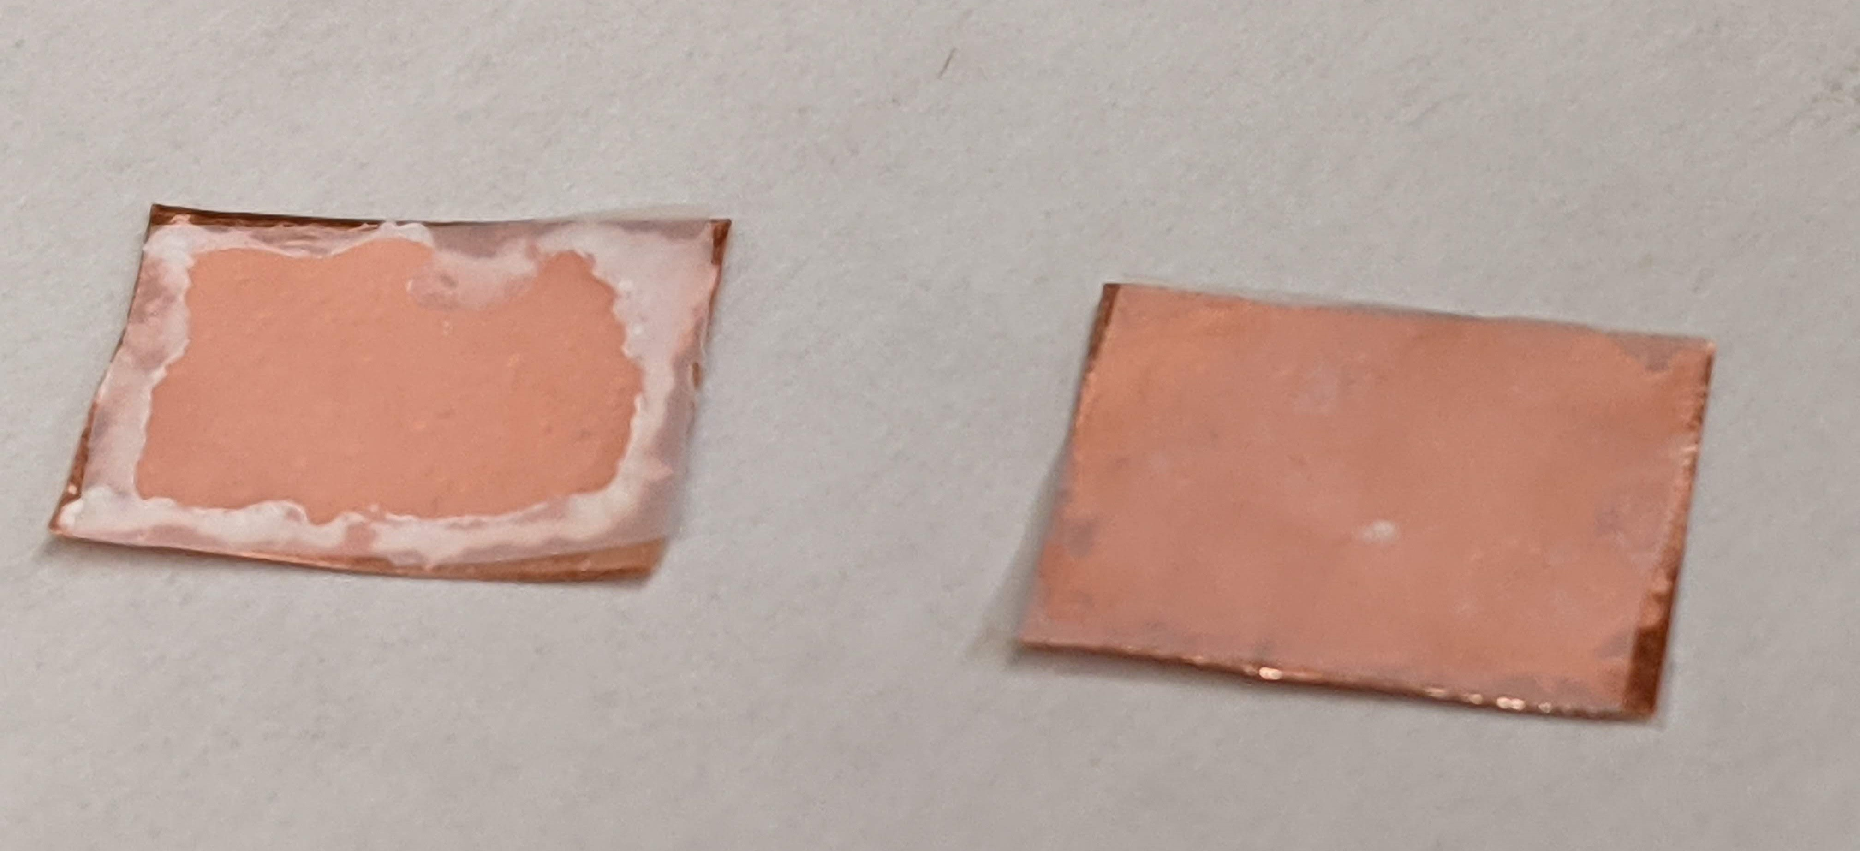
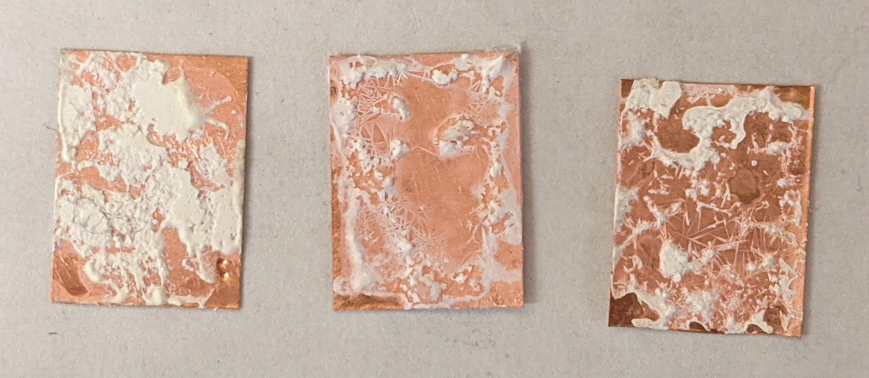
Deposition Procedure continued.
Glue side Teflon needs to remain during the drying process.
Teflon removed when not cured.
~20hr drying, still not cured

Slide 9
What’s Next
Install in prototype electrode.
Install with Teflon attached?
Determine how much time it takes to fully cure glue.
Will Teflon just peel off leaving behind the source material?
Continue with development of procedure, including adjustments to the mixture formula.
Improve uniformity of deposited material.

