Slide 1
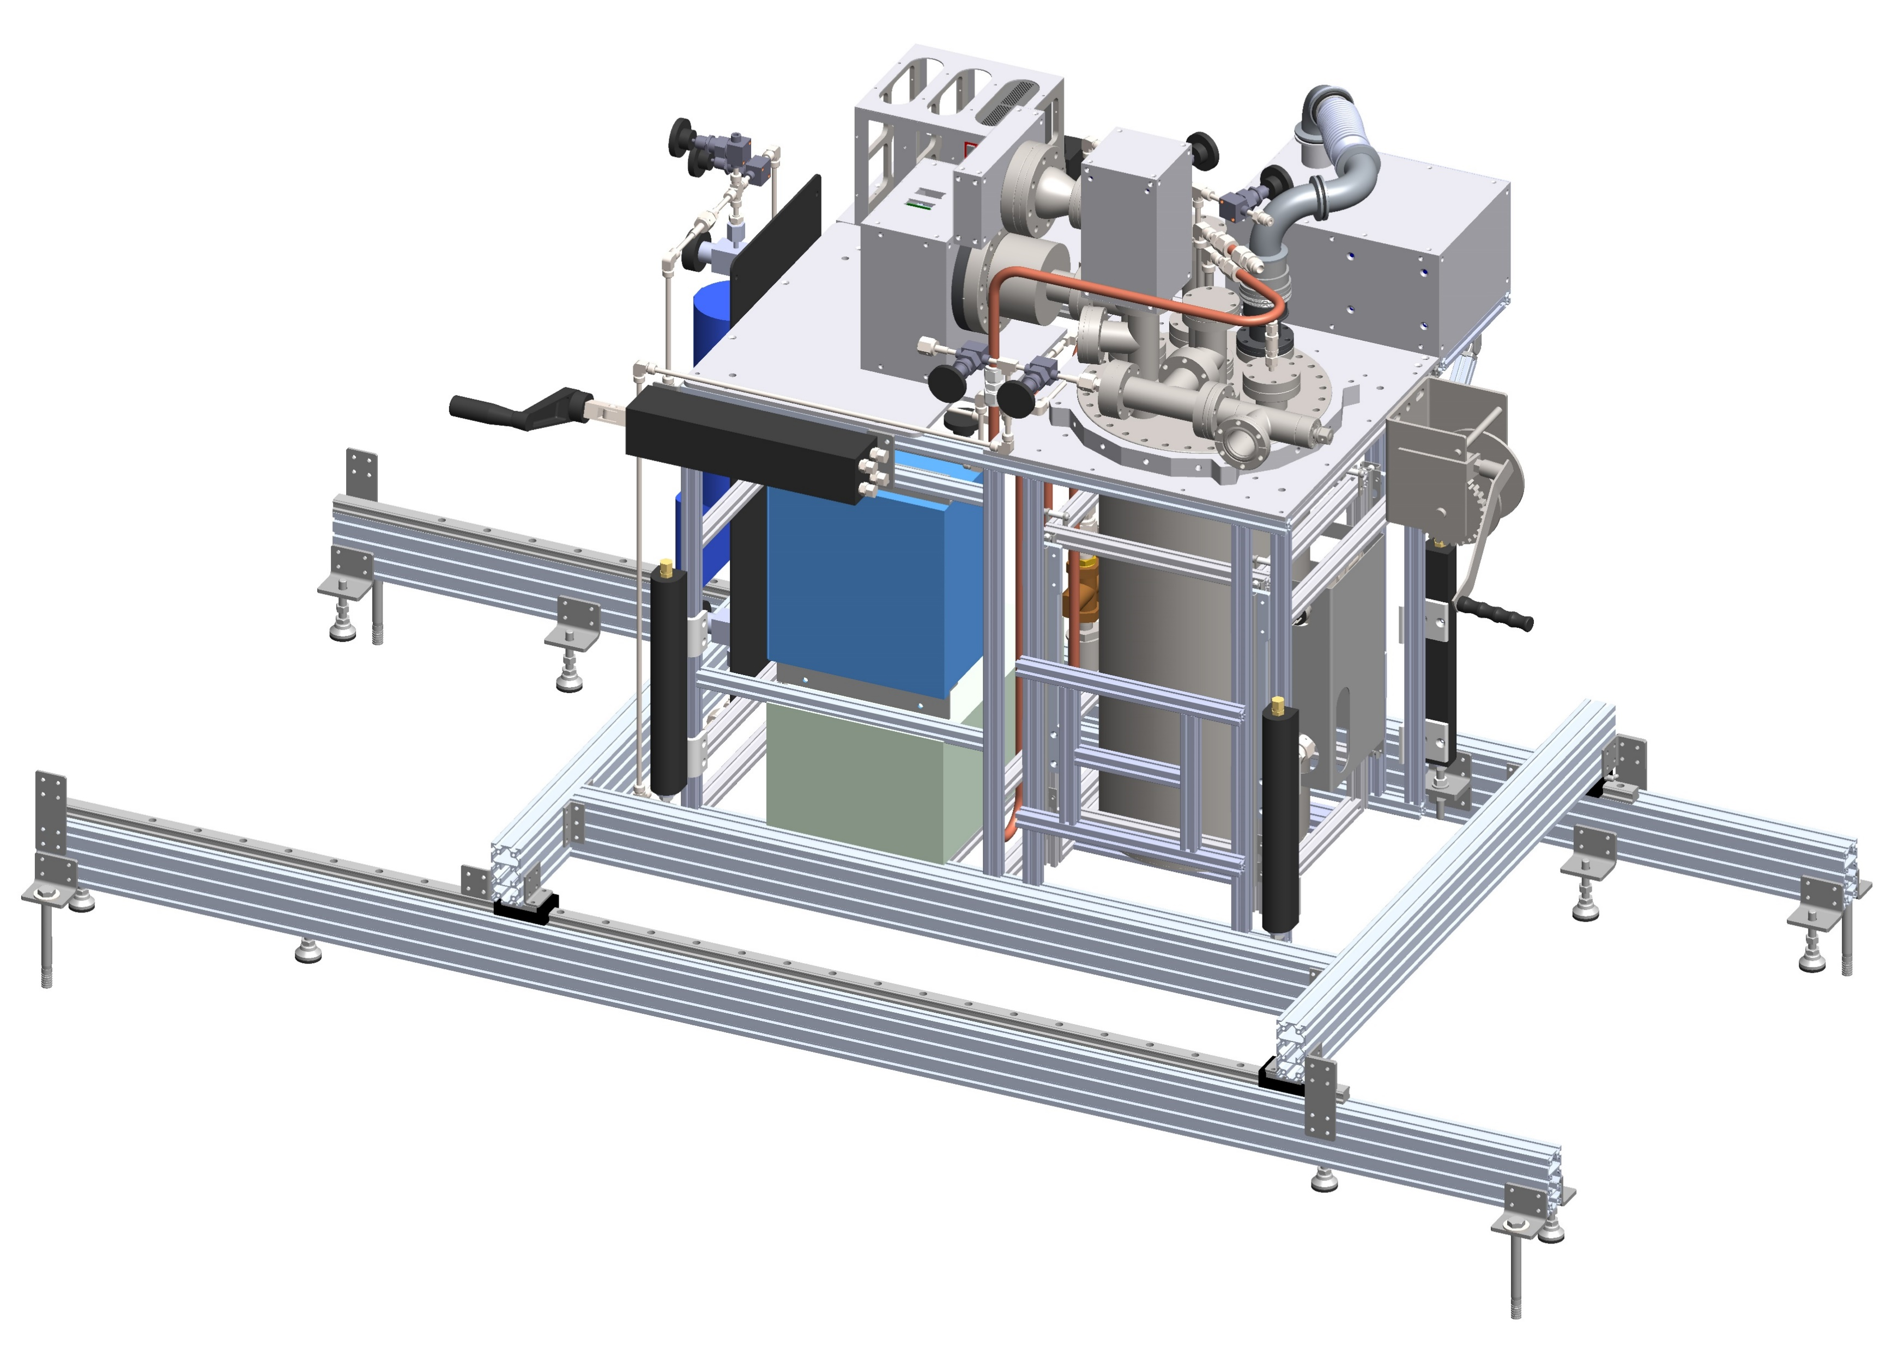
Source Foil R&D Updates
April 1, 2021
Robert Walker

Slide 2
Updates
Faraday cages have been submitted to the machine shop.
Adhesive R&D continues.
Elmer’s glue is looking more and more promising.
More work needs to be done.
Received the foil press parts yesterday.

Slide 3
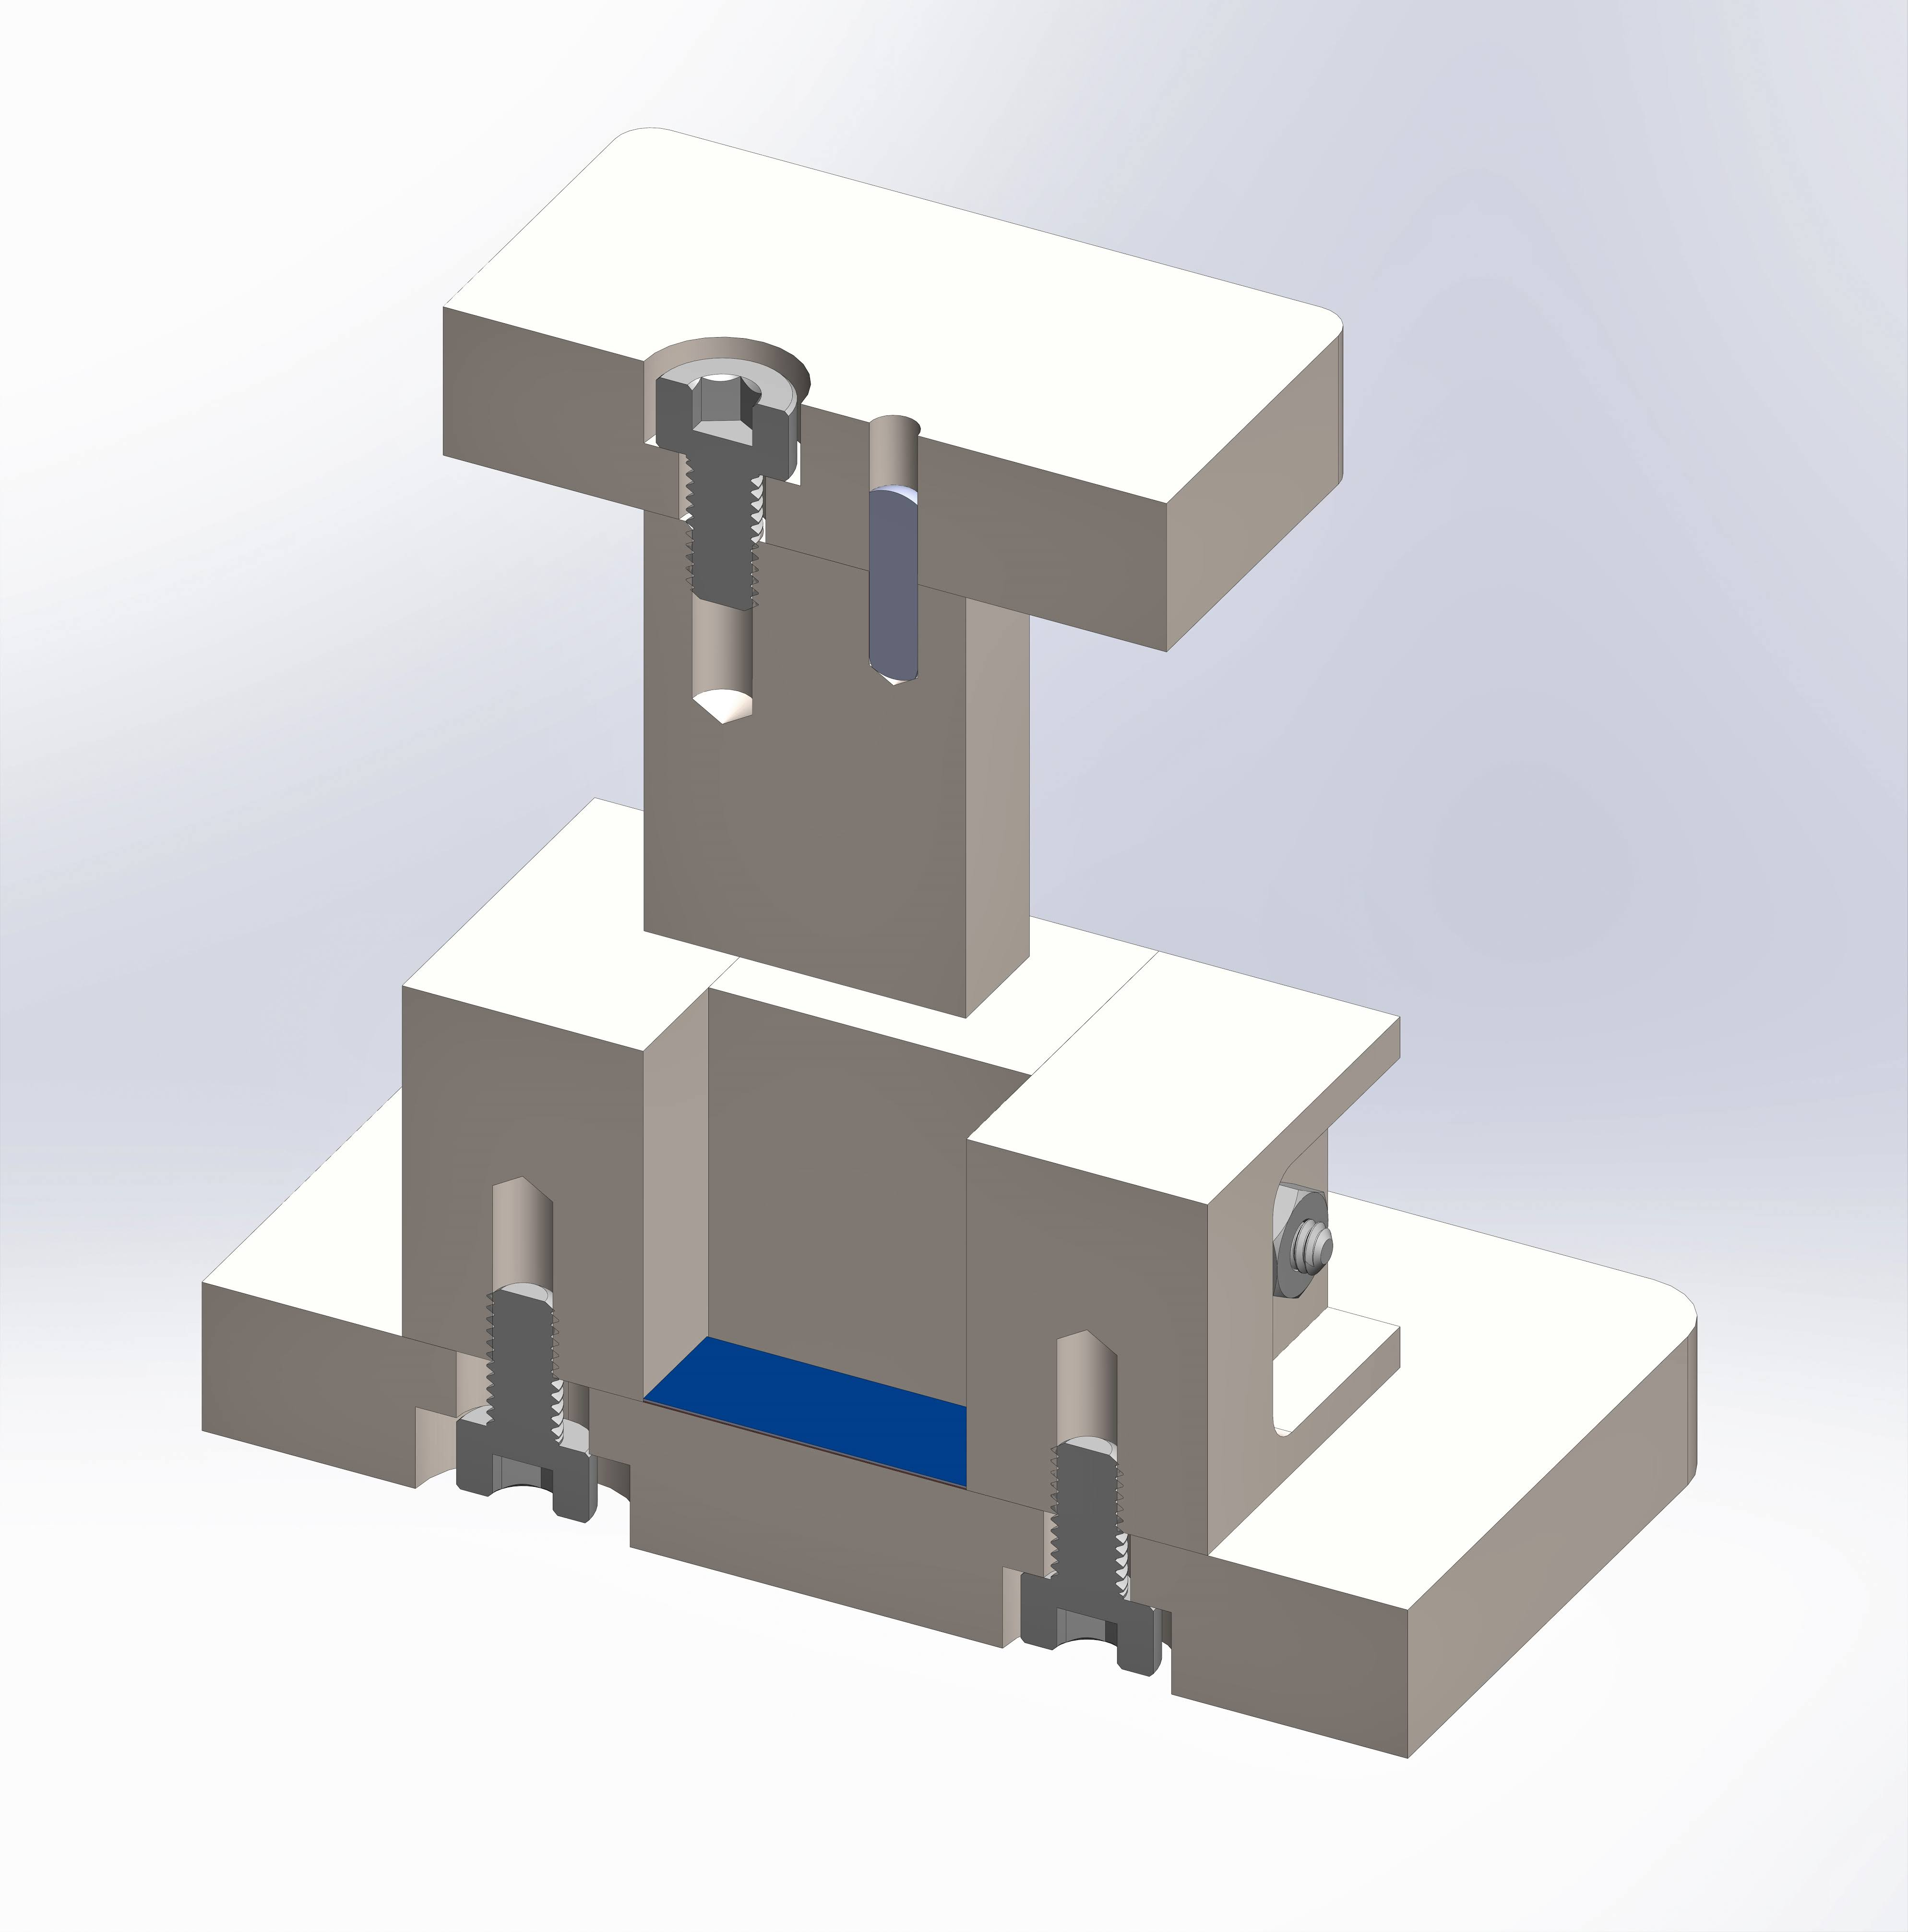
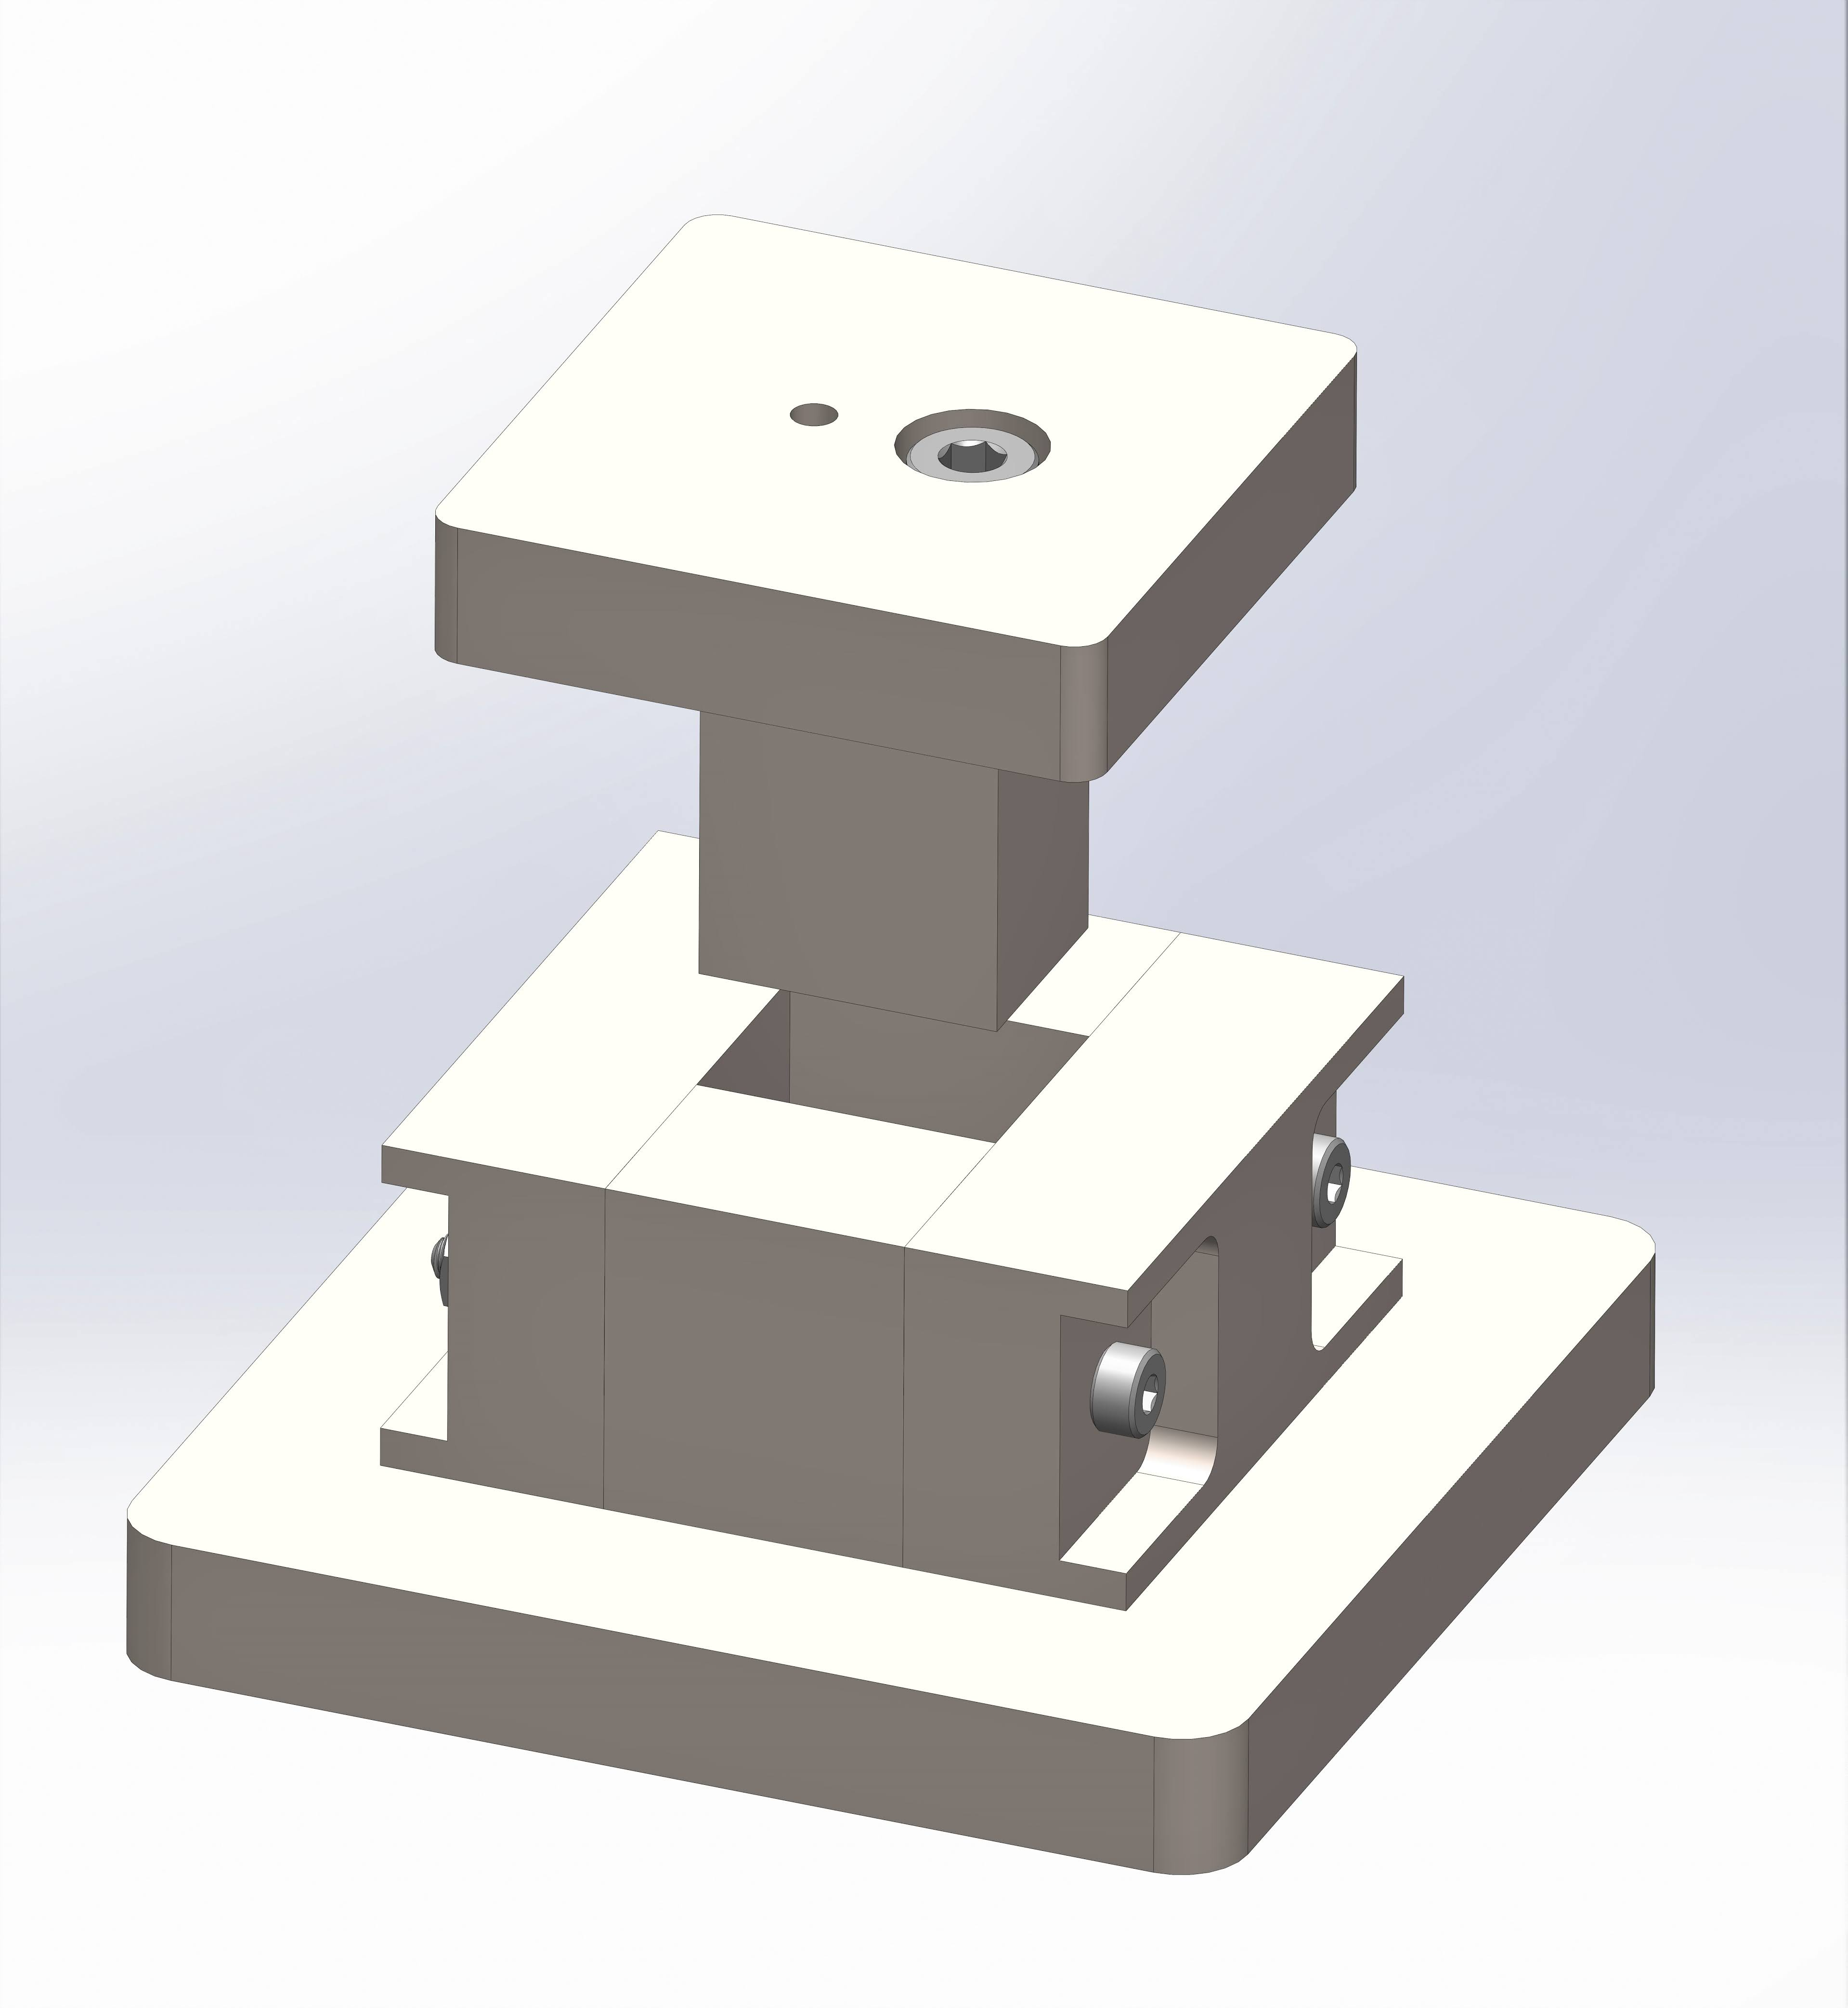
Foil Press Received
Surface finish was not satisfactory.
When assembled could see light between surfaces.
Solution: sand/polish to 2000 grit

Slide 4
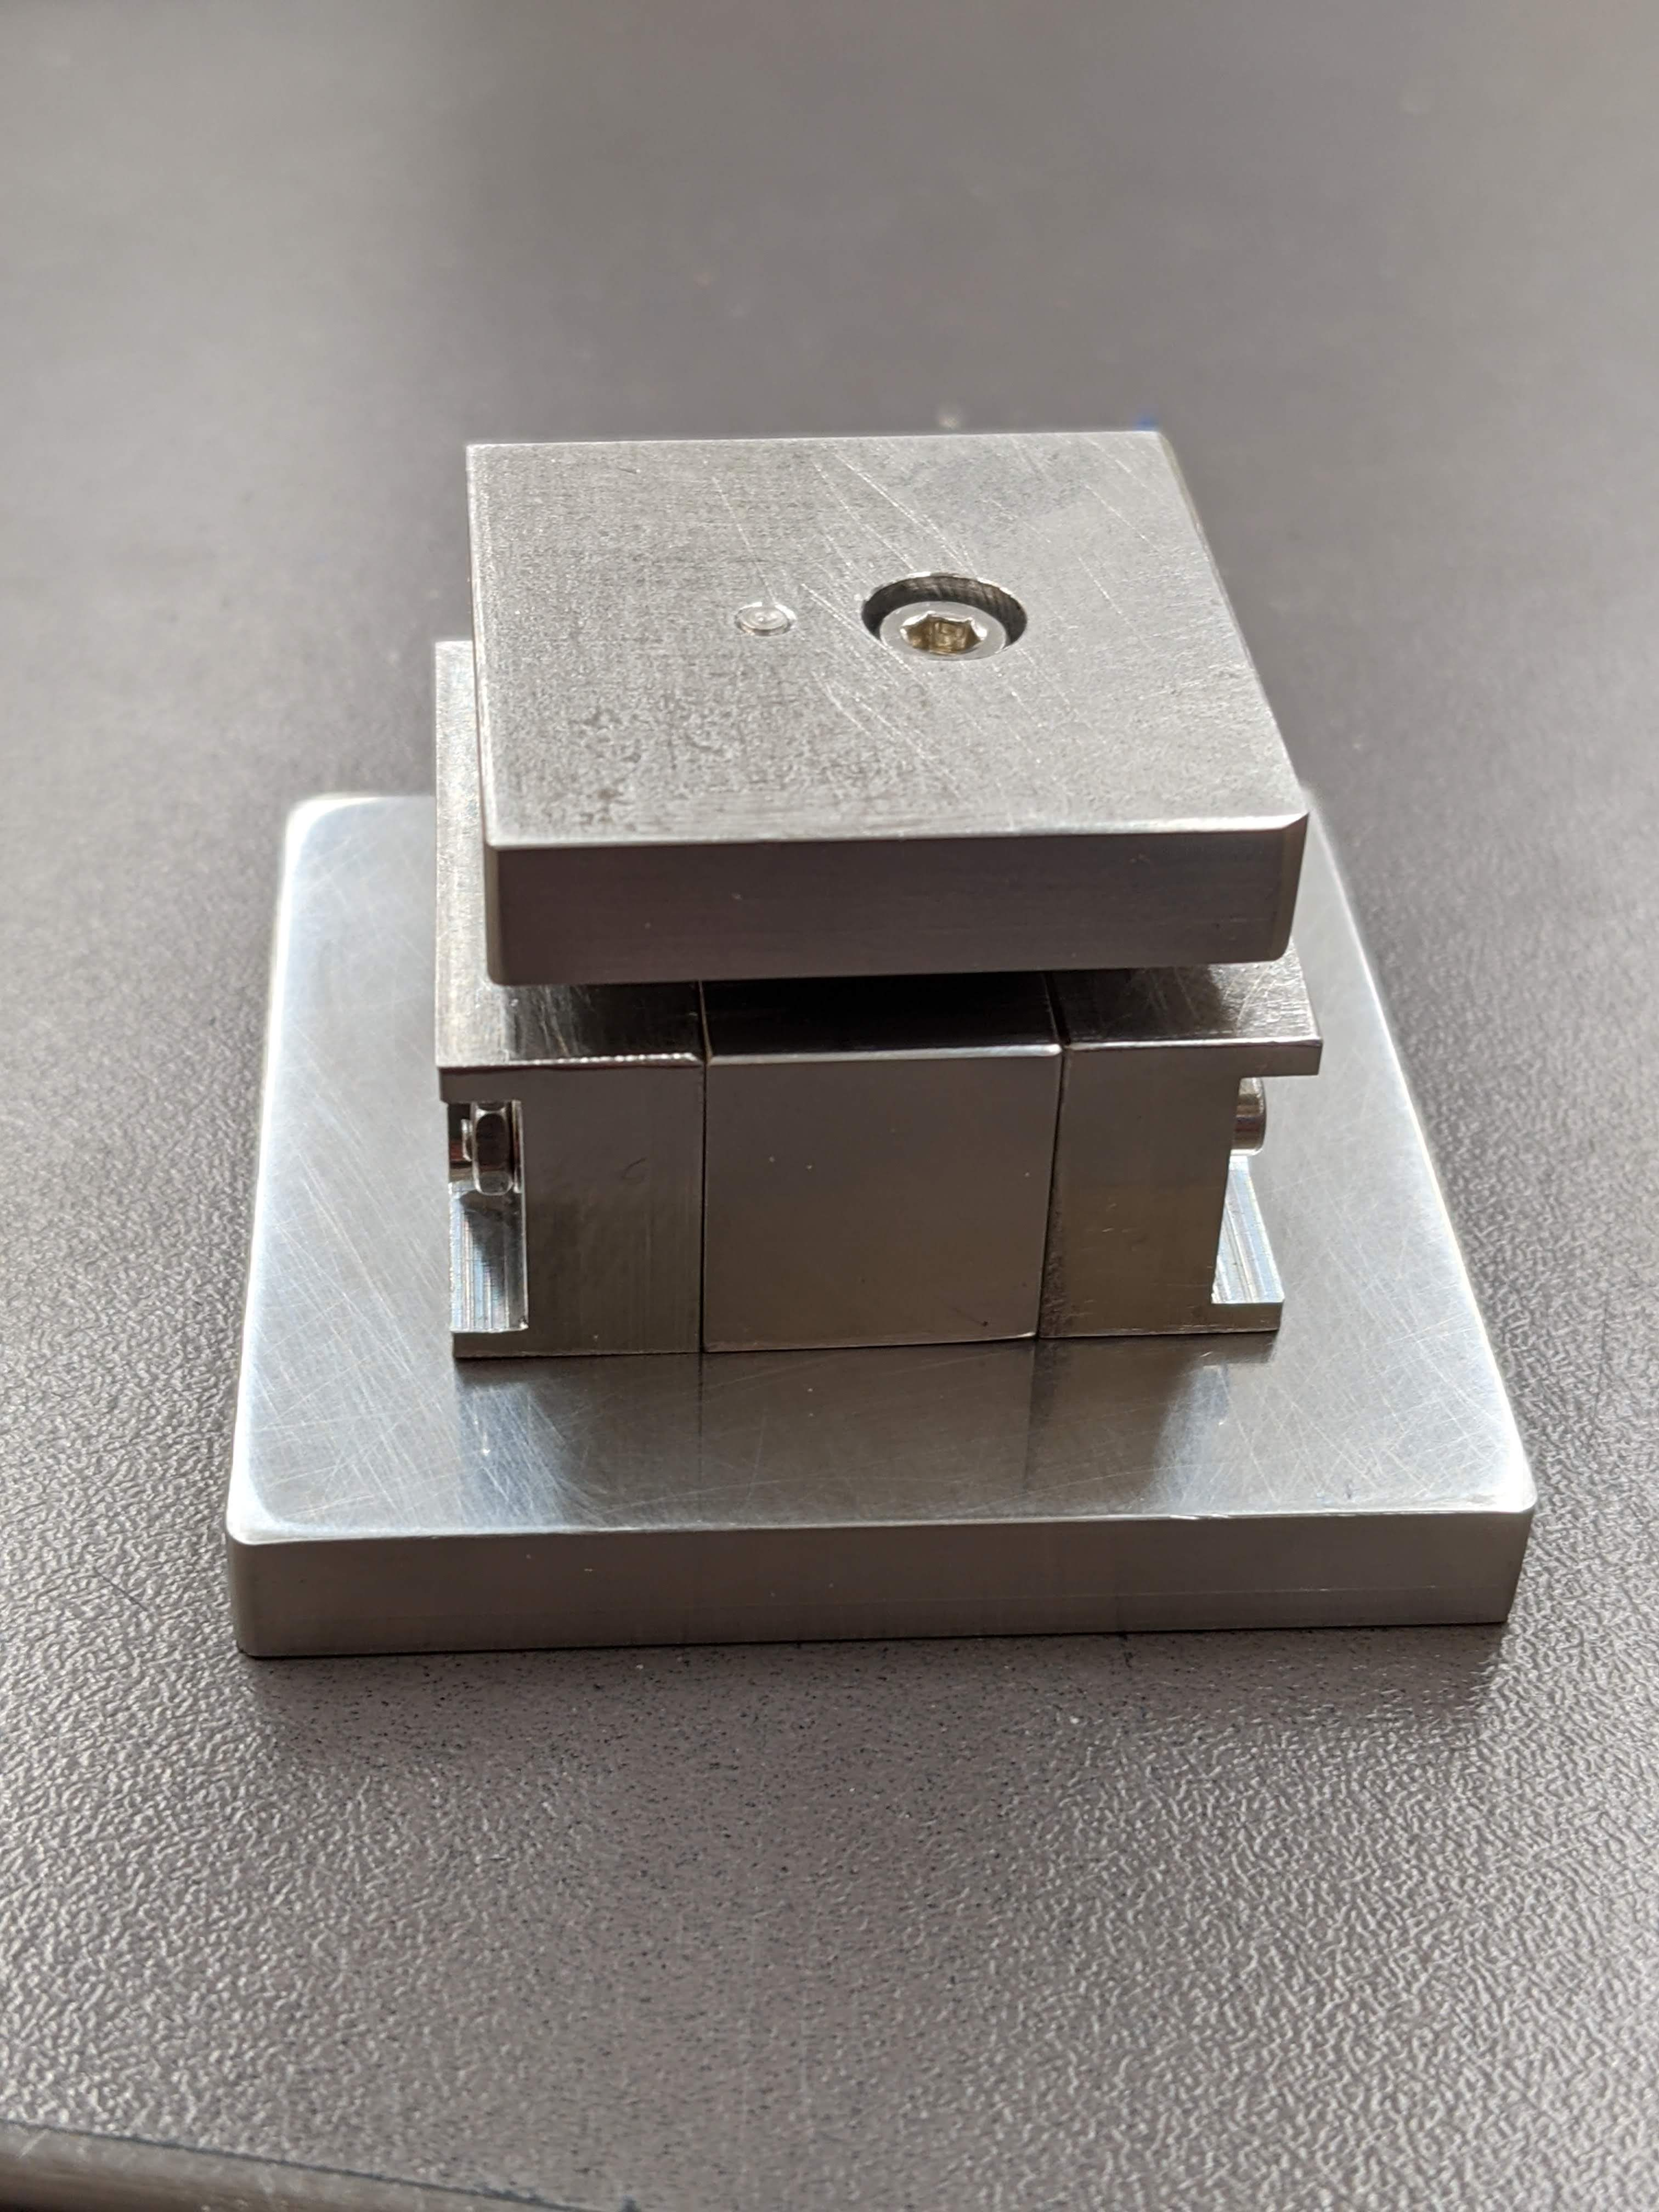
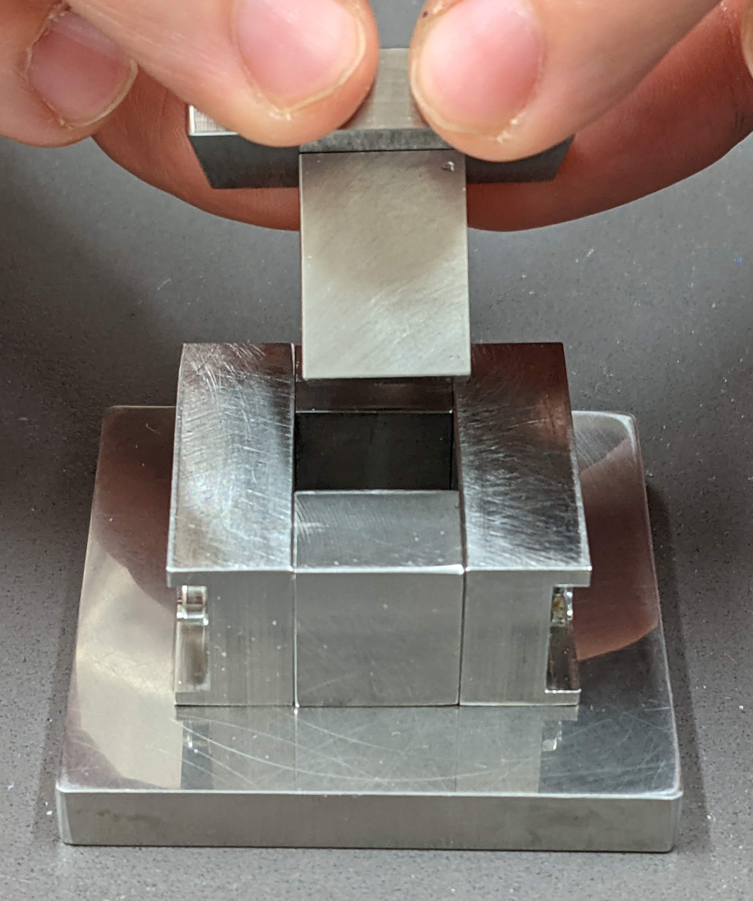
Foil Press continued

Slide 5
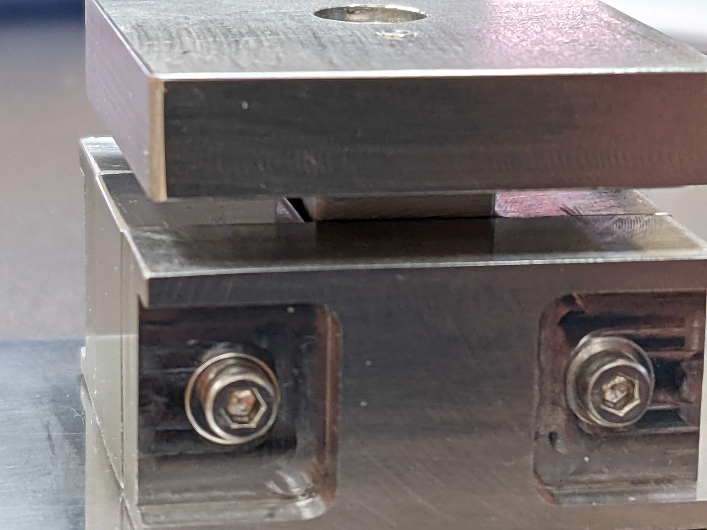
Foil Press continued
Alignment holes not drilled within spec tolerance.
One spacer piece undersized.
Results in a >0.5mm gap in press area.

Slide 6
What’s Next
Must determine specs of new piece to correct for errors.
Get new spacer piece made.
In the meantime, make temporary fix to existing press to move forward with R&D.
Glue foil and/or Teflon to fill gap.

