Slide 1
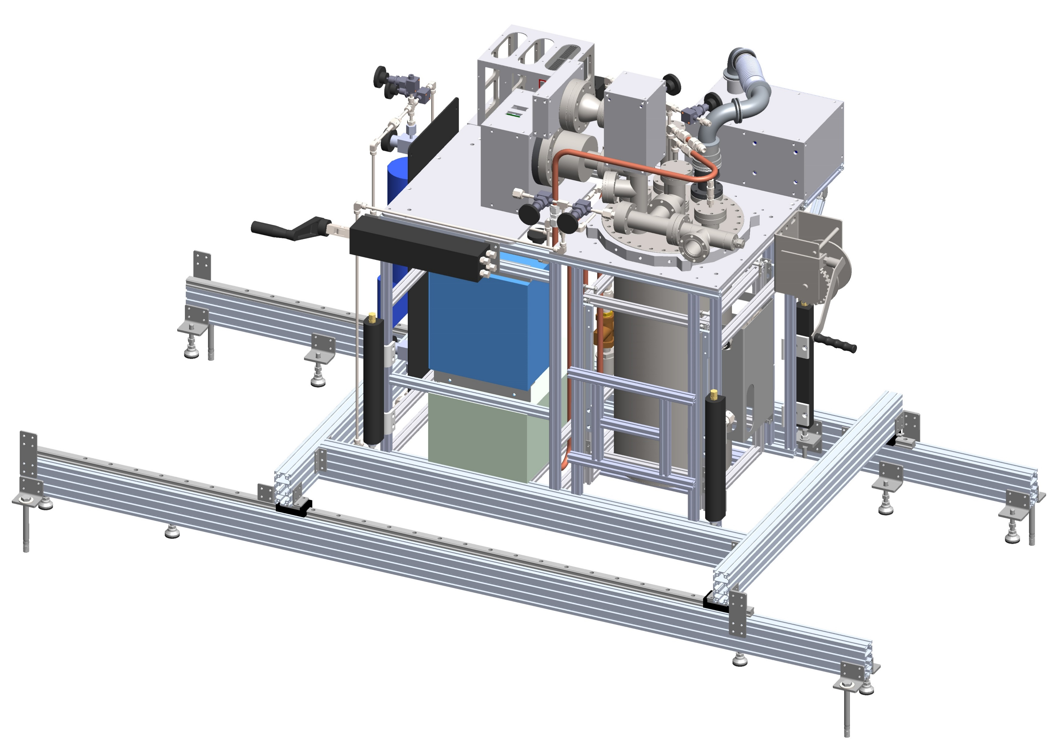
FCalPulse Updates
May 20, 2021
Robert Walker

Slide 2
General Updates
Source foil
Delayed in customs
Small design projects completed
MIL-SPEC FT clamp – Printed, fitted
Tarp tent frame – Designed, will order with counter stands next week
Counter Stands – Sasha has started design, will finalize next week and order
Oxygen gas manifold – Designed, parts ordered
Machine Shop
Faraday Cages and SCal should be completed tomorrow.
Not sure if SCal includes Tungsten plates.
Additional projects still being worked on.

Slide 3
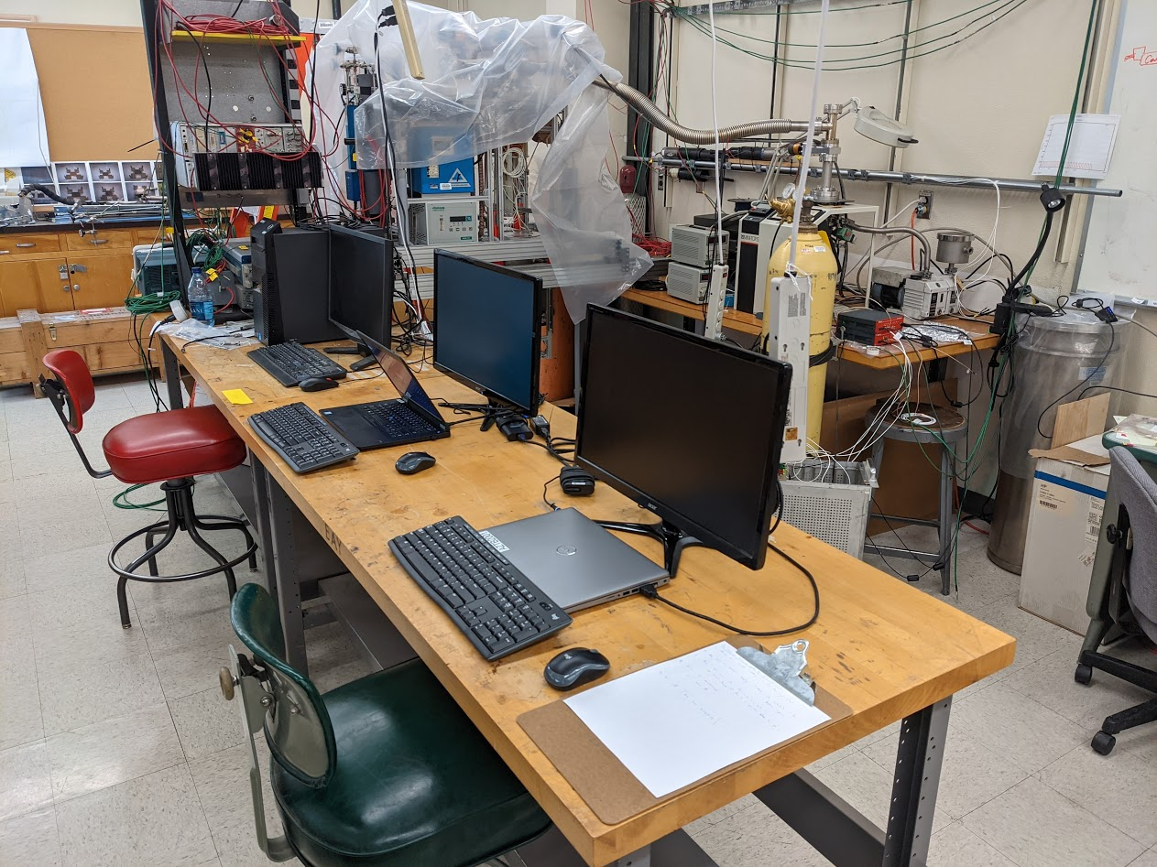
Electronics Test Station
Setup for electronics/DAQ testing started
Laptops have been setup for configuration
Windows: LabVIEW: Cryostat Monitoring, Digitizer Testing/Troubleshooting
Linux: Erich’s Data Acquisition
Will continue to add individual systems as they become available
Triggers
Digitizers
FAMPs
Etc.

Slide 4
What’s next
My focus:
Helping Billie program/troubleshoot digitizers
Electronic noise reduction
Cryostat monitoring
Setup with new faraday cages
Double check wiring
Verify all needs for electronics test
Cabling
Experimental setup
Continue thinking about shipping.
What do you need?
Make a list, give it to me, I’m creating a master checklist.
Do we need to order something?
How to package?
Box vs crate
Packing materials (bubble wrap, expandable foam, packing peanuts?)
What should be shipped together, what should be on its own.

