Slide 1
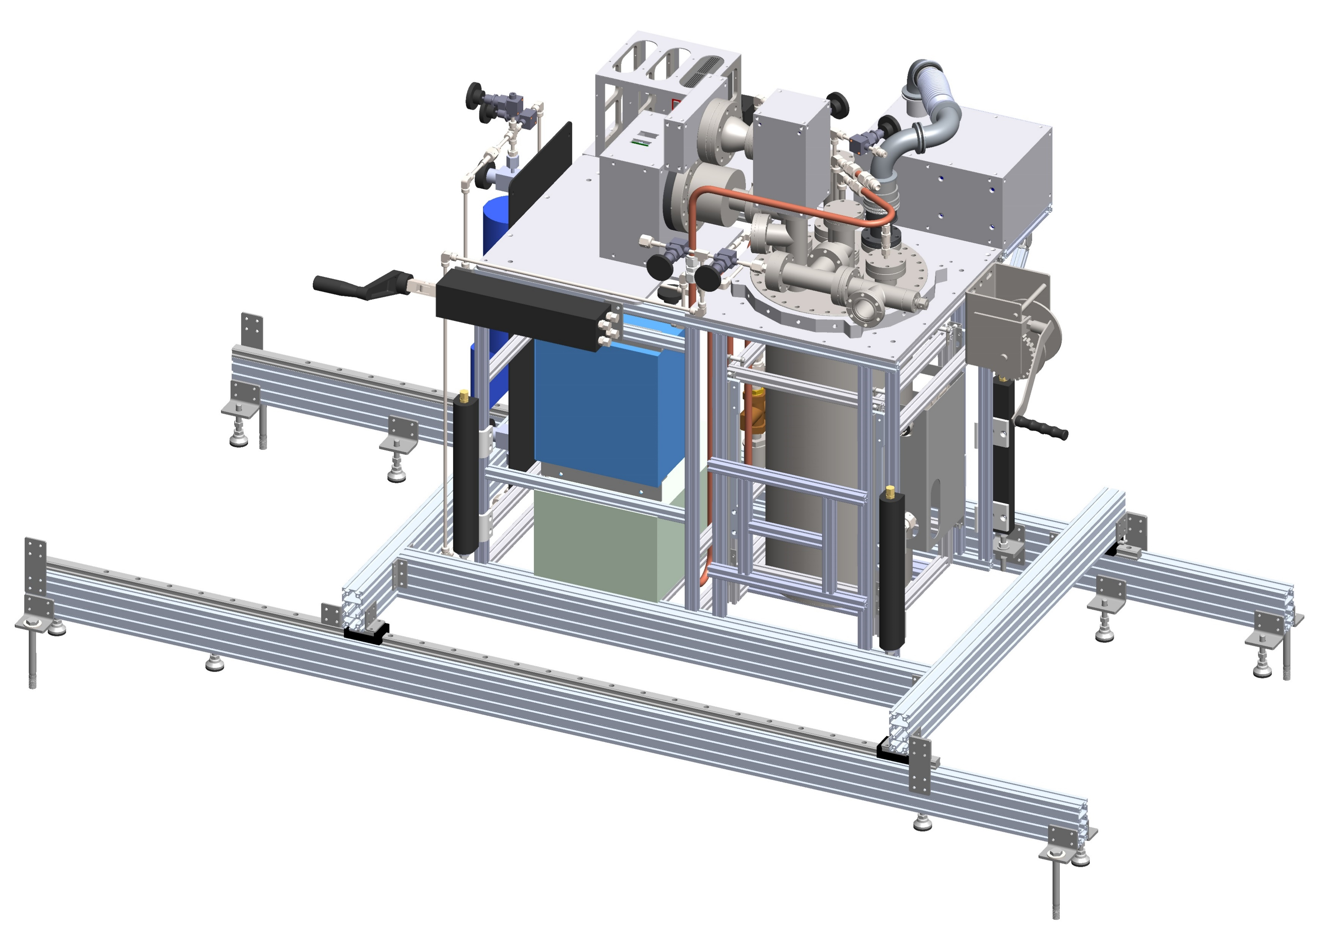
FCalPulse Updates
May 6, 2021
Robert Walker

Slide 2
General Updates
Machine shop update.
Light guides were finished Friday – 4/31
Passed on to Sasha for final polishing and assembly
Tape and covers for scintillator assembly has been ordered – should arrive today. (Arrived today)
Remaining parts will be worked on next week.

Slide 3
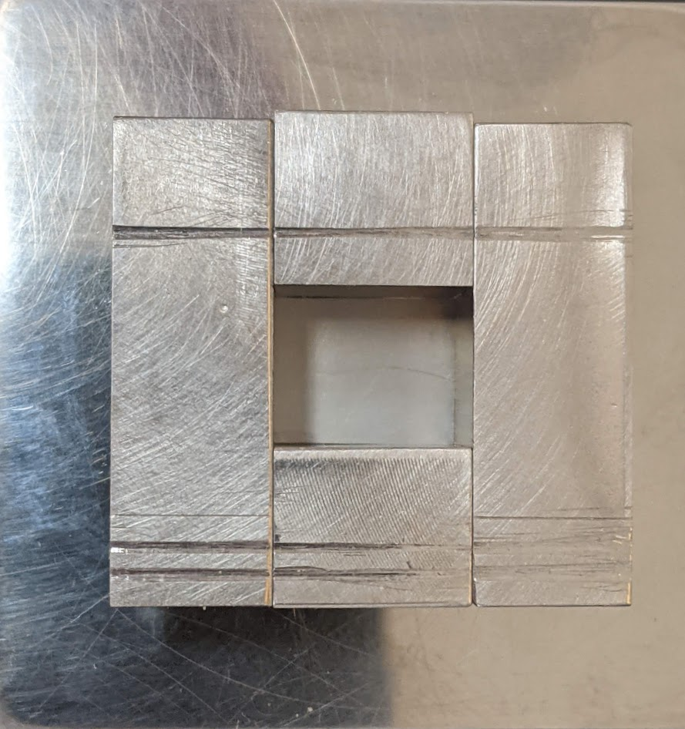
Source Foil R&D updates
Overlap of foil in final assembly was a concern.
Press was made smaller
Removed 1mm from sides to fit shorter foil lengths.
New foil dimensions: 9.9mm x 12.2mm
Easier to roll for installation.
Still have some overlap with installed foil.
Much better fit.
Delamination issues were solved with procedural updates.
Drying time for each step is important.
Added a 2nd mixing step
After mixture is on foil.
Breaks up crust on the top of the mixture, allowing for additional drying before pressing.
Mixture gets more “sticky” as it dries.
Less mixture transferred to press.
Last layer of superglue is key
Much greater chance of failed rolling if top superglue layer is skipped.

Slide 4
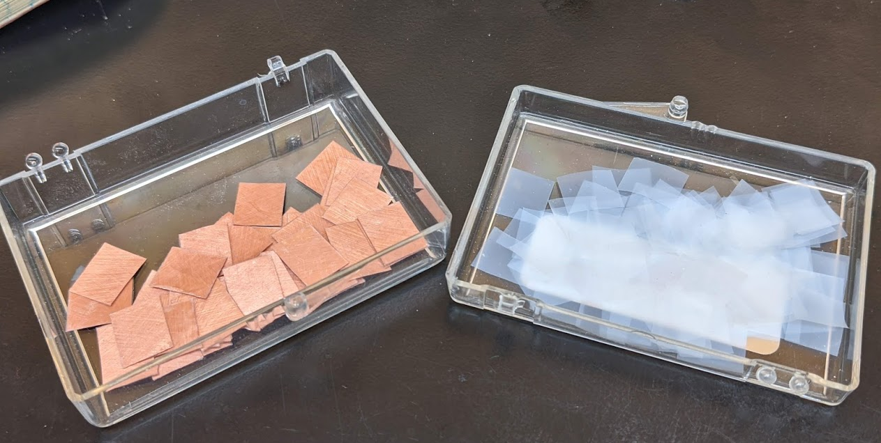
Updates from last week
Full procedure success rate:
Was ~50%
Now ~90%
Removal of Teflon?
Outer Teflon layer will remain
Rolled foil overlap
Improved with shorter foil length
Drying times
Finalized
Production foils and Teflon pieces
Cut and prepped with first superglue layer
Will probably cut more Teflon before shipping
3 pieces needed in procedure

Slide 5
What’s next
Finish writing procedure.
Needed new procedural pictures
Taken this morning, just need to place where needed.
Package and ship needed supplies.
Start working on multiple LabVIEW digitizer program
Our first attempt produced errors repeatably, why?

