Slide 1
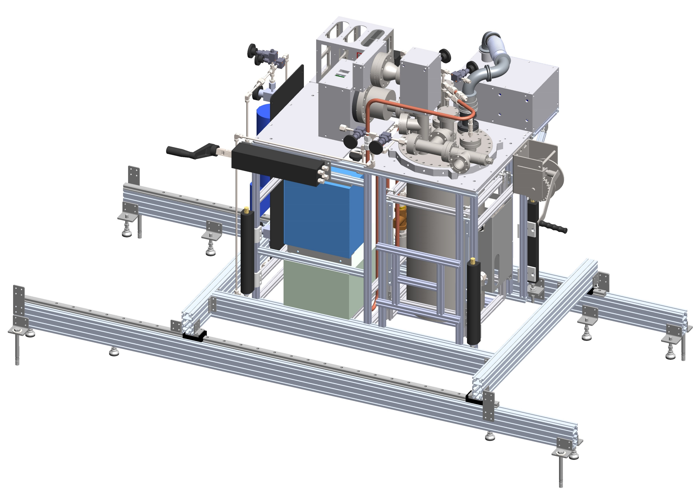
FCalPulse Updates
April 22, 2021
Robert Walker

Slide 2
General Updates
New scintillators have shipped
Arrival now Friday 4/23.
Machine shop delays
2 machines went down, sick machinist for 3 days.
Unknown impact on timelines, last update 4/19.
Digitizer external clock
Dan completed the timing/power module, have powered an FAMP board (old), and connected external clocks to both digitizers.
A LabVIEW vi has been created to switch between internal and external clocks that can be added to the testing software.
How to implement same switch in Linux code needs to be discussed.

Slide 3
Source Foil R&D updates
From source manufacturer:
Estimated salt mass used: 30-40mg.
Salt dried prior to use.
Bench tests now using approx. 40mg dried salt in tests.
Getting close to having a final formula and working procedure.
Outlined in the following slides.
Final “source” foil thickness: 350-450µm.
Includes 50.8µm Cu foil.

Slide 4
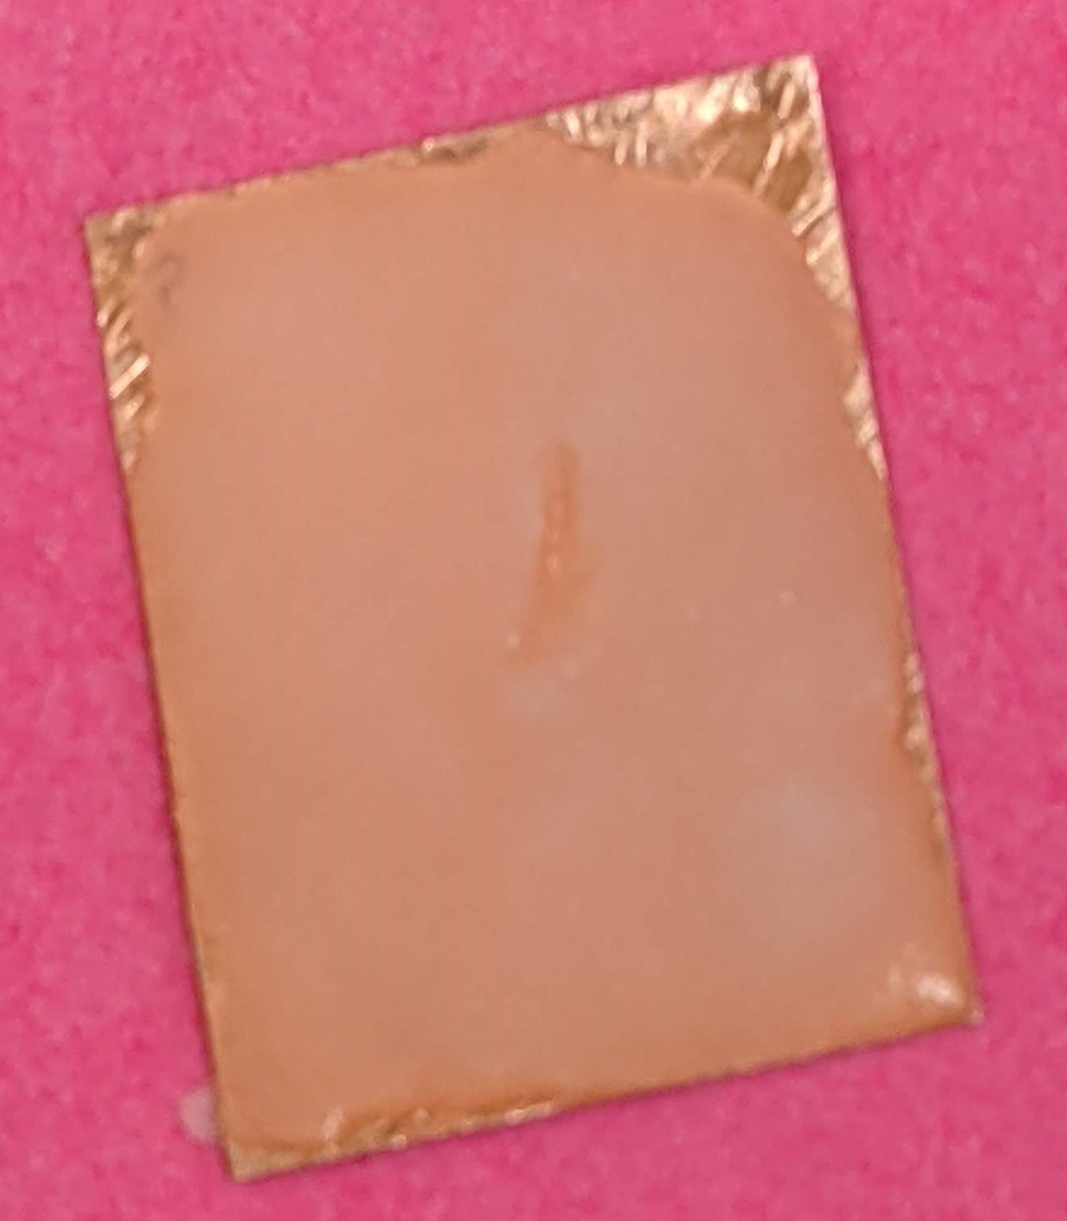
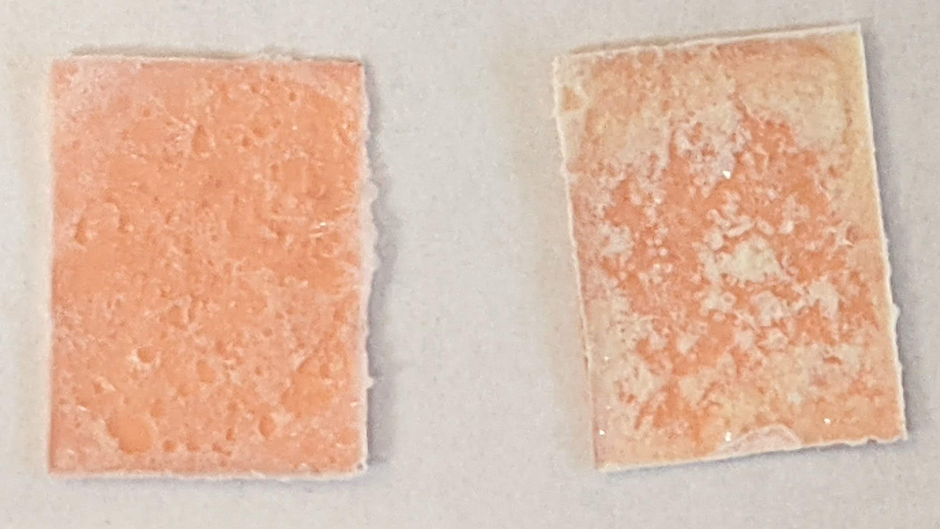
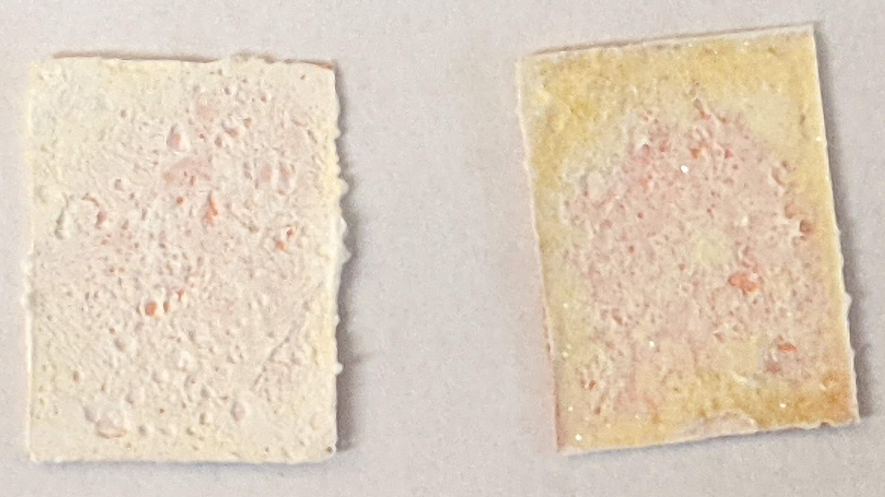
Source Foil “assembly” procedure
Current working formula: 1 part salt: 55% (±2%) H₂O: 80% (±5%) PVA
Step 1: Measure out 40mg Strontium Chloride salt (now dried).
Step 2: Measure out water (on foil being used).
Step 3: Mix salt with water.
Step 4: Measure out glue.
Step 5: Mix until uniform solution forms.
Step 6: Allow to dry slightly (30-45min by air, 5-15min with heat).
Step 7: Press (between Teflon pieces, with weight).
Step 8: Remove from press, remove bottom Teflon.
Step 9: Dry with heat (45min – 1 hour with top Teflon layer in place).
Step 10: Remove (carefully) the upper Teflon layer.
Step 11: Allow to fully cure (overnight by air, at least 1 hour with heat).
Step 12: Roll and insert into source holder following original procedure.

Slide 5
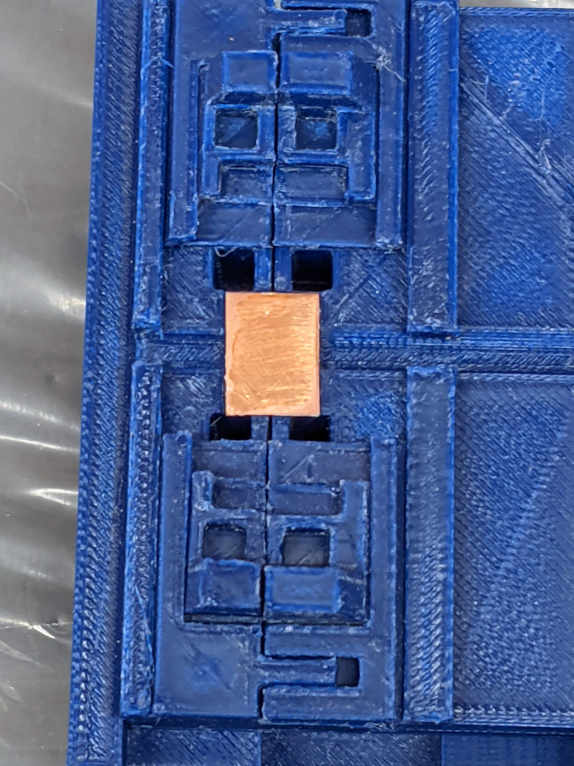
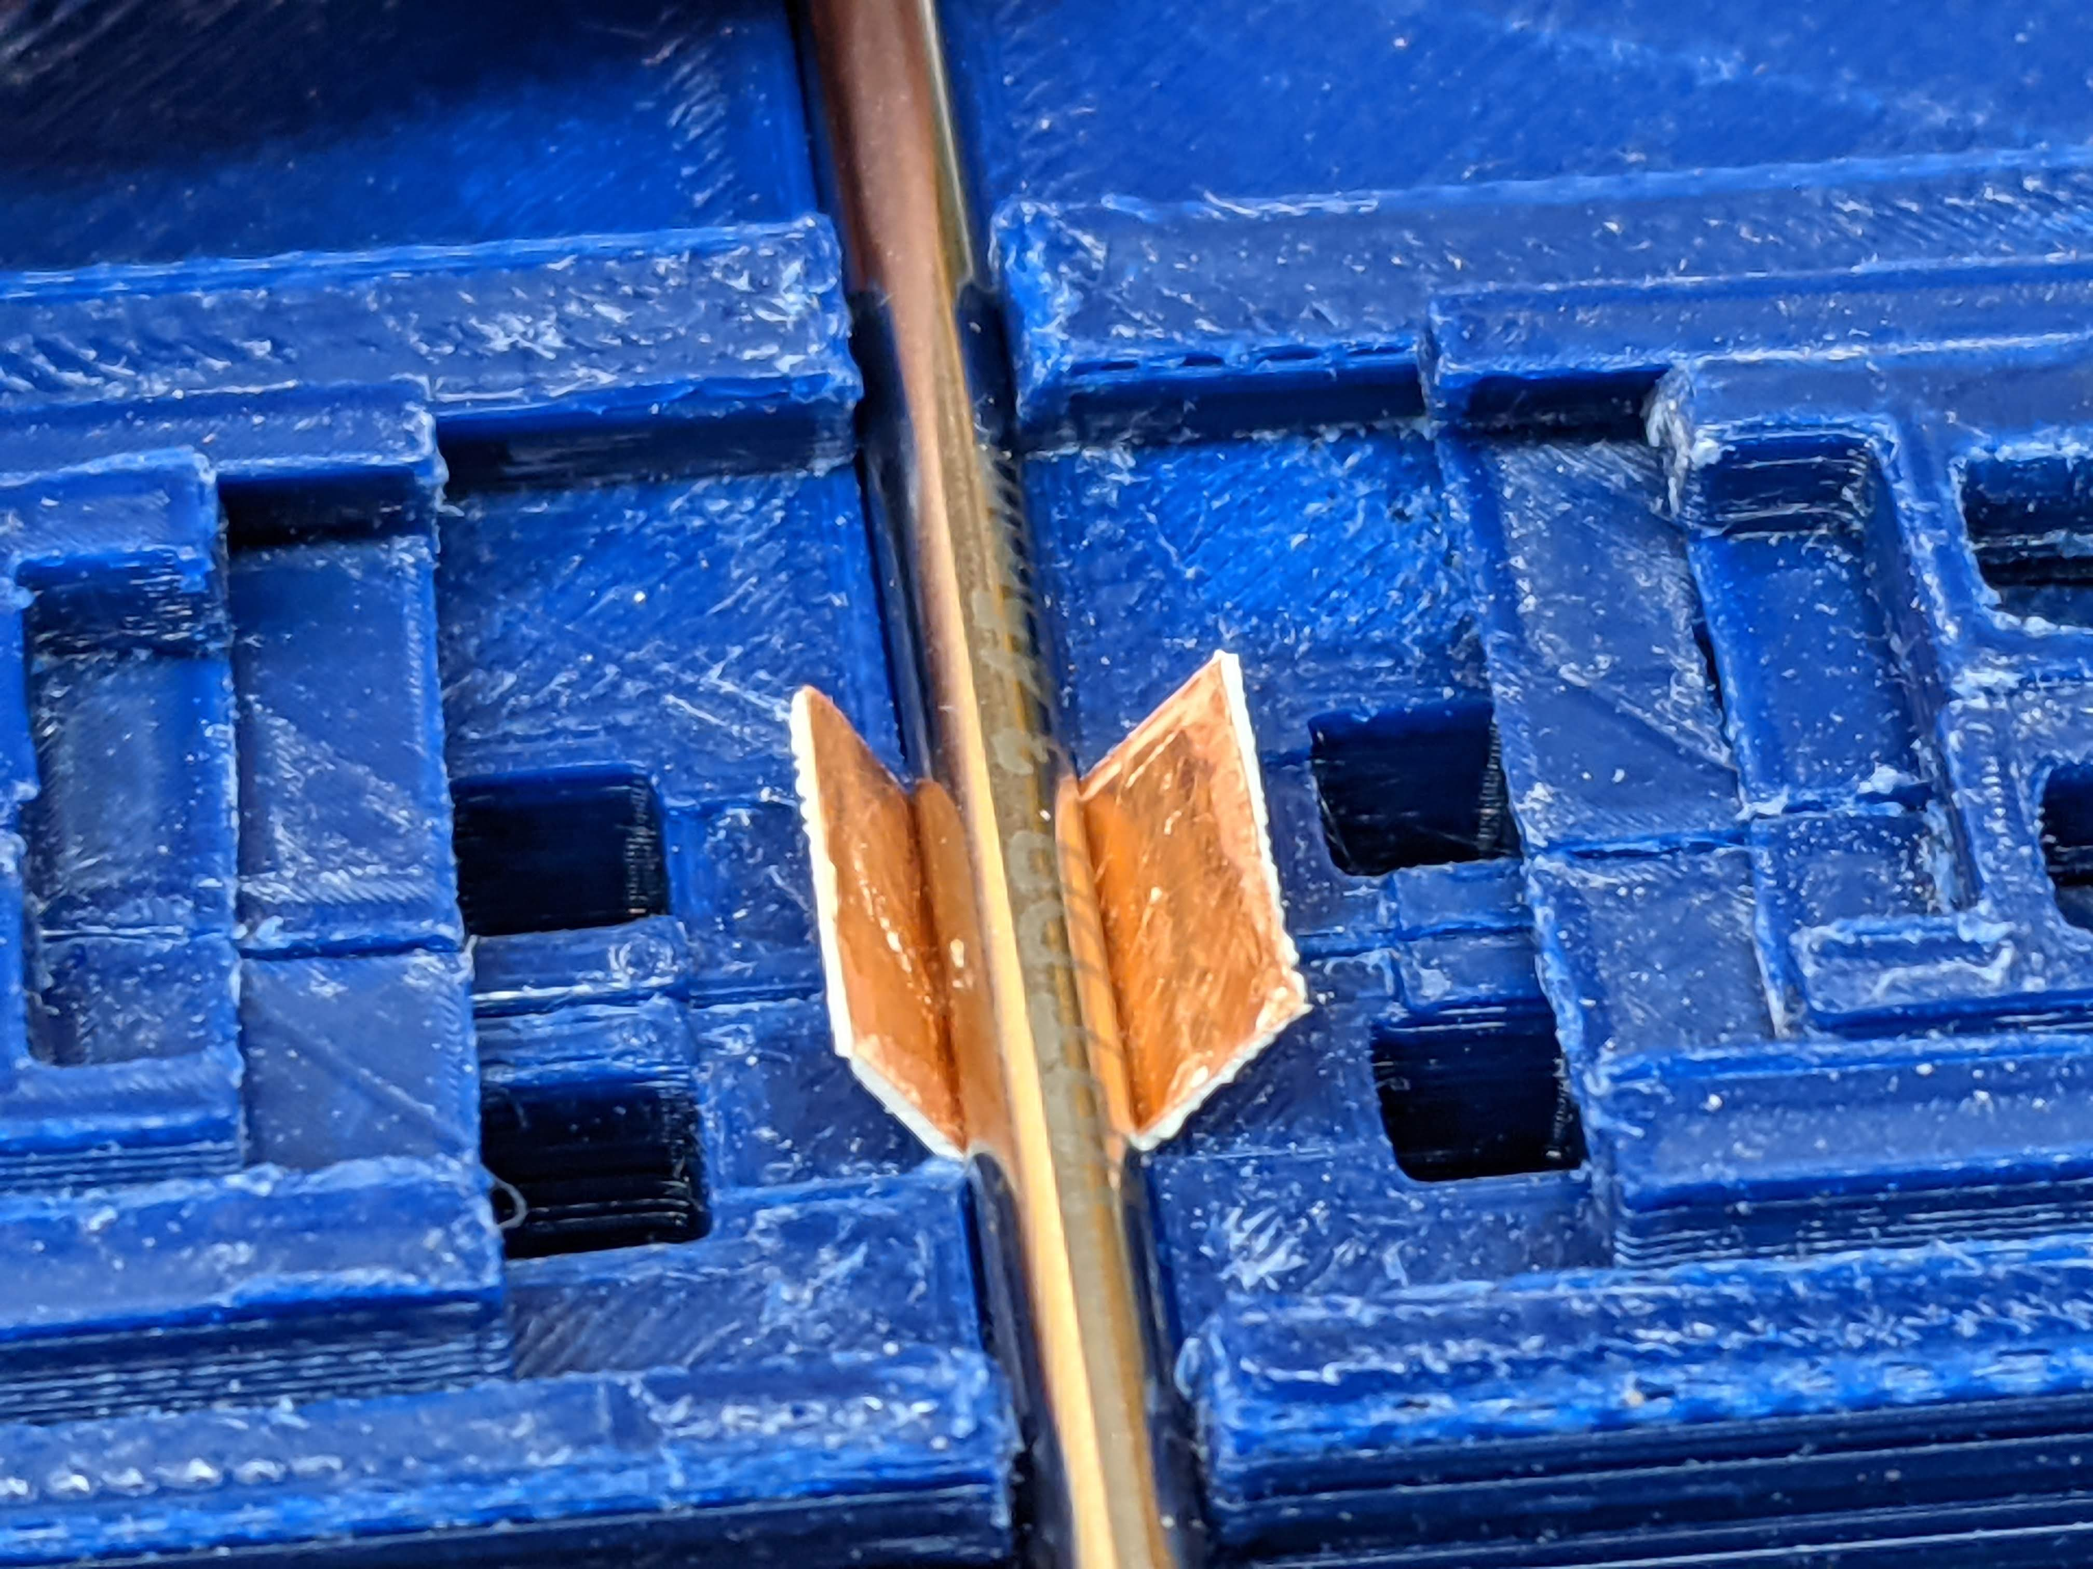
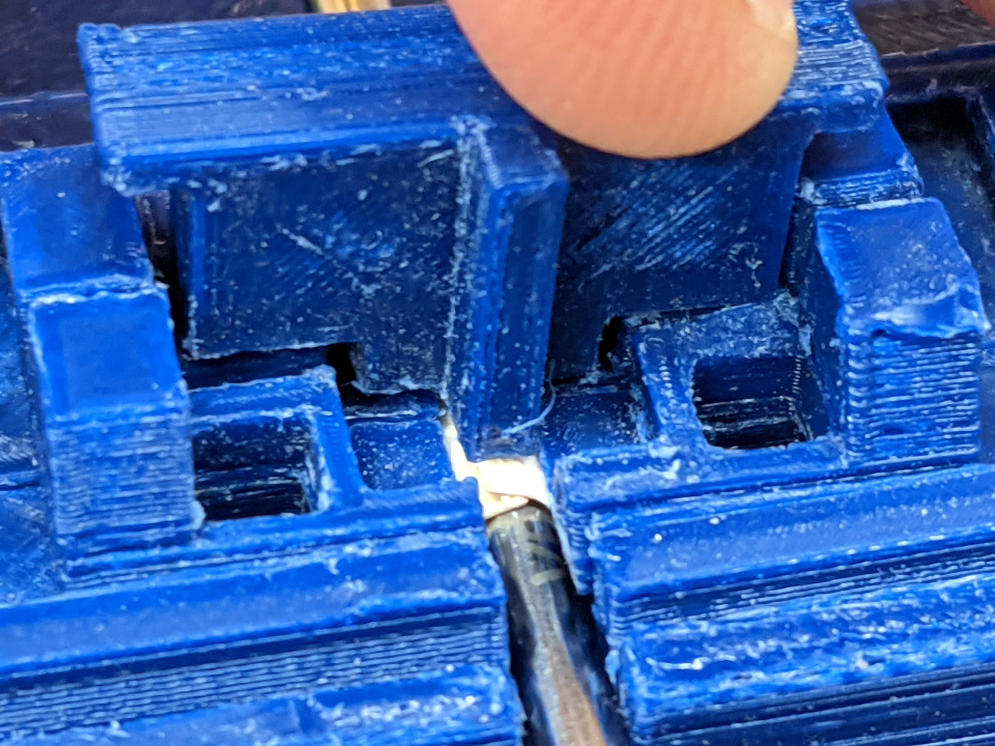
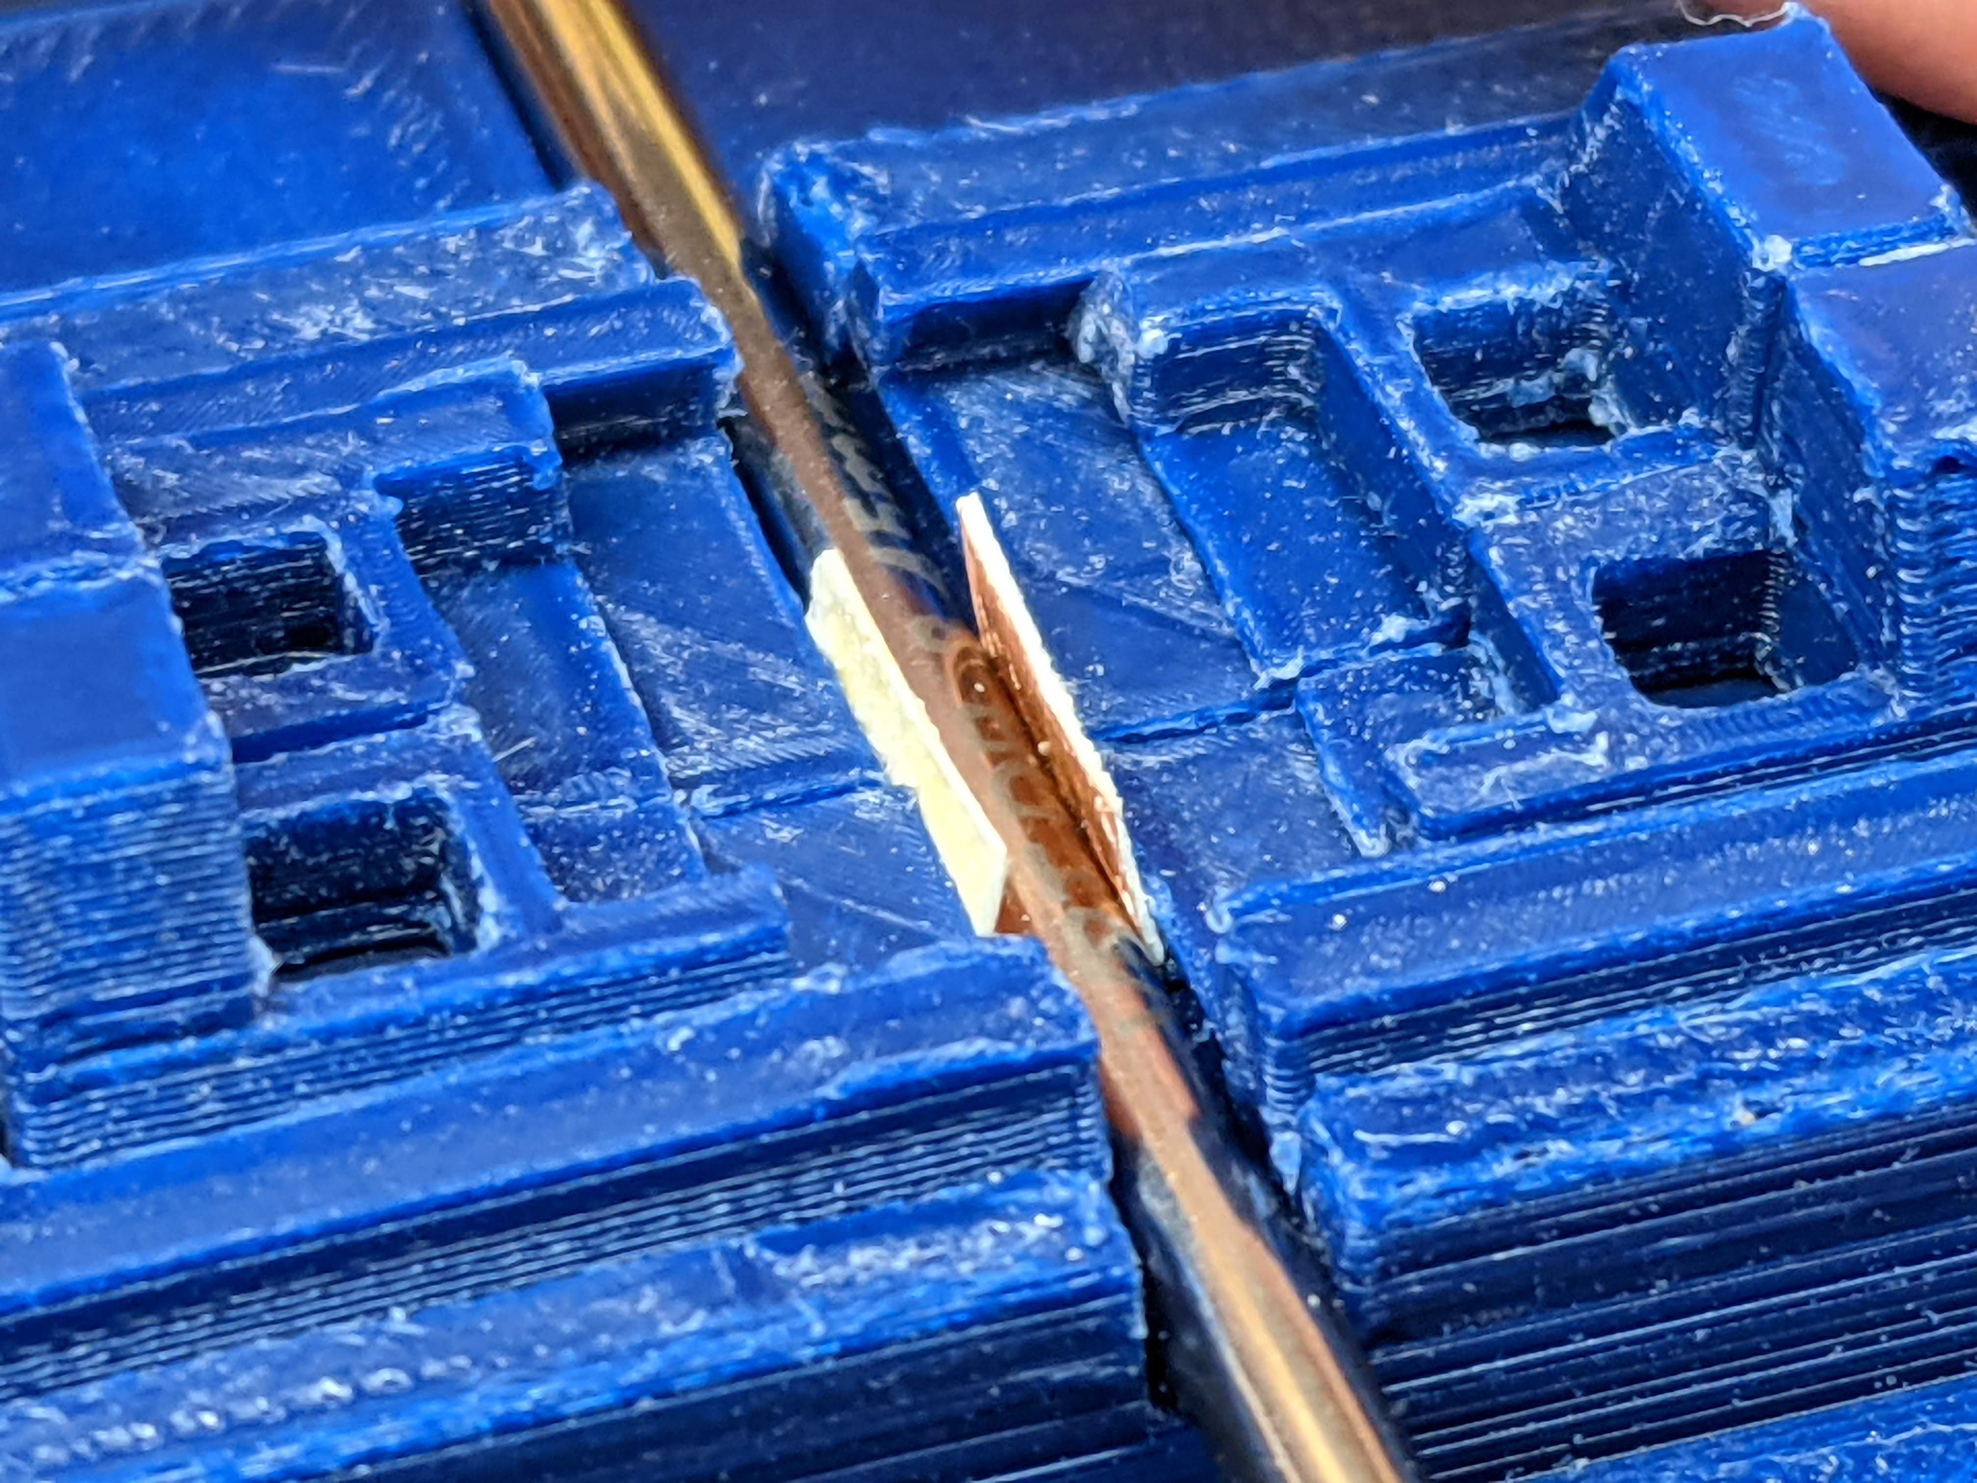
Source foil rolling
Step 1: Place foil in rolling jig, source side down.
Step 2: Place rod in slot.
Step 3: Slide first layer together.
Step 4: Slide second layer together.
Step 5: Install top pieces.

Slide 6
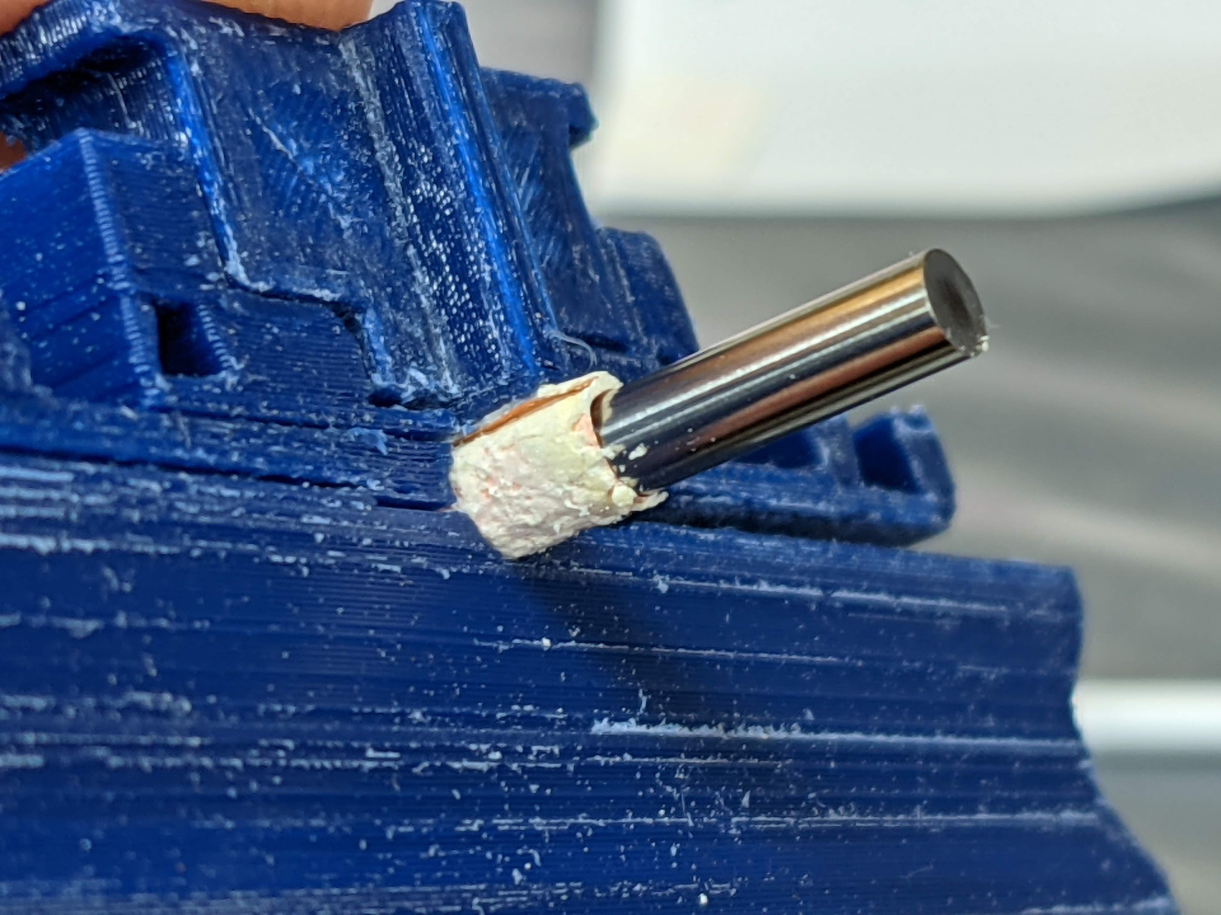
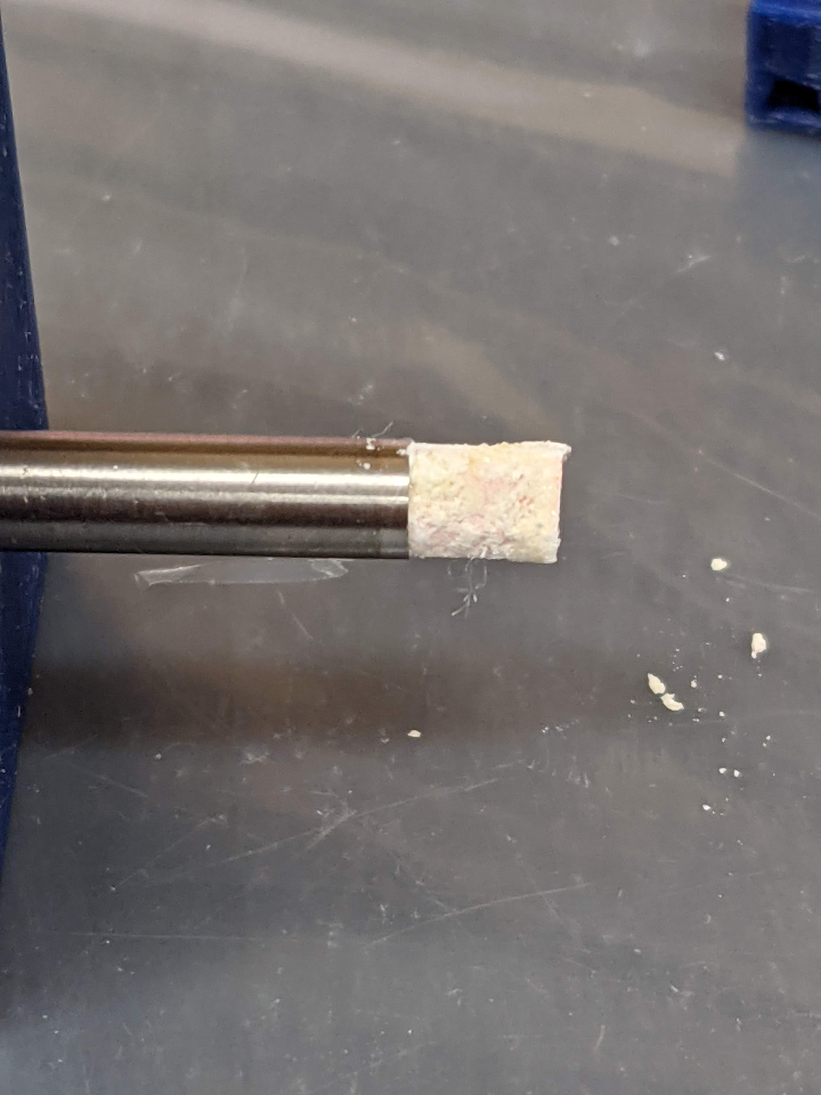
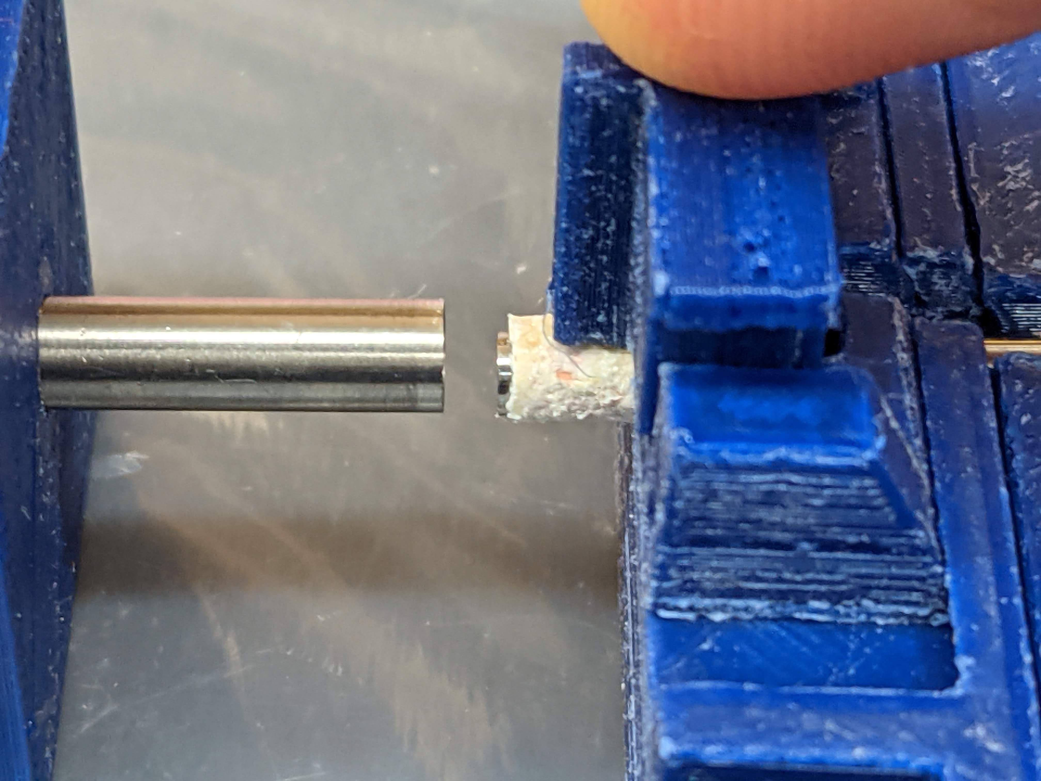
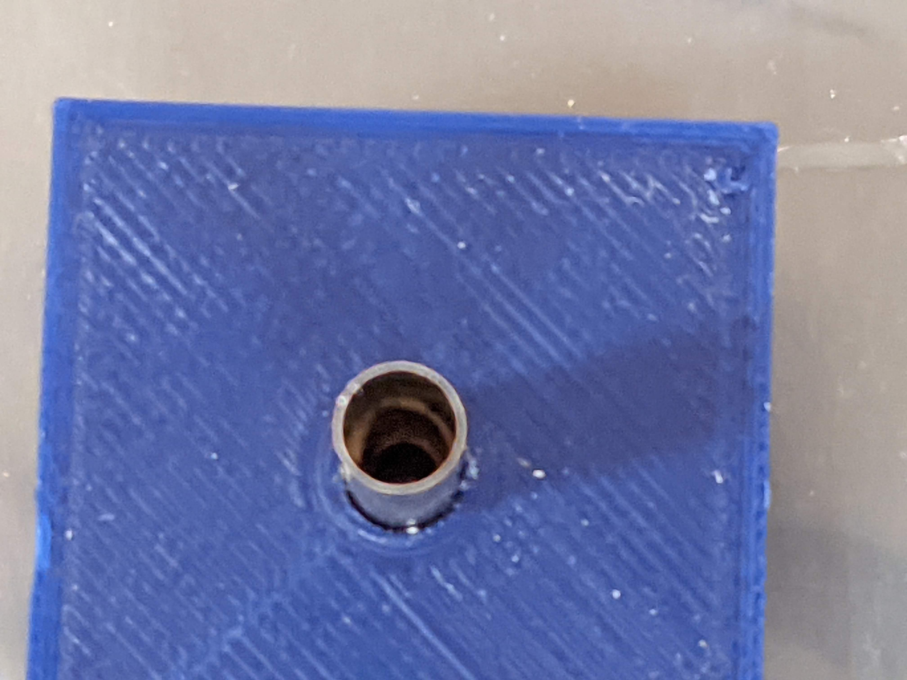
Source foil rolling continued
Step 6: Gently separate the jig.
Step 7: Align and install in source holder.
Step 8: Gently push to bottom of tube.

Slide 7
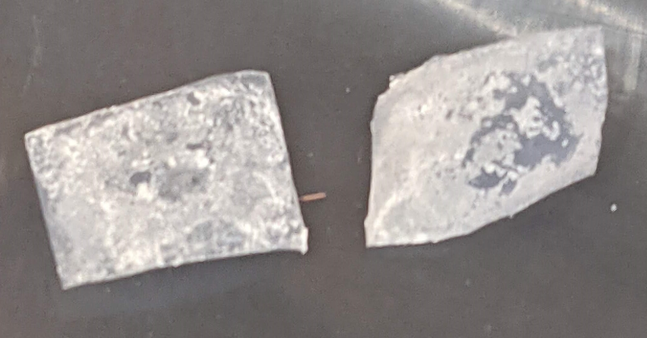
Source foil rolling observations
Higher glue ratio helps prevent cracking/separation when rolling.
Still losing some material from foil. Mostly along edges.
Collected and measured loss: 1.4mg and 2.2mg
Need to let dry longer before removal of top Teflon.
Reduce amount of salt that comes off during this step.

Slide 8
What’s next
Finalize procedure.
Need to be able to consistently produce a source foil and install.
Produce the written procedure for manufacturers.
Package and ship needed supplies.
Start tackling other FCalPulse tasks.

