Slide 1
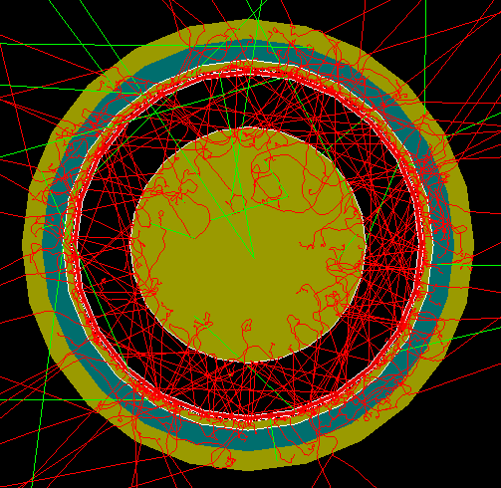
FCalPulse Local Mtg
J.Rutherfoord
29 April 2021
v1

Slide 2
Outline
Latest news
Billie Lubis – Reading out the preamps
Rob Walker report
Producing the Strontium foil
Erich Varnes – Data Acquisition System (DAQ)

Slide 3
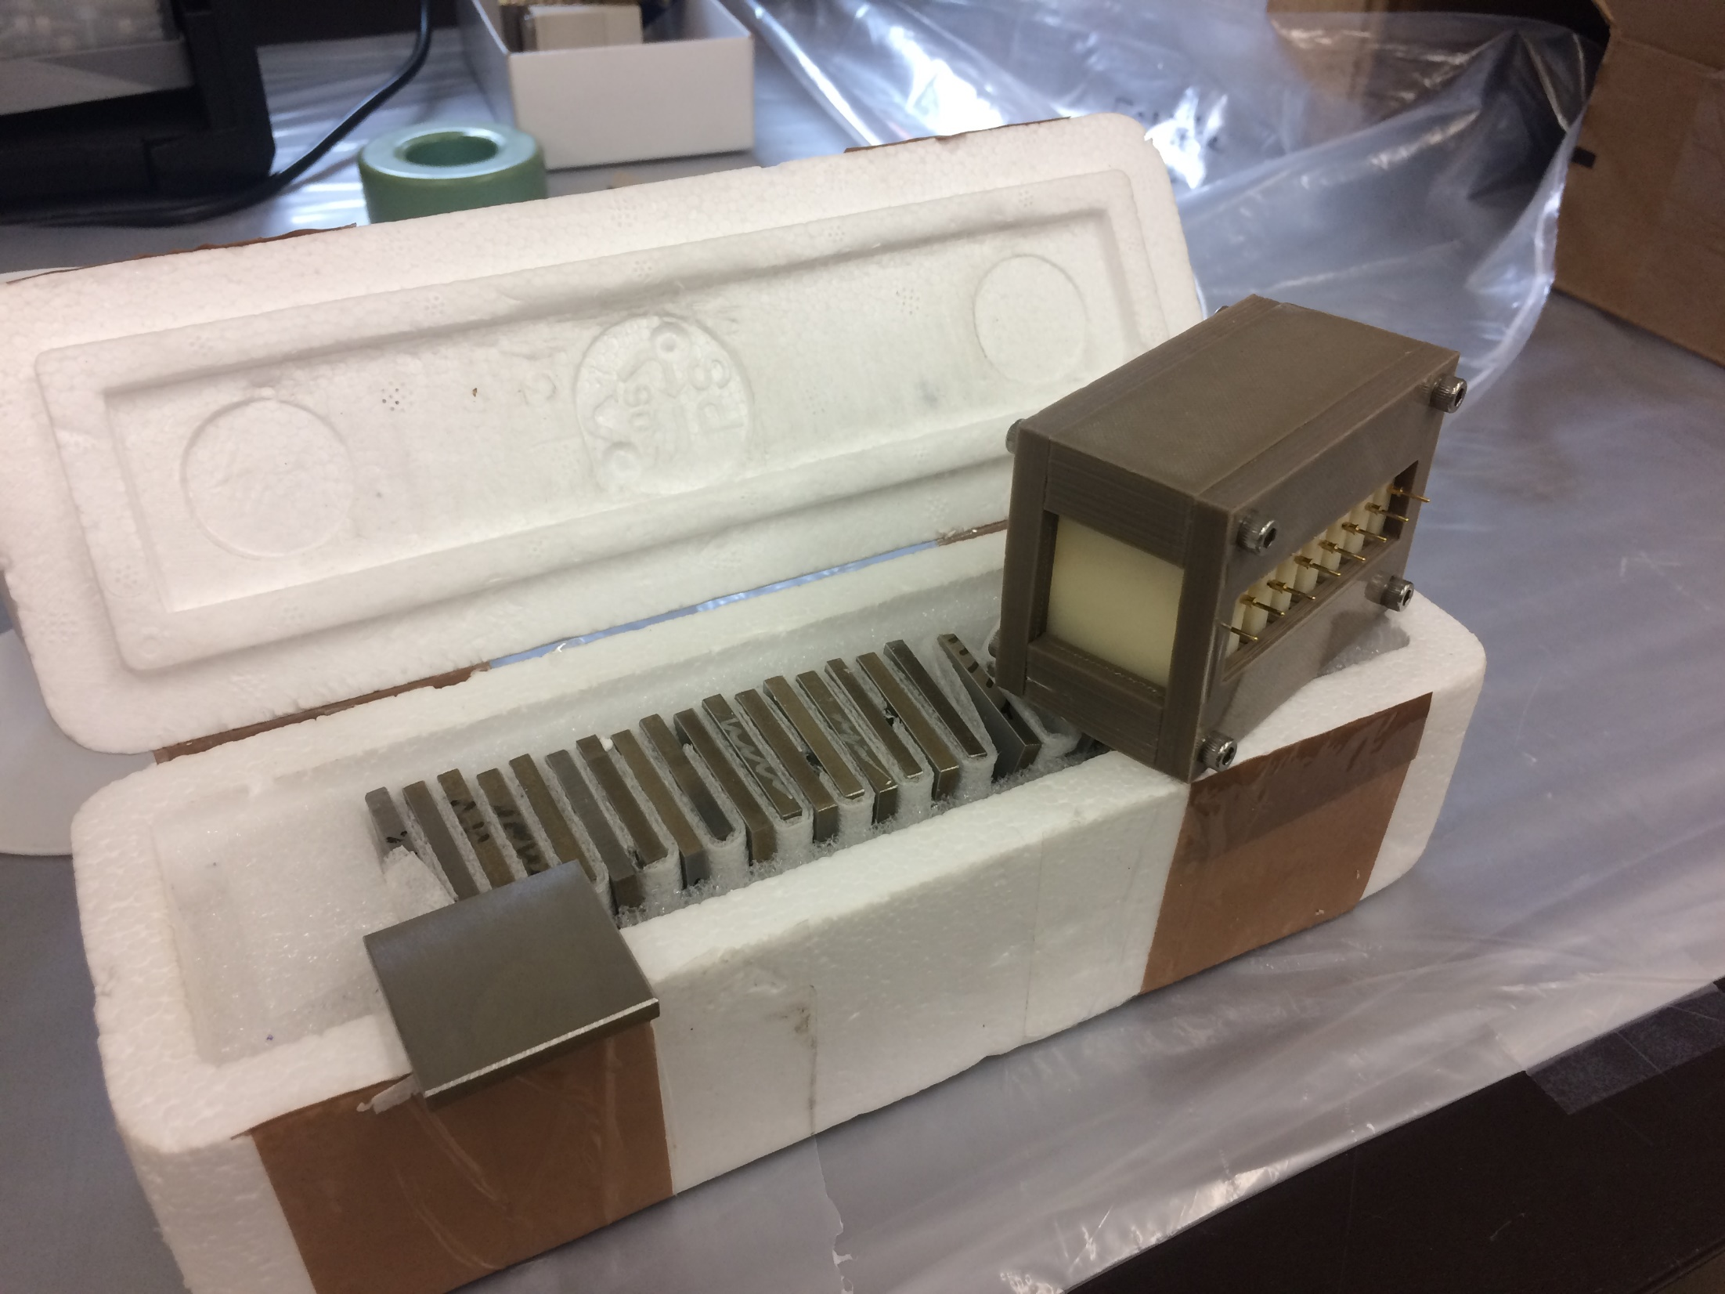
Tungsten plates for Shower Cals

Slide 4
W plates
IHEP (Institute for High Energy Physics) in Protvino, Russia – Sergey Denisov
Provided the Tungsten (W) plates
26 plates arrived yesterday
We need 24 plates 2×(8+4)

Slide 6
SPS Schedule
CERN plans to provide beam in the North Area starting mid-July.
The schedule is now set
We have a week of beam starting Aug 4th
The ITEP beam chambers will be tied up in the beam line next to us until Aug 11th
I’ve asked if our beam period can be delayed one week.

Slide 7
Accommodations at CERN
Housing – yet to be determined
Local transportation – 2 CERN vans + ?
Meals – CERN restaurants + ?

Slide 8
Paperwork preparation
Passport w/ expiration > 6 mos (+ visa?)
Proof of Covid vaccination(s)
https://newcomersguide.web.cern.ch/
CERN ID card
Medical certificate from your doctor
Safety training – General + Radiation
Dosimeter

