Slide 1
Forward Calorimeter Baseplane and FC1 Layer Sum Board
D. Tompkins
30 June 2015

Slide 2
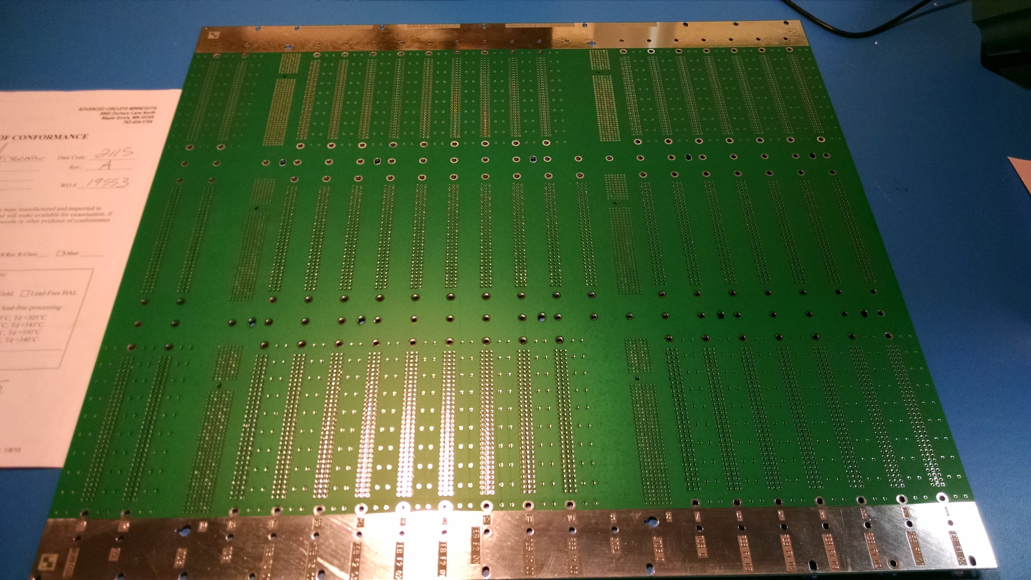
Rev A Prototype in Hand

Slide 3
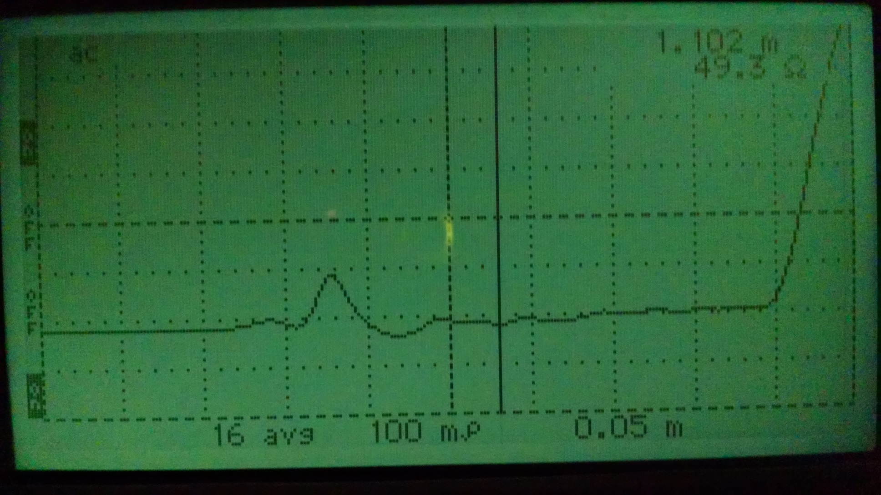
TDR testing shows trace impedance very close to 50 Ohms

Slide 4
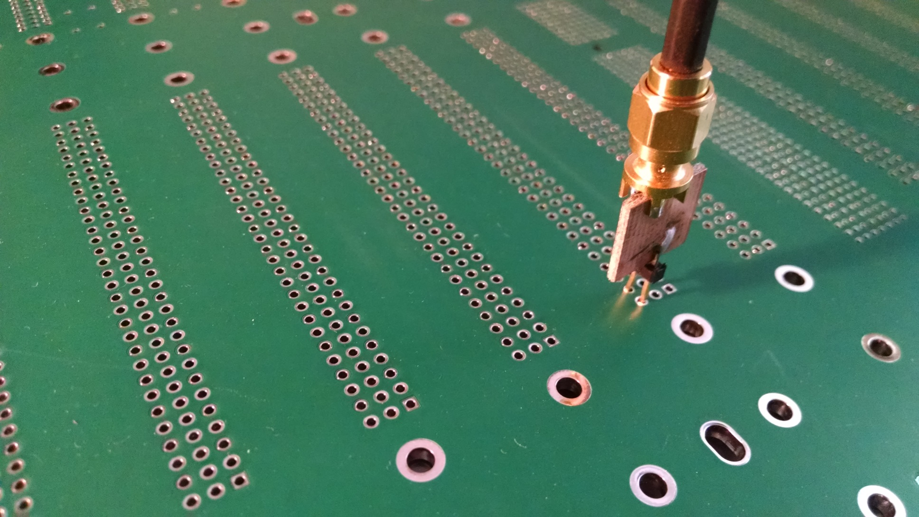
Data from 5 traces on each of the 7 routing layers:

Slide 5
Some issues:
Non-plated through holes are flooded over.
Unused pads removed on all internal layers. This was done to minimize crosstalk and preserve the ground plane as much as possible.
Current vertical dimension is at maximum for panel size. Any increase would require moving to the next larger panel size

Slide 6
One major problem
A new mapping scheme is needed to be compatible with the Back End Readout

Slide 7
New Mapping Scheme
The Back End System requires LTDB0 to handle all of the FCAL 1 trigger groups
B
AMC
LTDB0
AMC
FC1
LTDB1
AMC
FC2/3
LTDB1

Slide 8
LTDB0 Mapping

Slide 9
LTDB1 Mapping

Slide 10
Is this scheme feasible?
Preliminary routing indicates this scheme will be easier to route than the original.
The tower driver board connectors don’t need to be swapped.

Slide 11
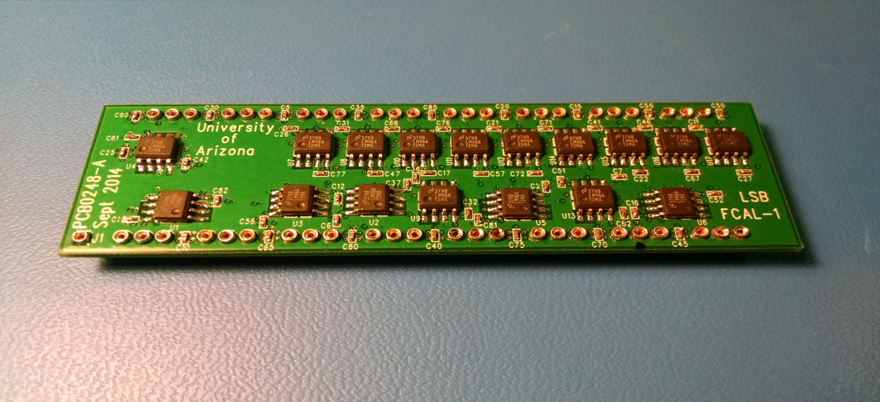
Layer Sum Board, Rev B
Redesigned to equalize delay
Now using single stage non-inverting summing circuits

Slide 12
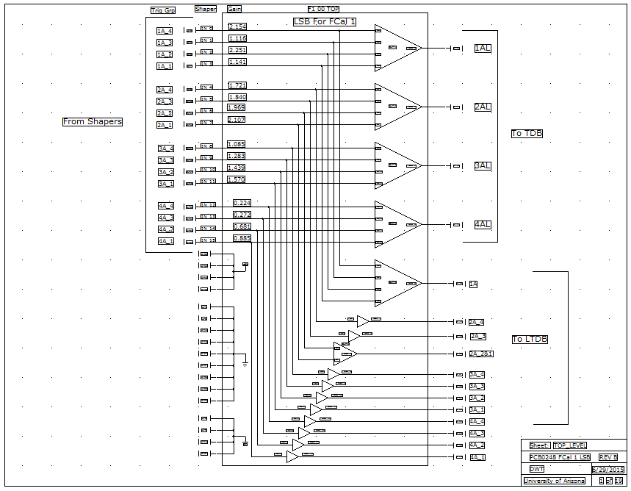
LSB Block Diagram

Slide 13
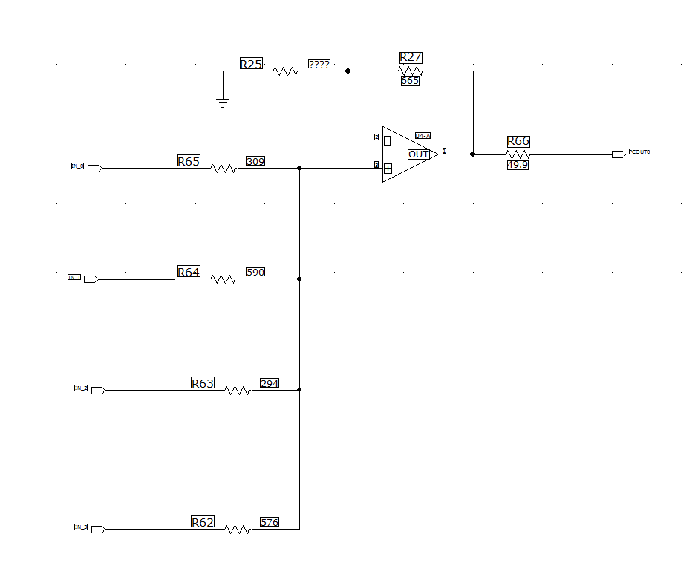
Summing Stage

