Slide 1
Forward Calorimeter Trigger Mapping Phase I Upgrade LAr Internal Review
J. Rutherfoord
28 May 2015

Slide 2
For additional information see
http://atlas.physics.arizona.edu/Arizona_Atlas_Downloads/tompkins
Subdirectories under this URL include gerber files

Slide 3
FCal BasePlane for Phase I
Goals of the Phase I upgrade
Description of the baseline and options
Present status

Slide 4
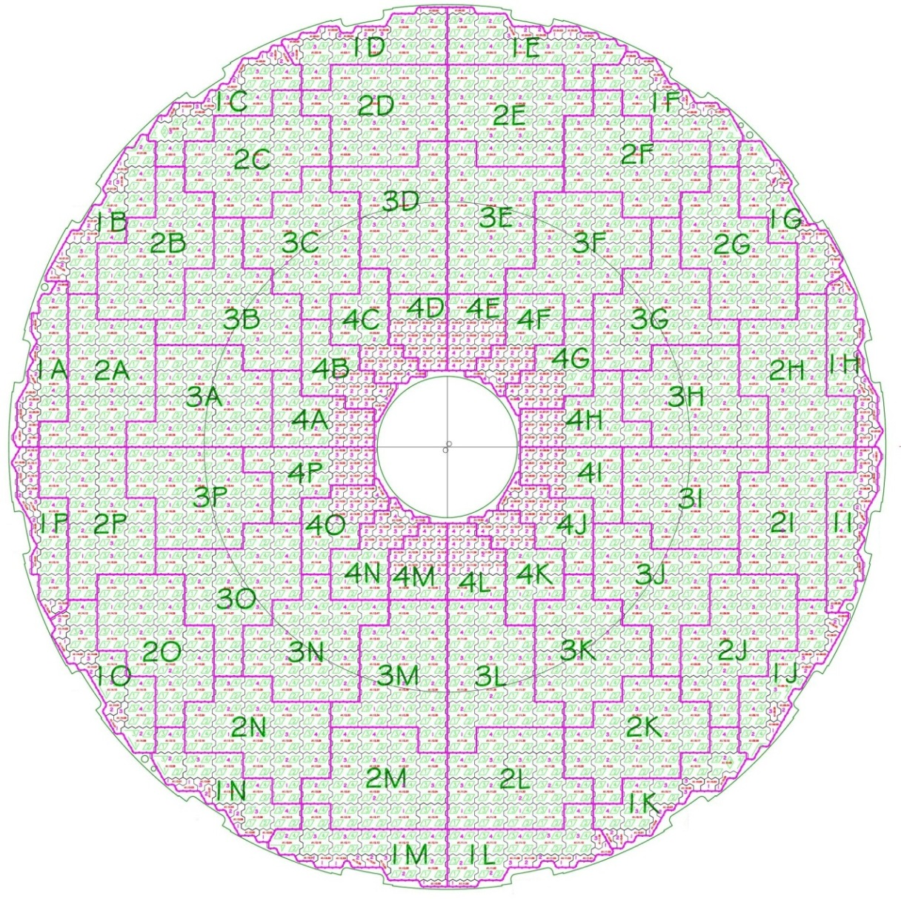
Motivation: Trigger Granularity
Existing FCAL1 trigger “towers”:
16 φ-slices
4 η-bins /slice
Δη×Δφ ≈ 0.45×0.4
64 towers / module
192 towers /side
Note: Irregular ϕ slices
FCal1
IP

Slide 6
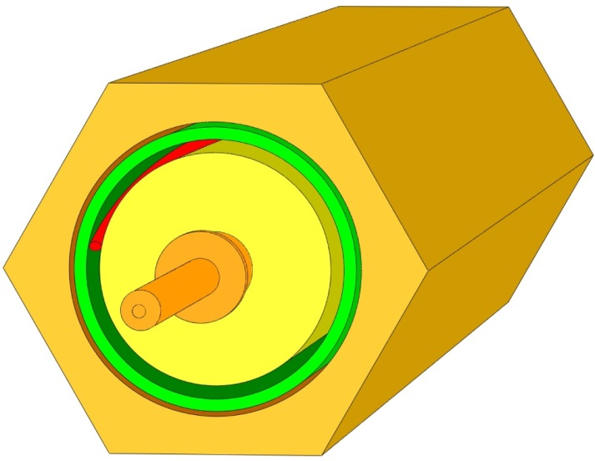
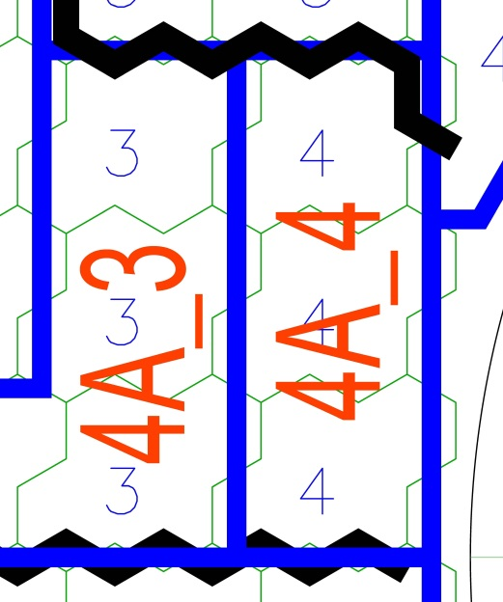
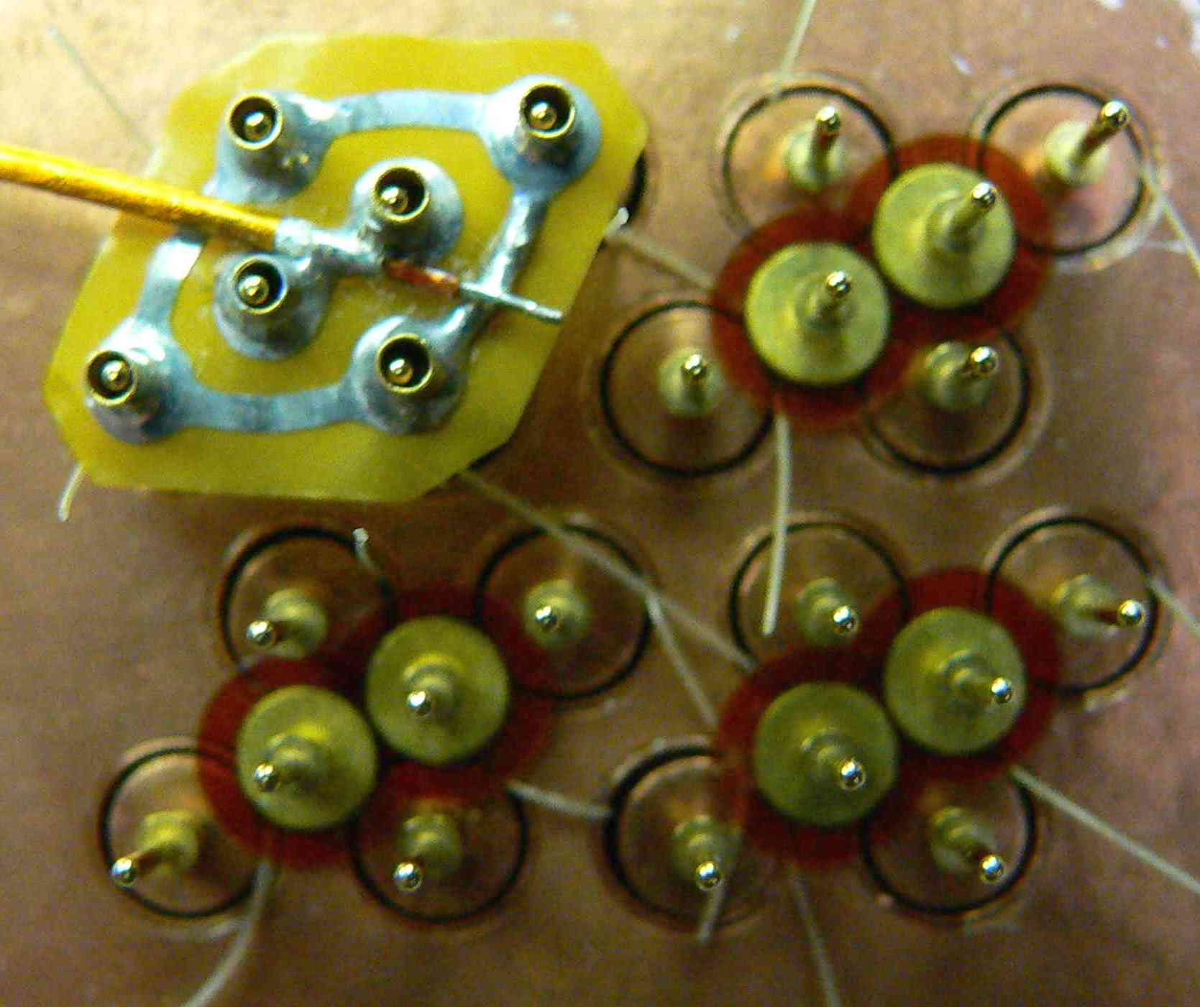
Unit cell – Electrode and Readout
Electrode Unit Cell
FCal1 Readout Unit Cell
Super cells

Slide 7
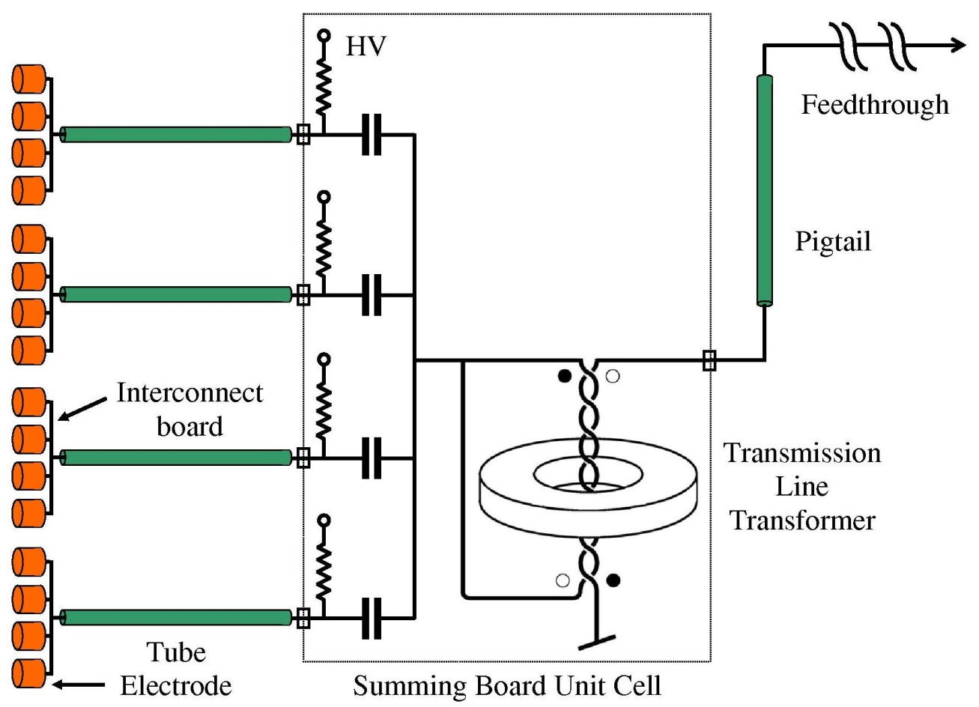
Summing electrode signals
Preamp
Shaper
Linear Mixer
Linear Mixer output goes to LSB input

Slide 8
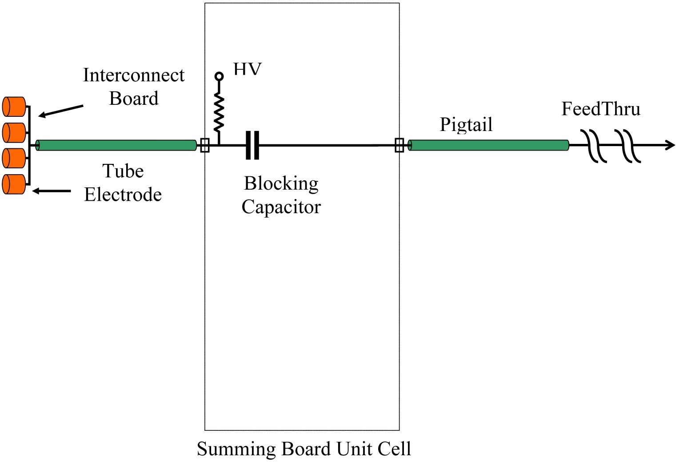
Un-summed electrode signals
Preamp
Shaper
Linear Mixer

Slide 9
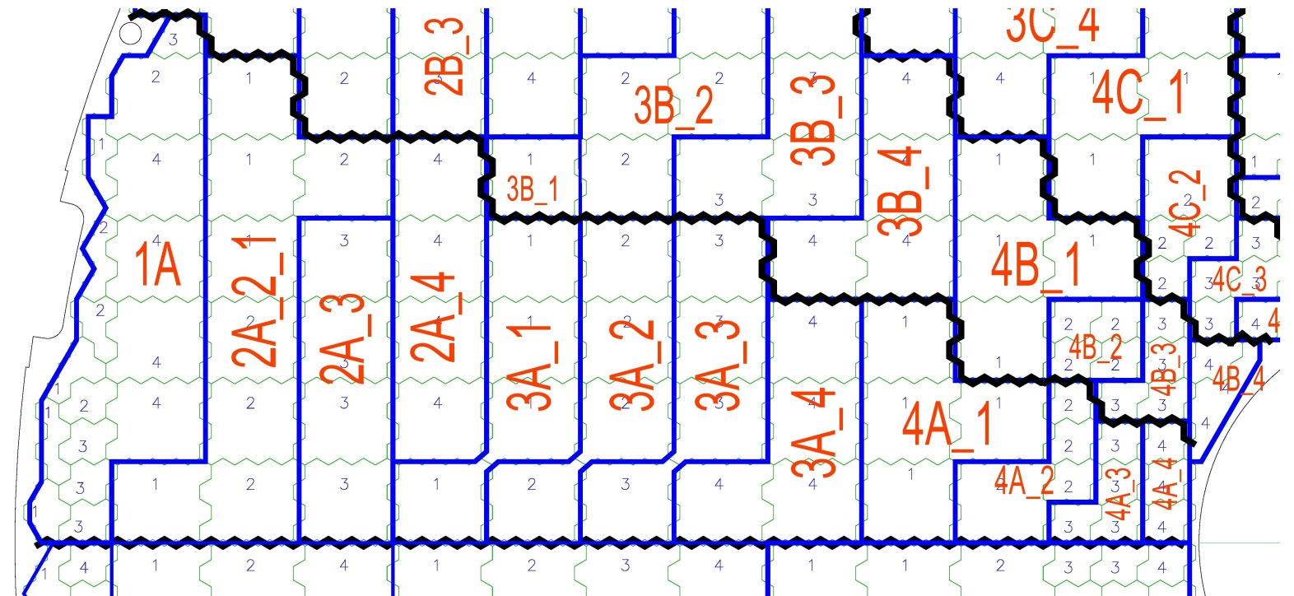
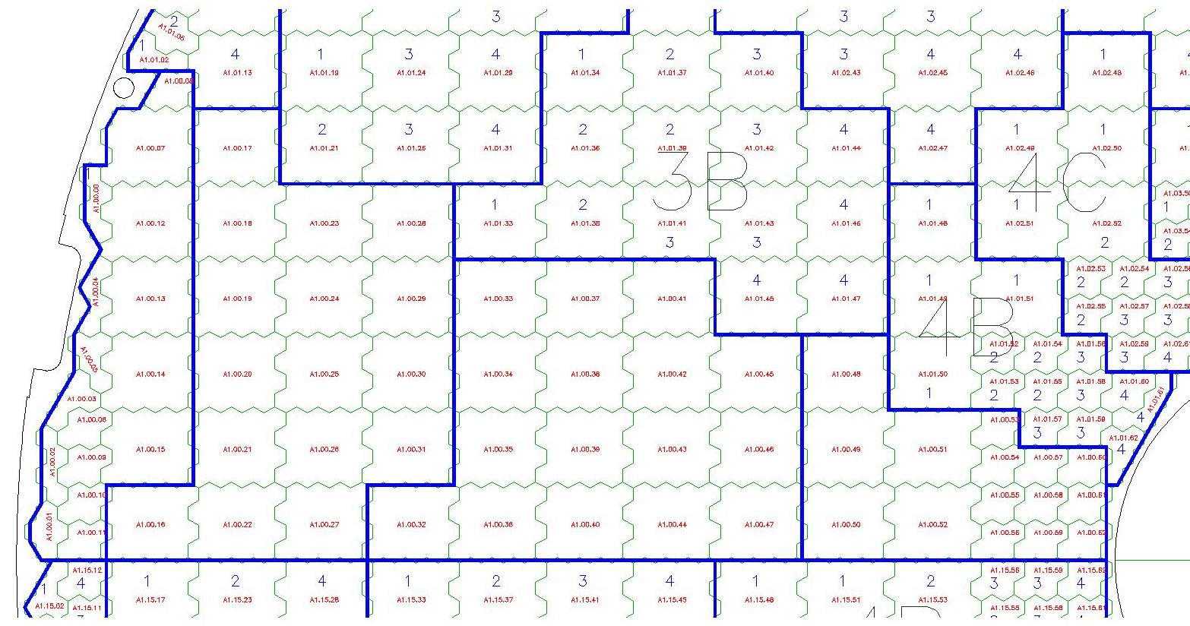
One FCal1 ϕ-slice
Will be 12 trigger towers per ϕ-slice
Now
Proposed
Now just 4 trigger towers per ϕ-slice

Slide 10
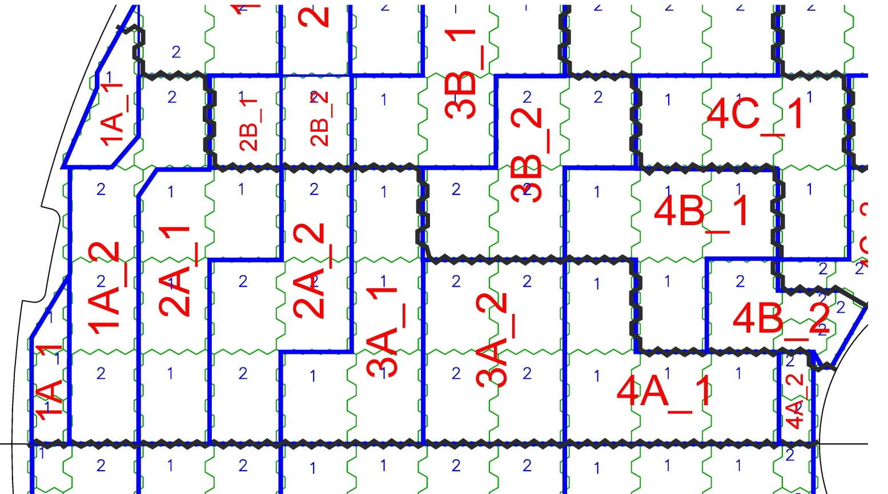
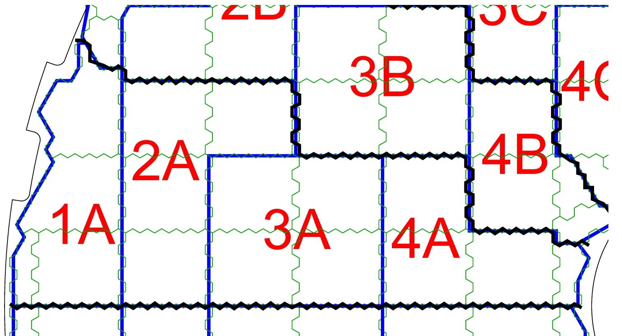
FCal2 ϕ-slice
FCal3 ϕ-slice

Slide 11
FCal front-end is different
Trigger summing
No summing in depth
All LSB inputs are individually weighted by sin(θ) – Of order 10 variation over FCal face
Baseplane
Calibration pulses injected into preamps – distributed on baseplane

Slide 12
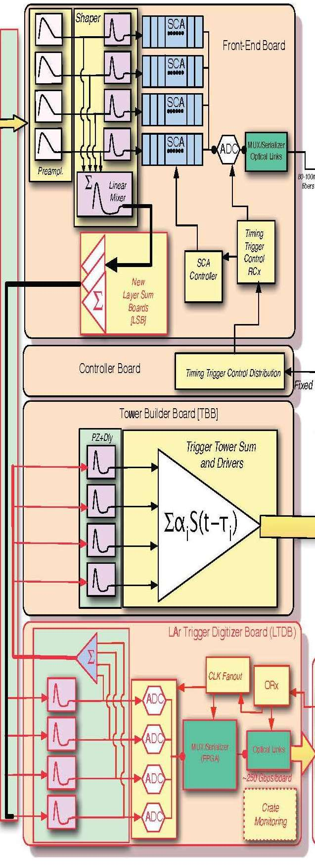
FCal Baseplane
The FCal baseplane passes trigger signals between the LAr electronics boards.
The FCal baseplane also routes calibration pulses to each FCal preamp (will change only because slot assignments will change)
Calib signal distribution will be integrated into the new baseplane
Baseplane

Slide 13
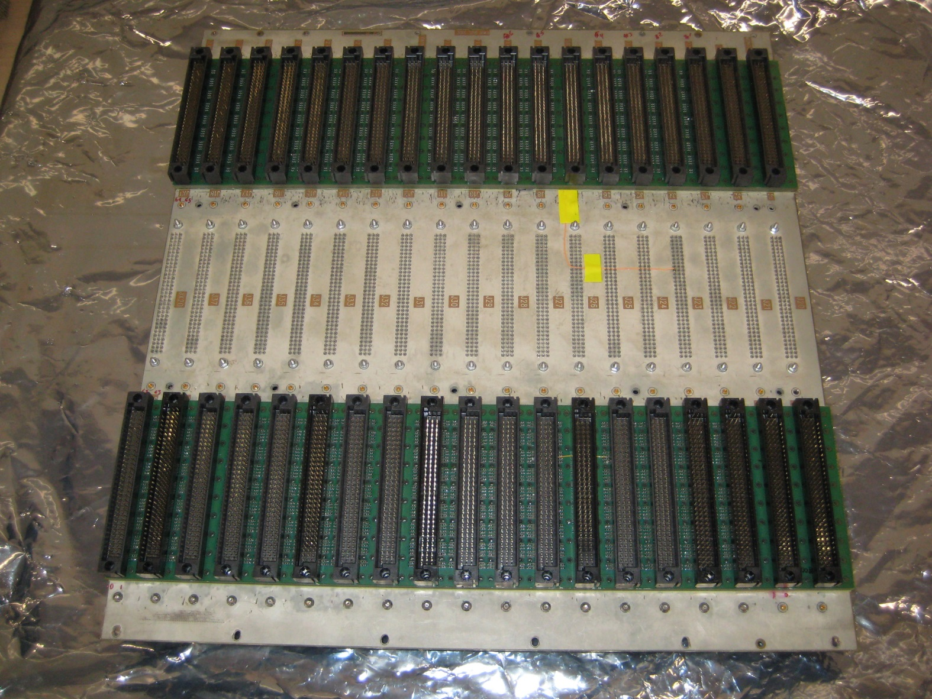
The present FCal Baseplane - Underside

Slide 14
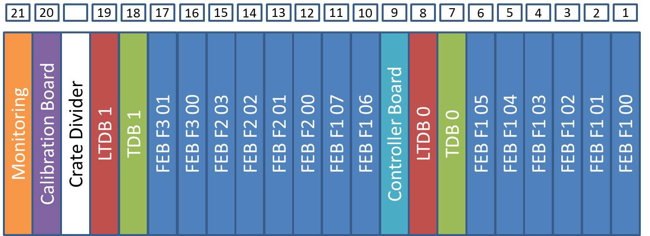
Proposed Slot Assignments
• Calibration board is on opposite side of crate divider.
If the baseplane extends beyond the crate divider, then the other baseplane will have its extension at the other end of the board.
Build two different baseplanes

Slide 15
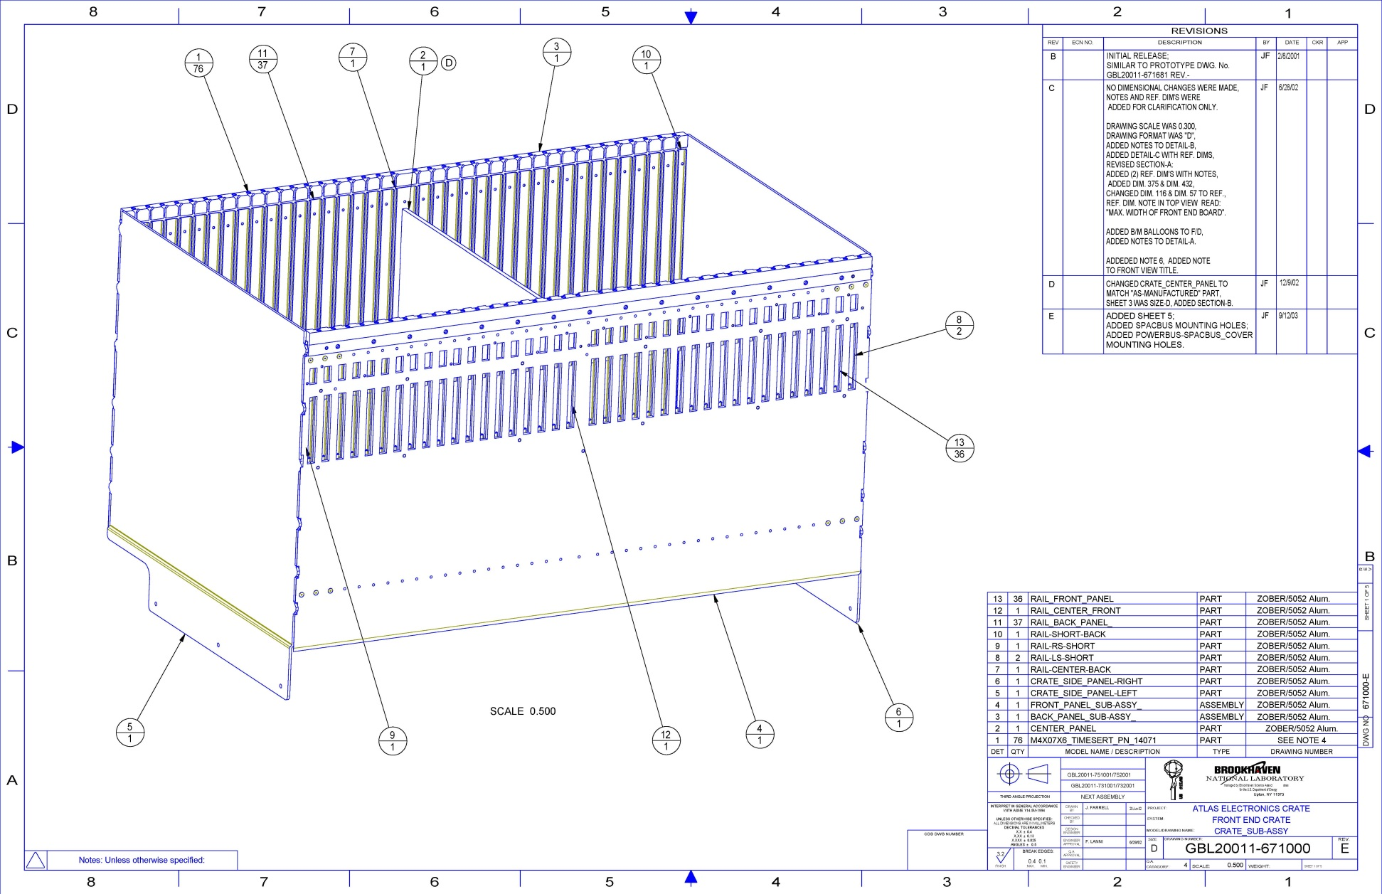
LAr Front-End Crate

Slide 16
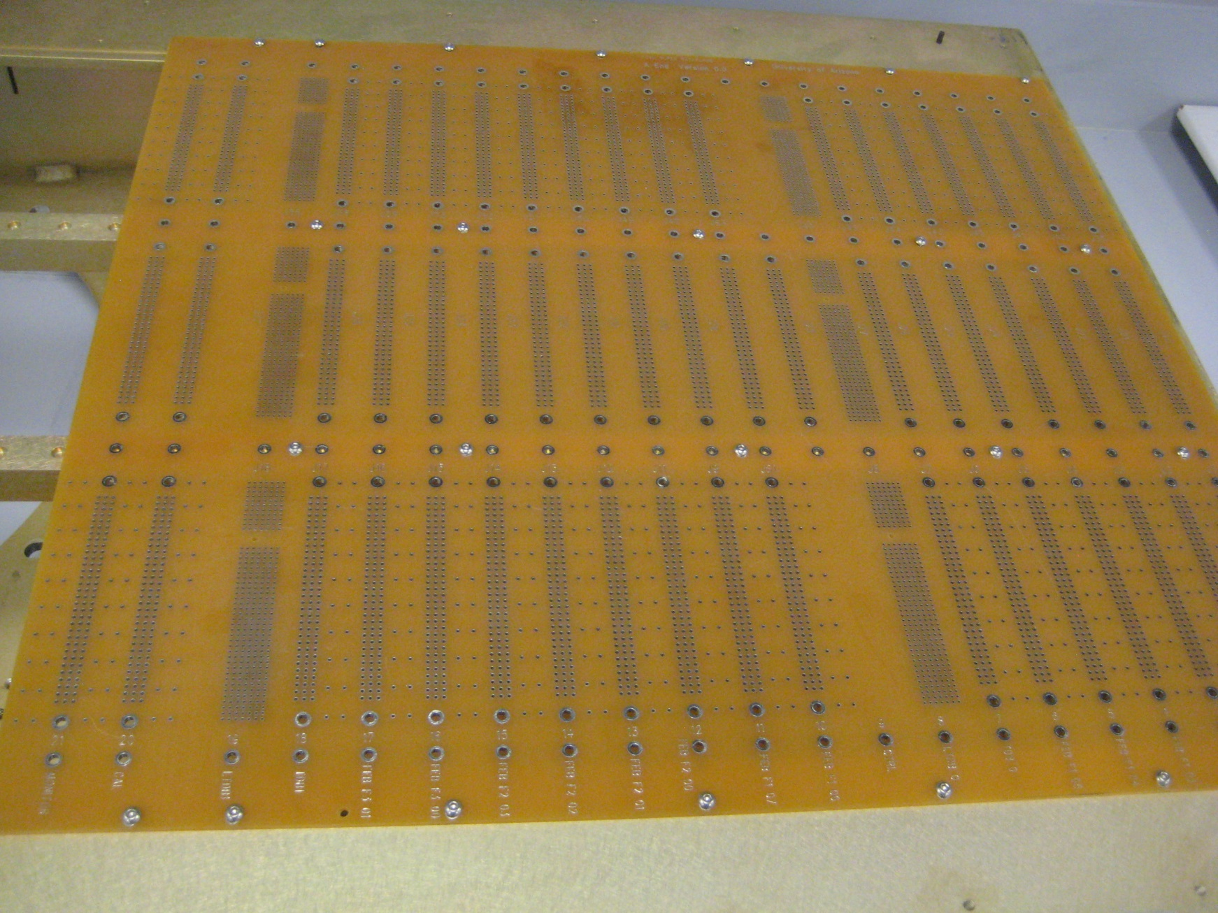
Mechanical Prototype on Pedestal
Note LTDB Connectors

Slide 17
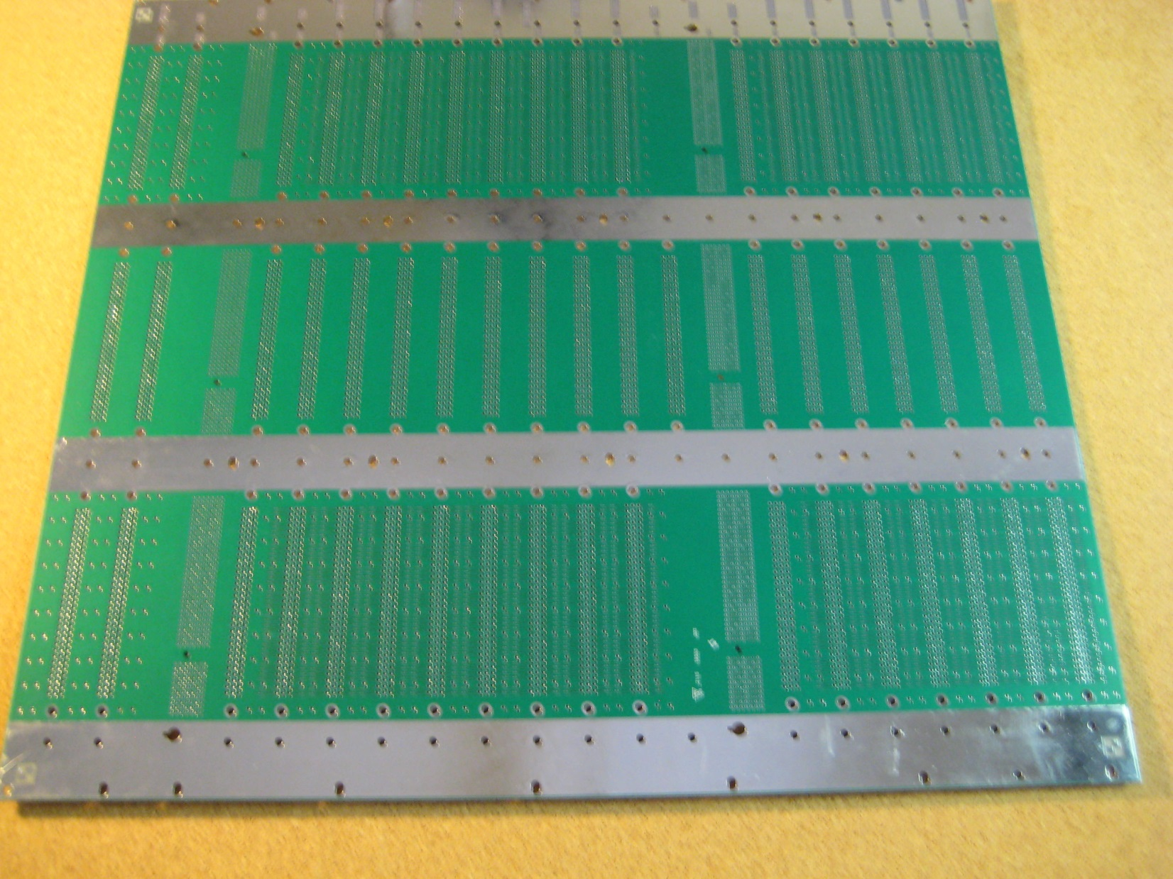
FCal Baseplane - V0 Prototype

Slide 18
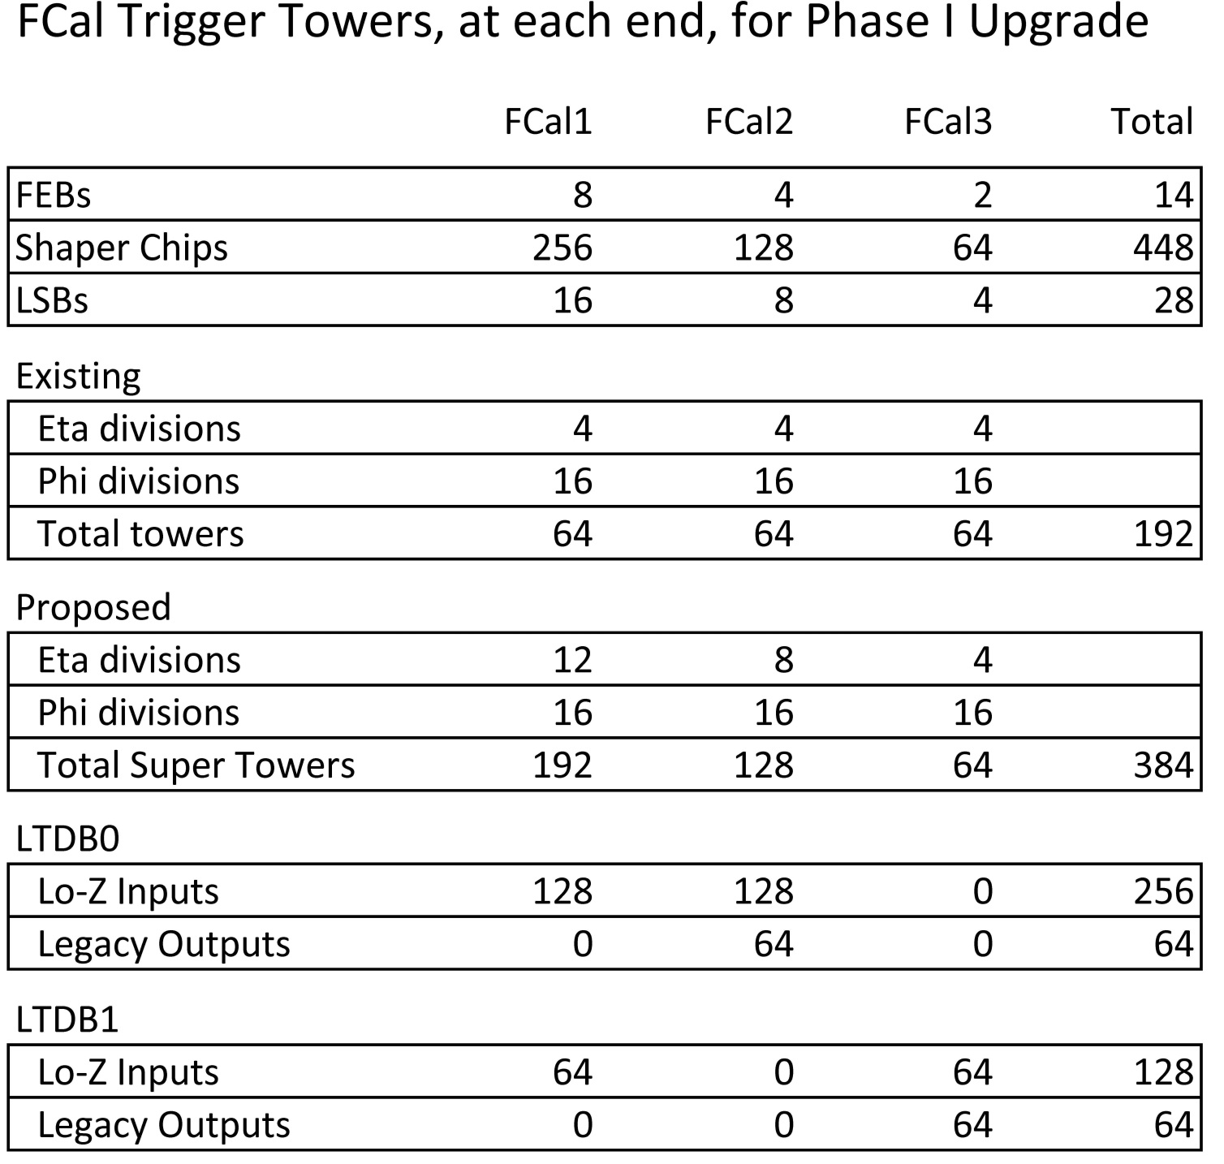

Slide 19
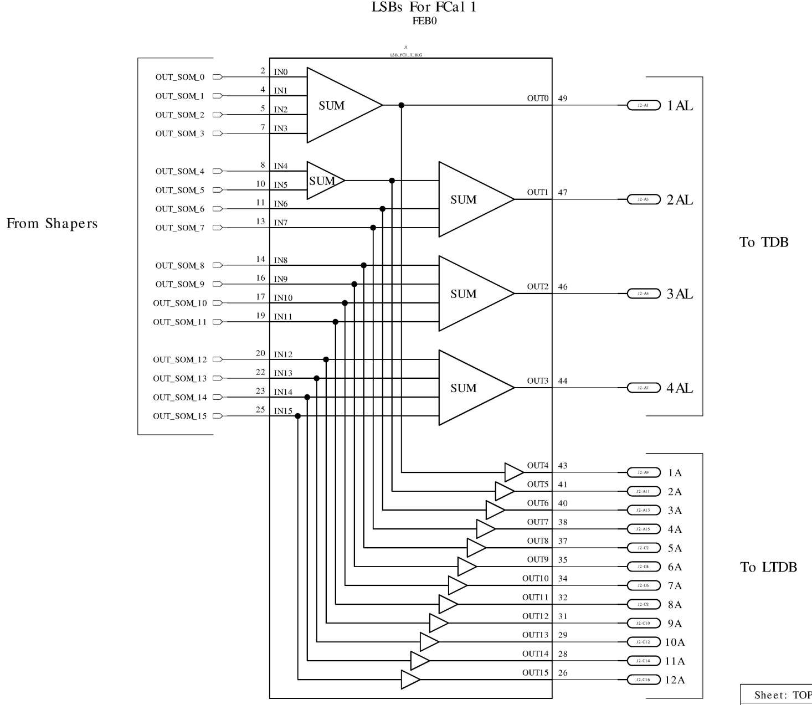
FCal1 LSB Schematic

Slide 20
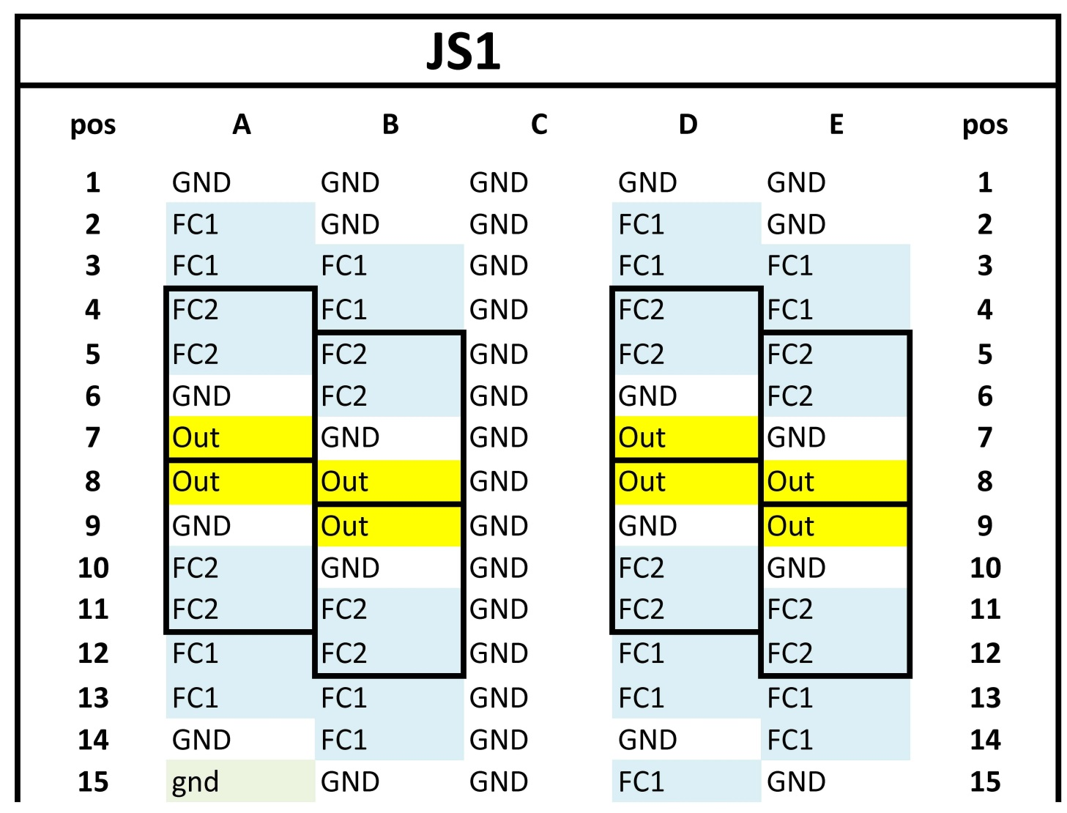
LTDB BasePlane Connector – Same (?) as for EMB
One end of one of three such connectors
“Out” is the legacy sum
64 groups of 4 Lo-Z inputs
on each LTDB
{

Slide 21
Add jumpers to LTDB
Legacy
Sum
Analog
ADC

Slide 22
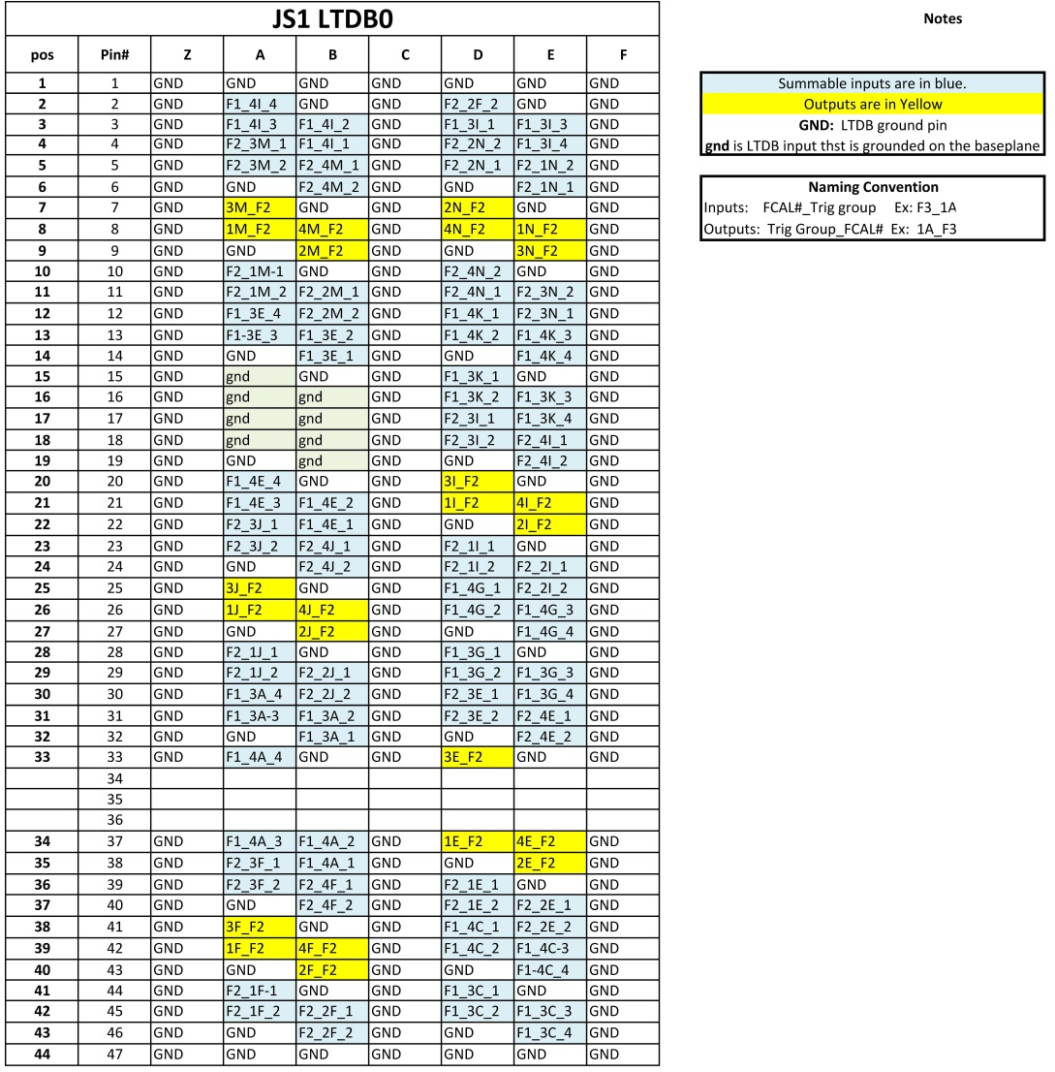
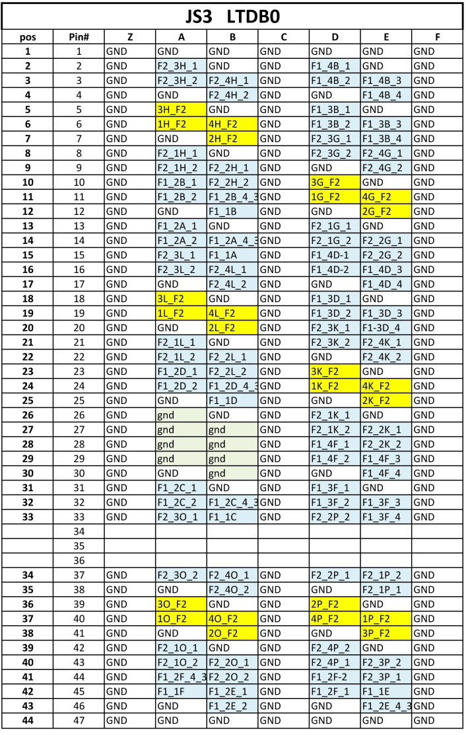
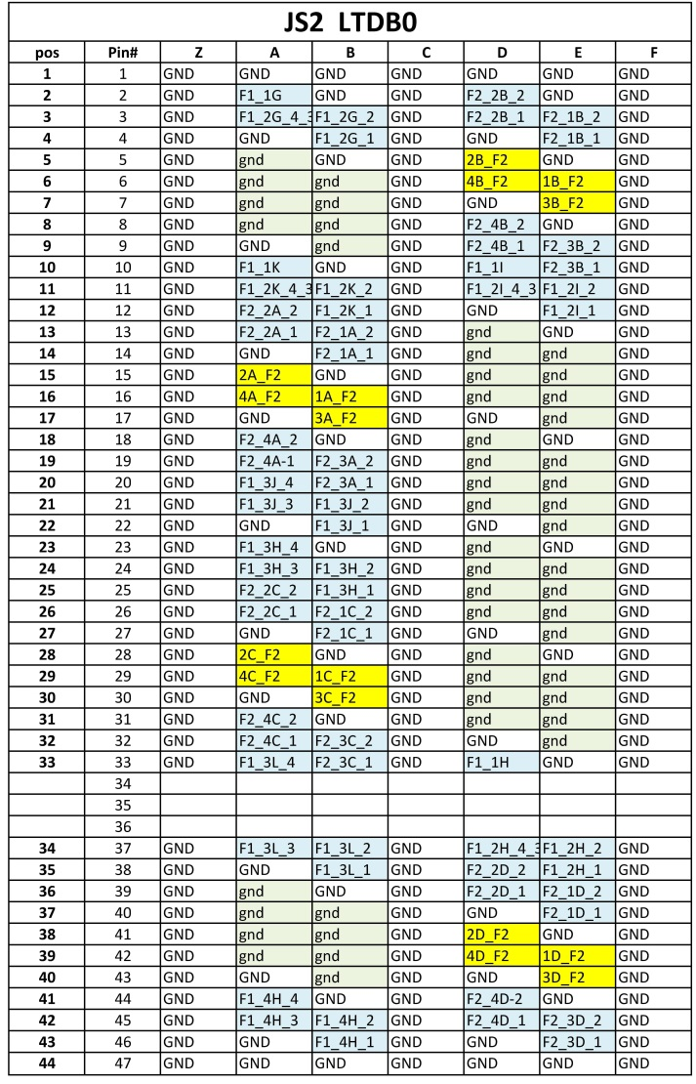
LTDB0 Baseplane Connectors

Slide 23
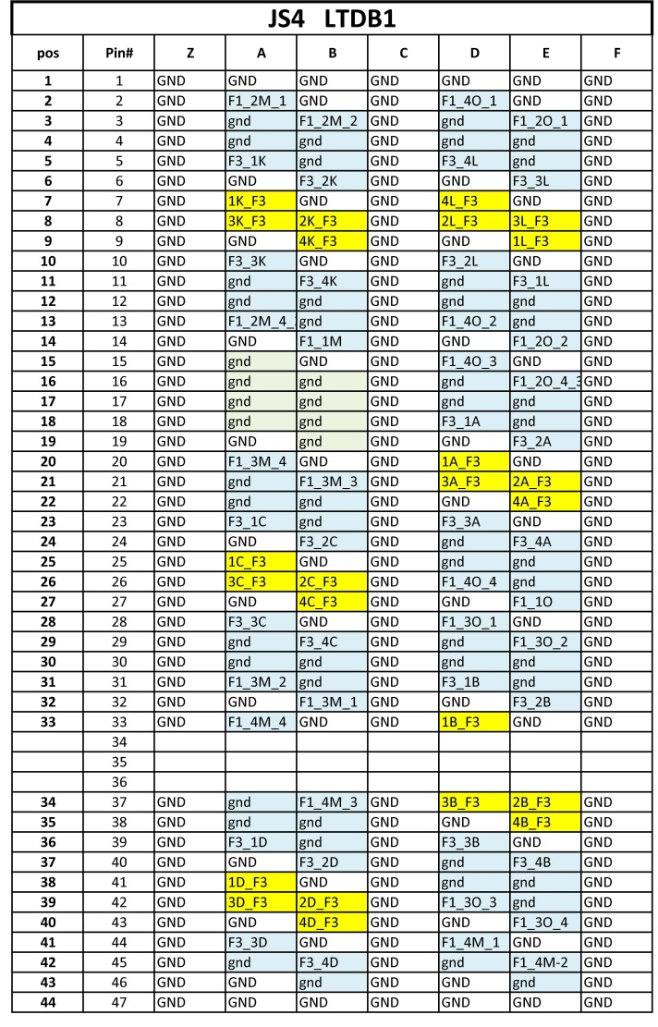
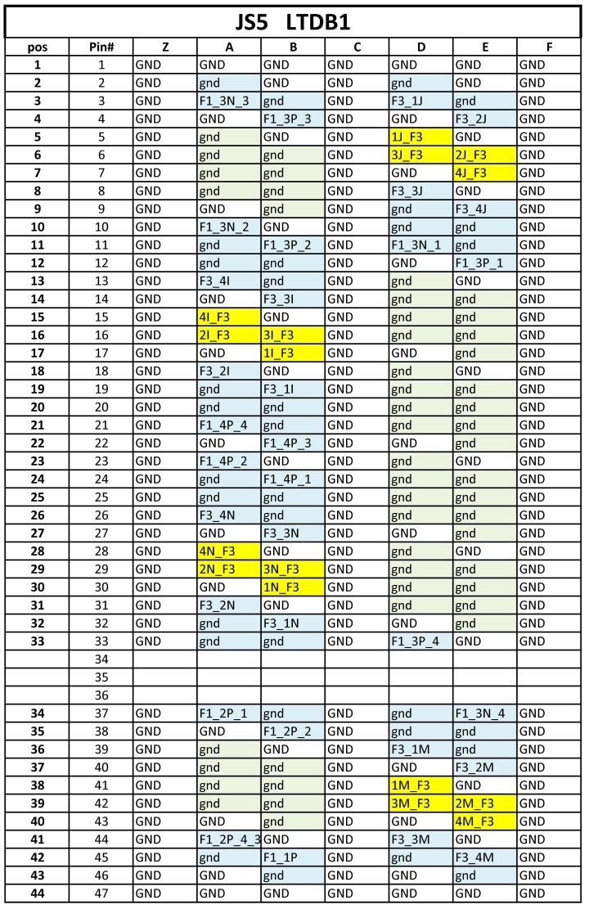
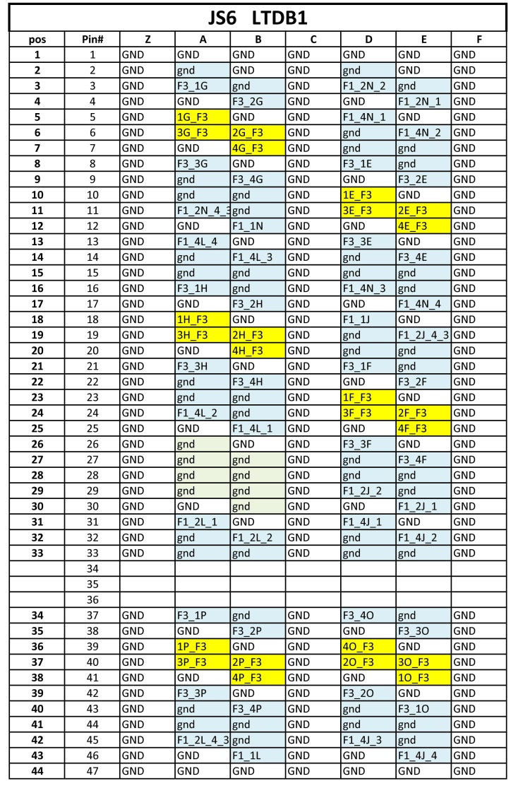
LTDB1 Baseplane Connectors

Slide 24
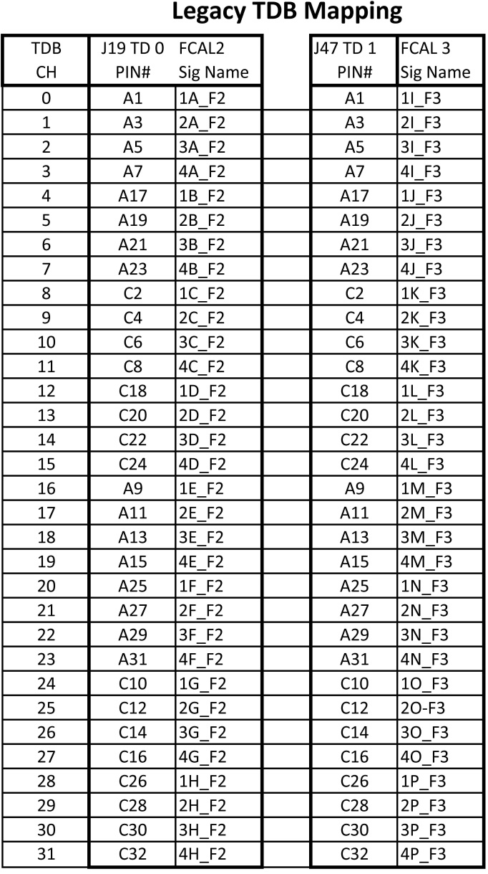
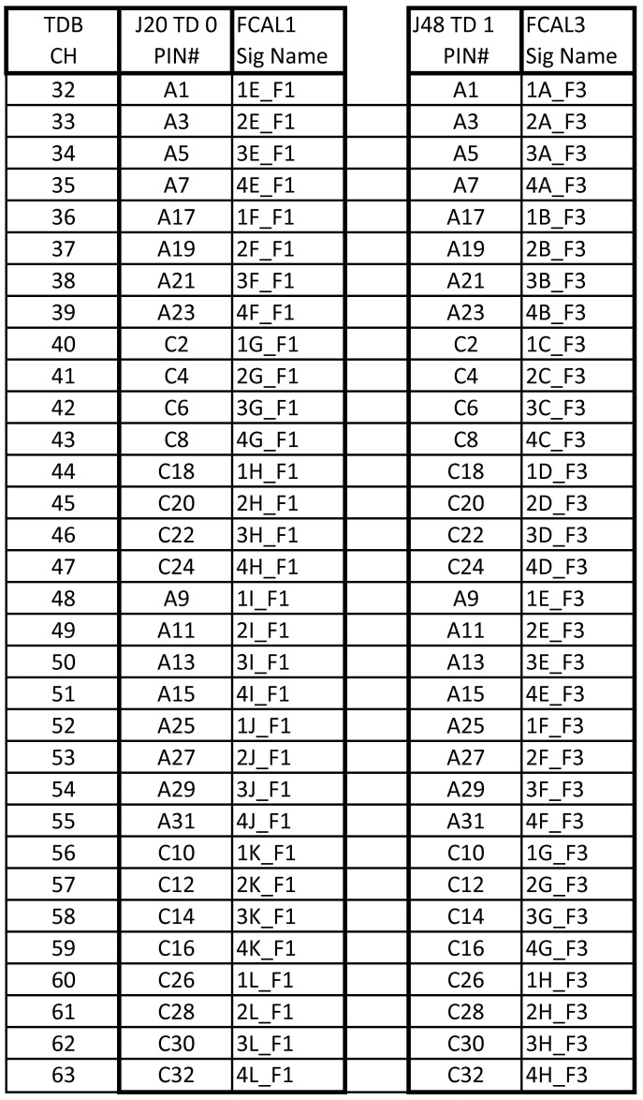
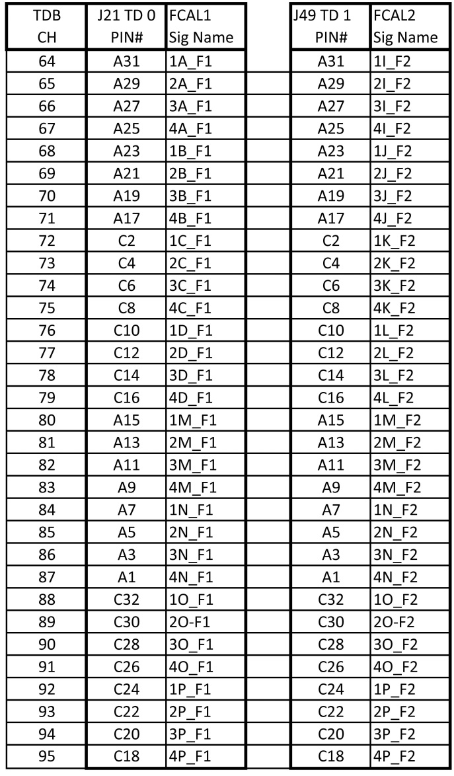
TDB0 & TDB1 Baseplane Connectors

Slide 25
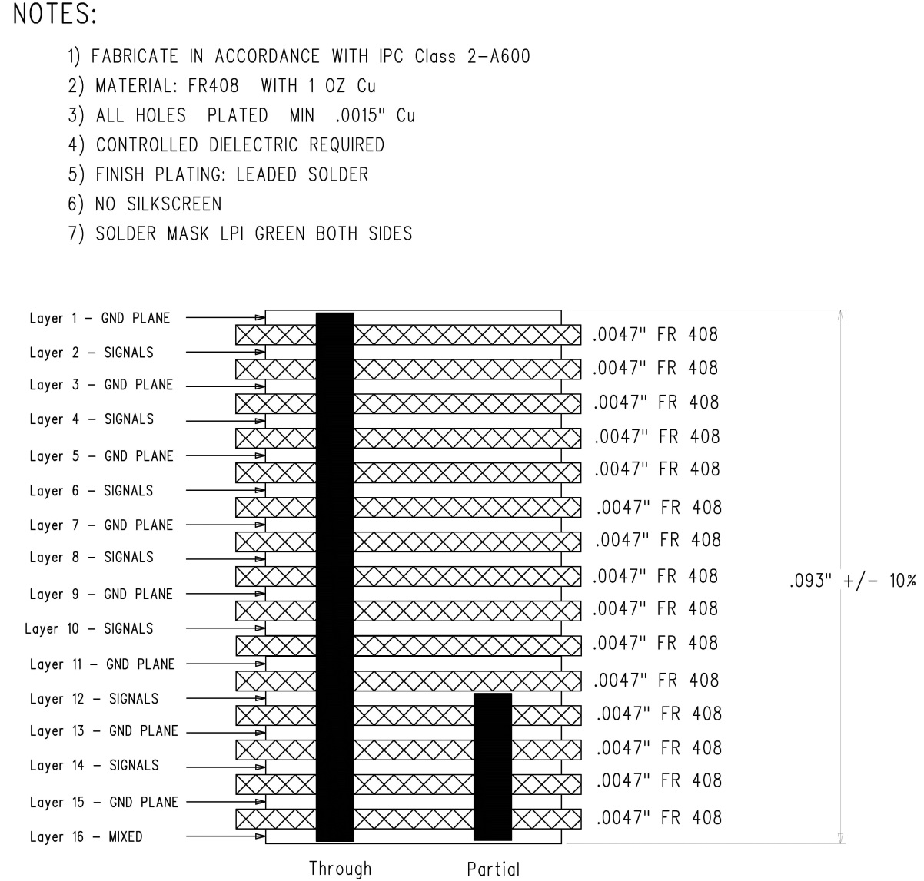
FCal Baseplane Stack-up

Slide 26
FCal Baseplane Layer 4

Slide 27
FCal Baseplane Layer 12

Slide 28
Injection resistor area

Slide 29
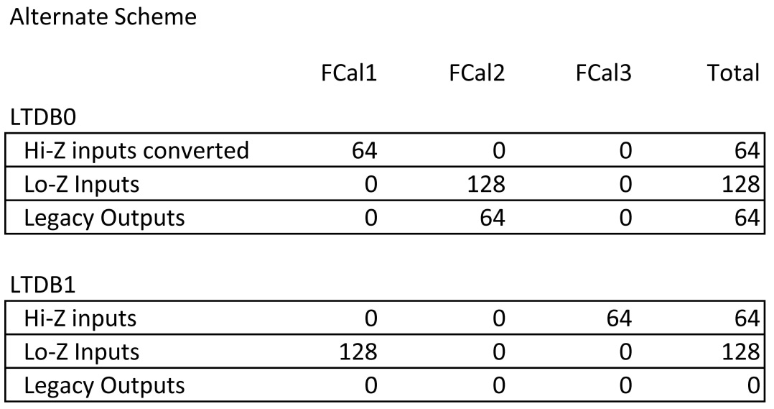
Alternate mapping to LTDBs
In case the L1 Calo requires FCal trigger towers from FCal1 on separate fibers from those from FCal2/3, we have considered an alternate mapping.
Converted to Lo-Z

Slide 30
Present status
Mechanical prototype baseplane produced and tested
V0 baseplane prototype laid out and two boards delivered
Most parts delivered
Still need RF springs – common to all baseplanes

