Slide 1
Calorimeter Transient Analysis for Steady State with ID Heat Leak and mini-FCal Analysis with 88.5°K Coolant in the Cooling Coil
July 25, 2014
Brian Cuerden

Slide 2
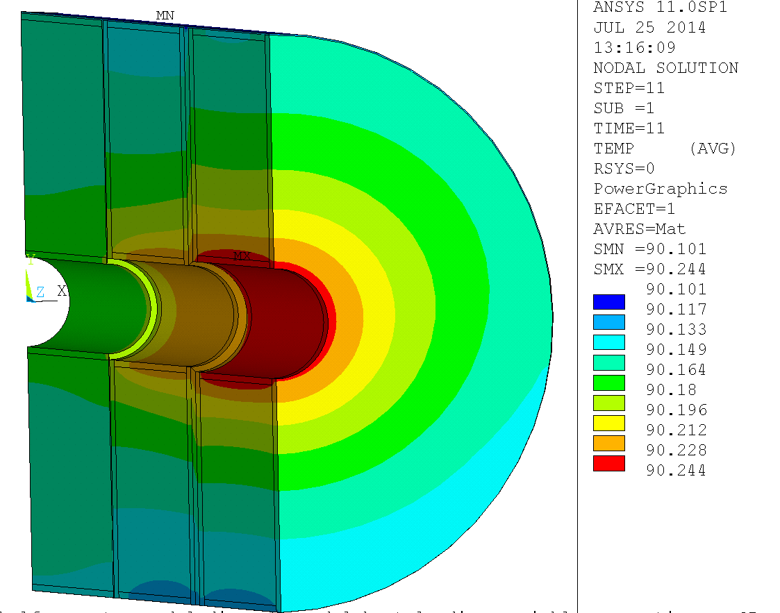
Steady State Temperatures, ID Heat Leak Only
Fcal 1
Fcal 3

Slide 3
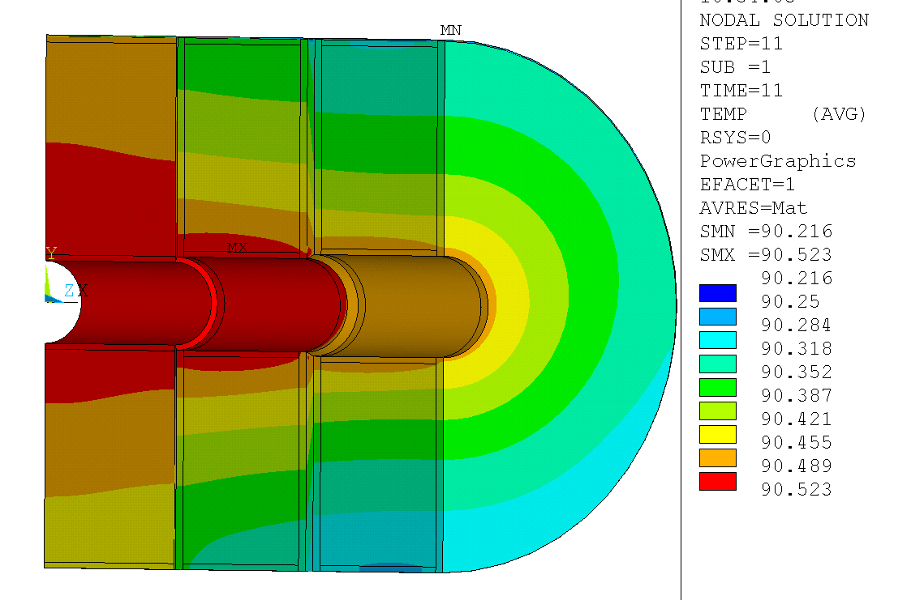
Steady State Results Nominal heat load, 20% Ohmic Heating, 10 W ID heat load
Node 2500 90.271°K
Node 15485 90.484°K
Node 28485 90.442°K
Node 2496 90.449°K
Node 2495 90.454°K
Node 2489 90.483°K
Node 2481 90.499°K
Node 4463 90.499°K
Node 4023 90.492°K
Radial Coordinates:
Node mm
2500 452.3
2496 440.0
2495 380.8
2489 161.1
2481 70.0
Nodes 4463 and 4023 are at thermocouple locations/ max temp locations
Node 15485 is in Fcal2 and 28485 in Fcal3 near the ID
The plotted Temps are steady state, Listed values are at 600,000 seconds

Slide 4
Nominal Heat Loads, Full Calorimeter (not half)
FEM loads are taken from FEA results
Integrated heat loads are the specified heat loads integrated over the volume specified.
ID heat leak is an additional 13.69 W

Slide 5
Temperature Change After Normal Beam Power is Applied

Slide 6
Temperature Change after a step application of nominal power
T4023 and T4463 are at temperature sensor locations in Fcal1
T15485 is in FCal2 near the ID
T28485 is in Fcal3 near the ID

Slide 7
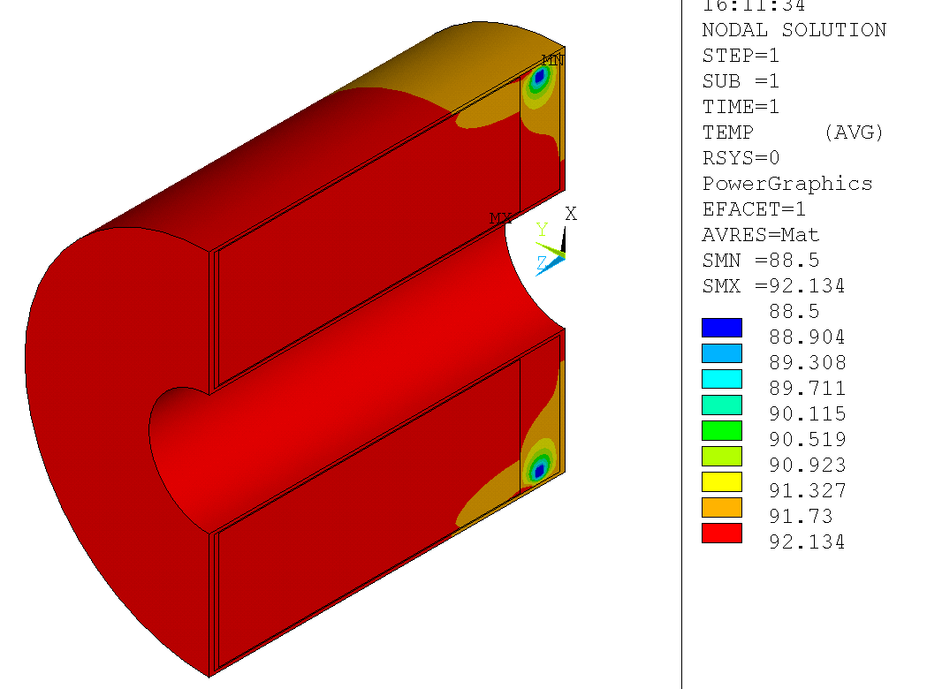
Mini-F-Cal Temperatures at 7.5x nominal power with 24 6x44mm straps to the LN₂ tube
Max Temp is 92.1°K
LN₂ tube is 88.5°K
Max Temp at nominal power is 89.0°K

Slide 8
Mini-F-Cal Performance with Fewer/Smaller Straps=

