Slide 1
Test Bed Cases Attempting to Duplicate Test Results
December 12, 2014

Slide 2
Summary
Enhanced cooling at the 12 mm argon layer can’t explain more than an 0.5°K drop in temperature but the heater layer drops 0.75°K
The aluminum plate side of the argon layer is +0.54°K relative to the bulk argon so it can only drop by this amount and nothing can drop by more than this as a result.
Increased cooling of the 3 mm copper plate could result in large, rapid temperature drops at the heaters.
Nucleate boiling has high enough convection
The test result indicates some sort of triggering event that results in increased heat removal.
Superheated argon and nucleate boiling?
Argon gas rising up the back of the copper plate after boiling off at the lower edge? (but I think the back of the copper plate is bonded to the G10 insulating plate).

Slide 3
Heat to State Just Before Sudden Change Under Test

Slide 4
Continuation of test with unchanged boundary conditions
Temperatures continue to rise slowly, they are asymptotically approaching steady state.

Slide 5
Continuation of test, Argon layer transitions to turbulent heat transfer
The conduction across the argon gap is doubled for turbulent heat transfer.
The heater layer drops ~0.06°K in 0.17 hours
In the test the heater layer dropped 0.8°K in ~0.01 hours

Slide 6
Continuation of test, Nucleate Boiling on the aluminum face at the Argon layer
The conduction across the argon gap is increased ten fold to represent nucleate boiling.
The surface of the aluminum plate cools ~0.23°K in ~0.02 hours.
Even if the argon gap conduction was infinite the heater layer temperature would not drop much more.
The heater layer drops 0.125°K in 0.17 hours
In the test the heater layer dropped 0.8°K in ~0.01 hours

Slide 7
Continuation of test, Nucleate Boiling on the vertical edges of the copper plate
The vertical edge of the 3mm copper plate is given a convection coefficient of 10,000 W/m2-°K (see next slide)
The copper plate seems to be cooling more slowly than the test.
Is this plate exposed to Argon on its backside?
The heater layer drops 0.9°K in ~0.1 hours
In the test the heater layer dropped 0.8°K in ~0.01 hours
The heaters were turned off at 0.13 hours in this run.

Slide 8
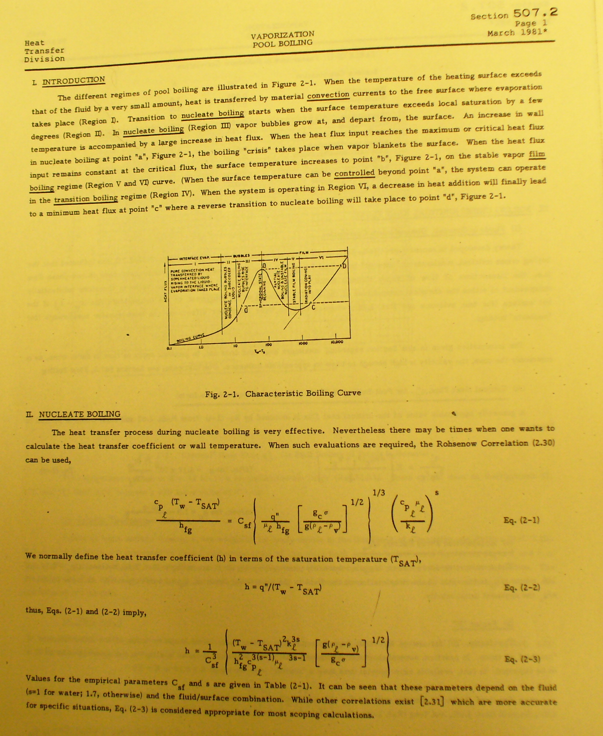
Nucleate Boiling
The smaller values of Csf (0.003) give
h=10,000 W/m²-°K for a 1°K differential and could explain the test results if applied to the vertical edges of the copper plate.
Note that the sudden offset and subsequent cooling seem to require that the Argon be superheated and for nucleate boiling to continue once triggered.

Slide 9
Nucleate Boiling Calculation

