Slide 1
Calorimeter Analysis Tasks
Brian Cuerden
10 July 2014

Slide 2
Calorimeter Time Constant Check
A simple model consisting of a mass with associated convective area was used for a time constant check. The mass and the convective surface are at the same temperature which increases over time due to applied heat. Model parameters are listed below.

Slide 3
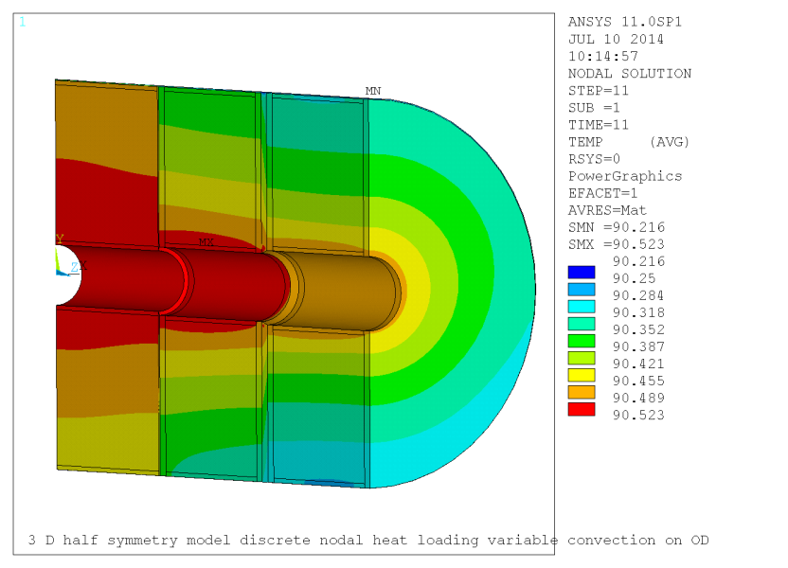
Simple model compared to calorimeter results
Steady state results are shown above. High temperatures occur in a fraction of the total volume in the heated region and away from the cooled region.
Simple model results are representative of the lower temperature nodes that were selected for the response plot. The gradients (in the detailed model) developed in 40,000 seconds after which the mass heated at a uniform rate. The time constant for gradient development (time to 63.2% of the steady state value) is 15,300 sec or 4.25 hrs.

Slide 4
Simple Model with Various Shell Convection Coefficients
The time constant of the simple model response is taken to be the time for 63.2% of the mass temperature change.
at 50% of the nominal convective coefficient the time constant is 9.86 hours
at 100% of the nominal convective coefficient the time constant is 4.58 hours
at 200% of the nominal convective coefficient the time constant is 2.50 hours

Slide 5
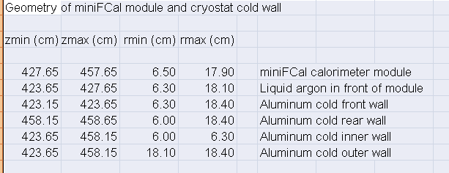
Length of Mini-F-Cal
The mini-F-Cal model was based on the “dimensions” tab of the Excel file “Heatmini.xlsx” as shown below.
The specified and modeled length of the calorimeter is 30 cm as was intended.

Slide 6
Test Bed External Boundary Conditions
Initially the six sides of the test bed box were constrained to be at 90°K
Based on the gap convection results, external convection could be as low as 49 W/m²-°K
Free convection in the 12 mm gap on the 900 mm diameter calorimeter was 38 W/m²-°K for an 0.5°K differential and 49 W/m²-°K for a 2°K differential
On the 144 mm diameter ID with a gap of 14 mm convection was calculated to be 40 W/m²-°K for an 0.15°K differential
Because the fluid is less constrained around the test bed as compared to the gap cases, the free convection coefficient is expected to be larger than the above cited gap values and 49 W/m²-°K is taken as a minimum value.
Conduction through the G10 on five sides is equivalent to 20 W/m²-°K (20 to 23.4 mm of G10). Adding convection to this gives 14 W/m²-°K or ~70% of the conduction expected if convection to the Argon pool is high.
Conduction through the copper matrix is high so the addition of convection to the Argon pool makes a large difference.
It is concluded that external convection cannot be neglected. Additional cases with external convection of 49 W/m²-°K and 98 W/m²-°K have been added to these results.

Slide 7
Summary of Test Bed Analysis Results
The conduction across the argon layer will be determined by measuring the heat flux through the G10 layer and the temperature drop across the argon layer.
Heat flux and temperature drop will be measured near the centerline.
Time required for stability:
The heat flux through the G10 will be calculated from the gradient through the G10. The ratio of the G10 and argon gradients is stable after 0.4 hours for both nominal (low) and high external convection cases.

Slide 8
Temperature of the Argon Layer
The argon layer temperature and the copper matrix temperature are sensitive to the external convection coefficient.
It should be possible to determine the external convection coefficient from the test data.
Boiling in the argon layer must be avoided.
If the external convection coefficient is low the argon layer temperature will be higher and boiling may occur. This will increase the heat transfer rate since nucleate boiling is a particularly effective heat transfer mechanism.

Slide 9
Mini-F-Cal with Conductive Bars
Contact conductance between the bar and the 12 mm OD pipe is estimated to be larger than or equal to an argon film 0.1 mm thick
Q/ΔT = 2.2 W/°K
Argon conductivity is 0.1315E-3 W/mm/K
Area in contact is 12π*44 mm²
Path length is 0.1 mm
For reference the conduction from the matrix to the tube through the 3x44mm strap is 12.4 W/°K
Copper conductivity is 0.542
Area is 3x44=132 mm²
Path length is ~ 30 mm (20 mm to the tube and ¼ the distance around the tube
Contact resistance is modeled by decreasing the conductivity of part of the copper bar near the “tube”. The tube is a region constrained to 77°K

Slide 10
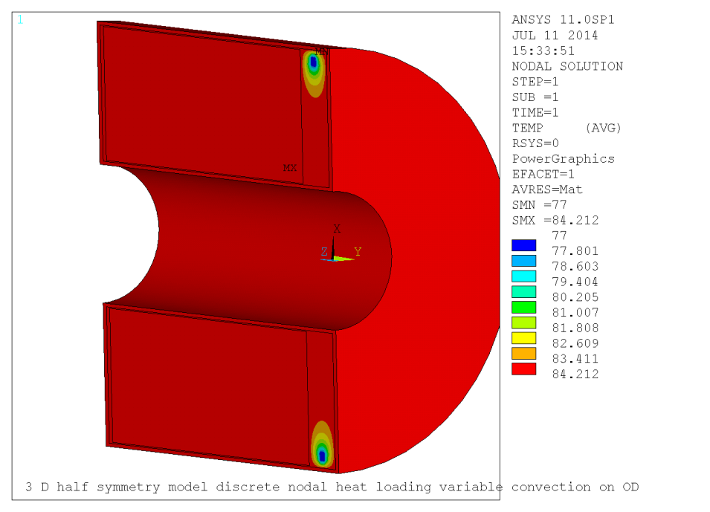
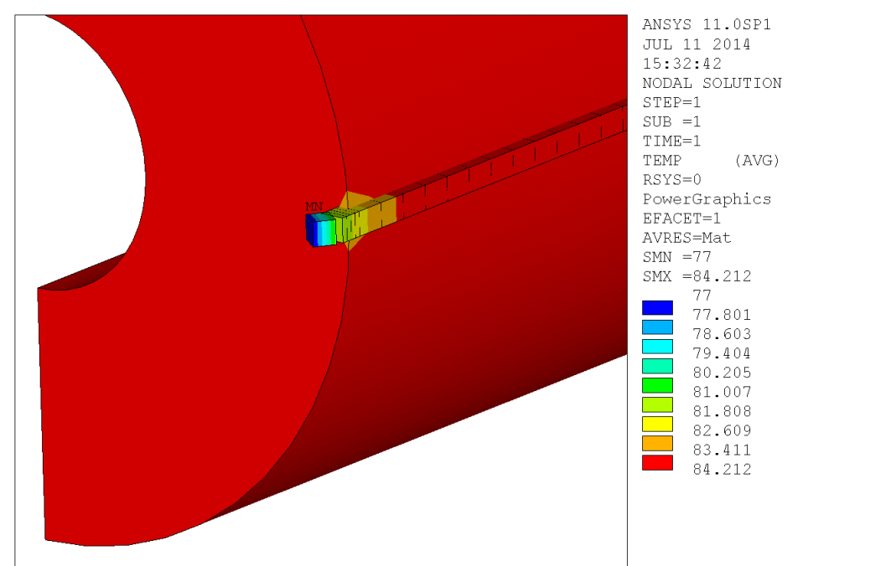
Nominal Power Level, Cooled only by the LN2 loop
Most of the collimator is near 84 K. The bar could be shortened since most of its length is at the same temperature as the copper matrix.
The only cooling here is from the LN₂ loop.

Slide 11
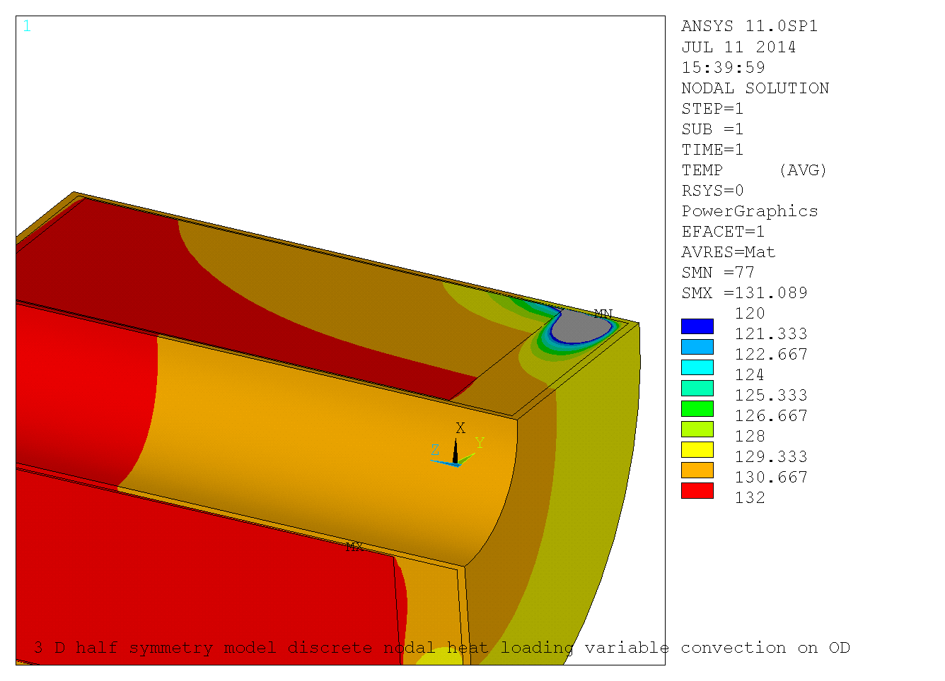
Operation at 7.5 times Power
The LN₂ loop is still at 77°K but 7.5 times the power is applied resulting in a peak temperature of 132 K. Again the only cooling is from the LN₂ loop.

Slide 12
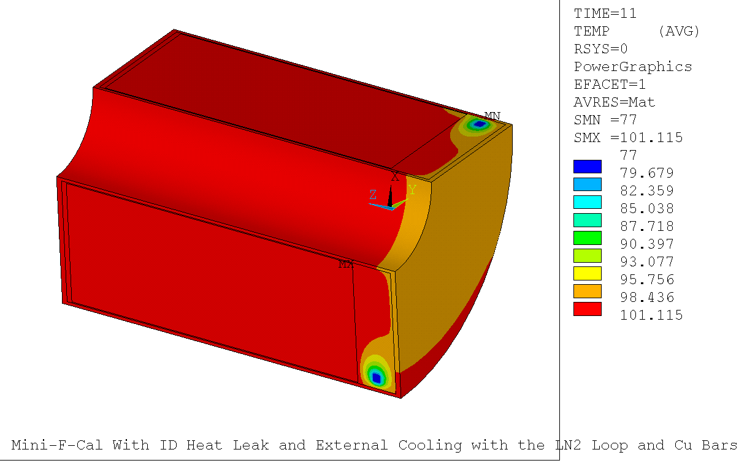
Operation at 7.5xPower with LN2 Loop Cooling and External Wall Cooling by 90°K Argon
Peak temp is 101°K

Slide 13
Backup Slides
Test bed results with various outer surface convection coefficients

Slide 14
Thermal Result for an 0.5°K Gradient Across the 12 mm Argon Layer, Net Conductance of the Argon is 3.8 Times the Conductivity of Argon
Total heat input = 6.75 W
Heat into 8 mm Al plate = 1.82 W
Heat into 12 mm Argon layer = 1.77 W (21.9 W/m²)
Heat out of Argon Layer = 1.67 W
Radial loss from Al and Argon 0.14 W
Heat lost through base = 4.84 W
Outer surfaces fixed at 90°K (very high convection coefficient)
72% of the input heat is lost through the base. Most of the rest passes through the Argon

Slide 15
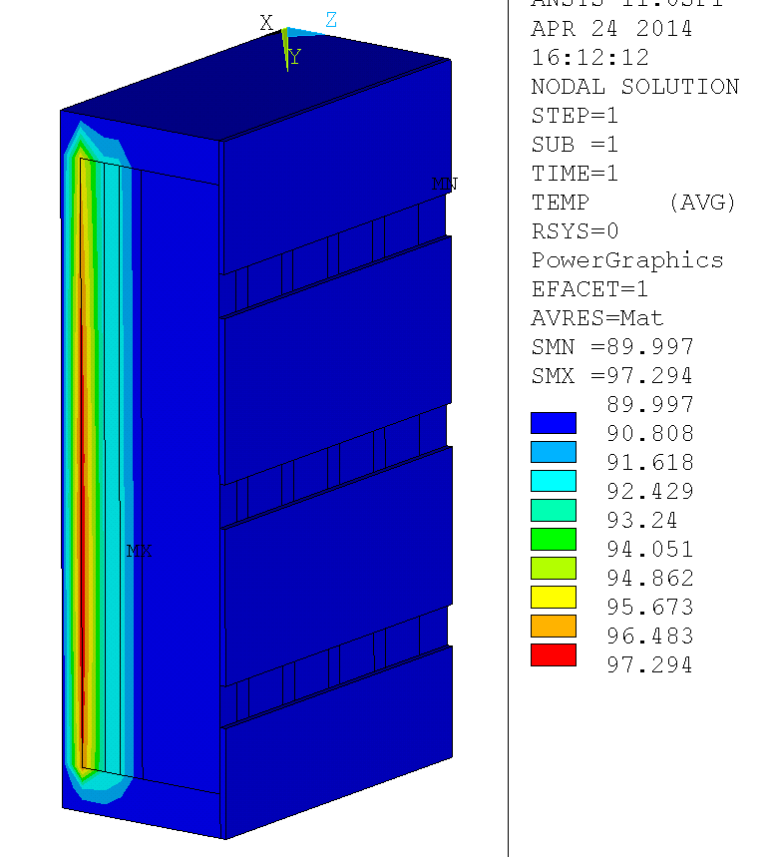
Thermal Result for a 2°K Gradient Across the 12 mm Argon Layer, Net Conductance of the Argon is 4.8 Times the Conductivity of Argon
Total heat input = 31.18 W
Heat into 8 mm Al plate = 8.78 W
Heat into 12 mm Argon layer = 8.62 W (107 W/m²)
Heat out of Argon Layer = 8.26 W
Radial loss from Al and Argon 0.49 W
Heat lost through base = 22.04 W
Outer surfaces fixed at 90°K (very high convection coefficient)
70% of the input heat is lost through the base. Most of the rest passes through the Argon

Slide 16
Thermal Result for an 0.5°K Gradient Across the 12 mm Argon Layer, Net Conductance of the Argon is 3.8 Times the Conductivity of Argon
Total heat input = 6.05 W
Heat into 8 mm Al plate = 2.00 W
Heat into 12 mm Argon layer = 1.90 W (23.6 W/m²)
Heat out of Argon Layer = 1.72 W
Radial loss from Al and Argon 0.32 W
Heat lost through base = 4.05 W
Outer surface convection to 90K is 49 W/m²-°K (nominal convection coefficient)
67% of the input heat is lost through the base. Most of the rest passes through the Argon

Slide 17
Thermal Result for a 2°K Gradient Across the 12 mm Argon Layer, Net Conductance of the Argon is 4.8 Times the Conductivity of Argon
Total heat input = 28.62 W
Heat into 8 mm Al plate = 9.72 W
Heat into 12 mm Argon layer = 9.35 W (116 W/m²)
Heat out of Argon Layer = 8.53 W
Radial loss from Al and Argon 1.41 W
Heat lost through base = 18.90 W
Outer surface convection to 90K is 49 W/m²-°K (nominal convection coefficient)
66% of the input heat is lost through the base. Most of the rest passes through the Argon

Slide 18
A tabular summary of test bed results with various external convection values and with 0.5 and 2°K gradients in the Argon layer
Reduced external convection results in a significant increase in the copper matrix and Argon layer) temperatures.
Reduced external convection changes the ratio of Argon layer to G10 layer heat flux from 81-84% for high coupling to 74-76% for low coupling efficiency.

Slide 19
Temperature Drop Across the Argon Layer

