Slide 1
Calorimeter Transient Analysis
April 25, 2014

Slide 2
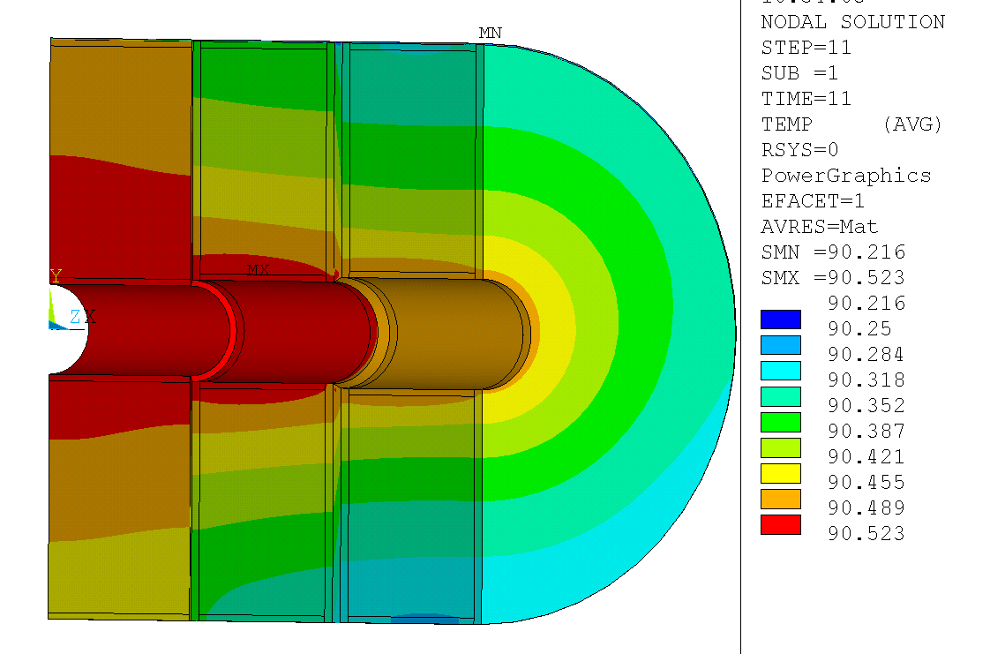
Steady State Results Nominal heat load, 20% Ohmic Heating, 10 W ID heat load
Node 2500 90.296°K
Node 2496 90.473°K
Node 2495 90.478°K
Node 2489 90.506°K
Node 2481 90.522°K
Radial Coordinates:
Node mm
2500 452.3
2496 440.0
2495 380.8
2489 161.1
2481 70.0

Slide 3
Calorimeter Transient Response
°K
240,000 seconds
(2.8 days)
Seconds (note 100x factor)

Slide 4
Calorimeter Transient Response
The first 100,000 seconds (27.8 hours) see Excel file for data points

Slide 5
Calorimeter Transient Response with Gridlines

