Slide 1
Atlas Calorimeter with LN₂ Cooling Loops
January 6, 2015

Slide 2
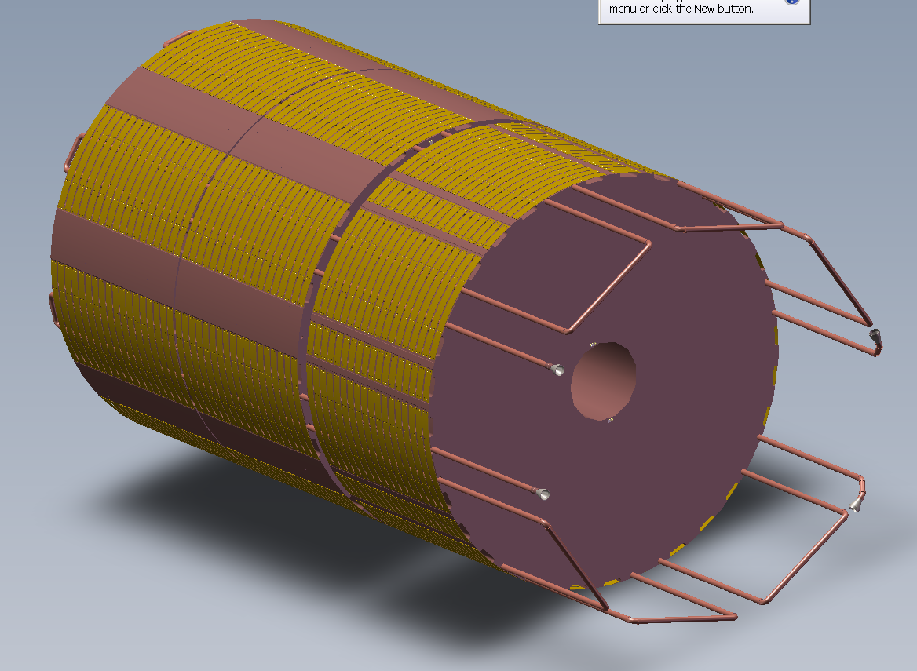
10mm ID, 12mm OD tubes added to calorimeter

Slide 3
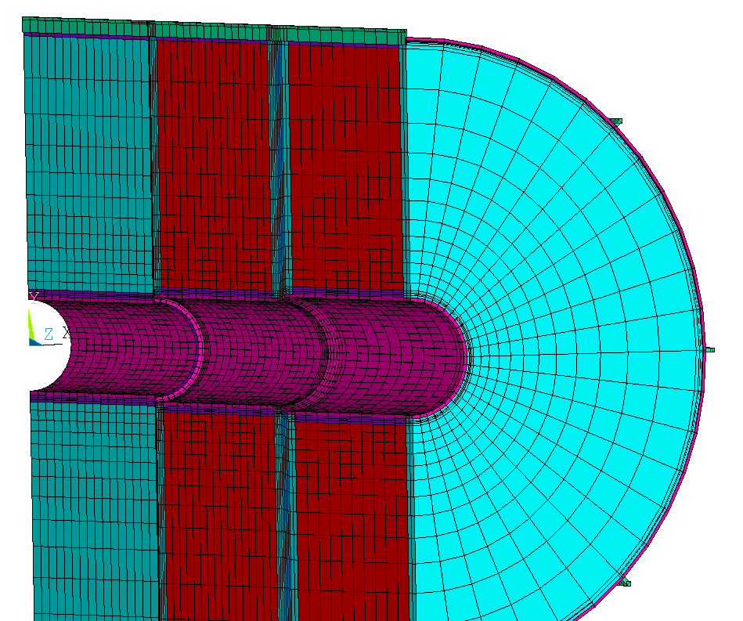
Finite Element Model of Calorimeter with LN₂ Cooling Loops
Conductive bar representing the tube
Conductive plate with a resistance matching 0.25 mm of Argon
The conductive plate is 20 mm wide and 5.28 mm thick (plates on the symmetry plane are half as thick). The material conductivity used is 0.01 W/mm-K giving a conductivity across the width of 0.0026 W/mm-K. This matches the conductivity of a 20 mm wide, 1 mm thick Argon layer.
The plate thicknesses are increased by four to represent the ¼ mm Argon layer cases.

Slide 4
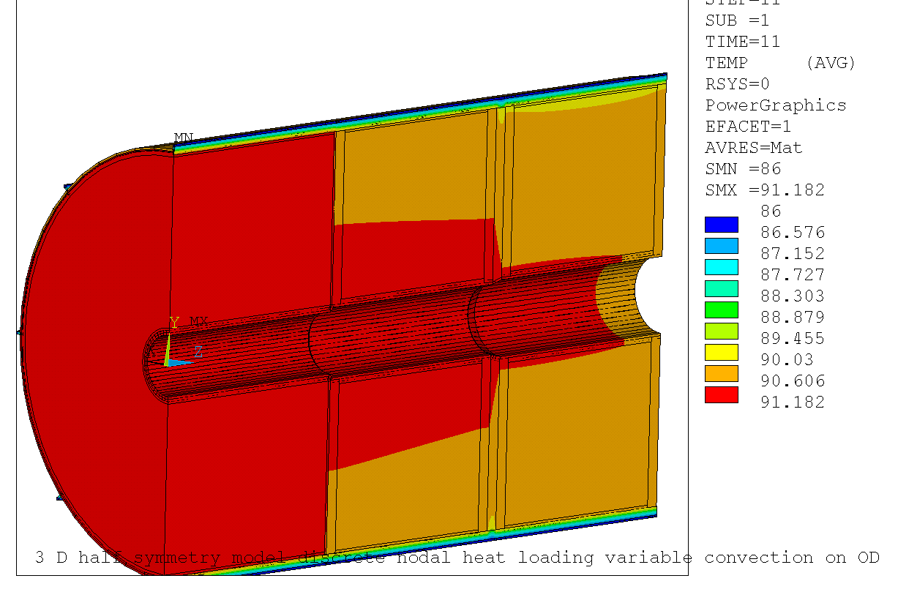
Steady State Temperatures 6x Power with 1 mm Argon Layer around the cooling tubes
The peak temperature here is 0.93°K less than was obtained without the cooling loop. There is a 4.9°K temperature drop across the 1 mm Argon layer around the cooling tubes indicating that these tubes need to be in good contact with the matrix.

Slide 5
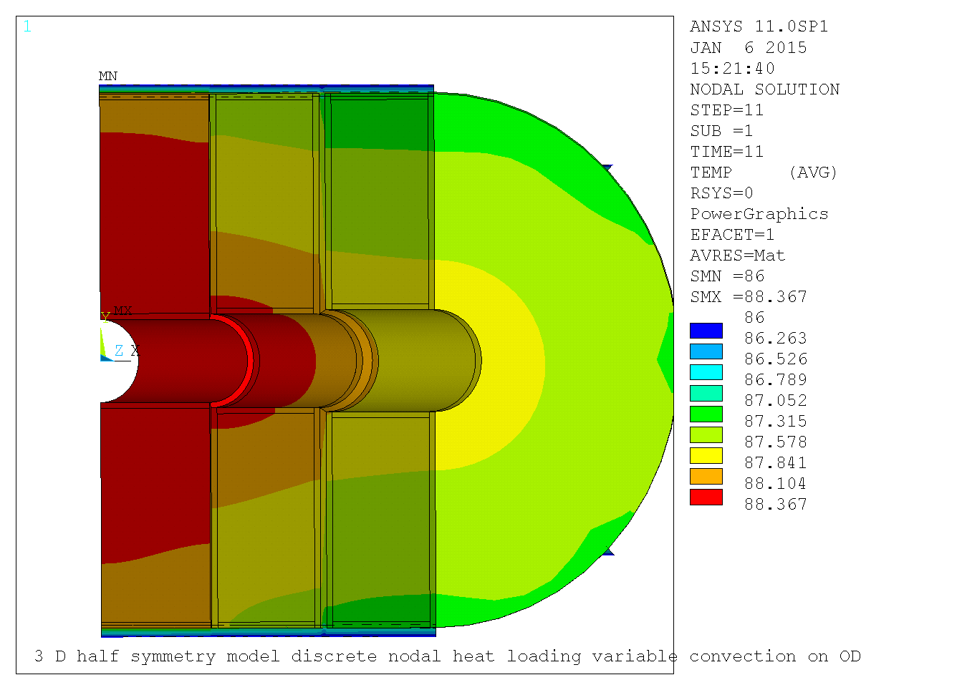
Steady State Temperatures 6x Power with 1/4 mm Argon Layer around the cooling tubes
Improving the fit of the tubes to limit the mean gap around the cooling tube to ¼ mm reduces the peak temperature to 88.4°K suggesting that all of the heat is being carried away by the LN₂
In this simulation heat flow into the matrix from the OD is suppressed, mainly because the non-linear fit for convection at the OD breaks down for small and negative delta T’s.

Slide 6
Summary of Results
Final report and no cooling cases verify that the current model agrees with earlier results when the LN₂ is not set to 86°K
The argon layer was modeled as 1 and ¼ mm thick over half the diameter of the tube. 1 mm is intended to represent a loose fitting tube and ¼ mm a tight fitting tube.

