Slide 1
ATLAS Calorimeter Argon Gap Convection Test Bed
April 25, 2014

Slide 2
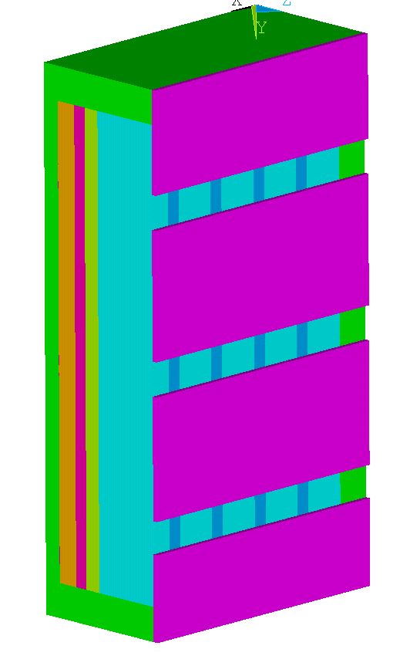
Test Model
This plane heated
Argon gap, 12 mm thick
Aluminum, 8 mm thick
Middle insulator, 12.7 mm
G10 CR, 10.7 mm thick
Aluminum, 3 mm thick
I added the 3 mm aluminum plate to reduce small scale temperature variations on the heated face of the middle insulator.

Slide 3
Earlier Results for Argon Layer Conductance
The equation used in the previous analyses gives a conductance of 52.8 W/m²-°K for a 2 °K temperature differential (see slide 4).
At lower temperature differentials, heat was transported from the lower regions of the inner cylinder to the upper regions of the outer cylinder, ref. slide 5, suggesting that size is more important at low temperature differentials (the convective cells that form are larger).
A test data point at a 2 °K differential temperature is recommended. The predicted effective conductivity of the Argon layer is 4.8 times the static conductance value. For this case het was predicted to move radially from the inner cylinder to the outer cylinder except at the top and bottom, ref. slide 6.

Slide 4
Outer Annulus, Equation for H
The equation fits the laminar results and was used in the runs reported on subsequent slides.

Slide 5
Heat Flux at 0.5°K Differential (Turbulent Option Off)
With inner and outer cylinders held at constant temperatures, heat tends to be removed from the lower regions of the ID and deposited at the higher regions of the OD.
The variation in heat removal on the inner cylinder is more pronounced for low temperature differences.

Slide 6
Heat Flux at 2°K Differential
At a 2°K differential the heat flow is more uniformly distributed making the use of a convection coefficient dependent on the local inner wall temperature justifiable.

Slide 7
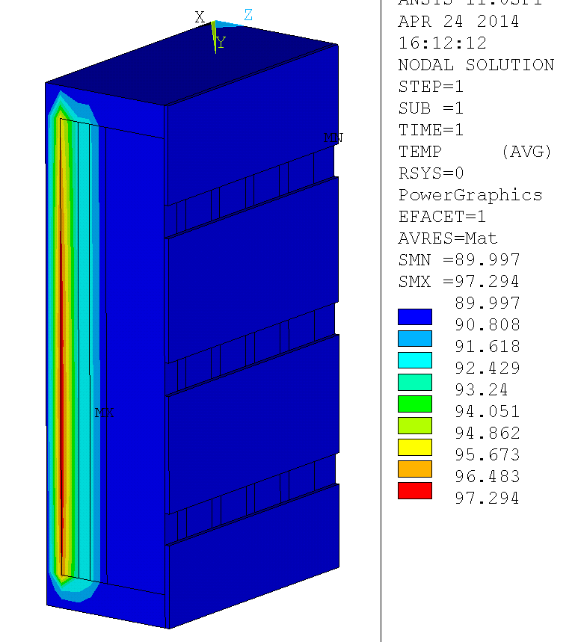
Thermal Result for a 2°K Gradient Across the 12 mm Argon Layer, Net Conductance of the Argon is 4.8 Times the Conductivity of Argon
Total heat input = 22.4 W
Heat into 8 mm Al plate = 8.78 W
Heat into 12 mm Argon layer = 7.99 W (99.1 W/m²)
Heat lost through base = 13.6 W
61% of the input heat is lost through the base. Most of the rest passes through the Argon layer (0.79 W is conducted laterally to the side walls by the 8 mm Aluminum plate).

Slide 8
Transient Response to 22.4 W
°K
Seconds
This is the power required to develop a 2°K gradient in the Argon gap

Slide 9
Transient Response to 22.4 W
°K
Seconds
The 2°K gradient is developed in 1200 to 1600 seconds.
The gradient through the middle insulator develops somewhat faster.

Slide 10
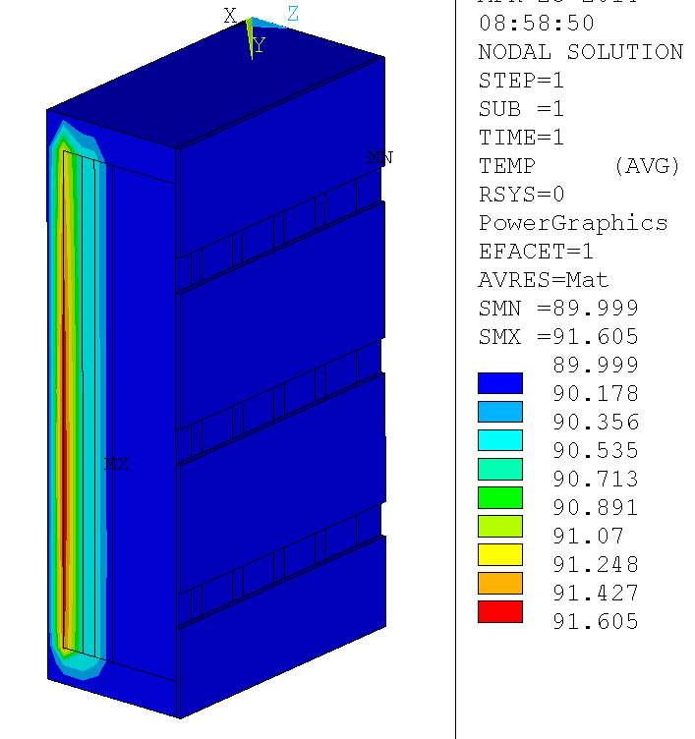
Thermal Result for an 0.5°K Gradient Across the 12 mm Argon Layer, Net Conductance of the Argon is 3.86 Times the Conductivity of Argon
Total heat input = 4.85 W
Heat into 8 mm Al plate = 1.823 W
Heat into 12 mm Argon layer = 1.767 W (21.9 W/m²)
Heat lost through base = 3.03 W
62% of the input heat is lost through the base. Most of the rest passes through the Argon layer (0.06 W is conducted laterally to the side walls by the 8 mm Aluminum plate).

Slide 11
Transient Response to 4.85 W
°K
Seconds
The 0.5°K gradient is developed in 1200 to 2000 seconds.
The gradient through the middle insulator develops somewhat faster.

Slide 12
Suggested Test Design Modification
Small spatial scale temperature variations on the heater side of the middle insulator are possible and might effect the accuracy of the heat flux calculated from the differential temperature across this member.
This can be reduced by adding a 3 mm plate on the heater side (assumed to be opposite from the Argon gap). Heaters should be bonded to the aluminum plate.

Slide 13
Initial Runs
In these runs the thermal conductivity of G10 was input as an isotropic material with K=0.0014
  This has been updated to K=0.000311 in-plane and K = 0.000453 W/(mm-°K) in the thickness direction
The effective conductivity of the Argon gap was set at ten times the static conductivity of Argon.
W/(mm-°K) replaces W/(m-°K) above (Correction 26-Apr-14)

Slide 14
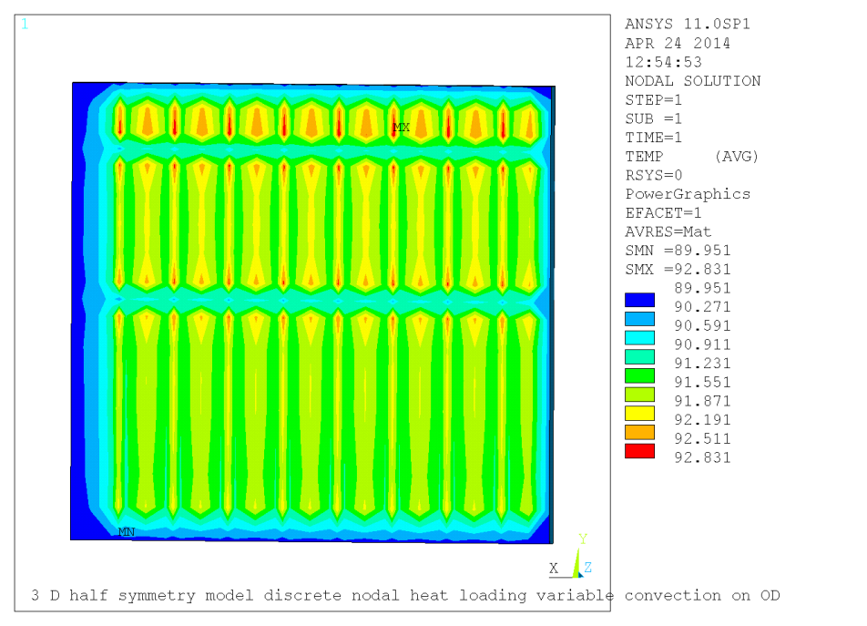
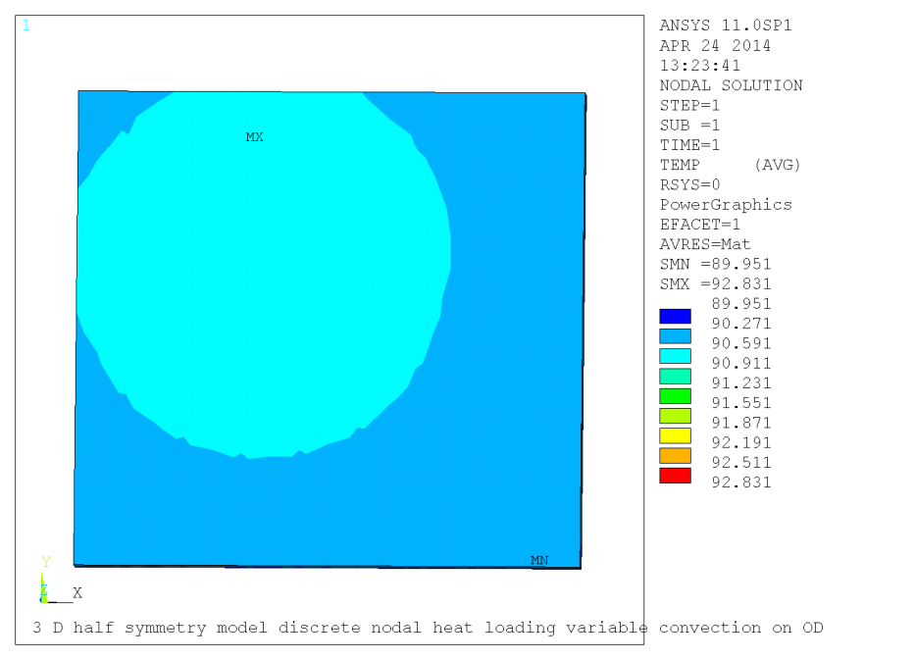
Middle Insulator Thermal Uniformity
There is no high conduction layer at the heater
Heater side, 90.0 to 92.4 °K
Heated nodes are 16.75 mm apart horizontally
Horizontal bands occur where there is an additional row of nodes between heated rows
Argon gap side, 90.5 to 90.6 °K

Slide 15
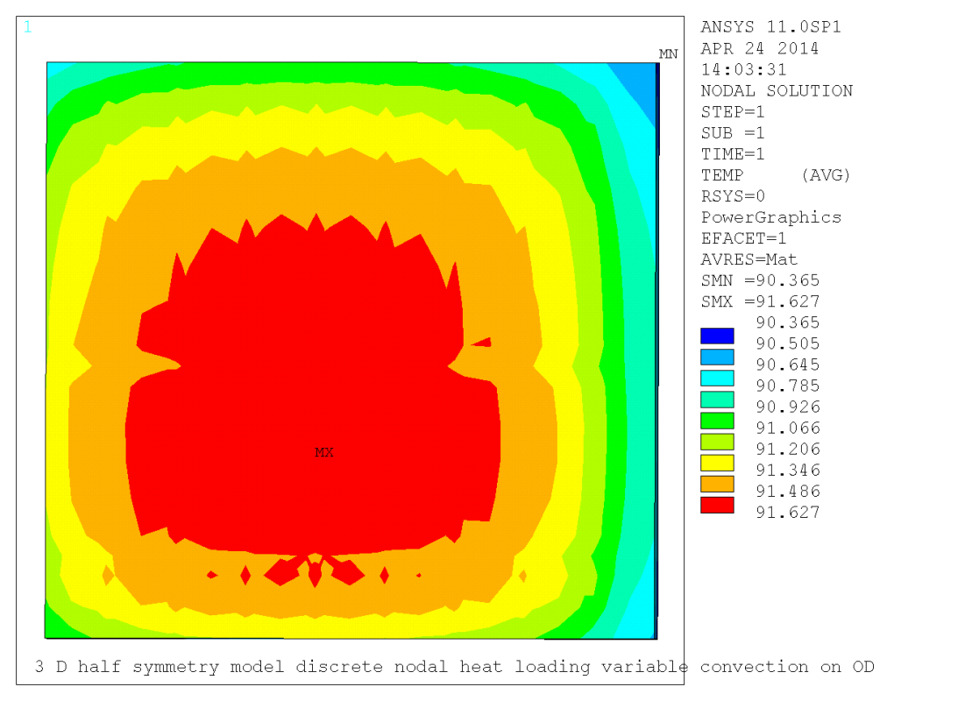
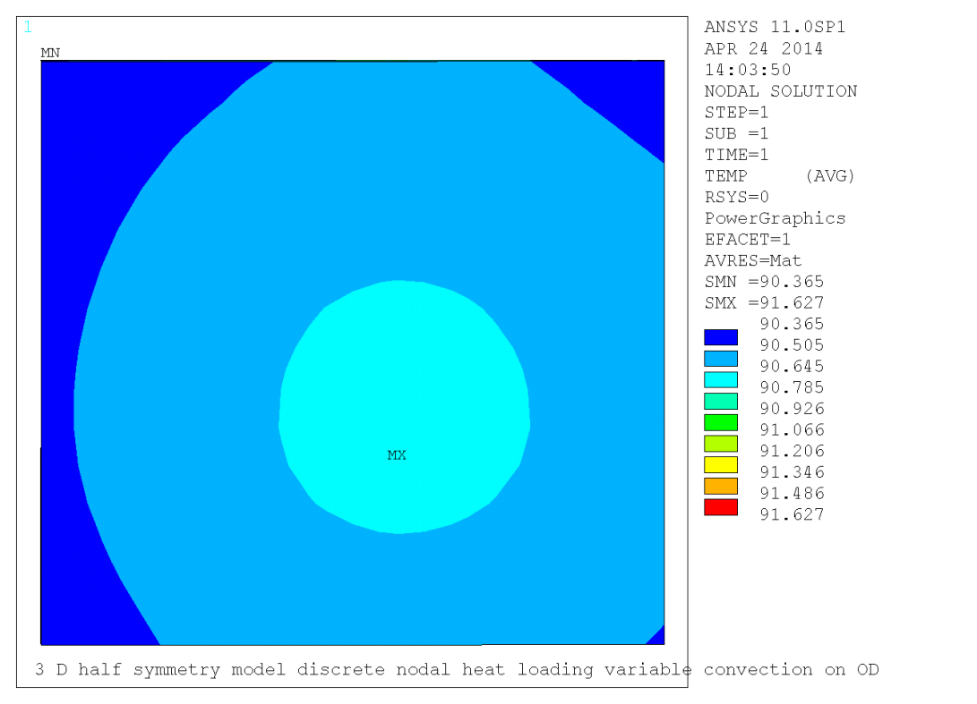
Middle Insulator Backed by 3 mm Aluminum Plate
Heater side, 90.6 to 91.6 °K
Argon gap side, 90.4 to 90.7 °K
Adding the 3 mm aluminum plate erases small scale temperature variations near the center of the middle insulator that might result from spatial variations in heat load due to heater wire spacing.

