Slide 1
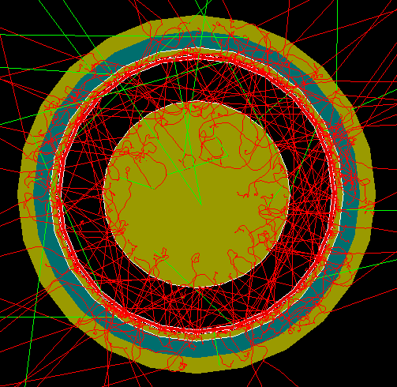
The FCalPulse R&D Project - Liquid Argon Calorimetry at a High Luminosity Collider
J.Rutherfoord
9 March 2021
v1

Slide 2
Outline
The problem – Argon ion buildup
The effect on the “triangle” pulse
Which calorimeters are affected
Measurements to date
What’s not known yet
The FCalPulse R&D Project
Virtues of this approach

Slide 3
Argon Ion Buildup
Time for Argon ion to drift across the FCal1 gap
T=3.6 ms at potential of 250 V
T=17 ms at potential of 54 V
When charge in the gap builds up to the charge on the electrode surfaces, the E-field at the anode drops to “zero”.
This happens at the Critical Ionization Rate

Slide 4
The ionization pulse
Normally the ionization electrons drift in the LAr at a constant speed.
But at high ionization rates the usual triangle pulse becomes
Smaller due to bulk recombination
Shorter because the gap region of fast-moving electrons is smaller
Distorted by developing a long tail
[See JR NIMA 482 (2002) 156]

Slide 5
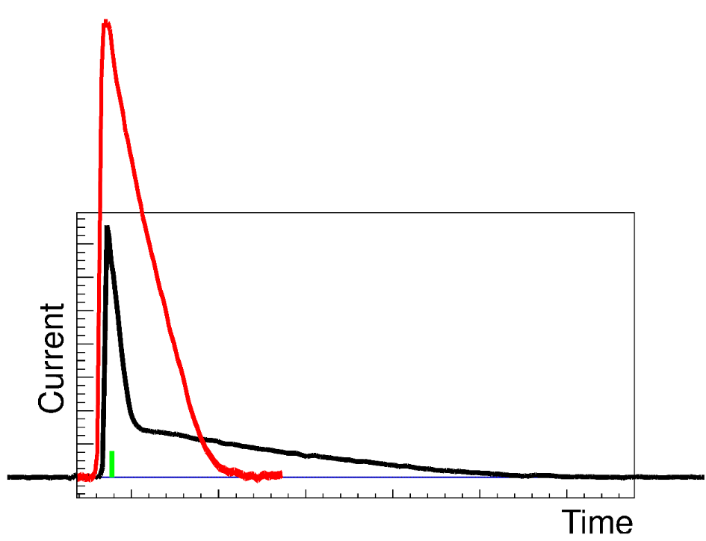
Normal and distorted signals
Normal LAr pulse (red) and space-charge distorted pulse (black). These are actual pulses from the HiLum test beam run at IHEP, Protvino. The relative magnitudes are adjusted to agree with theory. We’re working hard to determine the normalization from the data. These are “EMEC” signals. The shape of the FCal signal is wiped out by the RF bunch length which is about 30 ns long and by residual shaping in the electronics.

Slide 6
Attractions of LAr Calorimetry
To first order …
The triangle pulse shape is always the same
Assumes HV and temperature are fixed
Amplitude measures the Energy deposit
Radiation tolerant
Long-term stability
In the FCal1 the pulse at the electrode is the same for every channel

Slide 7
Above threshold simplicity is lost
At ionization rates above the critical value …
Pulse shape distorts as function of ionization rate
No longer simple triangle
Amplitude now a function of ionization rate
Decreases
FCal1 readout channel energy calibration
Different for all channels
Changes with changing luminosity

Slide 8
Which calorimeters are affected?
The highest |η| regions of FCal1 are affected the most (> 40 × critical)
But the high |η| region of FCal2 is also affected
And even the high |η| region of the EMEC inner wheel is affected

Slide 9
Measurements to date
PIB at Arizona – Determined the critical ionization rate [JR NIMA 776 (2015) 65]
Also HiLum2 [L.Kurchaninov et al]
EndCap HiLum at IHEP Protvino
Measured pulse shapes. We’re now trying to determine the pulse amplitudes.
EndCap HiLum2 at IHEP Protvino
Analysis in process

Slide 10
What’s not known
We know that, at high ionization rates, the energy calibration depends on this rate. But, at a fixed ionization rate, is the pulse still linearly proportional to the energy deposit?
Bulk recombination rate at relevant E-field
Effect of Oxygen contamination
Are there plasma instabilities

Slide 11
The Passage of High Energy e⁻, e⁺, and γ Through Matter
Processes
Ionization e ± + (Ar) → e ± + (Ar⁺ + e⁻)
Delta rays
Excitation e ± + Ar → e ± + Ar*
Bremsstrahlung (e±) + A → (e± + γ) + A
Pair Production (γ) + A → (e⁺ + e⁻) + A
Energy loss and energy deposit

Slide 12
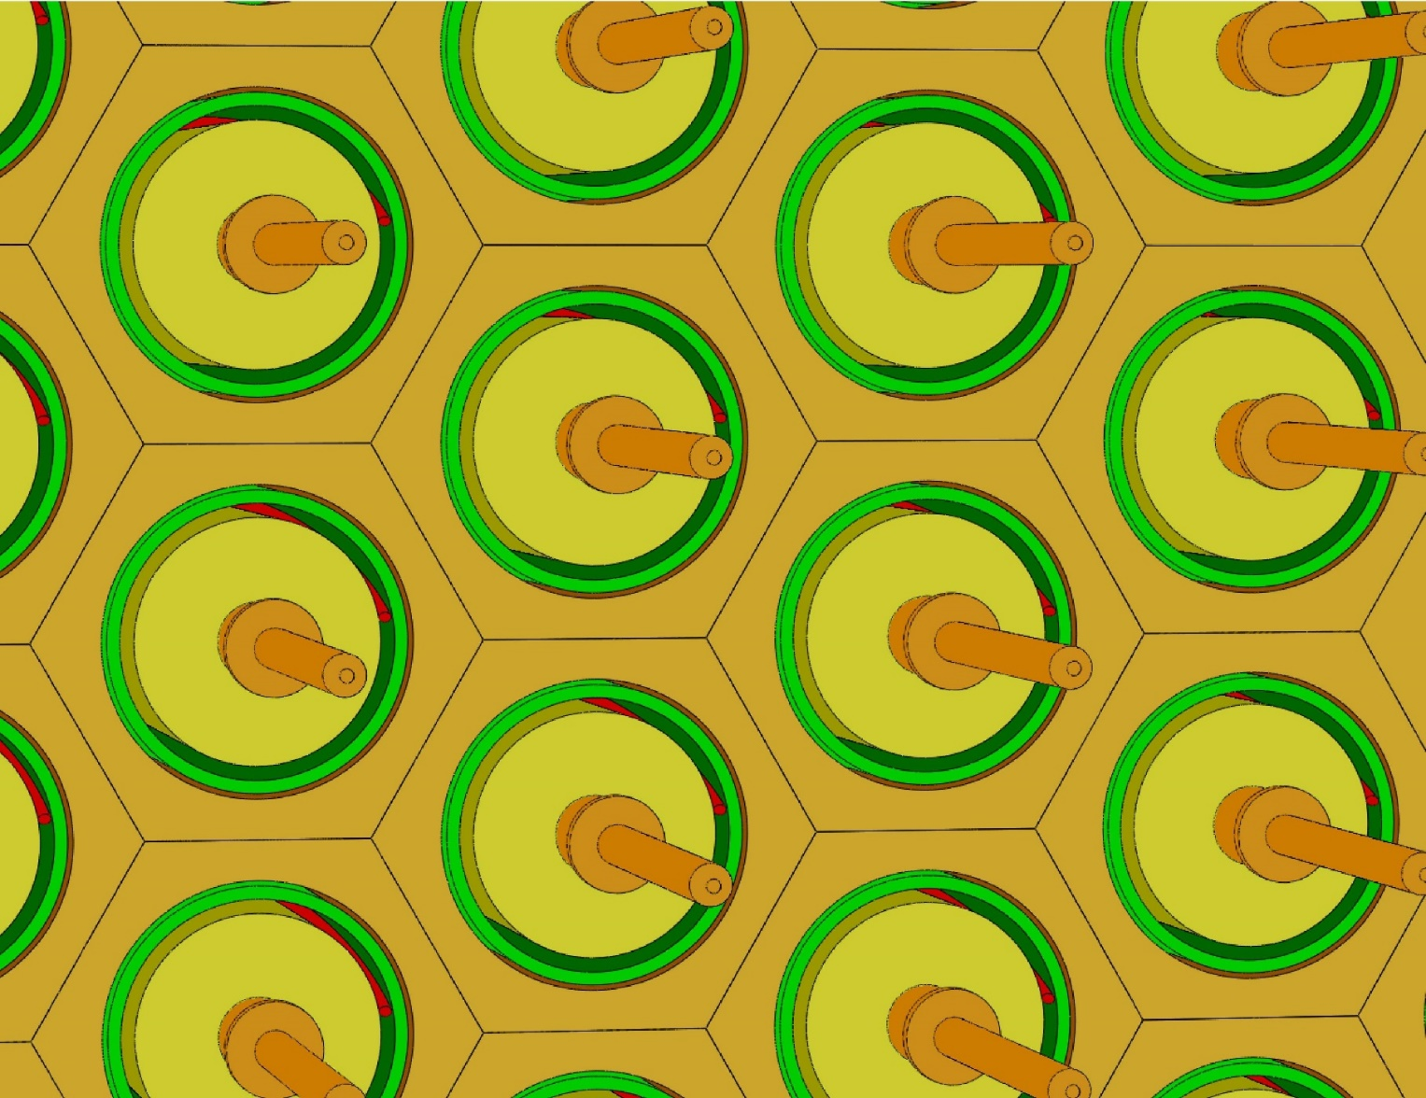
FCal1 front face unit cells
•Solid Cu matrix
•Solid Cu rods
•Cu tubes
•Insulating PEEK fiber
•LAr gap between rod and tube
•Imaginary lines demark unit cells

Slide 13
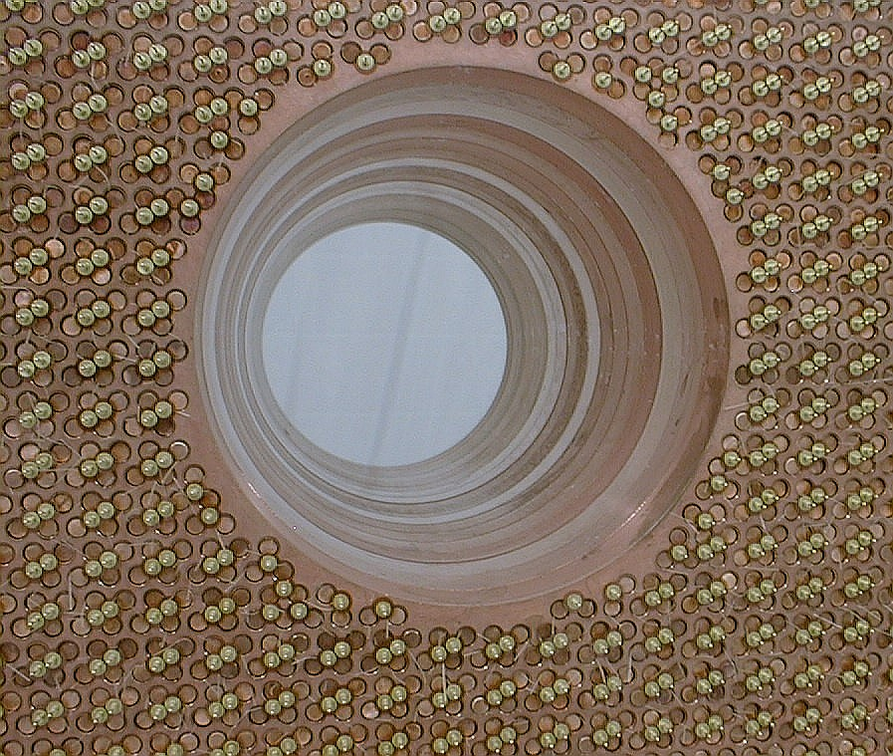

Slide 14
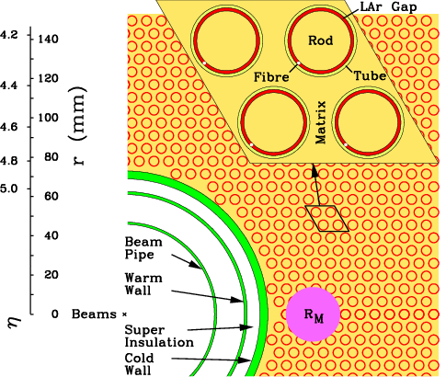
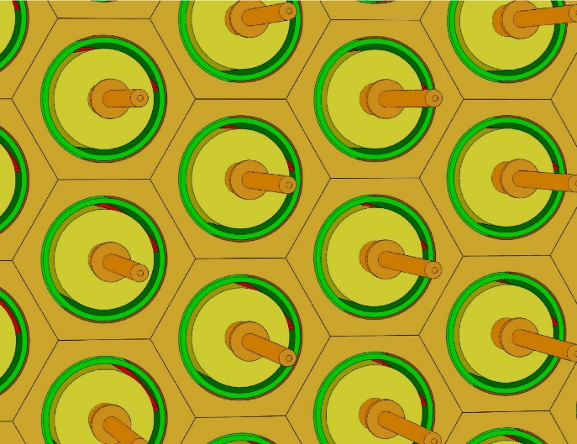
Worst ionization rates
Inner region of the front face of the ATLAS Forward Calorimeter
Moliere radius
Electrode segment at EM shower max
This is where the rates are at their worst

Slide 15
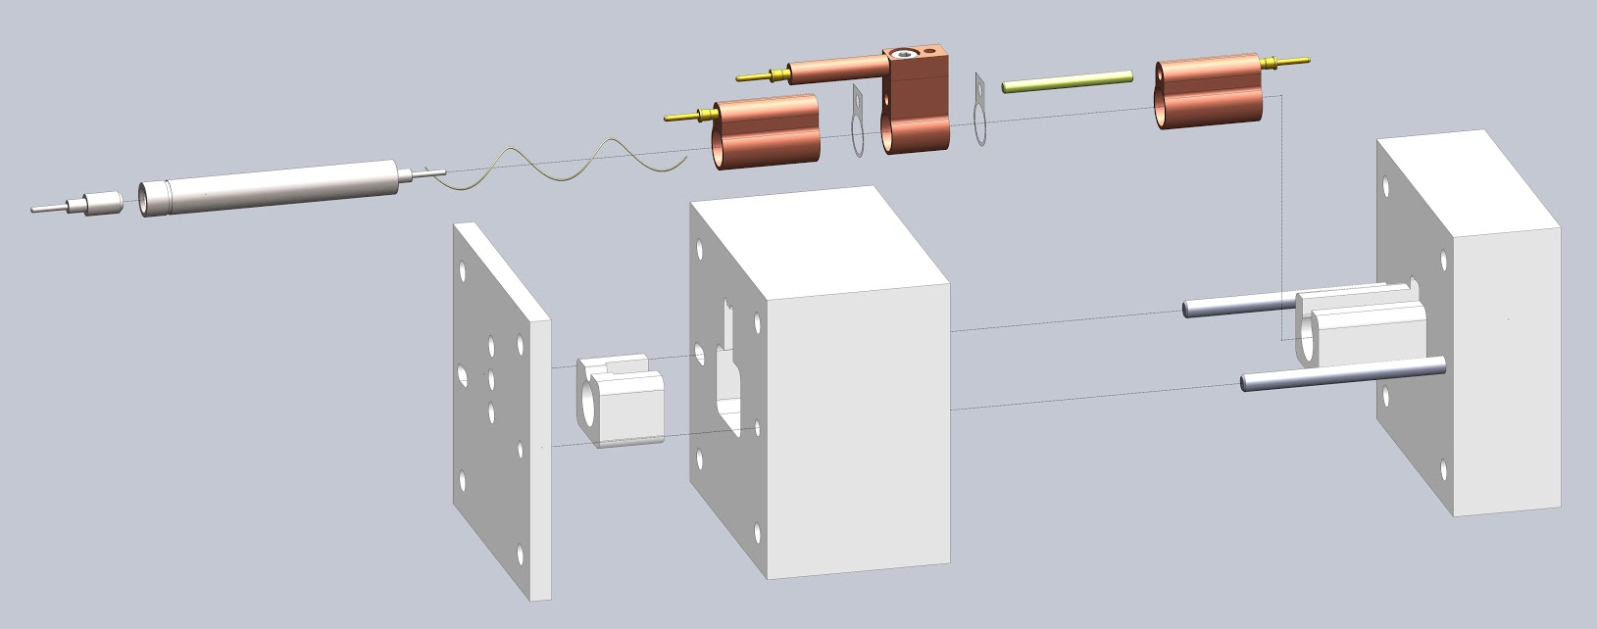

Slide 16
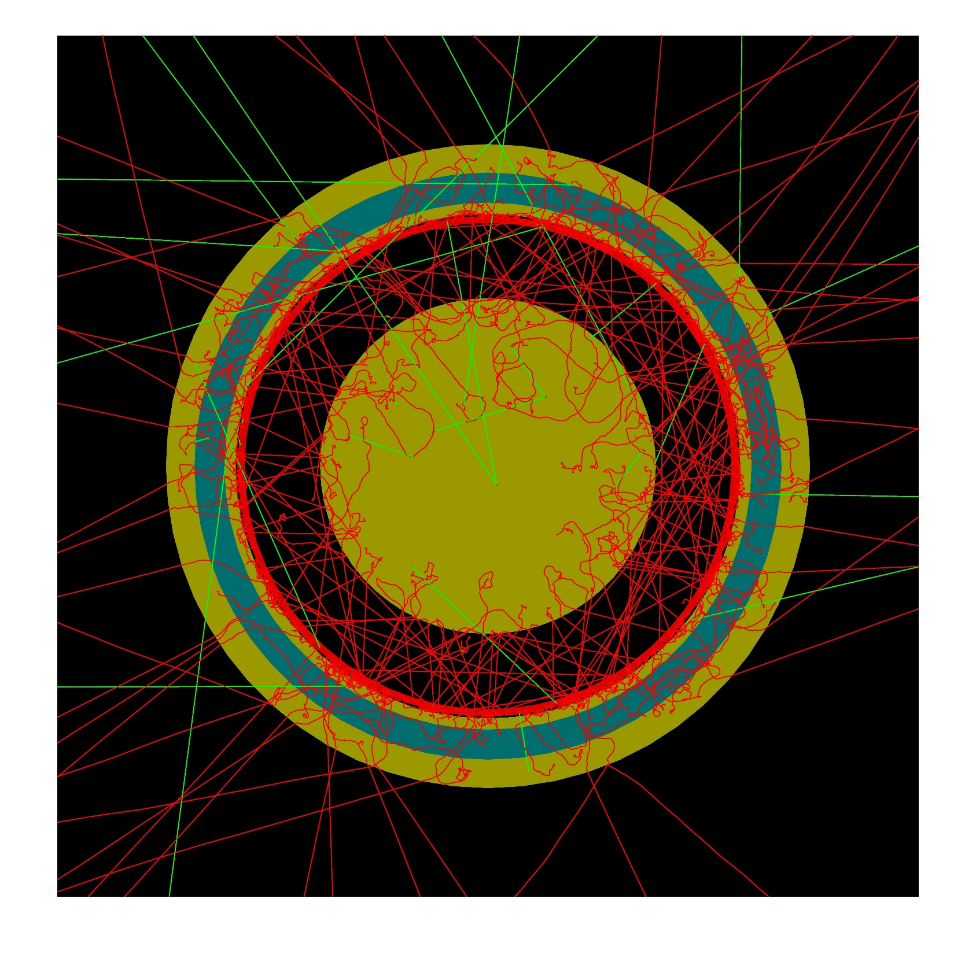

Slide 17
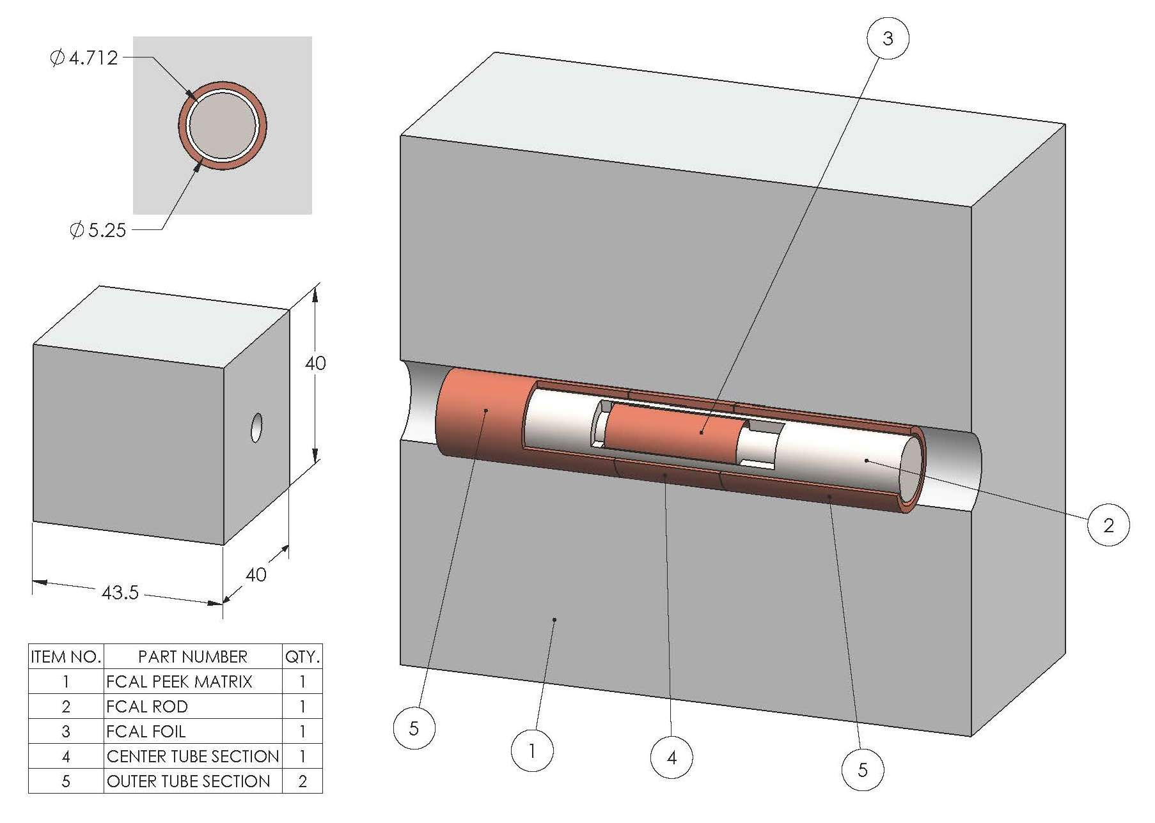

Slide 18
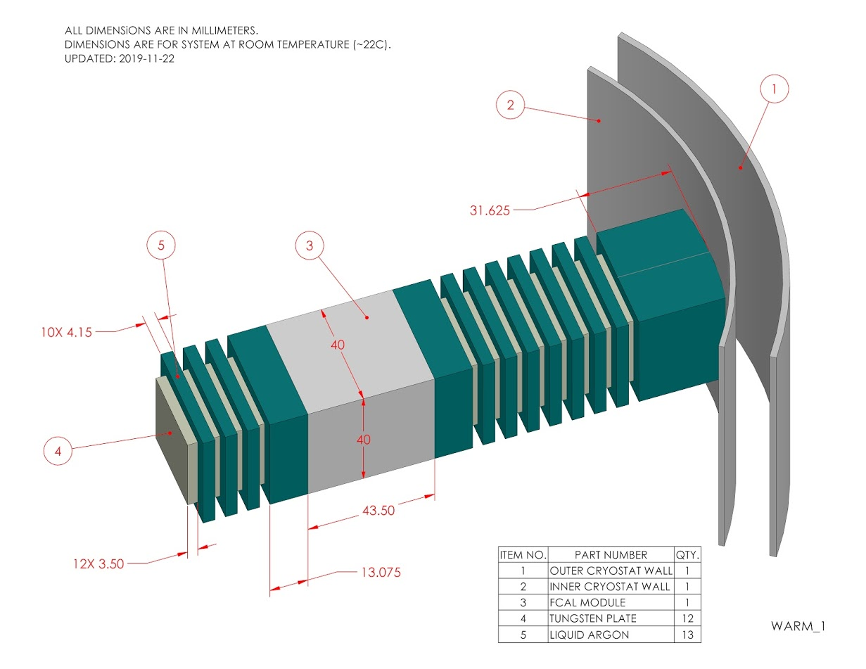

Slide 20
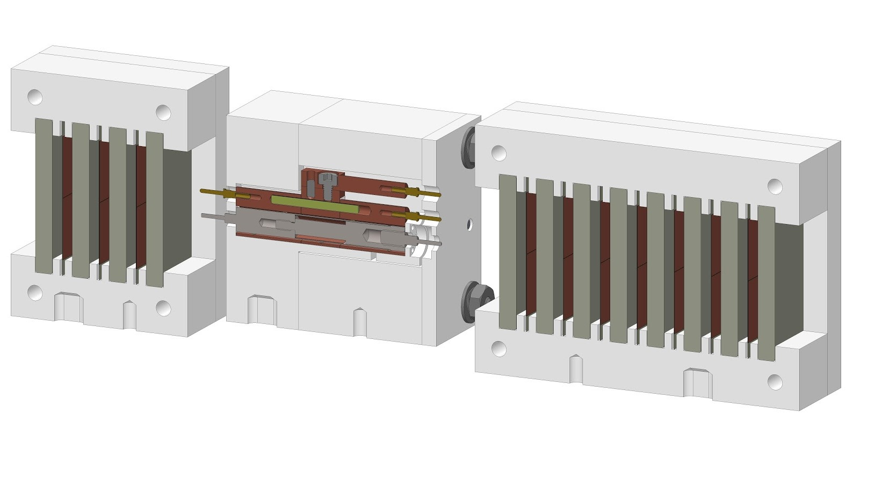
Electron beam enters from right
Tail catcher
Electron shower reaches max here
Tungsten plate shower calorimeter
}
FCal1-style electrode with Sr-90 beta source

Slide 21
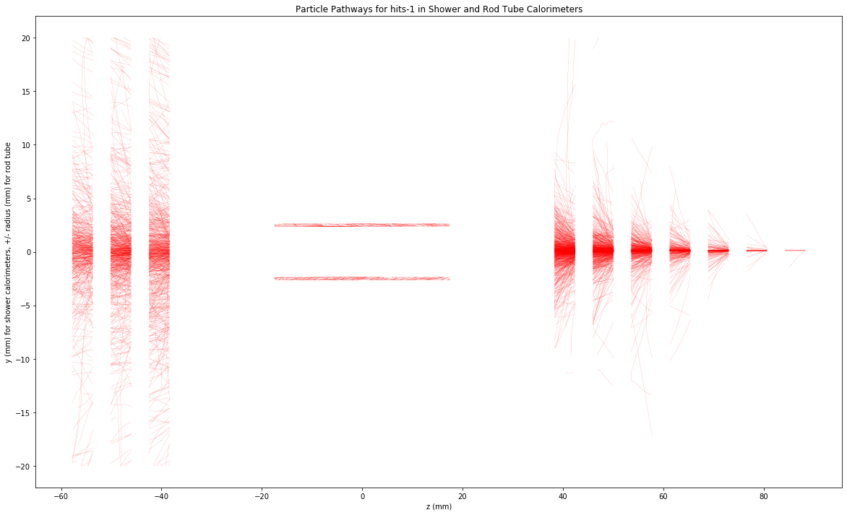
Single 350 GeV e⁻ Shower

Slide 22
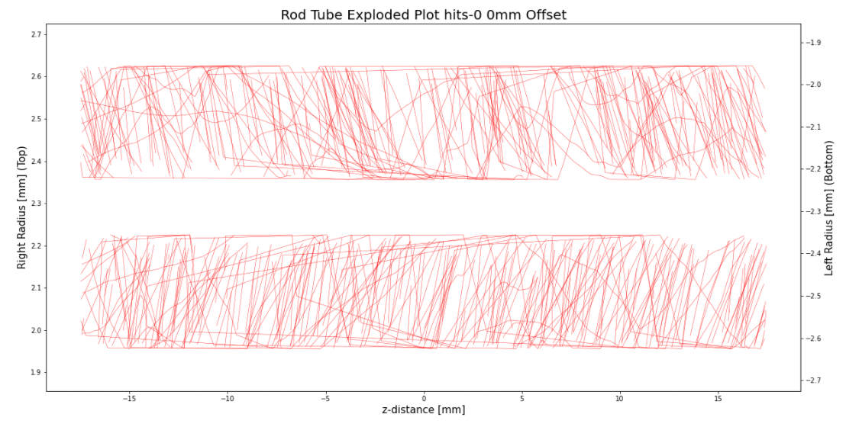
One electron shower in Rod/Tube LAr Gap
Shower particle tracks in the rod/tube LAr gap as seen in previous slide but blown up vertically and then translated vertically for easy viewing. Scale on left for upper gap, scale on right for lower gap. From GEANT4 simulation.

Slide 23
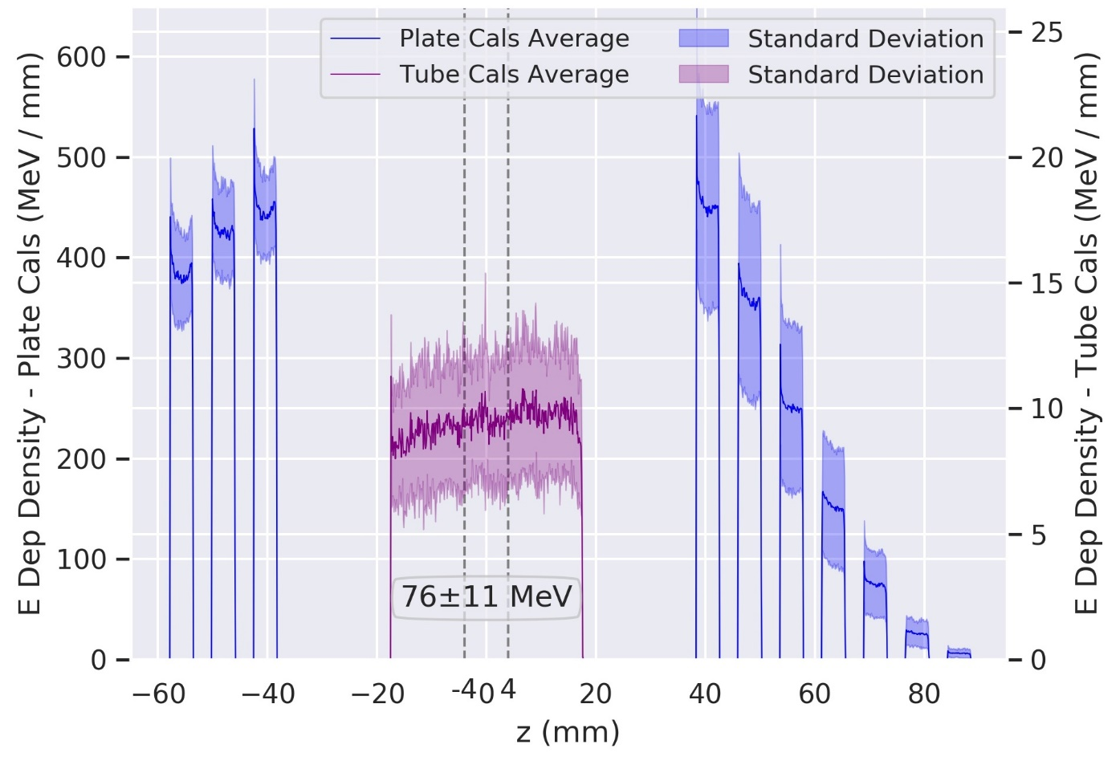
EM Shower development

Slide 24
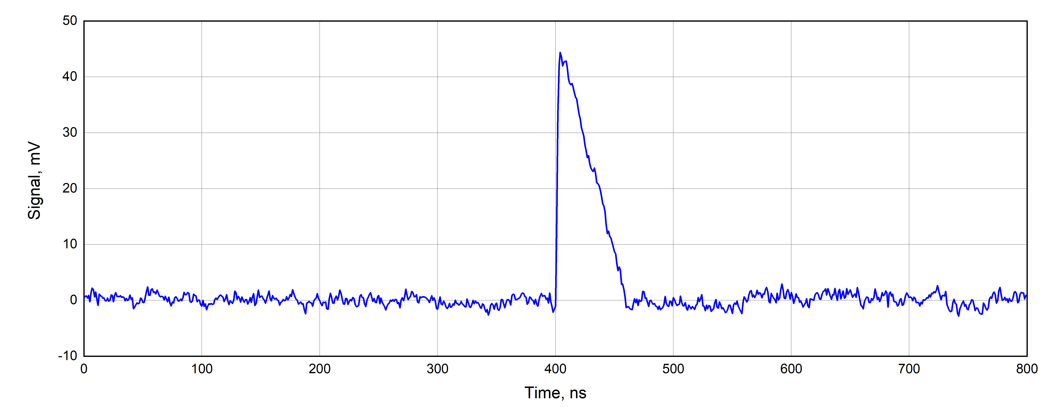
Simulated pulse and noise

Slide 25
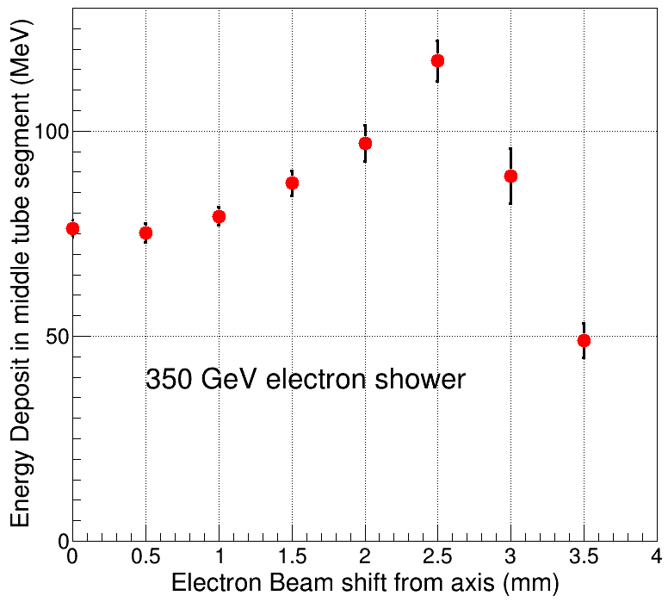

Slide 26
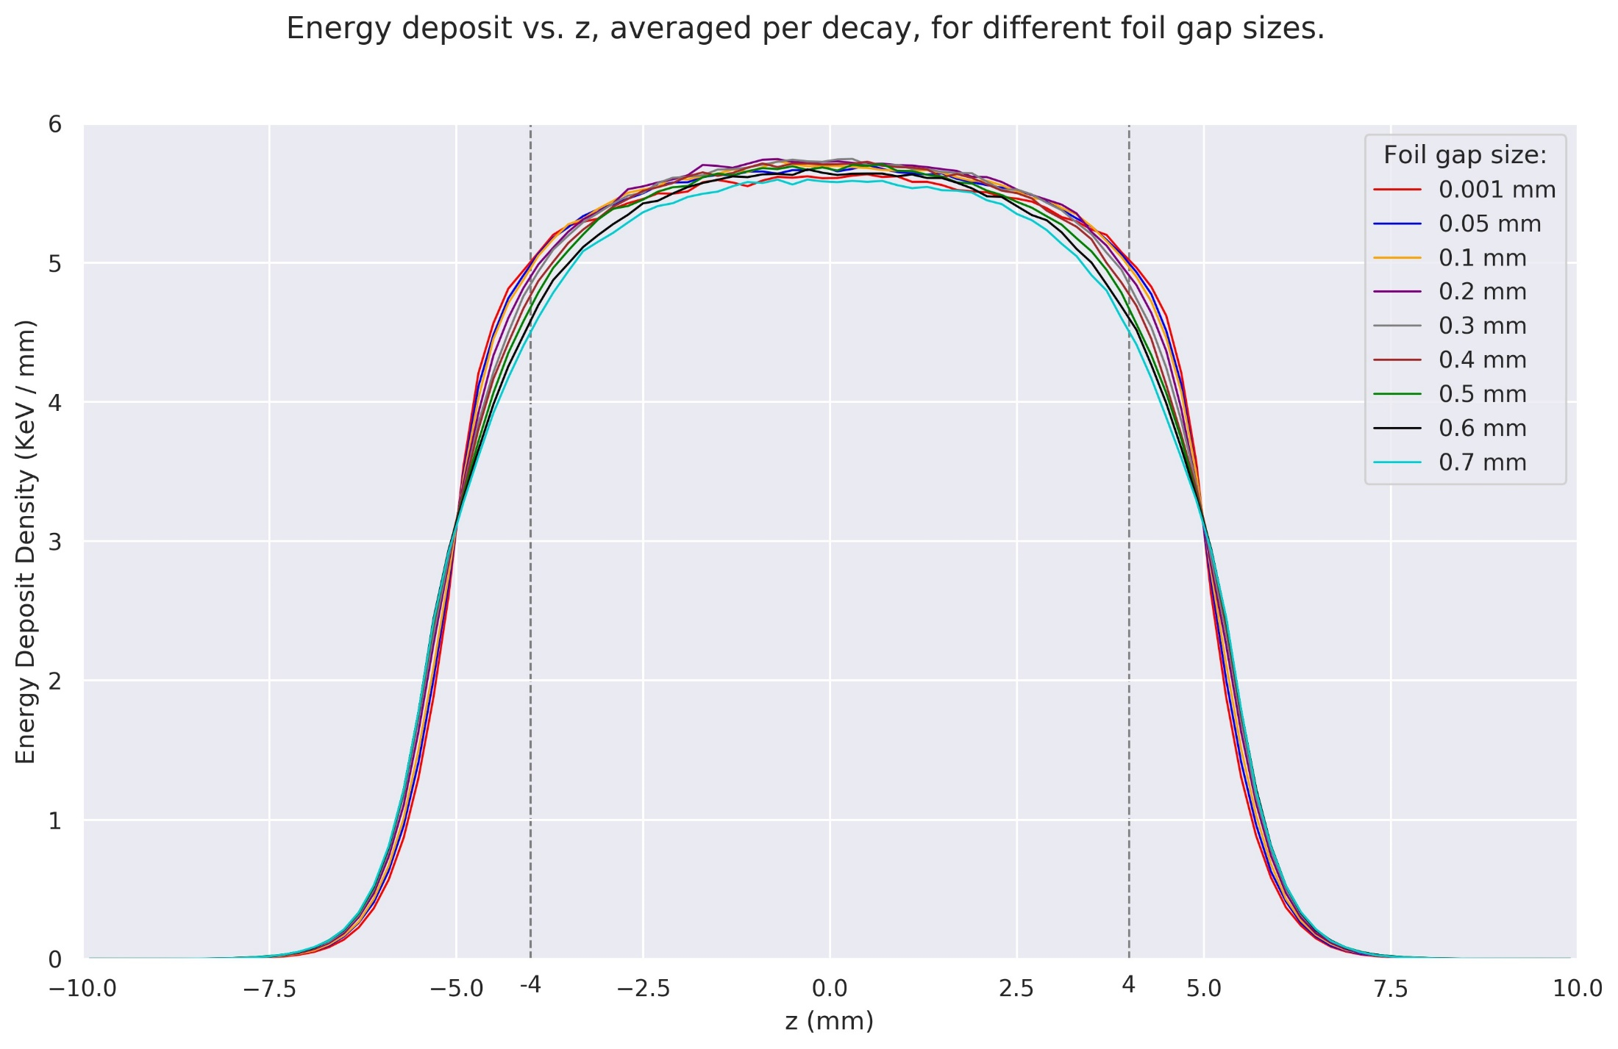

Slide 27
For more information
Please see
“FCalPulse R&D Project, Reconstructing the FCal Pulse in the HL-LHC Era”
at https://indico.cern.ch/event/927863

Slide 28
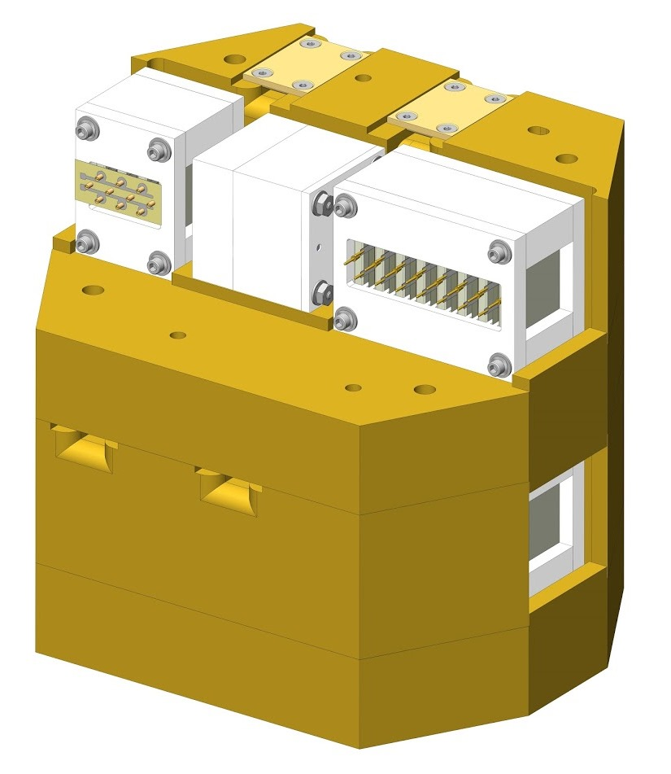
Personnel shielding cut away

Slide 29
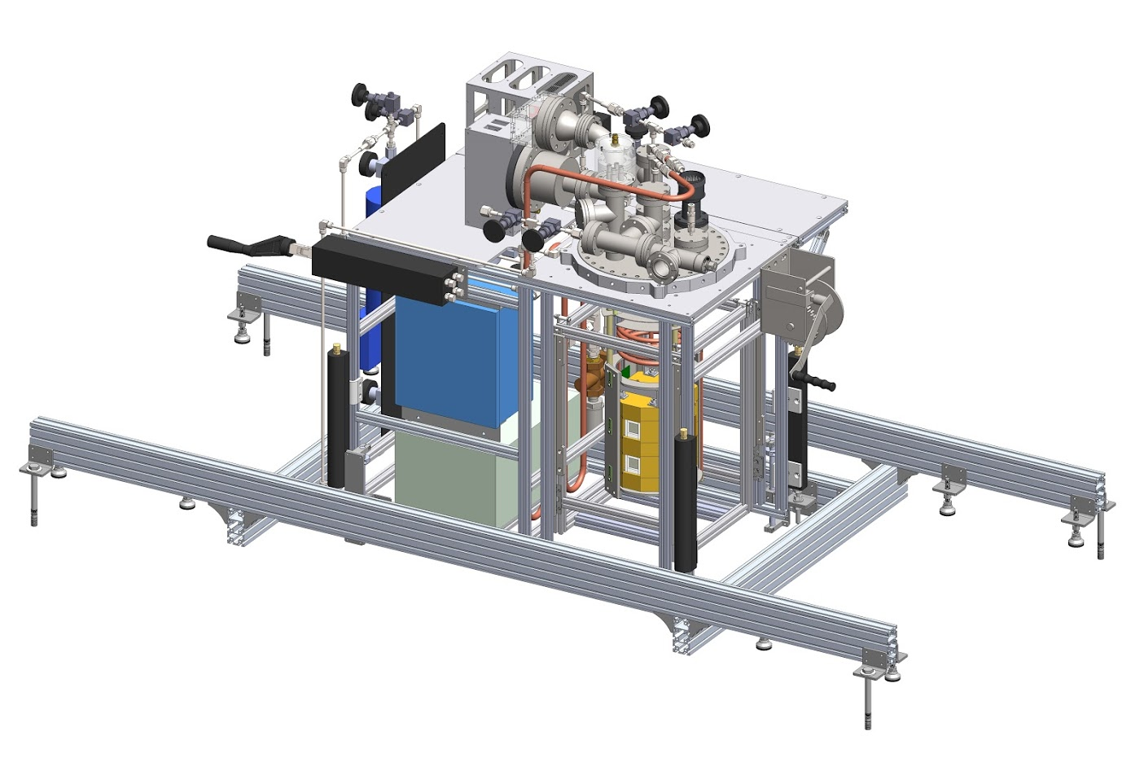
Setup in CERN North Area

Slide 30
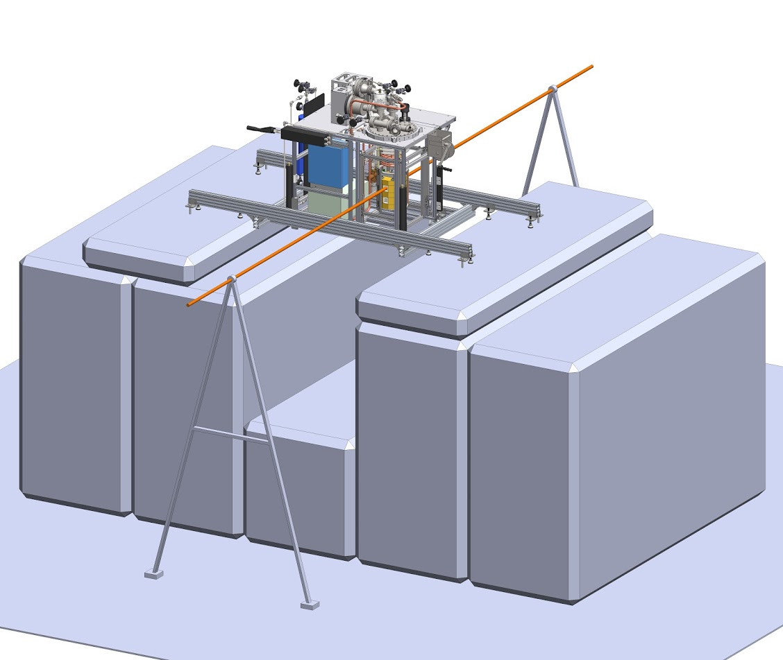
Mounted on concrete blocks in H4 beam line
Double-wall cryostat is mounted from below

