Slide 1
Progress with beam counters
Alexandre Savine Special thanks to Billie Lubis and Robert Walker May 6, 2021

Slide 2
Timing resolution. Weighting scheme.
Weighting scheme (“optimal filtering”) was tried;
Formula T=$\sum_{i=0}^{i=N}{w_{i}}t_{i}A_{i}$/$\sum_{i=0}^{i=N}{w_{i}}A_{i}$ from April 22 talk is wrong. Actual array of weights must be 2-dimensional! Correct formula shall look like T=$\sum_{i,j=0}^{i=N}{w_{ij}}t_{i}A_{j}$/$\sum_{i,j=0}^{i=N}{w_{ij}}A_{j}$;
For example, the half-peak threshold scheme, described in April 15 talk (next slide) corresponds to following $w_{ij}$ matrix:
0.0 0.0 0.0 0.0 0.0 0.500 -0.500 0.0 0.0 0.0
0.0 0.0 0.0 0.0 0.0 0.0 0.0 0.0 0.0 0.0
0.0 0.0 0.0 0.0 0.0 0.0 0.0 0.0 0.0 0.0
0.0 0.0 0.0 0.0 0.0 0.0 0.0 0.0 0.0 0.0
0.0 0.0 0.0 0.0 0.0 0.0 0.0 0.0 0.0 0.0
0.0 0.0 0.0 0.0 0.0 0.0 -1.000 0.0 0.0 0.0
0.0 0.0 0.0 0.0 0.0 1.000 0.0 0.0 0.0 0.0
0.0 0.0 0.0 0.0 0.0 0.0 0.0 0.0 0.0 0.0
0.0 0.0 0.0 0.0 0.0 0.0 0.0 0.0 0.0 0.0
0.0 0.0 0.0 0.0 0.0 -0.500 0.500 0.0 0.0 0.0
Assuming, that peak is at sample #9 and half-crossing is between samples #5 and #6

Slide 3
Event Details (from April 15 talk)
Timing for Trigger, S1, S2, S3 is done by crossing of $\frac{Max+Min}{2}$level;
Integral for S1, S2, S3 computed as sum of 25 samples, shown here;
Second event has no signal in S3, just a tail of the S2 pulse;

Slide 4
Timing resolution. Weighting scheme.
Iteration procedure was used to find weights, minimizing following expression: σ²(t₁-t₂)+ σ²(t₁-t₃)+ σ²(t₂-t₃), where t_{i} – time, measured by counter S_{i};
Procedure was performed for 9, 10, 11, 12, 13, 14, 15 and 20 samples to determine optimal amount;
Procedure converges, but… Can be caught by a “false minimum”. Better to seek an analytical solution.
Example of resulting optimum (S3, 12 samples):
-0.091 0.011 -0.010 -0.011 -0.012 0.494 -0.504 -0.005 0.010 -0.002 0.013 0.006
-0.011 0.002 -0.002 -0.002 0.002 0.002 0.001 0.000 0.001 0.009 0.002 0.008
-0.012 0.001 -0.000 -0.001 0.001 0.000 0.001 0.000 0.001 0.002 0.006 0.008
-0.011 -0.001 -0.000 0.001 0.001 0.001 0.001 0.001 0.002 0.005 0.009 0.027
-0.025 0.000 0.000 -0.000 0.000 0.000 0.001 0.000 0.002 0.002 0.012 0.007
0.000 -0.000 -0.000 -0.001 -0.002 -0.004 -1.000 -0.009 -0.008 -0.035 -0.040 -0.042
0.023 0.001 0.001 0.034 0.014 0.994 -0.006 0.007 -0.015 -0.020 -0.027 -0.029
0.053 -0.001 0.002 0.002 0.049 0.007 0.019 0.013 0.035 0.033 0.029 0.030
0.004 0.001 -0.000 0.000 0.000 -0.004 0.006 0.001 0.019 0.012 0.003 -0.045
0.016 0.001 -0.000 0.001 0.000 -0.496 0.504 -0.002 -0.003 -0.005 -0.008 -0.026
0.005 0.001 0.000 0.000 0.000 0.001 0.003 0.005 0.000 -0.008 -0.002 -0.002
-0.009 0.000 0.000 0.000 0.002 0.002 0.014 0.033 0.013 0.017 0.008 0.009

Slide 5
Timing resolution. Weighting scheme. 12 and 20 samples

Slide 6
Timing resolution. Weighting scheme. 9 and 12 samples

Slide 7
Timing resolution. Weighting scheme summary.
Using more than 12 samples does not improve the time reconstruction;
Looks like we can get resolution 300ps. S1 can have issue with fan-out linearity or PMT base;

Slide 8
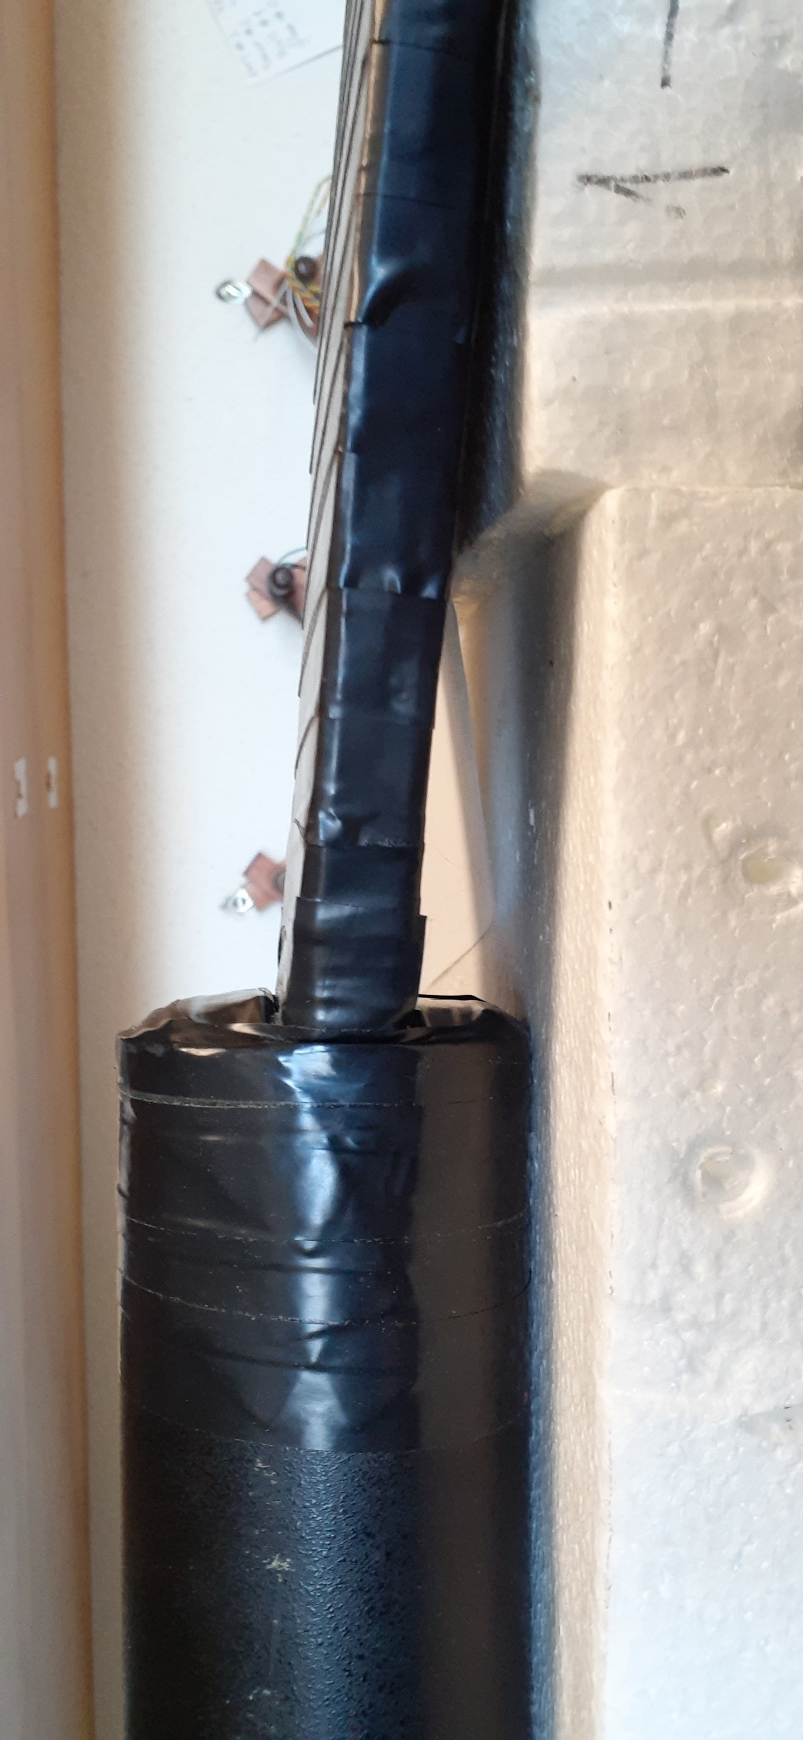
Assembly progress
4 counters are ready (left):
3 for wide beam;
1 for leakage (hadrons, muons) detection;
Second leakage counter candidate found, requires repairs;

Slide 9
Assembly progress – 4 counters on the scope

Slide 10
Assembly progress – light guides for “Narrow Beam” scintillator

Slide 11
Trigger logics
So… I started to build a scheme for the trigger logics;
Since we are using all-new DAQ, I started with some “bare-bones”;
Only “advanced feature” so far is selection of the beam width by the DAQ/Run Control;
Handmade drawings are ugly!

Slide 12
Trigger logics
To exclude ugly drawings, a ROOT script is under development;
Allows to draw trigger logics components, connect them as necessary;
Flexibility and nice graphics.

