Slide 1
Progress with beam counters
Alexandre Savine
Special thanks to Billie Lubis and Robert Walker
April 22, 2021

Slide 2
Progress on plans from 2021-04-15
Problem with “no-trigger” events solved;
S2 was rebuilt to the “tube” standard;
Work on scintillator counters preparation continues;
Individual resolution of counters was estimated without the trigger timing;

Slide 3
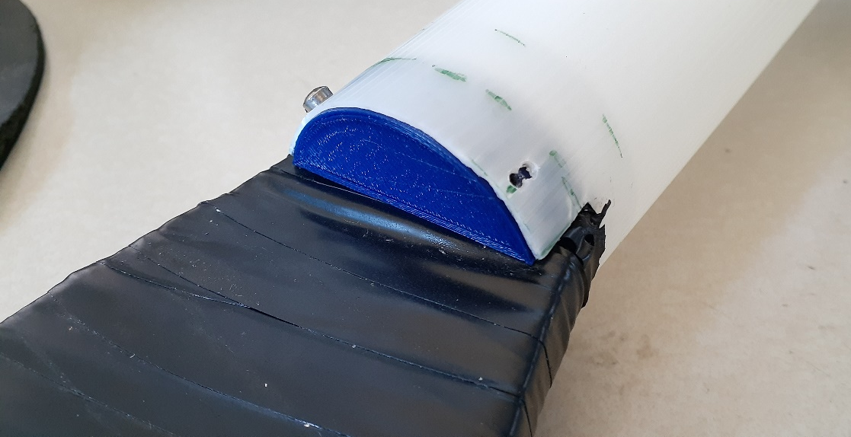
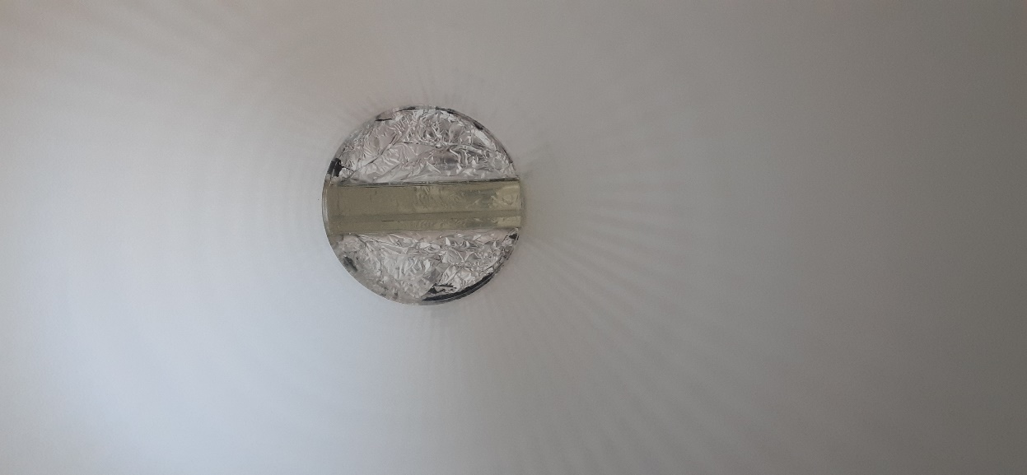
Counter assembly – old tube

Slide 4
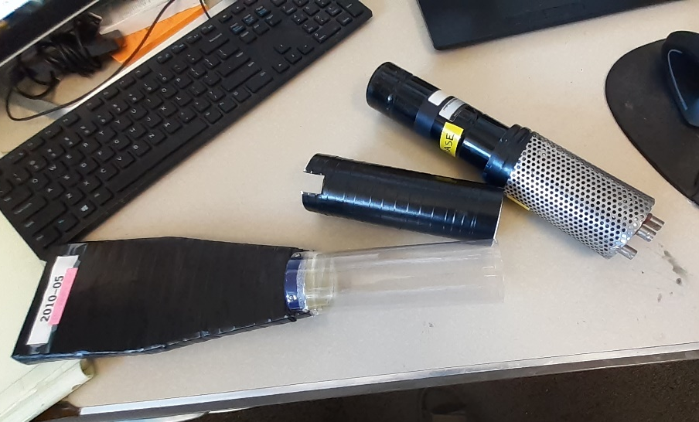
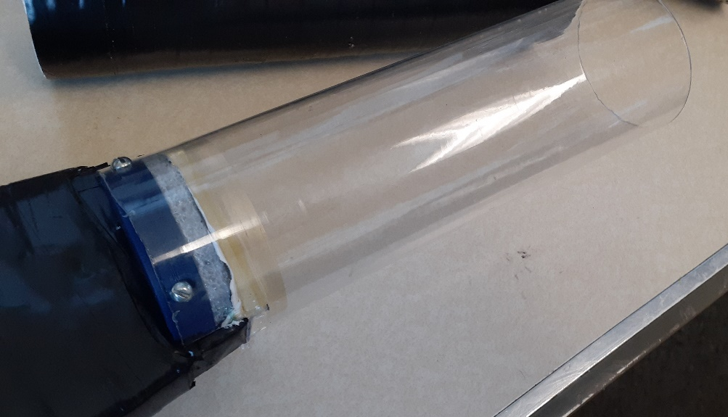
Counter assembly – new tube

Slide 5
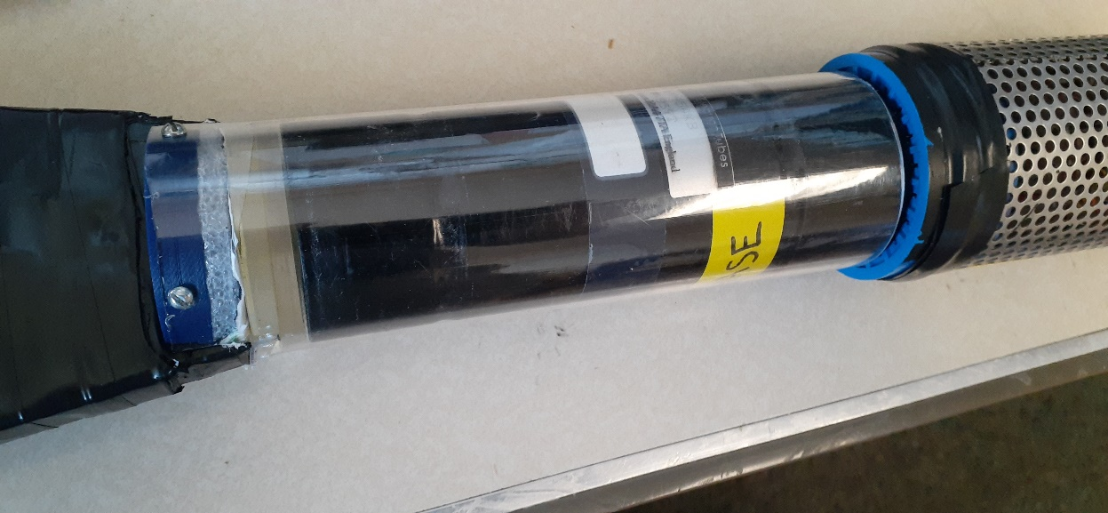
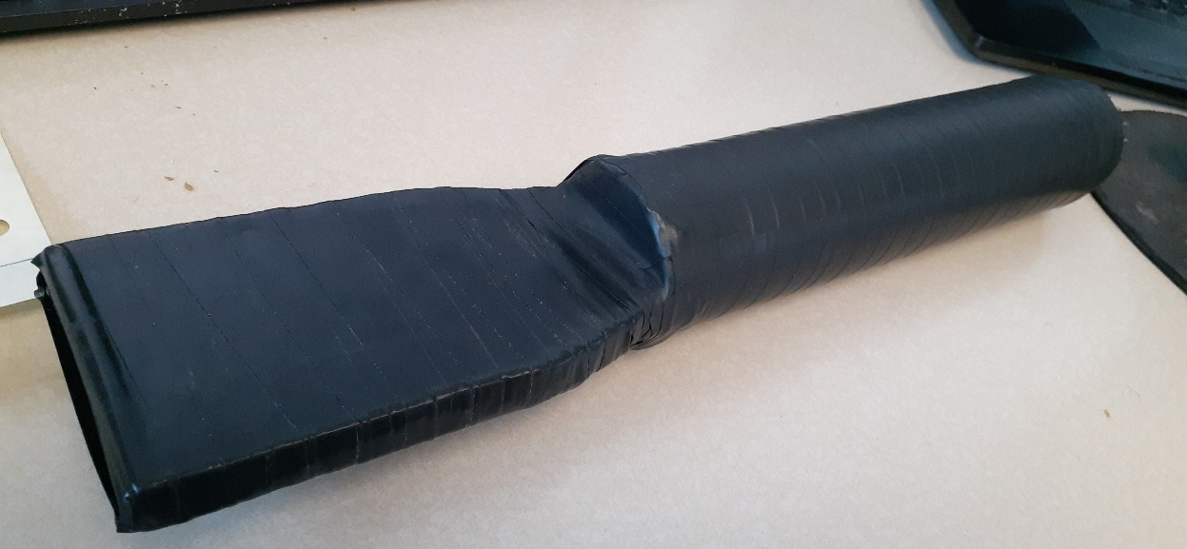
Counter assembly – new tube

Slide 6
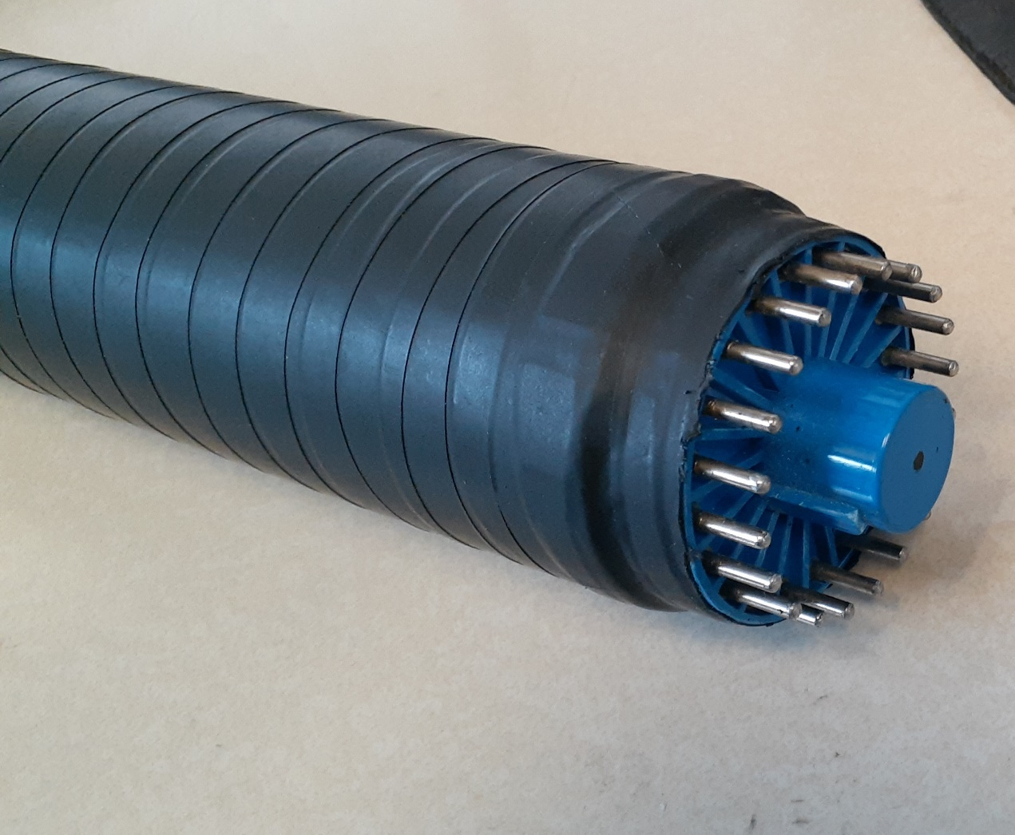
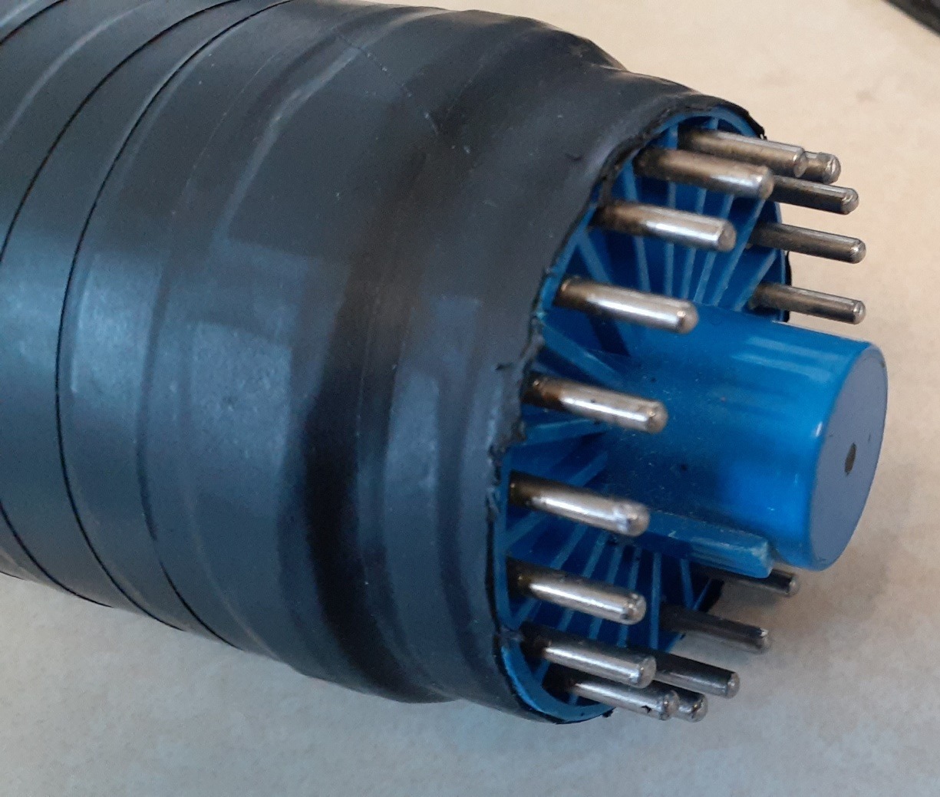
Counter assembly – new tube

Slide 7
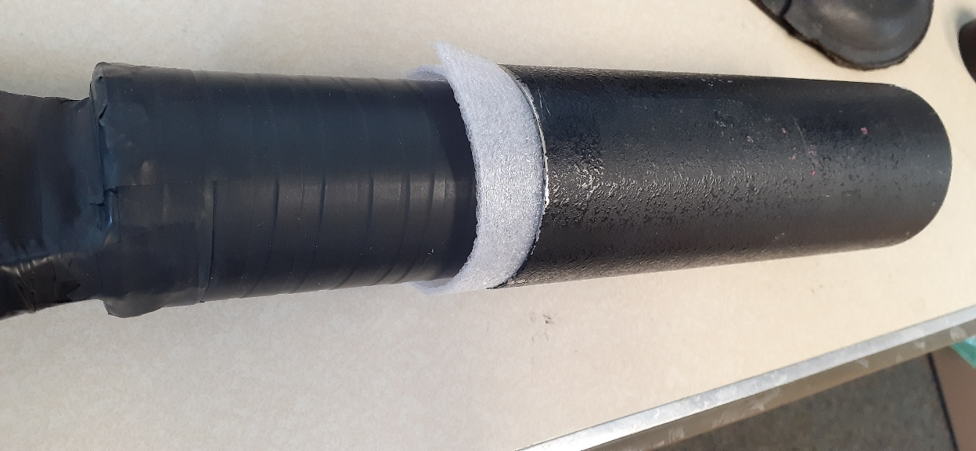
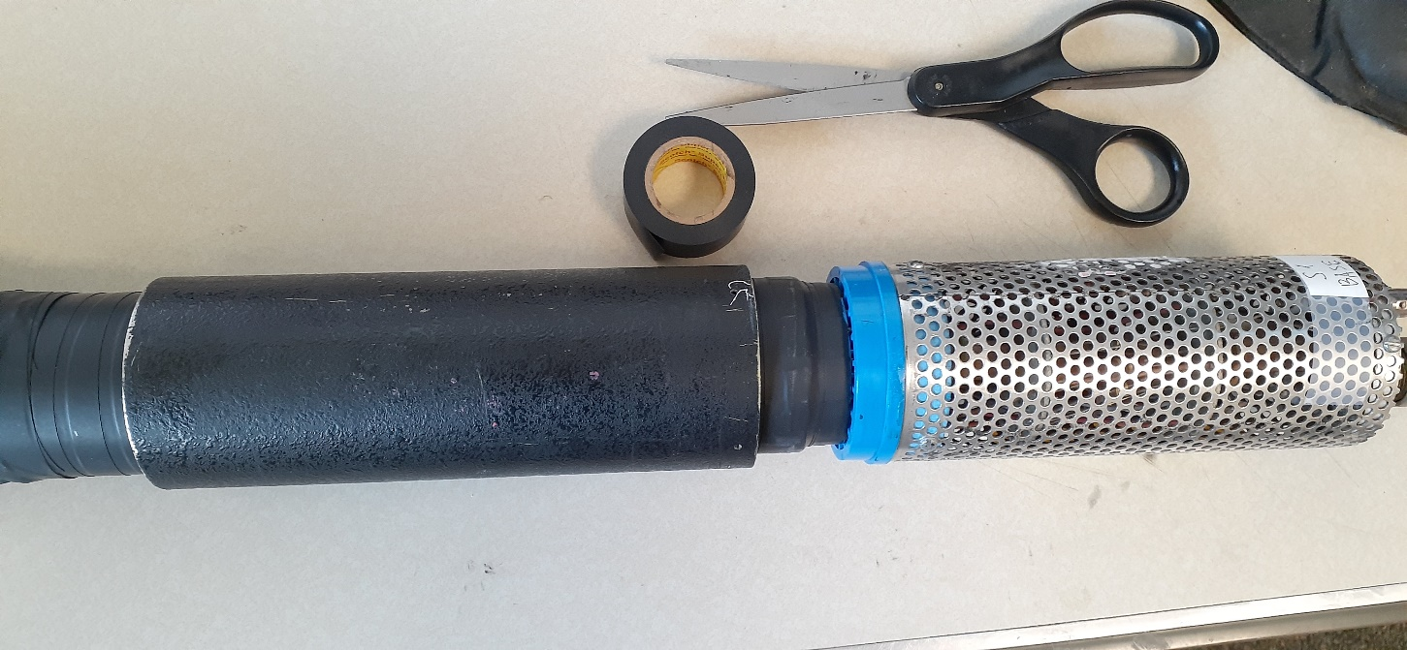
Counter assembly – new tube

Slide 8
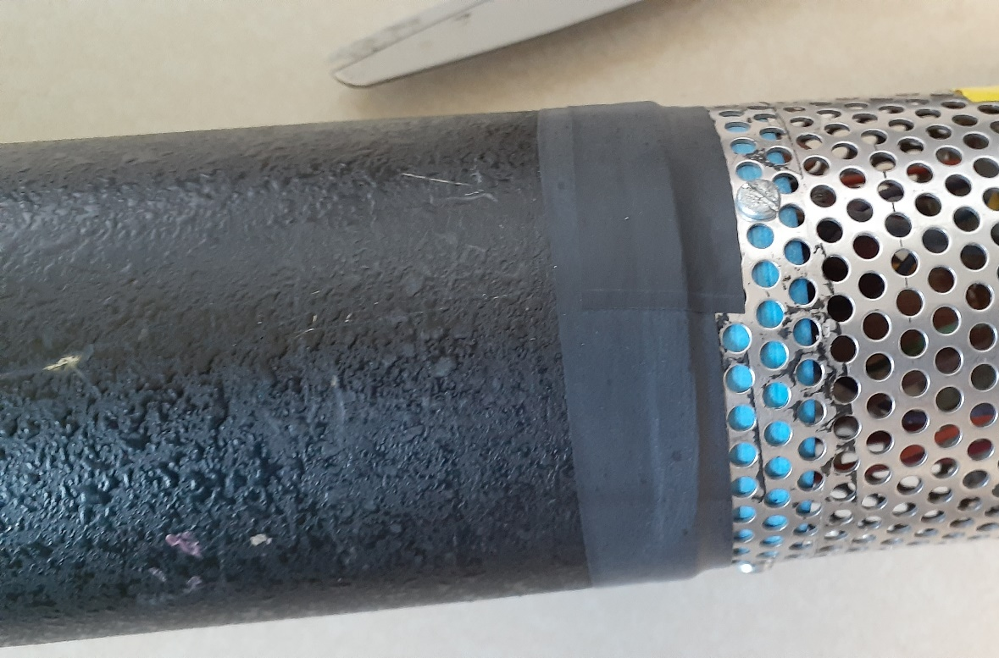
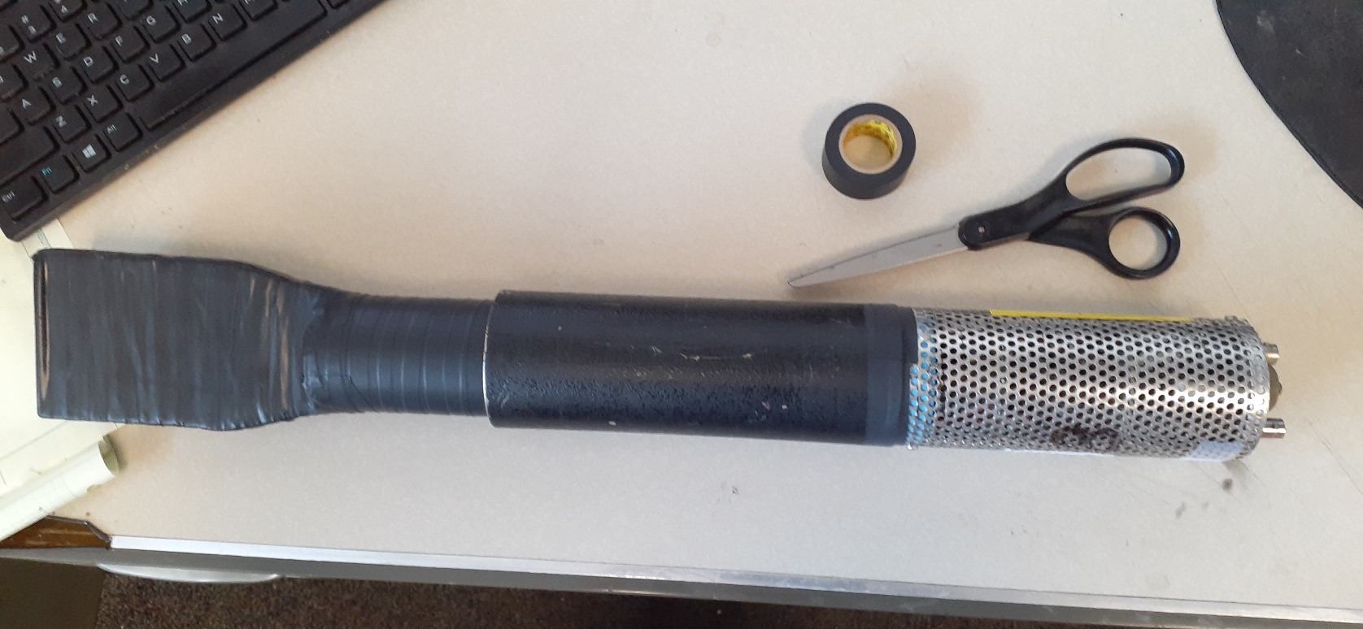
Counter assembly – new tube

Slide 9
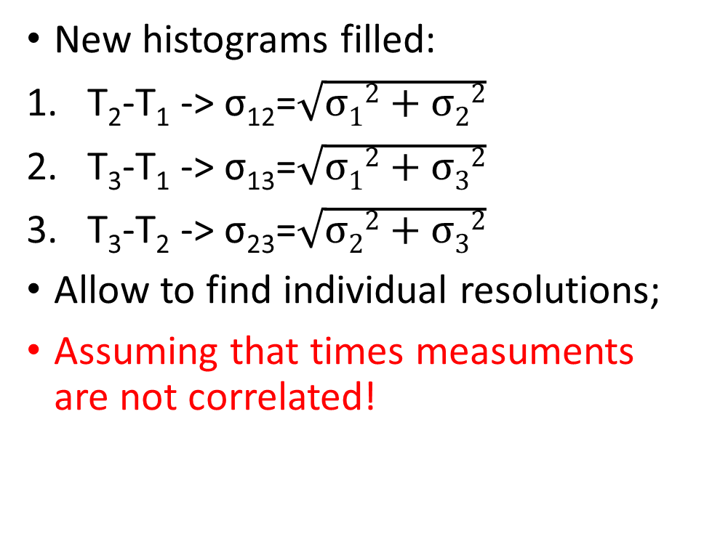
More data analysis
New histograms filled:
T₂-T₁ -> σ₁₂=$\sqrt{σ12+σ22}$
T₃-T₁ -> σ₁₃=$\sqrt{σ12+σ32}$
T₃-T₂ -> σ₂₃=$\sqrt{σ22+σ32}$
Allow to find individual resolutions;
Assuming that times measuments are not correlated!

Slide 10
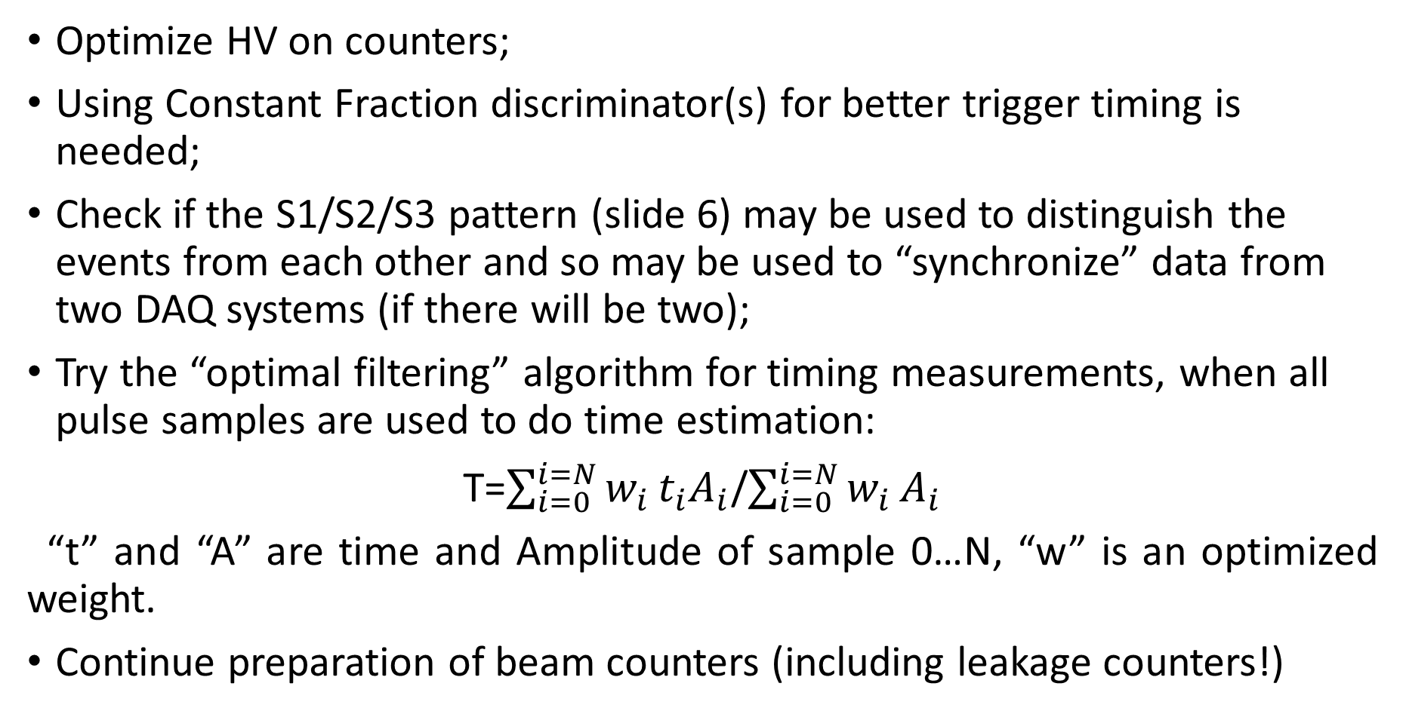
Plans
Optimize HV on counters;
Using Constant Fraction discriminator(s) for better trigger timing is needed;
Check if the S1/S2/S3 pattern (slide 6) may be used to distinguish the events from each other and so may be used to “synchronize” data from two DAQ systems (if there will be two);
Try the “optimal filtering” algorithm for timing measurements, when all pulse samples are used to do time estimation:
T=$\sum_{i=0}^{i=N}{w_{i}}t_{i}A_{i}$/$\sum_{i=0}^{i=N}{w_{i}}A_{i}$
“t” and “A” are time and Amplitude of sample 0…N, “w” is an optimized weight.
Continue preparation of beam counters (including leakage counters!)

