Slide 1
Cosmic rays trigger and readout of beam counters.
Offline analysis.
Alexandre Savine
Special thanks to Billie Lubis and Robert Walker
April 15, 2021

Slide 2
Setup description
Three scintillators S1, S2, S3;
Trigger – coincidence S1xS2;
ADC readout – two channels:
Sum of S1 + S2 (32ns delay) + S3 (64ns delay). Will be presented as blue waveform;
Trigger pulse (same as initiates ADC buffer readout). For timing and more. Will be presented as red waveform;

Slide 3
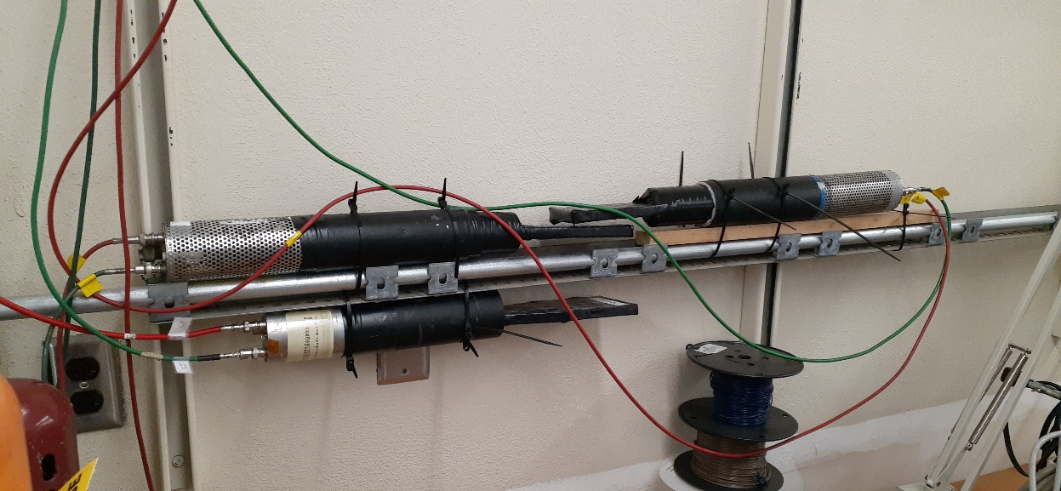
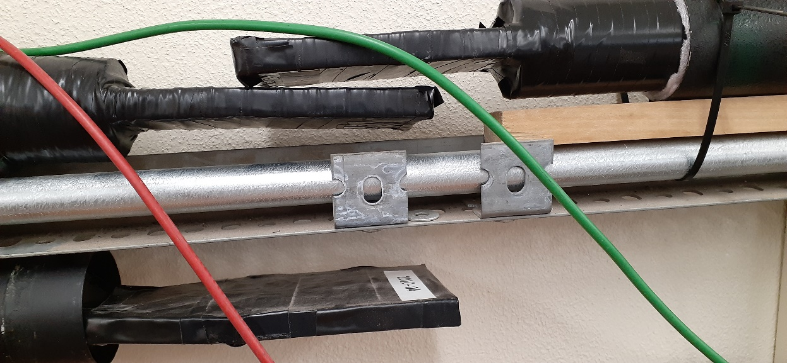
New counters layout

Slide 4
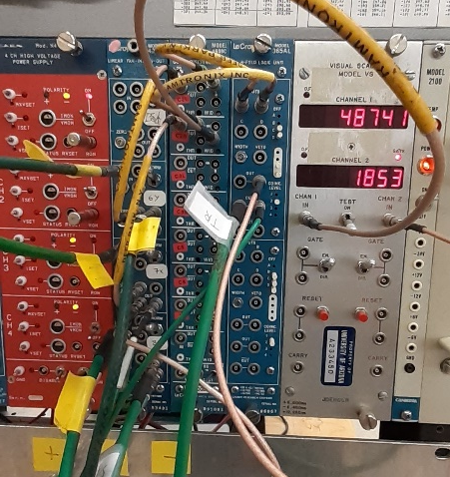
Electronics – same as in April 8 talk
Left to right:
HV supply;
Analog Fan-IN Fan-OUT. Signals from S1, S2 are split (#2, #3) and summed with delay (#4);
Octal Discriminator;
Coincidence. Produces S1xS2 signal as a Trigger;
Scaler. Ch#1 – S2, Ch#2 – S1xS2

Slide 5
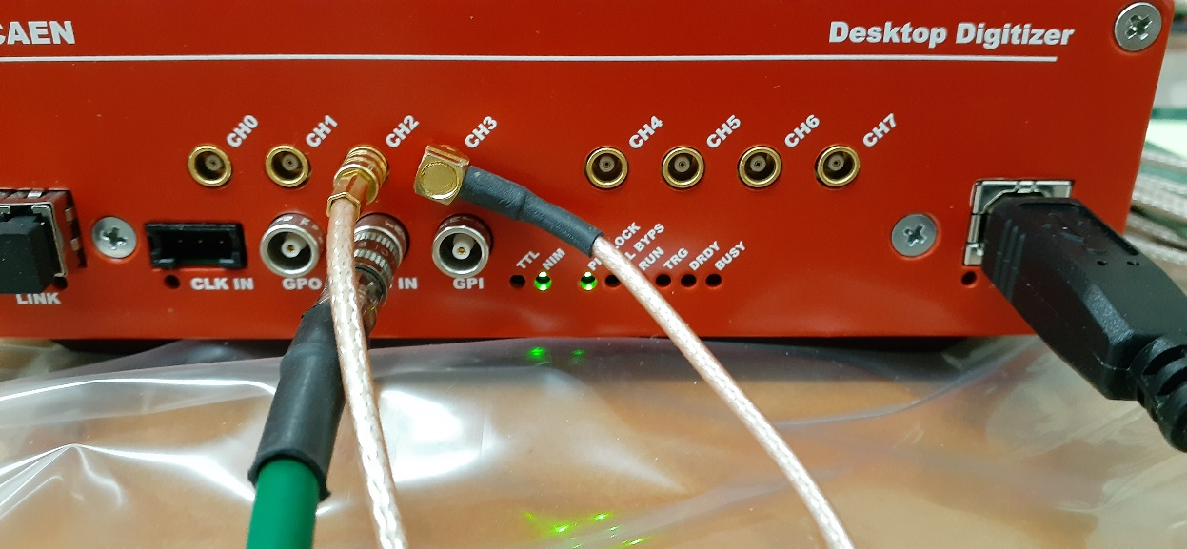
ADC module

Slide 6
Event examples – with and without hit in S3

Slide 7
Examples of “no-trigger” events

Slide 8
About the “no-trigger” events
Common feature: ADC=0 (underflow). Underflow occurs mostly in the S3 which has higher gain;
Rate is approximately 8%;
Very bad thing – may seriously complicate analysis if there will be separate DAQ, recording events strictly by trigger:
MWPC data (ITEP DAQ);
Scintillator counters, digitized by ITEP DAQ;
Rate of parasitic events may be increased depending on beam area environment;

Slide 9
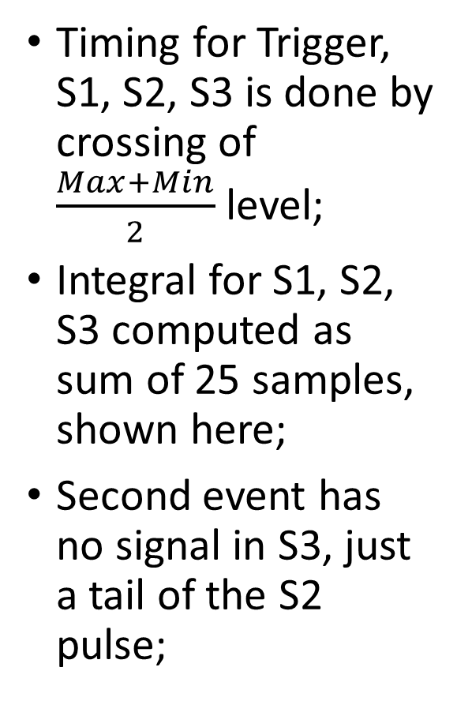
Event Details (correspond to slide 6)
Timing for Trigger, S1, S2, S3 is done by crossing of $\frac{Max+Min}{2}$level;
Integral for S1, S2, S3 computed as sum of 25 samples, shown here;
Second event has no signal in S3, just a tail of the S2 pulse;

Slide 10
Amplitude Spectra
Electronics + PMT noise (red) is negligible. May be studied in more details;
Counters shall be brought to a “common MIP” by adjusting HV;
Low amplitudes in S1 and S2 are due to:
Particles hitting edge of scintillators;
Particles hitting light guides and phototubes;
S3 has more low amplitudes because some tracks, causing the trigger, cam miss it entirely;
S3 has something much bigger than noise because it’s signal “sits” on top of tail from S1 and S2. May be improved by longer delays;

Slide 11
Timing resolution – relative to trigger
T(counter) – T(trigger) is showh;
Low amplitudes from previous slide are shown in blue and not used in the resolution estimation;
S2 has the closest match with trigger pulse – no wonder, trigger is set so it is determined by S2 pulse;
Counter-counter timing shall be studied as well;
In the test beam setup timing resolution will be better:
Beam crossing the scintillator strictly at 90º;
Hits will be concentrated around the center of the scintillator;
No showers (presumably);

Slide 12
Conclusion
“Non-trigger” events must be understood and eliminated. Wonder if they are caused by some accidental/factory settings in Digitizer;
HV settings not optimal. Shall be adjusted;
Nature of cosmic rays limits timing optimization: random directions, hits on light guides and phototubes, multiple particles;

Slide 13
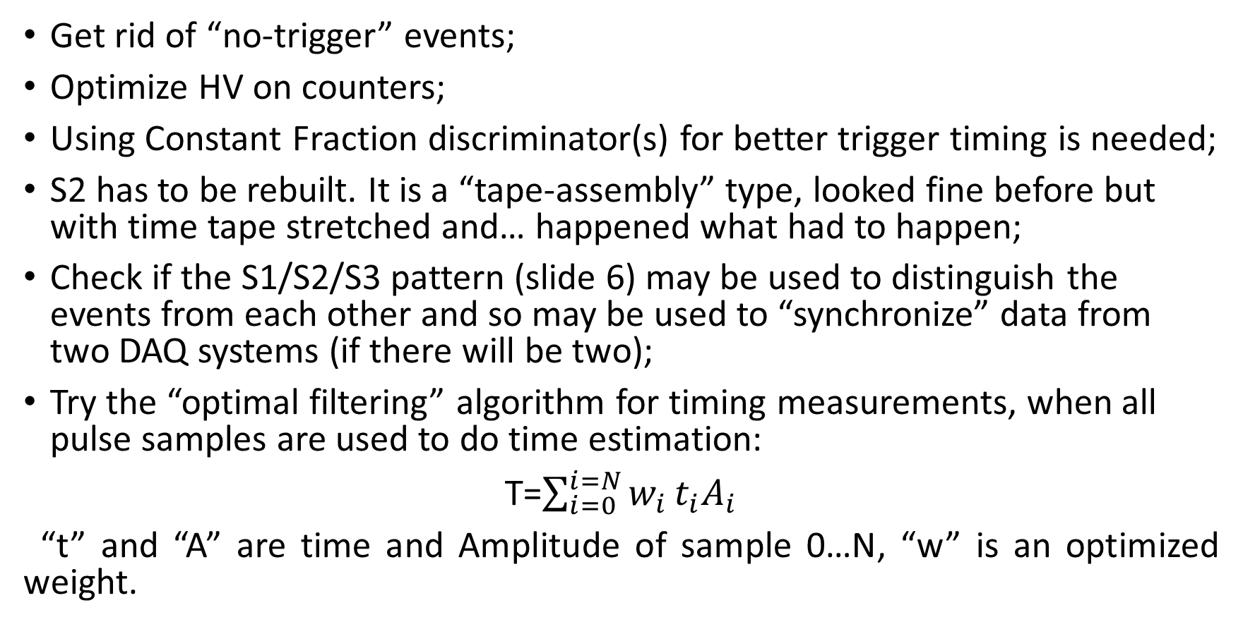
Plans
Get rid of “no-trigger” events;
Optimize HV on counters;
Using Constant Fraction discriminator(s) for better trigger timing is needed;
S2 has to be rebuilt. It is a “tape-assembly” type, looked fine before but with time tape stretched and… happened what had to happen;
Check if the S1/S2/S3 pattern (slide 6) may be used to distinguish the events from each other and so may be used to “synchronize” data from two DAQ systems (if there will be two);
Try the “optimal filtering” algorithm for timing measurements, when all pulse samples are used to do time estimation:
T=$\sum_{i=0}^{i=N}{w_{i}}t_{i}A_{i}$
“t” and “A” are time and Amplitude of sample 0…N, “w” is an optimized weight.

