Slide 1
Cosmic rays trigger and readout of beam counters
Alexandre Savine
Special thanks to Billie Lubis and Robert Walker
April 8, 2021

Slide 2
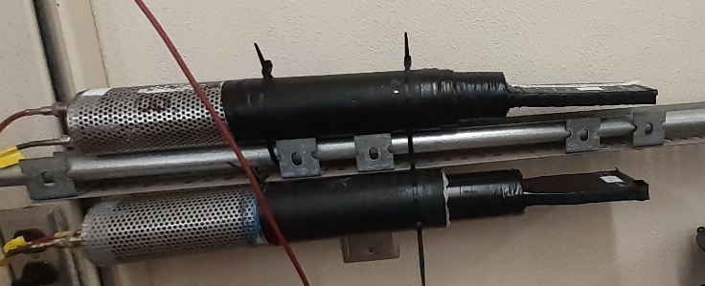
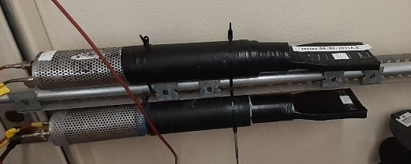
Trigger counters

Slide 3
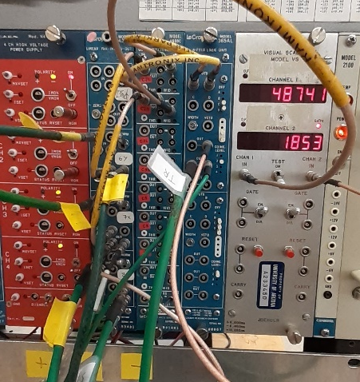
Electronics - minimal
Left to right:
HV supply;
Analog Fan-IN Fan-OUT. Signals from S1, S2 are split (#2, #3) and summed with delay (#4);
Octal Discriminator;
Coinsidence. Produces S1xS2 signal as a Trigger;
Scaler. Ch#1 – S2, Ch#2 – S1xS2

Slide 4
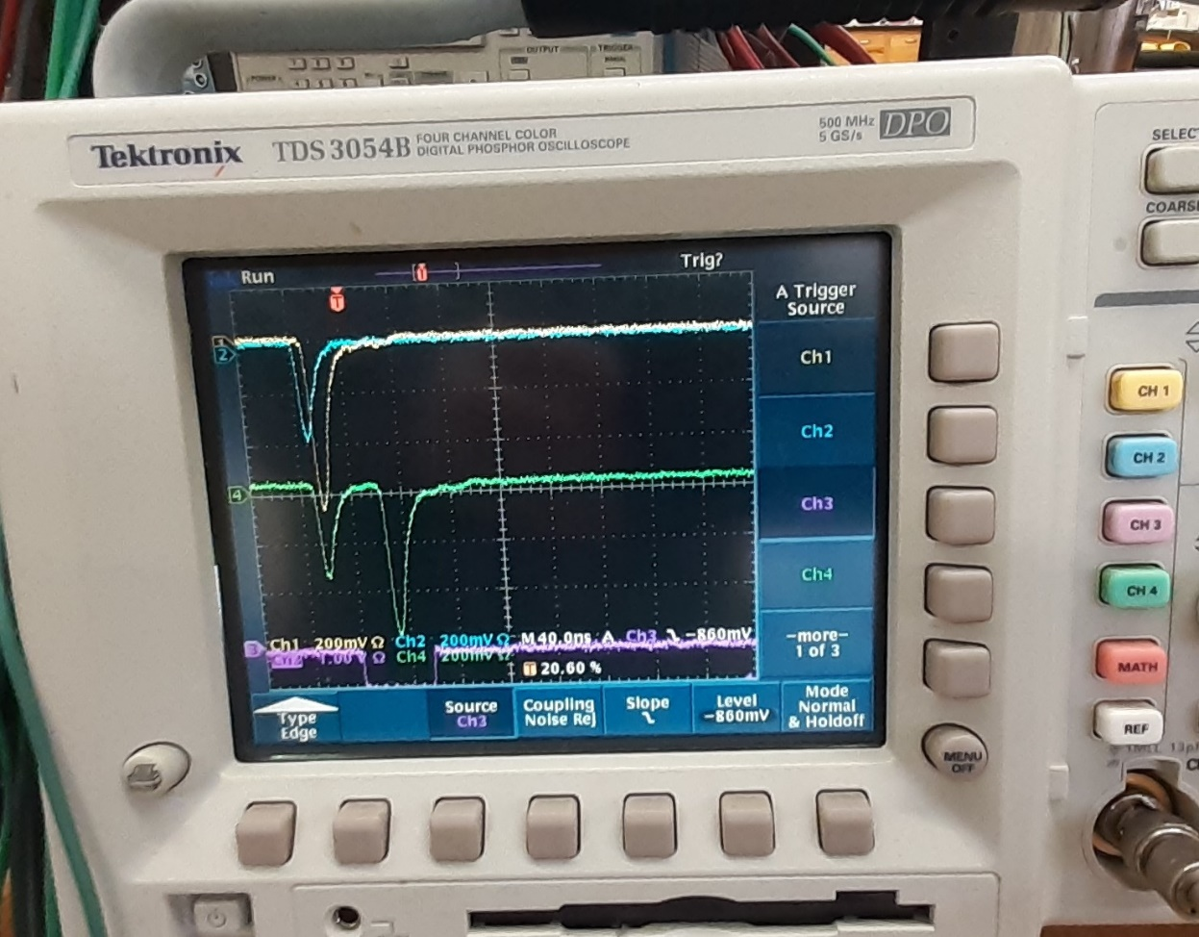
Scope screenshot
Ch1 and Ch2 (yellow and blue, top) – S1 and S2
Ch4 (green, middle) –
S2 + S1_{DELAYED}
Ch3 (purple) – trigger, S1xS2

Slide 5
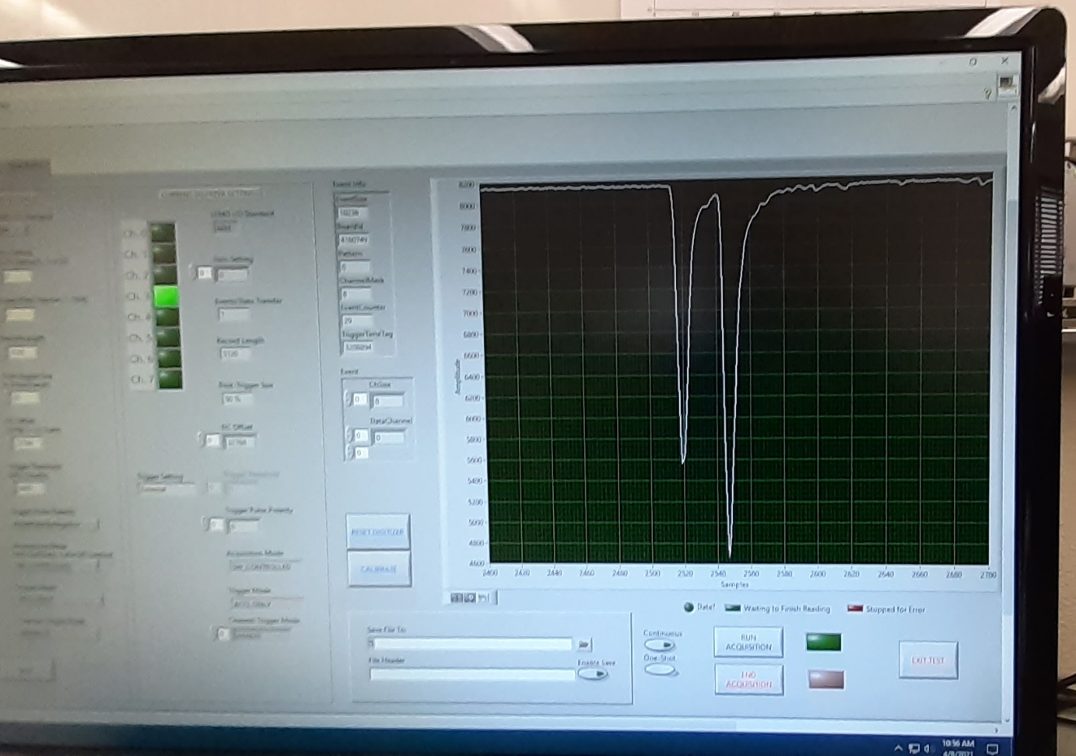
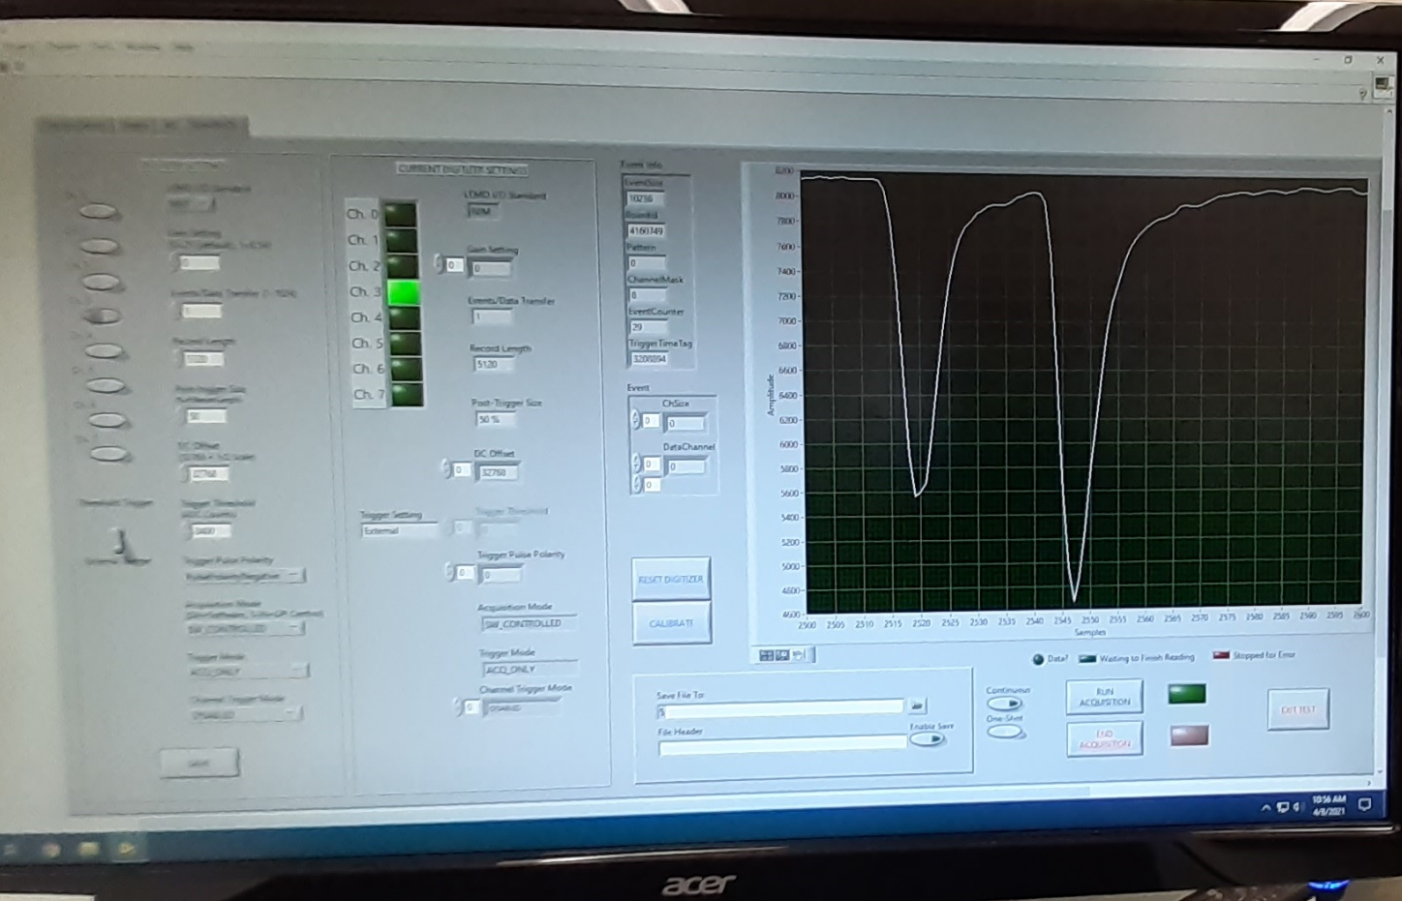
DAQ readout, initiated by the S1xS2 trigger

Slide 6
Conclusion
Readout of multiple counters by single ADC channel is possible;
Using Constant Fraction discriminators for better trigger timing, we can estimate timing capability for the off-line analysis using cosmic rays;
Preliminary optimization of beam counters HV and thresholds may be performed here at UofA.

