Slide 1
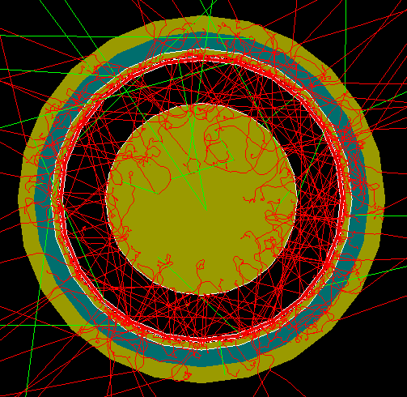
FCalPulse Local Mtg
J.Rutherfoord
8 Jul 2021
v1

Slide 2
Agenda
News
Preparations – Rob
Monitoring and on-line analysis - Graham

Slide 3
News
LN2 dewars
Indium foil
Learning https://lms.cern.ch/ekp/servlet/ekp?TX=widgetcontainerpage
COVID-19 Health and Safety Measures
Proximeter
Safety at CERN
Emergency Evacuation
Radiation Protection – Awareness
ISIEC Form for our FCalPulse experiment

Slide 4
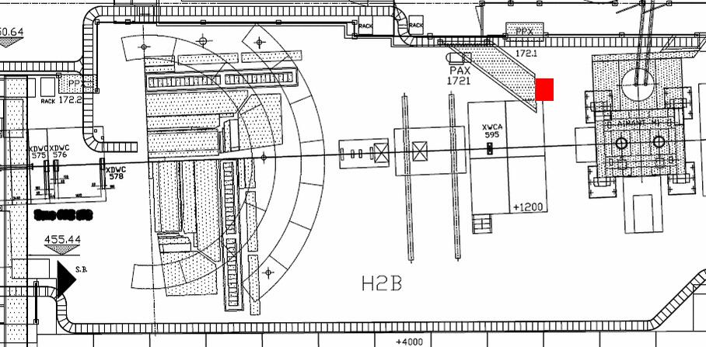
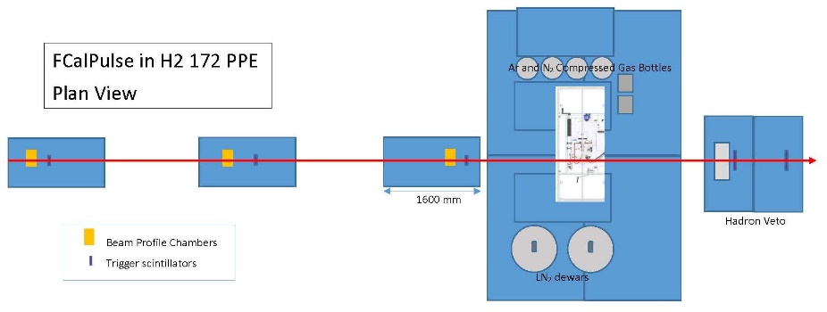
FCalPulse in H2 zone PPE 172
9 m

Slide 5
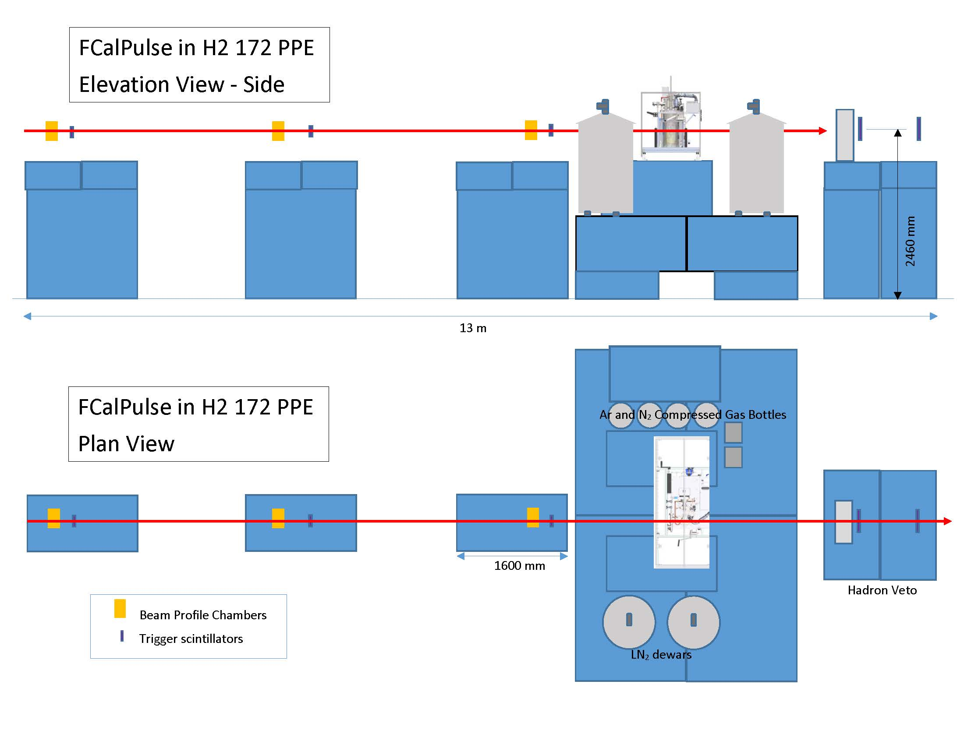

Slide 6
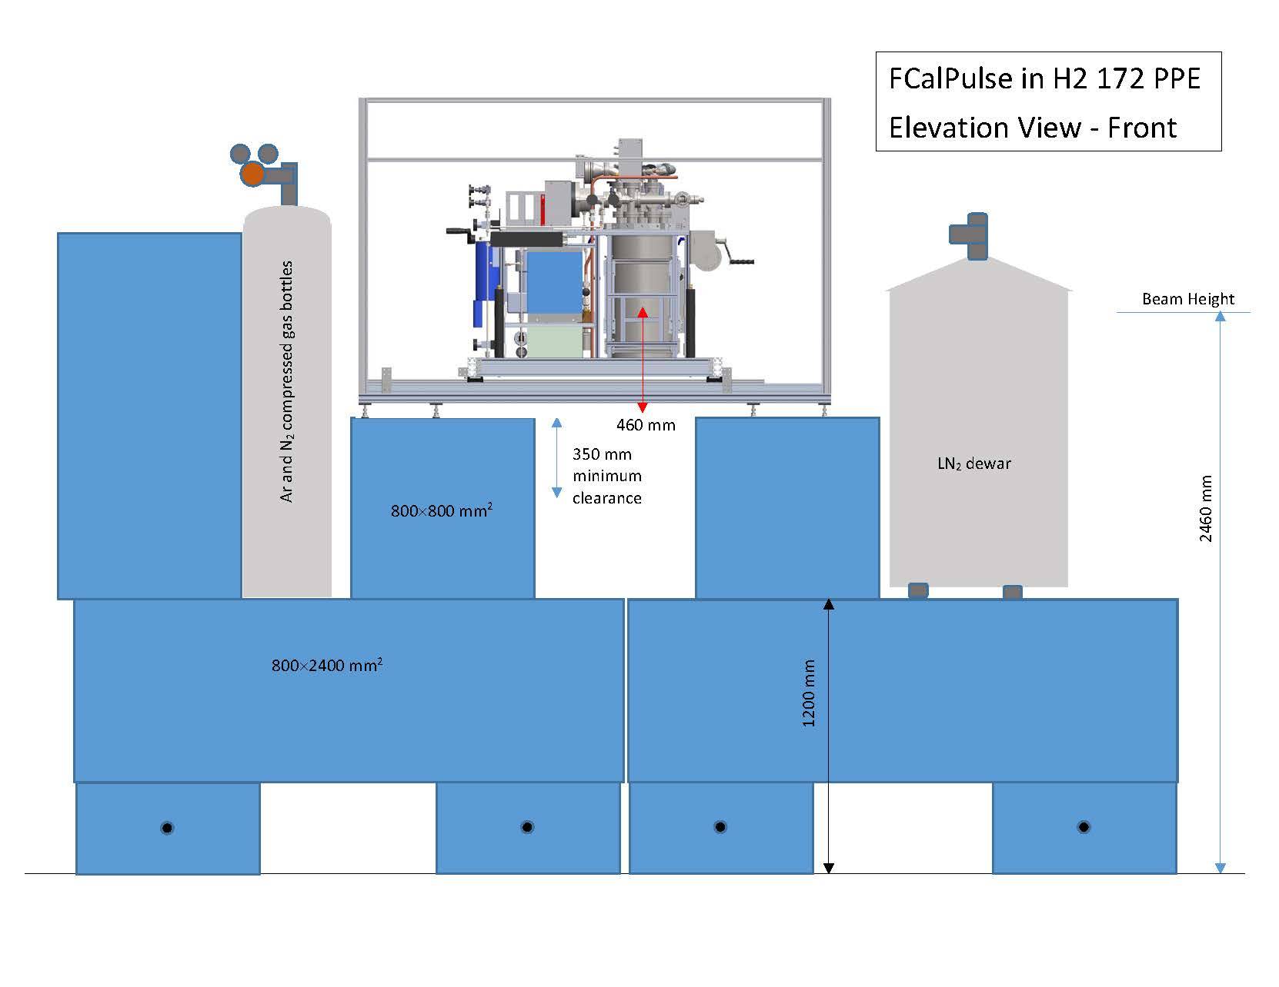

Slide 7
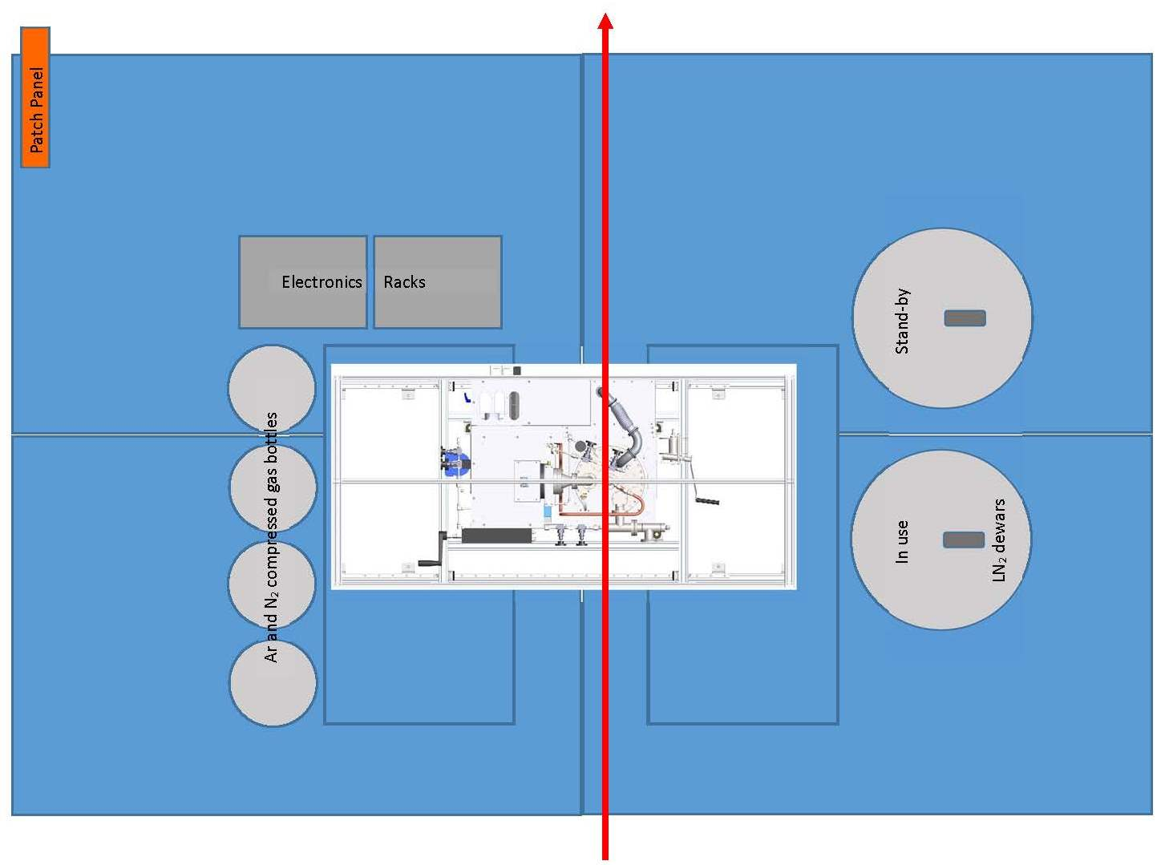

Slide 8
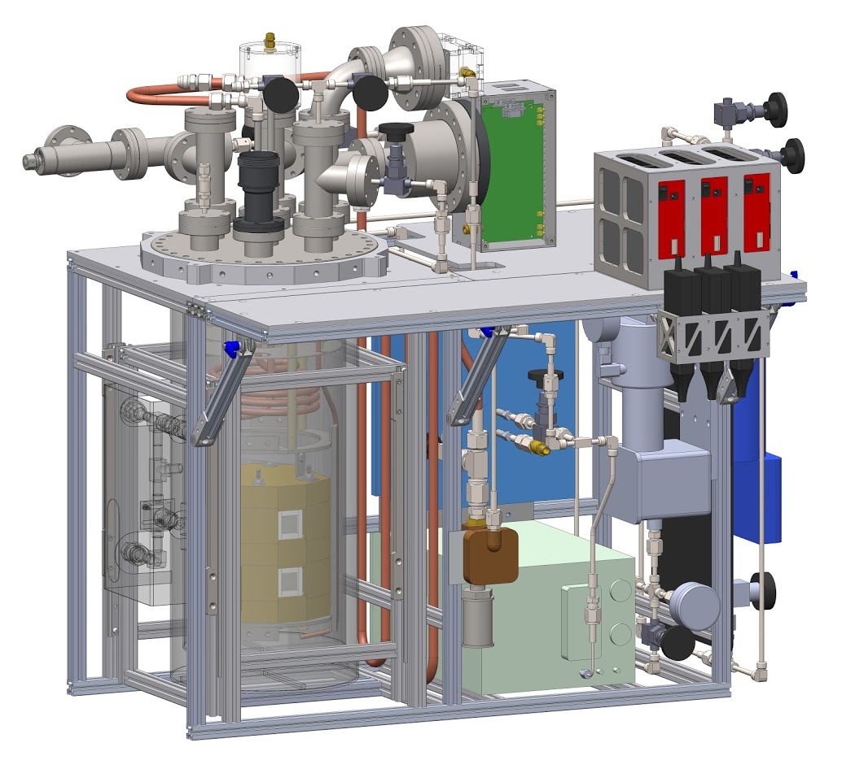
The cryostat can has been made semi-transparent in this drawing to show the cooling loops and brass shielding inside. This shielding is to cut down on the Sr-90 radiation.
Exposure at 1 m is expected to be approximately at the natural background level.
Cryostat temperature regulation is via gas pressure, so immune to power outages.

