Slide 1
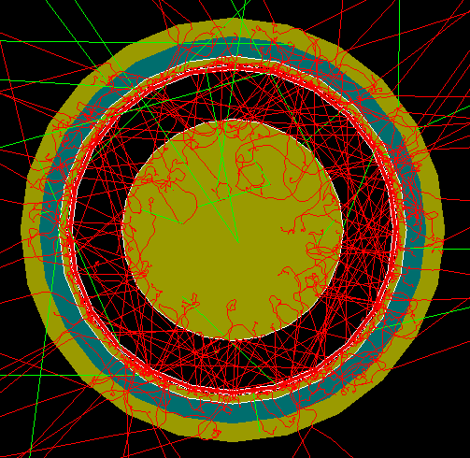
FCalPulse Local Mtg
J.Rutherfoord
2 Jul 2021
v1

Slide 2
Outline
Latest news
Rob Walker – Shipping status and cryo diagnostics
Graham Woolley – Semi-online analysis

Slide 3
The latest
Shipping the apparatus to CERN
Billie’s Comprehensive Oral Exam
Written report now circulated
Strontium-90 source
2nd attempt to send Indium foil now shipped
Liquid Nitrogen dewars
Swiss visa experience
To-do lists

Slide 4
CERN.Entry.Require.txt Early Draft
2 July 2021
J.Rutherfoord
List of things to prepare for our trip to CERN
1. New USER registrations- your Team Leader must start the Pre-registration
(via the PRT tool [usersoffice.web.cern.ch]) for you.
* Ensure to attach all relevant documents to the PRT (HID, passport copy,
invitation letter and Swiss visa).
* All CERN contracts are currently being established remotely. The ATLAS
spokesperson or Technical Coordinator must give their green light to
approve all PRTs.
* For urgent requests please contact the users.office@cern.ch Further
information here: https://usersoffice.web.cern.ch/ [usersoffice.web.cern.ch]
2. CERN Users working on projects requiring their presence on the CERN site
should refer to the following HSE page in relation to the current colour-coded
level in place: General - [ Level 3 ] "Orange" | HSE unit at CERN [hse.cern]
3. You must pass a compulsory COVID-19 Health and Safety Measures course in order
to access the CERN sites. → This course is available from the Learning Hub
[lms.cern.ch].
4. Sign the CERN COVID-19 Self-Declaration
+ All newcomers coming on the CERN sites must sign a form to declare that
they have read and understood the current COVID-19 related access
restrictions in force at CERN. Please provide the completed declaration
to the Users’ Office upon registration. Please read the accompanying
Instructions [edms.cern.ch] before signing the Declaration.
The Declaration is available here.
5. Familiarise yourself with the COVID-19 measures in place on site. They are
available on the HSE page [hse.cern] and FAQ [hse.cern]
CERN.Entry.Require.txt Early Draft
2 July 2021
J.Rutherfoord
List of things to prepare for our trip to CERN
1. New USER registrations- your Team Leader must start the Pre-registration
(via the PRT tool [usersoffice.web.cern.ch]) for you.
* Ensure to attach all relevant documents to the PRT (HID, passport copy,
invitation letter and Swiss visa).
* All CERN contracts are currently being established remotely. The ATLAS
spokesperson or Technical Coordinator must give their green light to
approve all PRTs.
* For urgent requests please contact the users.office@cern.ch Further
information here: https://usersoffice.web.cern.ch/ [usersoffice.web.cern.ch]
2. CERN Users working on projects requiring their presence on the CERN site
should refer to the following HSE page in relation to the current colour-coded
level in place: General - [ Level 3 ] "Orange" | HSE unit at CERN [hse.cern]
3. You must pass a compulsory COVID-19 Health and Safety Measures course in order
to access the CERN sites. → This course is available from the Learning Hub
[lms.cern.ch].
4. Sign the CERN COVID-19 Self-Declaration
+ All newcomers coming on the CERN sites must sign a form to declare that
they have read and understood the current COVID-19 related access
restrictions in force at CERN. Please provide the completed declaration
to the Users’ Office upon registration. Please read the accompanying
Instructions [edms.cern.ch] before signing the Declaration.
The Declaration is available here.
5. Familiarise yourself with the COVID-19 measures in place on site. They are
available on the HSE page [hse.cern] and FAQ [hse.cern]

Slide 5
Before departing you will need to
Ensure your passport was issued less than 10 years ago and will not expire
until at least December of this year.
Get your Swiss Visa
Fill out a U of A Travel Authorization Form (Shane can help)
Register your international travel with
https://ua-risk.terradotta.com
Arrange for a travel advance, if necessary
Book your flight
Accommodations are already booked in your name
Prevessin-Moens - Residhome Appart Hotel Le Carre D'Or

Slide 6
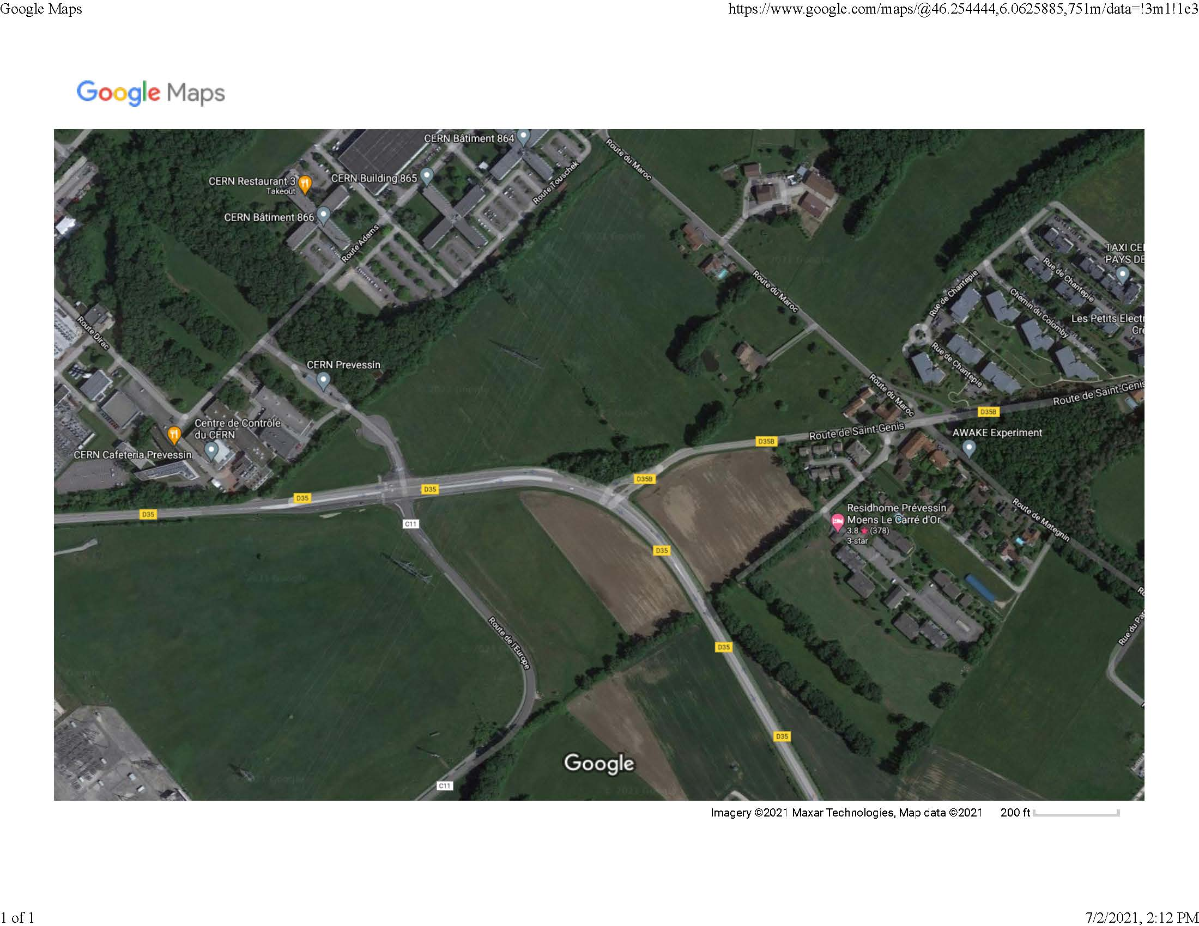

Slide 7
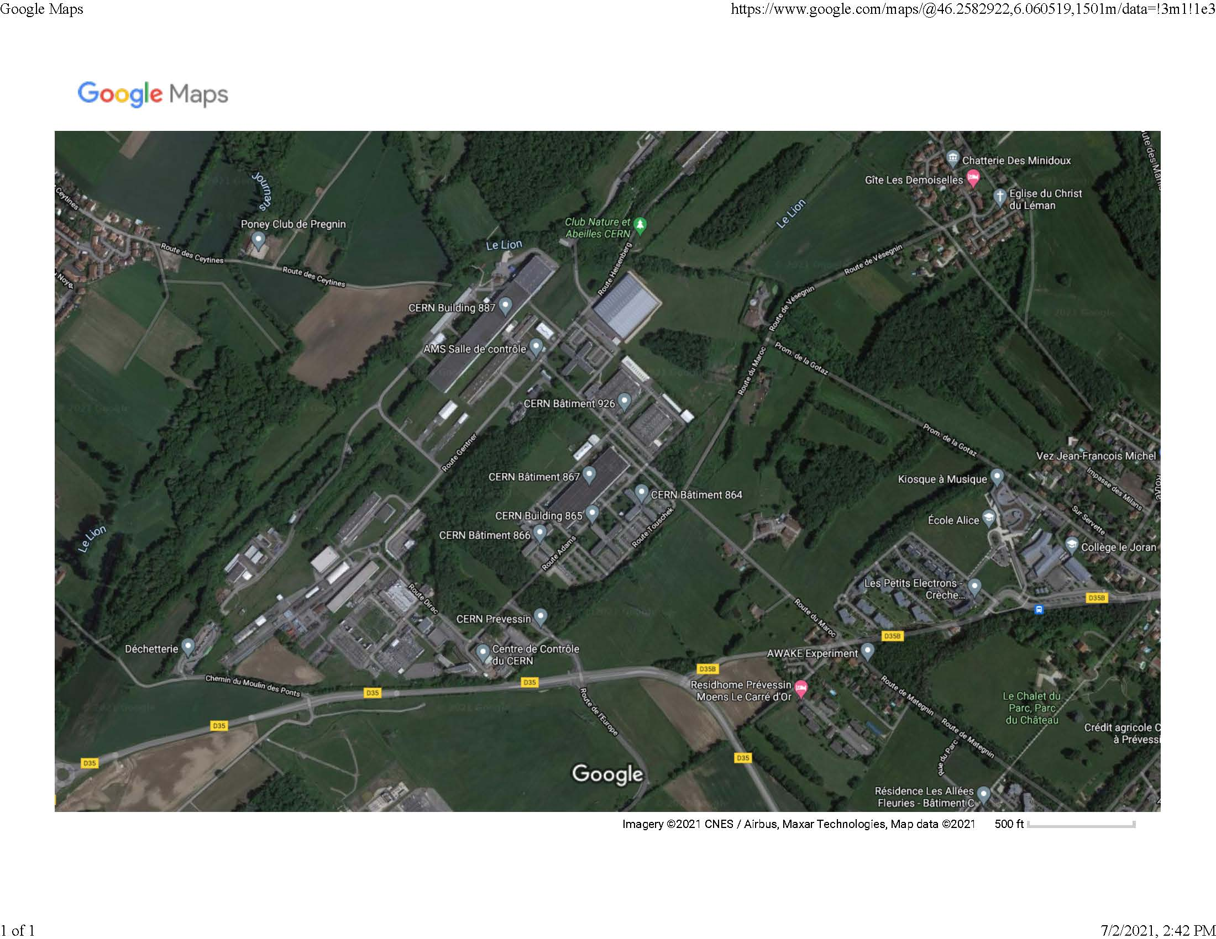

Slide 8
For entering Switzerland you will need
Your passport
Your Swiss visa (in your passport)
A copy of your CDC COVID-19 Vaccination Record Card
A copy of your PCR test results from Thursday or Friday before departure
A copy of a letter explaining that you are an essential worker at CERN.
This letter should include an explanation that your expenses are paid.
I have written this letter and will distribute.
A copy of a letter explaining your health and accident insurance
Your invitation letter from CERN
Your Convention d'Accueil from CERN
Fill out a Sworn Statement to Abide by the Rules for Entry into the
Metropolitan National Territory
For entering CERN
Take the covid learning
Fill out a Declaration of Honour
And more ……

