Slide 1
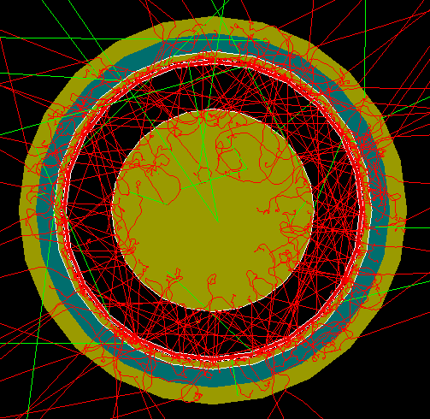
FCalPulse Local Mtg
J.Rutherfoord
24 Jun 2021
v1

Slide 2
Outline
Latest news
Rob Walker – Shipping plans and cryo diagnostics
Sasha Savin – Update on the trigger scintillators
Graham Woolley – Diagnostics

Slide 3
We need Swiss visas
This means we must all travel to San Francisco to register and leave our passports
You must email the Swiss visa office to make an appointment. You will need to attach an invitation from CERN
You must request an invitation from the ATLAS Secretariat (I’ve done that already so now we must follow up.)

Slide 4
Tentative schedule
2 July Ship equipment to CERN
18 July Team arrives at CERN
19 July Get CERN ID and rad badges
20 July – 3 Aug
Stage our apparatus in PPE 182
Arrange safety inspections
Organize gas and cryo deliveries
Set up trigger electronics
Take required training

Slide 5
Tentative schedule – Con’t
4 Aug Supervise infrastructure deployment and install our experiment
When beam returns at the end of the day
Start cryostat cool-down?
Time-in the trigger
Use BPCs to locate and tune beam
4 Aug (evening) to 5 Aug Tune beam
5 Aug – 11 Aug (morning) Take data

Slide 6
Tentative Schedule – Con’t
5 Aug
Beam tuning
DAQ commissioning
Trouble-shooting all systems
6 – 10 Aug Normal (?) data taking
Cycle thru O₂ contamination
Cycle thru HV settings and polarity to the rod/tube electrode
Cycle between up/down assemblies
Study x-talk between tube segments

Slide 7
Critical Milestones (With dates)
Receive Sr-90 source from IPPE ?
Prepare system DAQ test – Start 17 May
Full system DAQ test – Start 14 Jun
Full system cryo test – Start 21 Jun
Determine Sr-90 activity
How to beat down the electronics noise
Ship apparatus to CERN – 7 Jul
Team arrives at CERN – 21 Jul
Beam starts – 4 Aug

