Slide 1
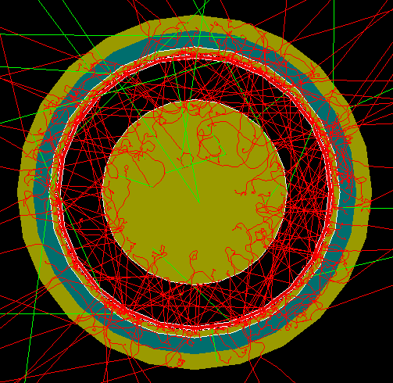
FCalPulse Local Mtg
J.Rutherfoord
3 Jun 2021
v1

Slide 2
Outline
Welcome
Latest news
Updated beamline layout
Rob Walker
Updates
Sasha Savin
Evolution of the trigger logic

Slide 3
Arrangements and Accommodations
At the U of A
Purchase plane tickets (arrange for payment)
Fill out travel forms (2 forms)
At CERN
Register at CERN
Get invitation and visa(s)?
Residhome Appart Hotel Le Carre D’Or in Prevessin-Moens rooms reserved

Slide 4
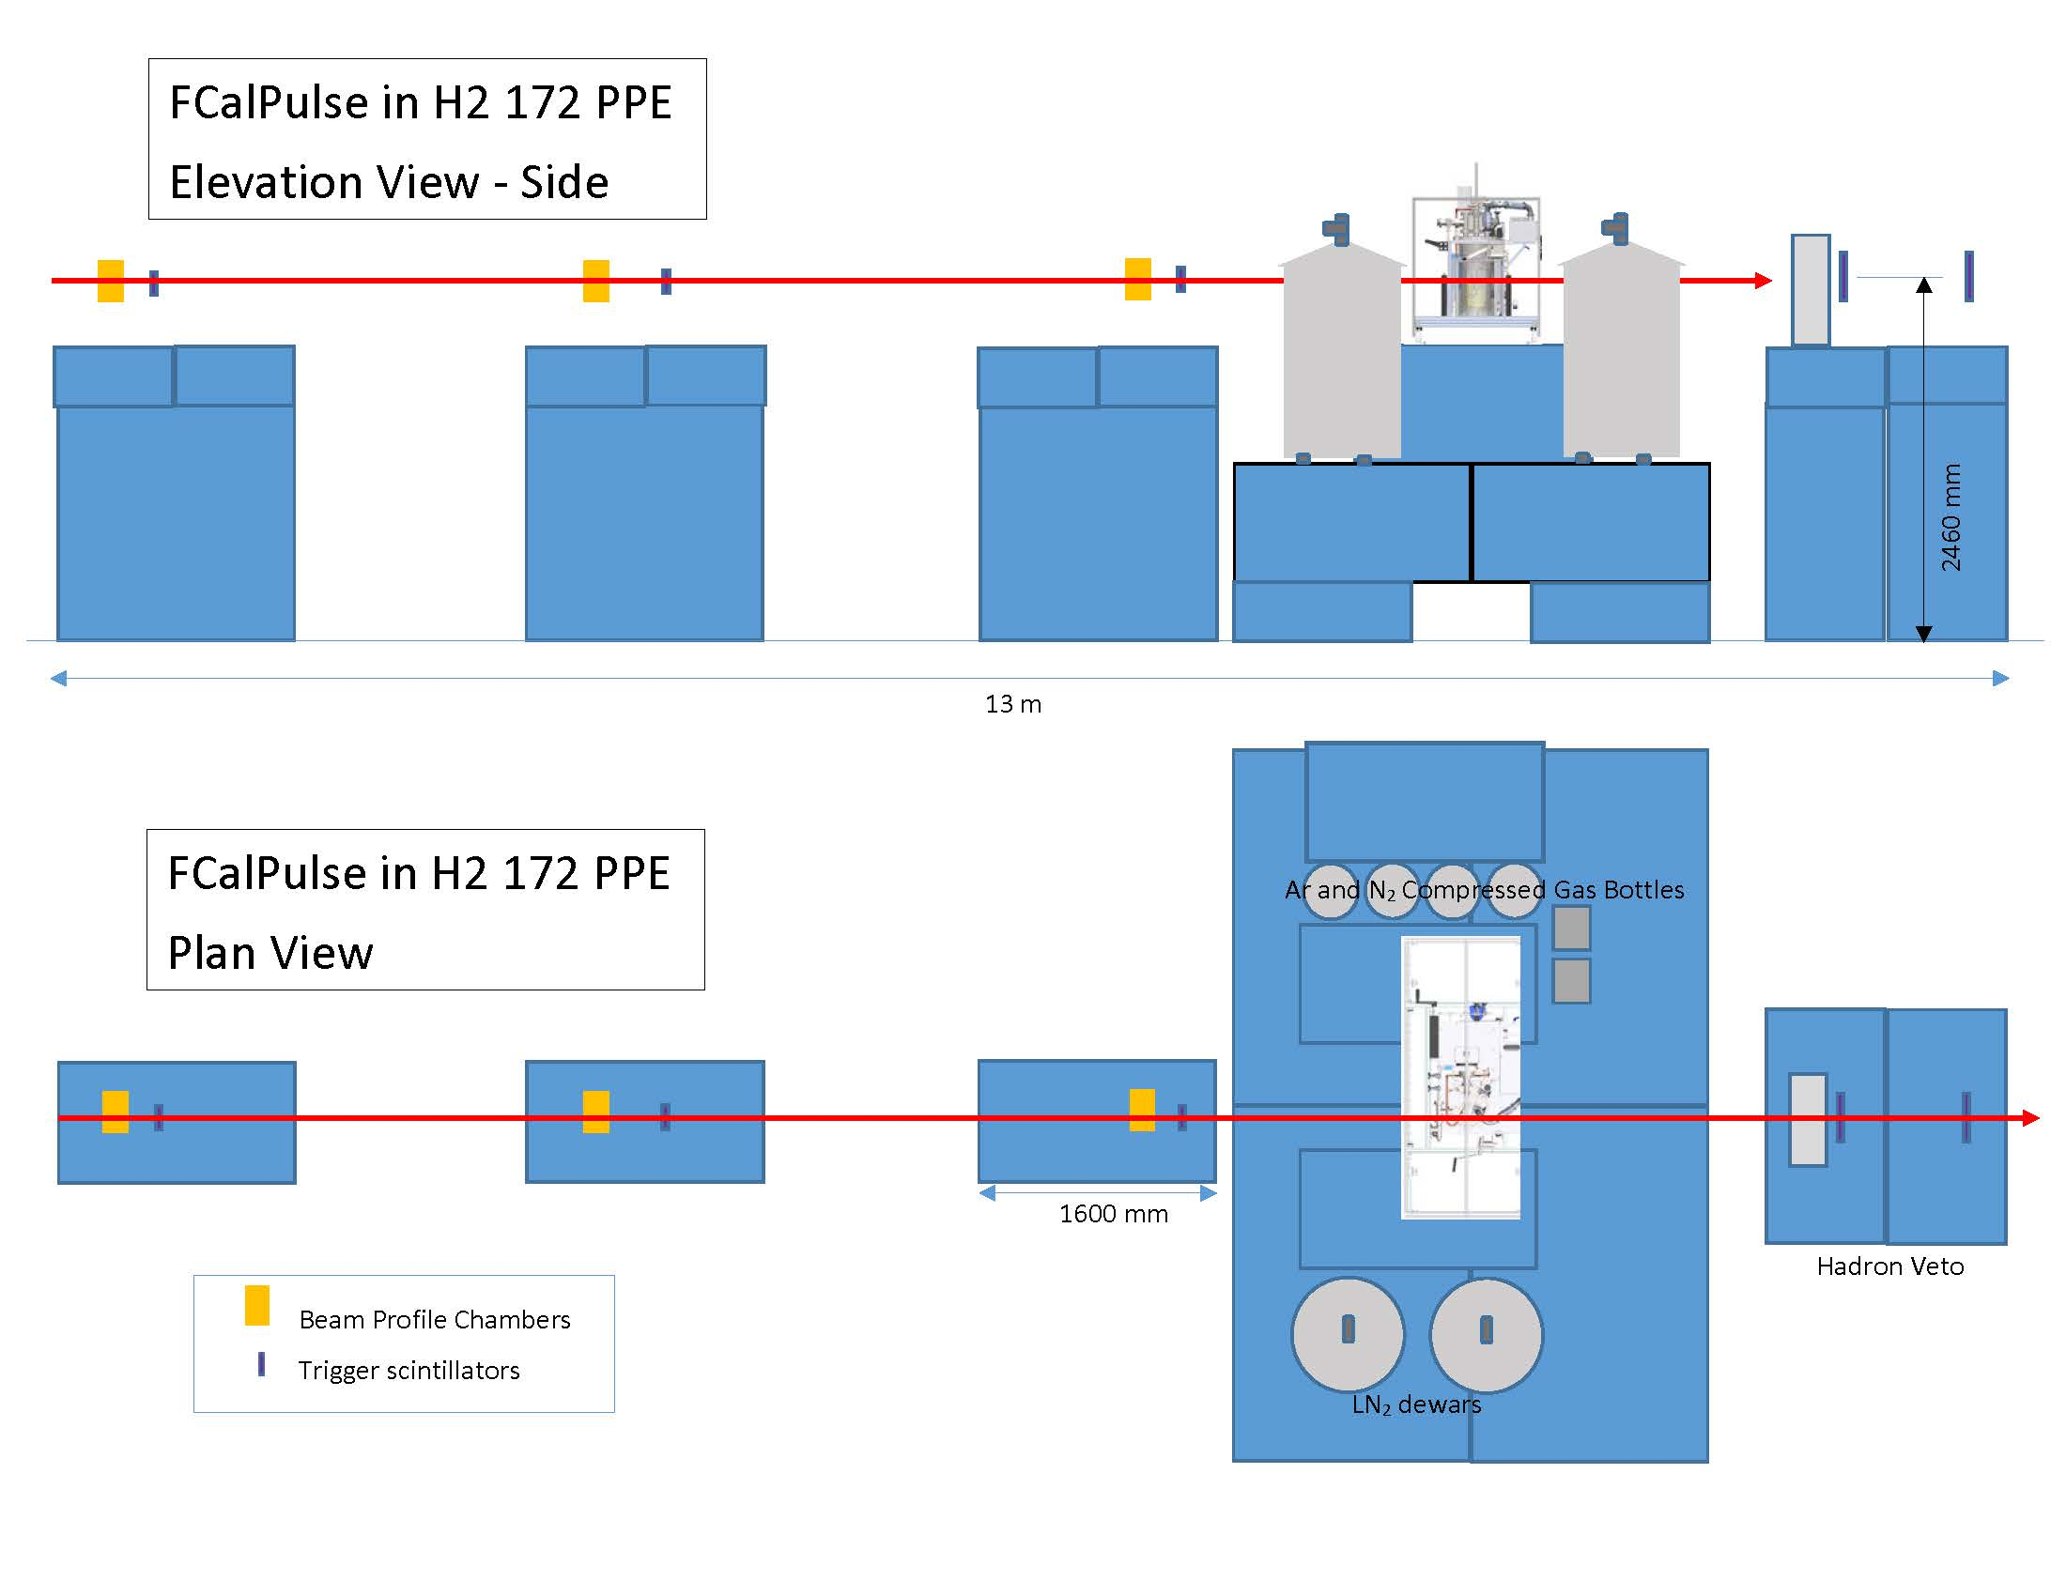

Slide 5
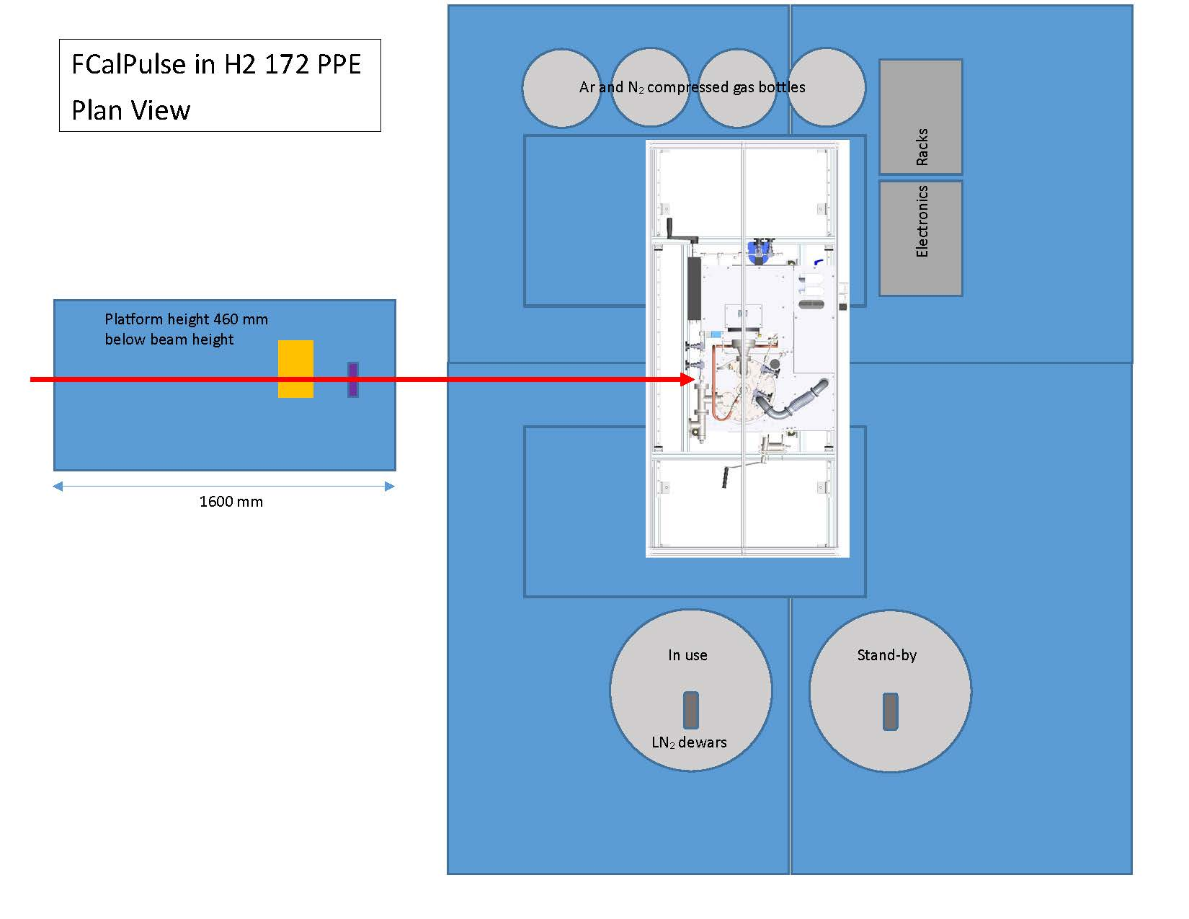

Slide 6
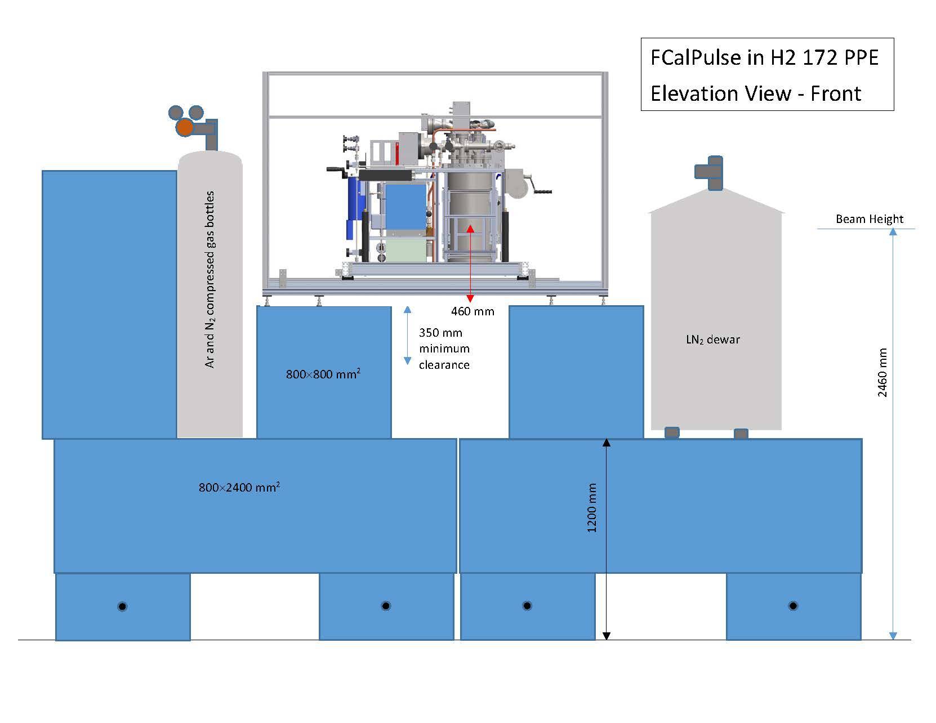

Slide 7
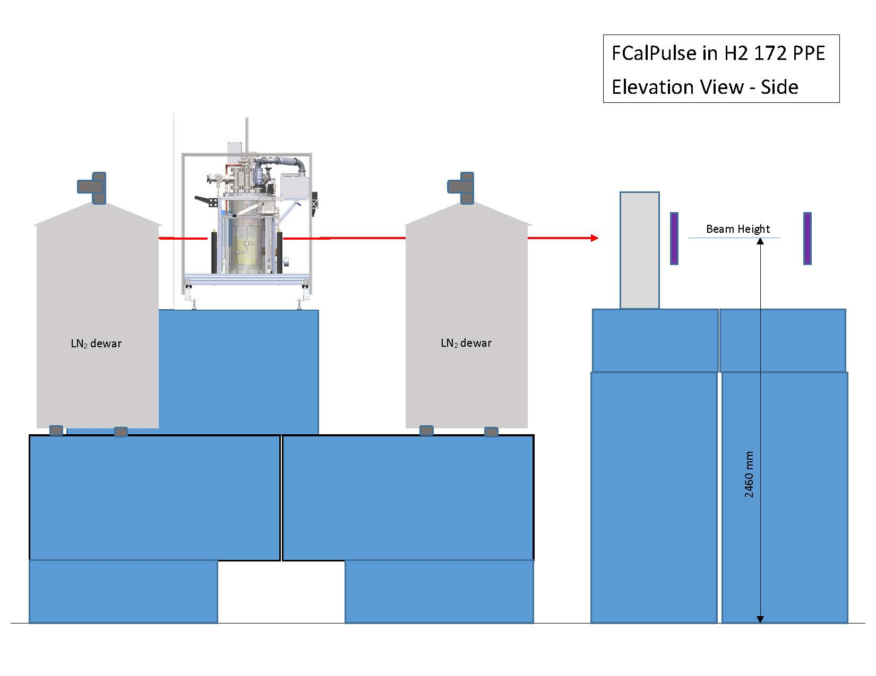

Slide 8
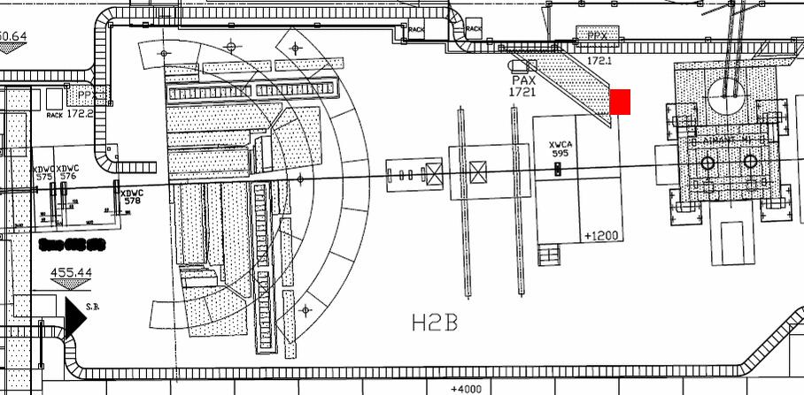
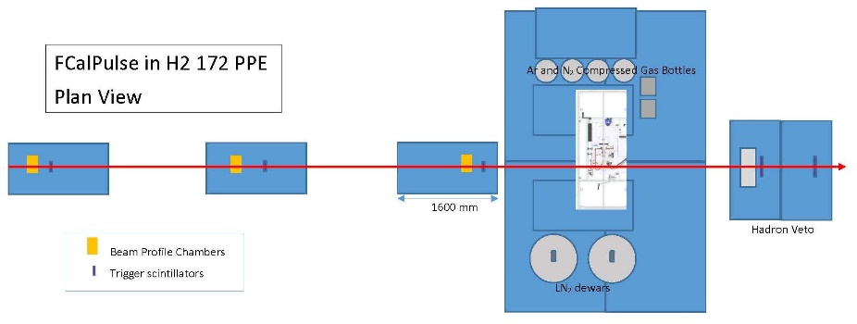
FCalPulse in our H2 zone
9 m

Slide 9
Tentative schedule
2 July Ship equipment to CERN
18 July Team arrives at CERN
19 July Get CERN ID and rad badges
20 July – 3 Aug
Stage our apparatus in PPE 182
Arrange safety inspections
Organize gas and cryo deliveries
Set up trigger electronics
Take required training

Slide 10
Tentative schedule – Con’t
4 Aug Supervise infrastructure deployment and install our experiment
When beam returns at the end of the day
Start cryostat cool-down?
Time-in the trigger
Use BPCs to locate and tune beam
4 Aug (evening) to 5 Aug Tune beam
5 Aug – 11 Aug (morning) Take data

Slide 11
Possible Schedule – Con’t
5 Aug
Beam tuning
DAQ commissioning
Trouble-shooting all systems
6 – 10 Aug Normal (?) data taking
Cycle thru O₂ contamination
Cycle thru HV settings and polarity to the rod/tube electrode
Cycle between up/down assemblies

Slide 12
Critical Milestones (With dates)
Receive Sr-90 source from IPPE ?
Prepare system DAQ test – Start 17 May
Full system DAQ test – Start 14 Jun
Full system cryo test – Start 21 Jun
Determine Sr-90 activity
How to beat down the electronics noise
Ship apparatus to CERN – 7 Jul
Team arrives at CERN – 21 Jul
Beam starts – 4 Aug

