Slide 1
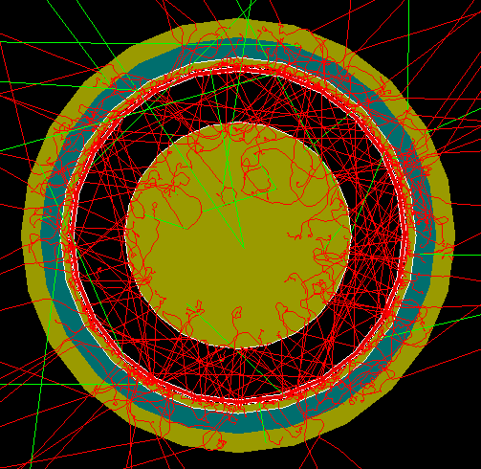
FCalPulse Local Mtg
J.Rutherfoord
13 May 2021
v1

Slide 2
Outline
Latest news
Critical Milestones
Rob Walker
Updates
Dan Tompkins
Register
Erich Varnes
Coordinating two separate DAQs

Slide 3
News
No response yet from
SPS Coordinator re swapping weeks
But Petr Gorbounov doesn’t think it’s necessary
Monnier re “Essential Worker” status
Travel restrictions lifting in France and Switzerland?
Beam line setup plans – just starting

Slide 4
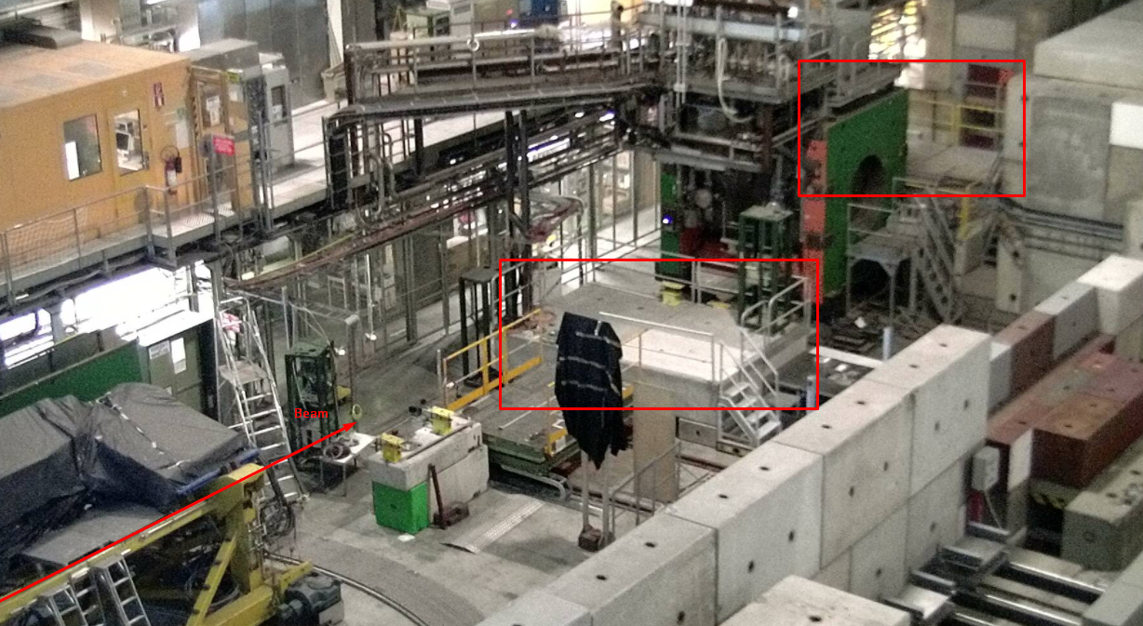
Our assigned H2 beam area

Slide 5
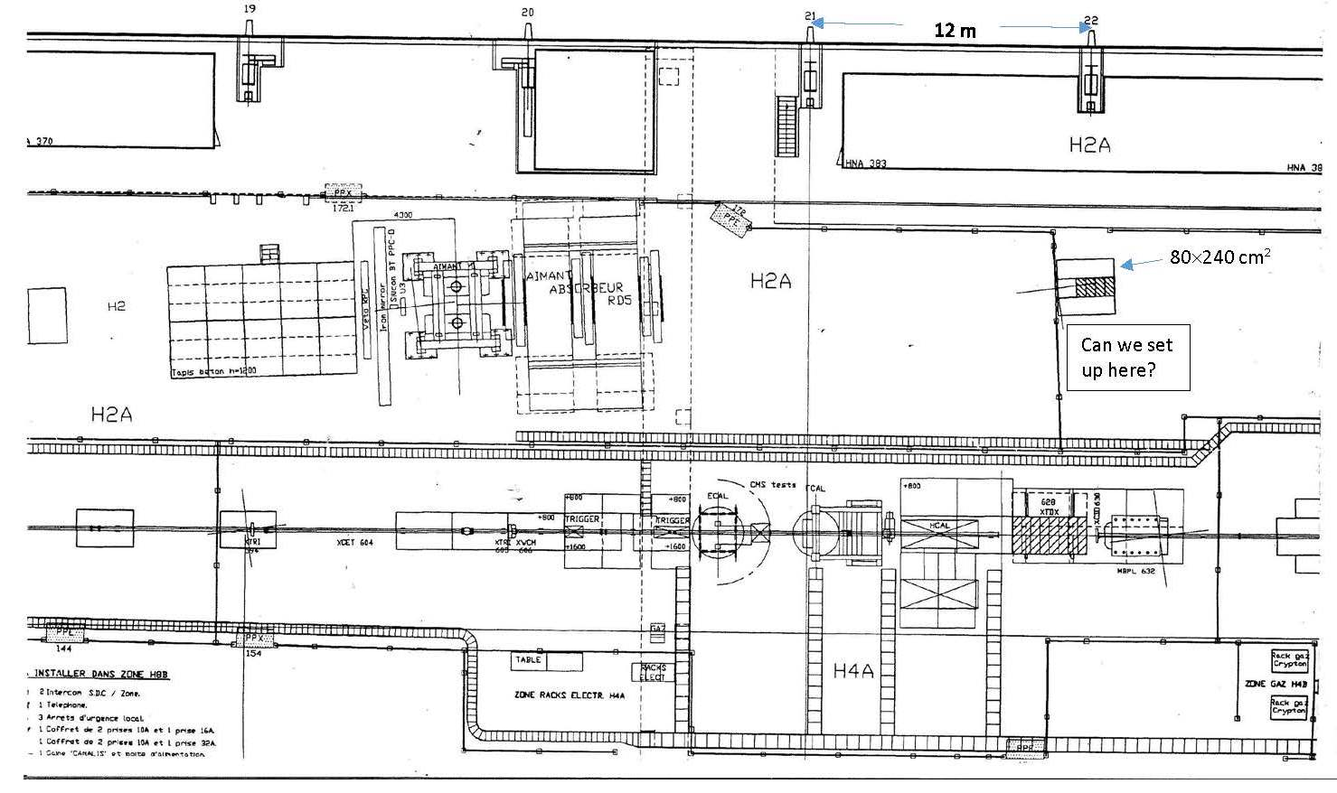
Drawing from 1995

Slide 6
Critical Milestones (With dates)
Receive Sr-90 source from IPPE ?
Prepare system DAQ test – Start 17 May
Full system DAQ test – Start 14 Jun
Full system cryo test – Start 21 Jun
Determine Sr-90 activity
How to beat down the electronics noise
Ship apparatus to CERN – 7 Jul
Team arrives at CERN – 21 Jul
Beam starts – 4 Aug

