Slide 1
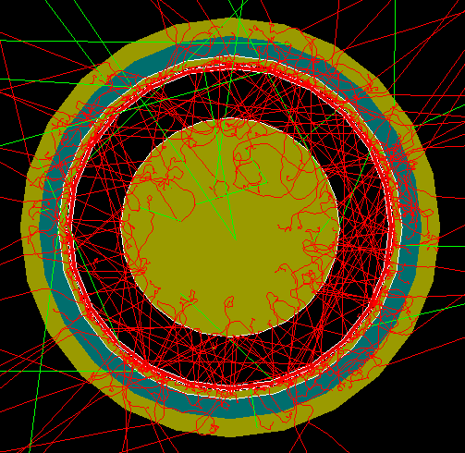
FCalPulse Local Mtg
J.Rutherfoord
6 May 2021
v1

Slide 2
Outline
Latest news
Critical Milestones
Rob Walker report
Producing the Strontium foil
Sasha Savin – Timing of the Scintillator Signals

Slide 3
News
No response yet from
SPS Coordinator re swapping weeks
IPPE re shipping tooling/parts to Obninsk
Monnier re “Essential Worker” status
Travel restrictions on US side - no problem?

Slide 4
Critical Milestones (Need dates)
Receive Sr-90 source from IPPE
Full system DAQ test
Need proxy for BPC readout
Calibration and other auxiliary runs
Full system cryo test
Determine Sr-90 activity
How to beat down the electronics noise
Ship apparatus to CERN

