Slide 1
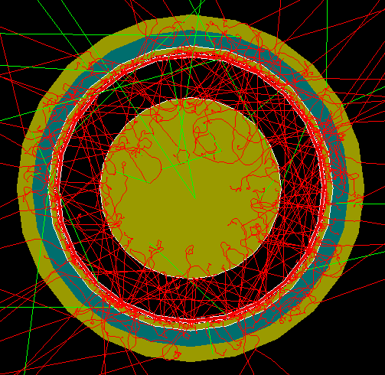
FCalPulse Local Mtg
J.Rutherfoord
22 April 2021
v1

Slide 2
Outline
ITEP Beam Profile Chambers
Rob Walker report
Producing the Strontium foil
Sasha Savin – Triggering phototube status
Dan Tompkins – On-line control to/from outside

Slide 3
ITEP Beam Profile Chambers
Measures the track of the incident electron
Electron exits the vacuum beam pipe
Travels through air and BPCs
Enters our cryostat
Vacuum Beam Pipe
Our Cryostat

Slide 4
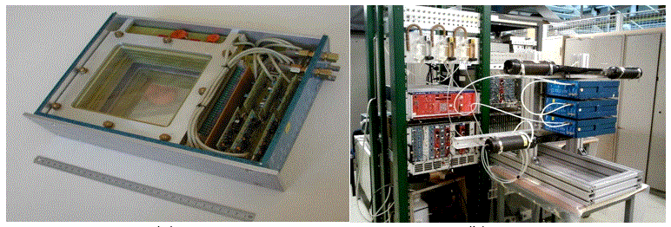
ITEP BPCs
Cover opened on one BPC assembly
Three BPCs stacked vertically with cosmic ray trigger

Slide 5
Half of a BPC Assembly
Plane of anode wires perpendicular to the page
Two planes of cathode wires running perpendicular to the anode wires
Each cathode wire is connected to its image on the other side of the anode plane
• Gas: 80% Ar + 20% CO₂ at 1 atmosphere
• 25 anode wires, 6 mm spacing, 20 μm diameter
• All anode wires are connected together
• 31 cathode wires, 4 mm spacing, 100 μm diameter in each of the two planes.
• 5 mm from anode plane to either cathode plane
• The other half is identical but rotated by 90° about the beam axis.

Slide 6
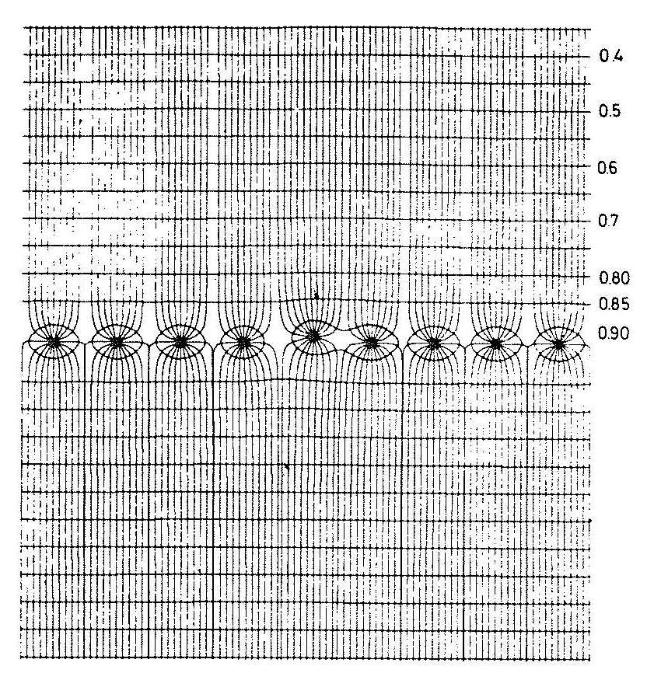
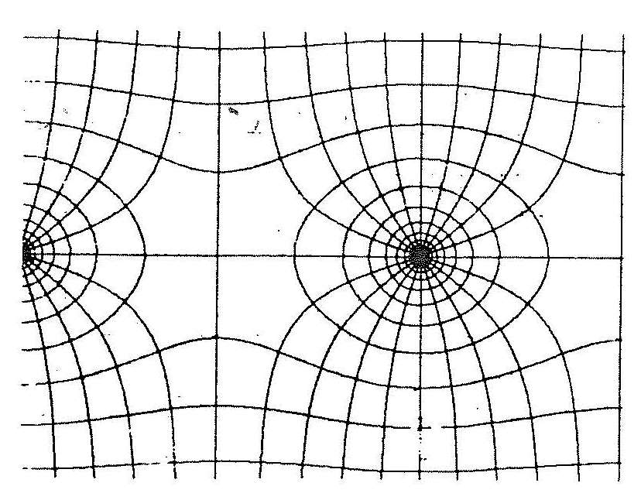
Electric field configuration
Electric field lines and equipotential planes.
Potential between planes: 2250 V

Slide 7
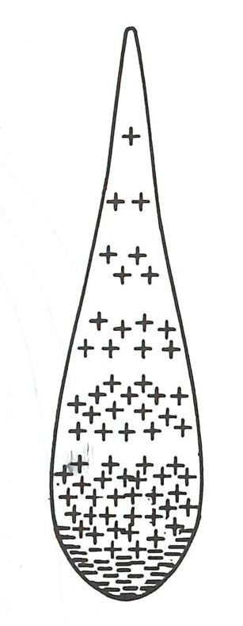
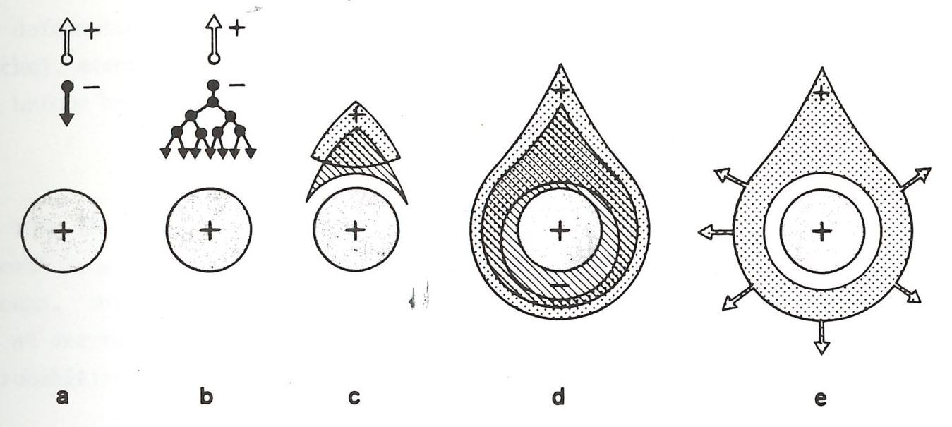
Ionization at one anode wire
Time evolution from a to e
Consider just one ion pair out of ~ 30 per track

Slide 8
Cathode Delay-Line Readout
One cathode wire fires
Amplifier-shaper
To TDC
To TDC
Pulse travels on lumped delay line (slow propagation speed)
A “lumped” delay line is a pseudo transmission line made up of discrete inductors and capacitors

Slide 9
The measurement
Sum of times is a constant (if only one cluster of cathode wires fire)
Time difference determines position of cluster
ITEP BPCs resolution < 200 μm

