Slide 1
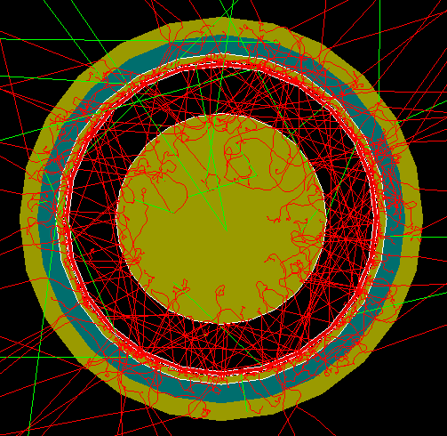
FCalPulse Local Mtg
J.Rutherfoord
15 April 2021
v1

Slide 2
Outline
Beam time
Rob Walker report
Producing the Strontium foil
Sasha Savin – Triggering on events
Evan LaForge – Simulated beam spot y vs x

Slide 3
Data taking at CERN
Each electron passing through our scintillators is an “event”.
For each event we record
Signals from the digitizers (24 channels)
Digitize the voltage every 2 ns for 10 μs
Signals come from LAr gaps and scintillators
Signals from the beam chambers
Time of pulse from magnetostrictive readout
Pulse amplitudes

Slide 4
Data taking at CERN –
Expect 10 to 1000 events per “spill”
Spill lasts for ~ 4 seconds
Spills come every ~ 24 seconds
A “run” will be ~ 20 minutes long
Each run may have different settings

Slide 5
Data taking at CERN - Settings
Vary rod/tube electrode HV
Take a series of runs with a range of HV settings on the rod/tube electrodes
Range: 50 V < HV < 250 V
Both HV polarities
Switch between upper to lower assemblies
If time allows, we may add some O₂ to the LAr

Slide 6
HV Settings
Ideally we would vary the ionization rate-density “D_{i}” from the Sr-90 beta source. But we can’t.
By varying the HV we are varying the critical ionization rate-density “D_{c}”
We expect the space-charge effects to depend on the ratio “r” of the actual ionization rate to the critical value.
r ≡ D_{i} /D_{c}

Slide 7
Varying the HV
In the Forward Calorimeters in ATLAS the HV will unavoidable vary (sag).
This sagging is mostly what drives the FCal electrodes into the space-charge regime.
Why does the HV sag?

Slide 8
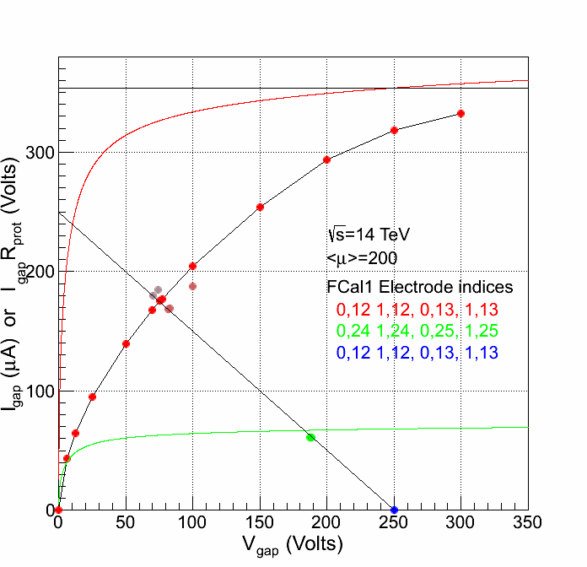
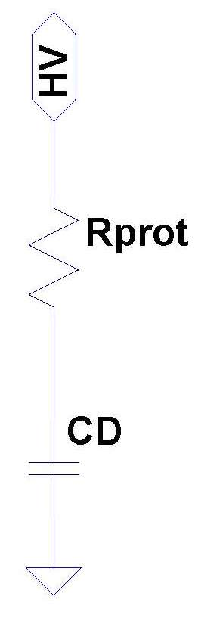
Ans: The protection resistors
250 V
I_{gap}
V_{gap}

