Slide 1
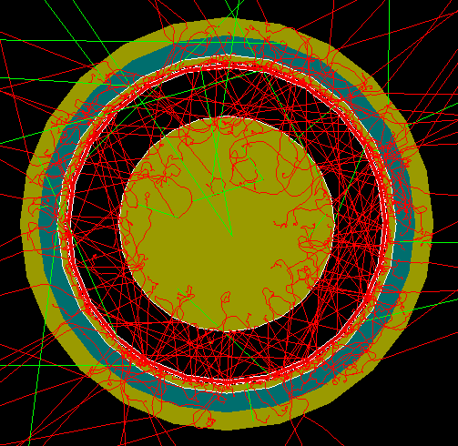
FCalPulse Local Mtg
J.Rutherfoord
8 April 2021
v1

Slide 2
Outline
Beam time
Rob Walker report
Sticking the Strontium salt to the foil
Nick Foo – SPS begin/end spill signal simulation
Graham Woolley - Aligning rod/tube pulses
Sasha Savin – Trigger scintillators

Slide 3
Test beam time in the CERN North Area
Preliminary news from the CERN SPS coordinator
H4 beam line is over-subscribed
We are tentatively scheduled for
1 week of beam
In the H2 beam line
Mid-August
First version of schedule out in 2 weeks

Slide 4
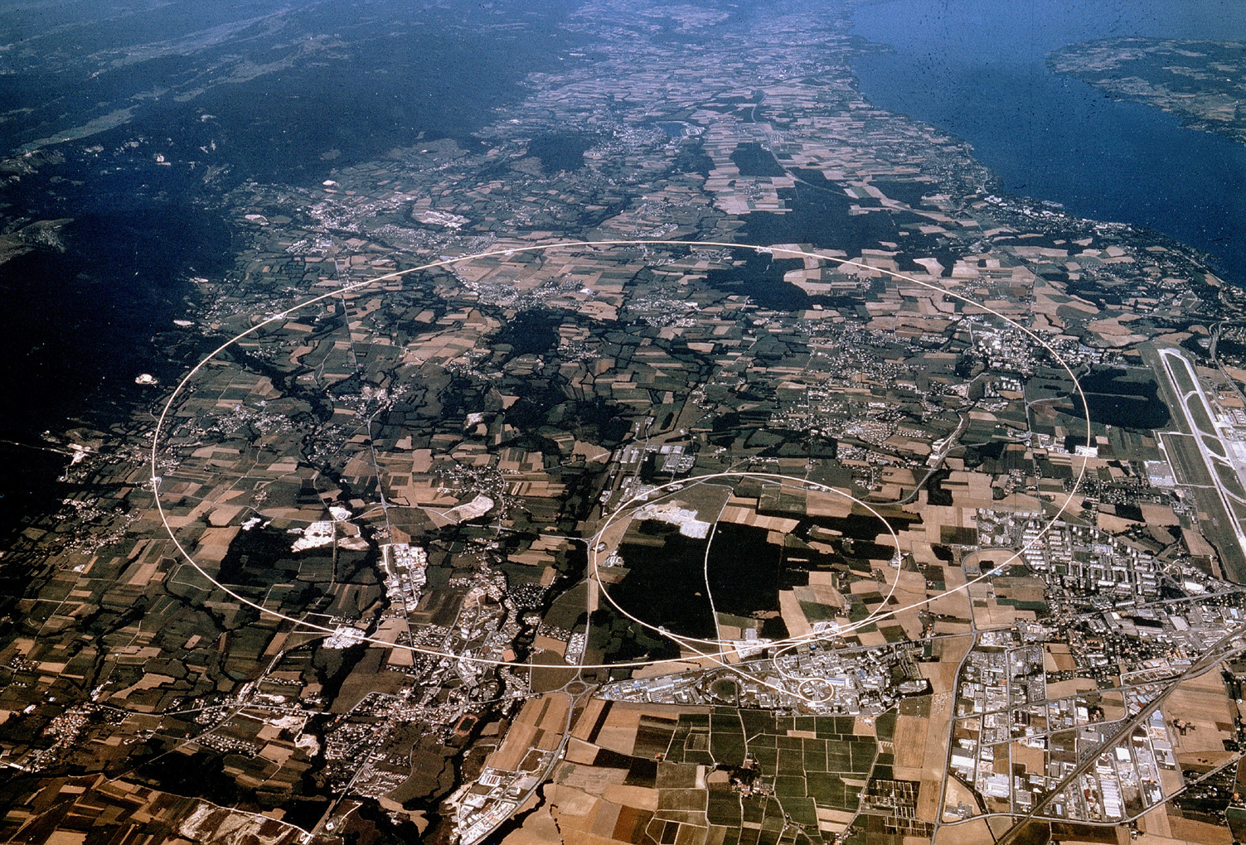
Lake Geneva
Airport
North Area
SPS
ATLAS
LHC

Slide 5
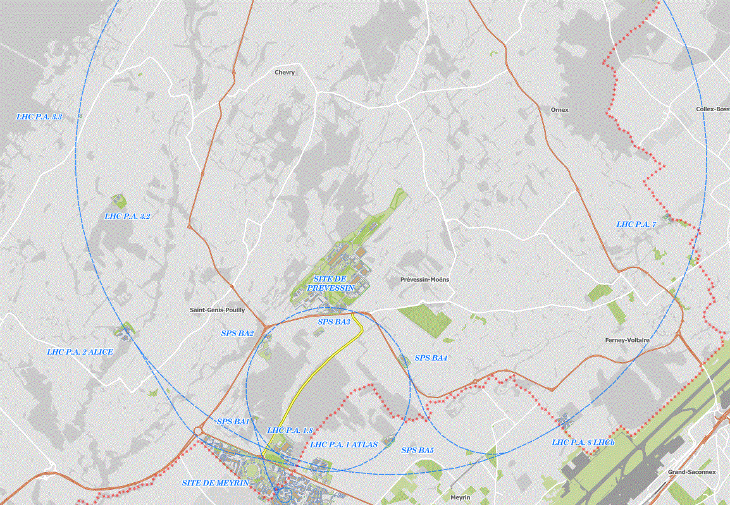

Slide 6
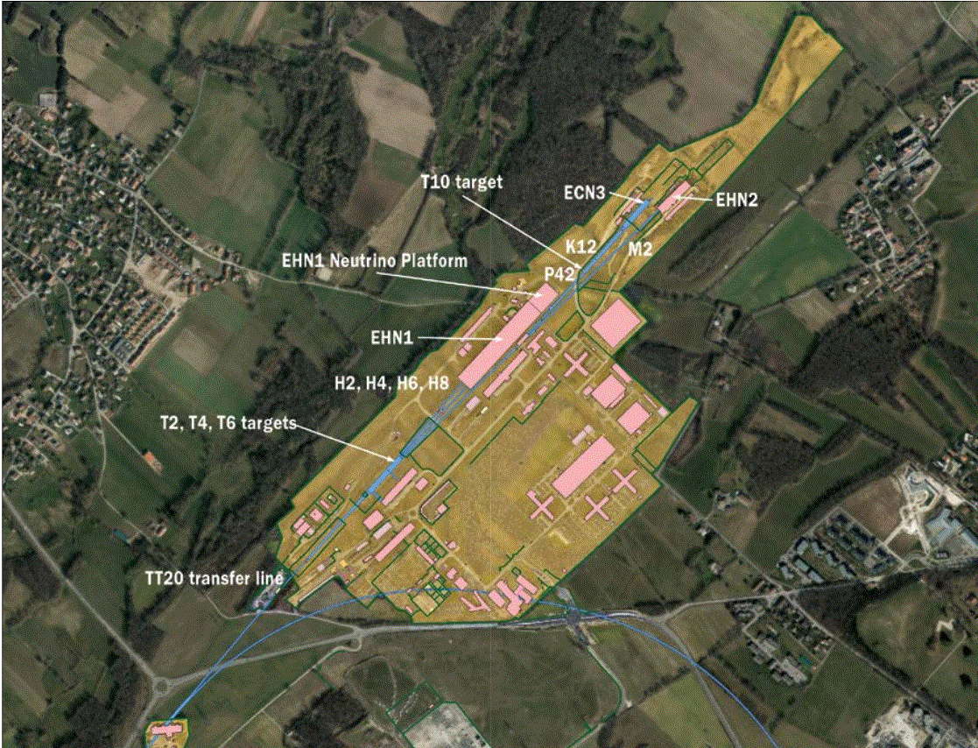

Slide 7
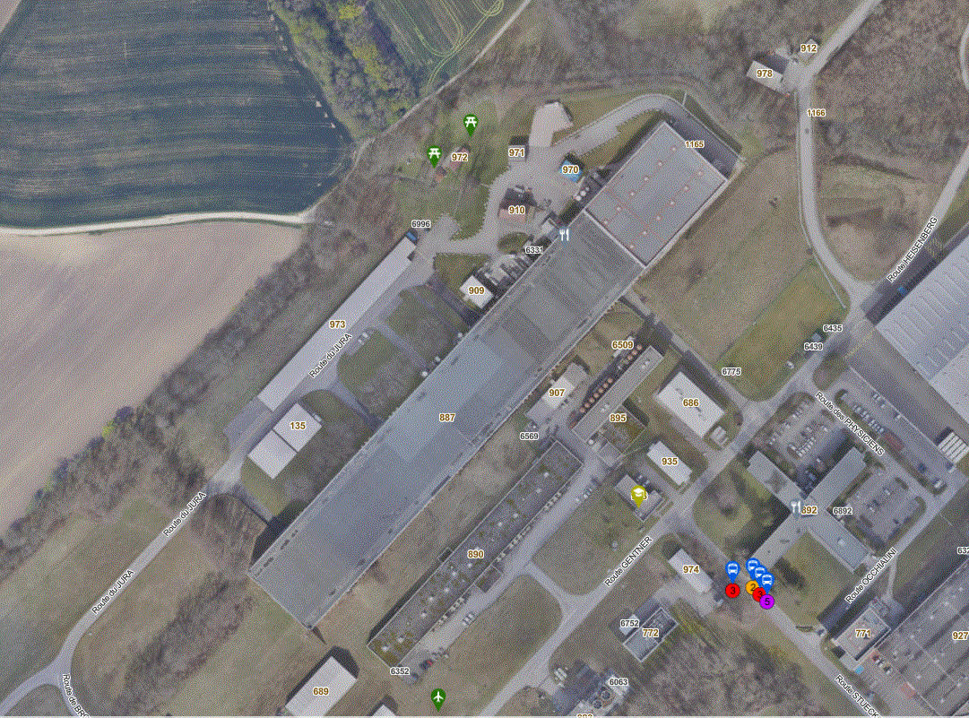

Slide 8
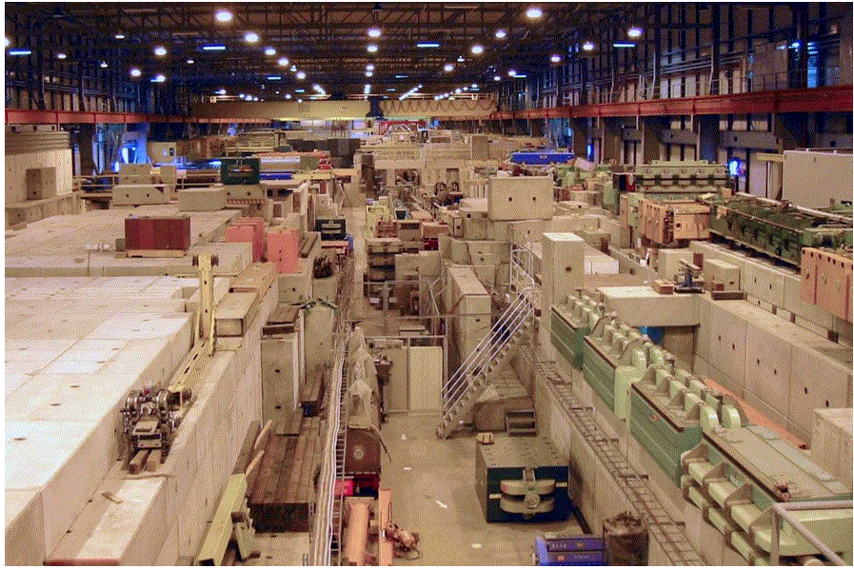

Slide 9
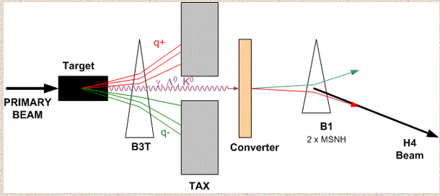
Tertiary electron beam

Slide 11
