Slide 1
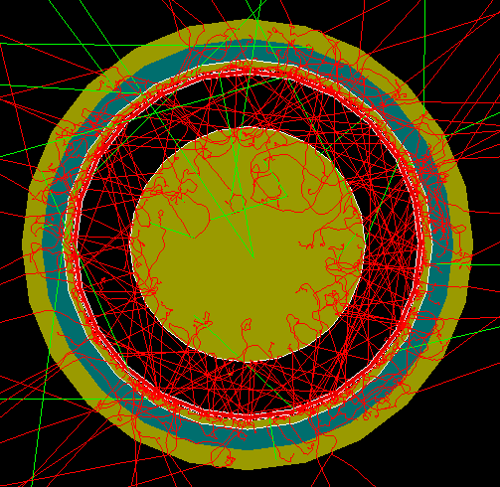
FCalPulse Local Mtg
J.Rutherfoord
1 April 2021
v1

Slide 2
Outline
New PreAmplifiers
Rob Walker report
Sticking the Strontium salt to the foil
Jobs in the shop
Justin Hink and Evan LaForge
Shower leakage out the sides
Graham - update on “Adding Pulses”

Slide 3
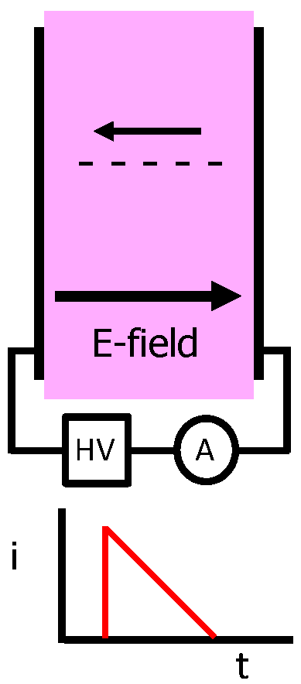
FCalPulse Readout
Pink is liquid argon between two electrode plates
Leonid Kurchaninov (TRIUMF) provided
22 preamp channels
16 digitizer channels
Pulser by Giam Jia Hao
HV board by Dan Tompkins
A is current measuring device
Schematic of one channel (of 22) of our current measuring devices

Slide 4
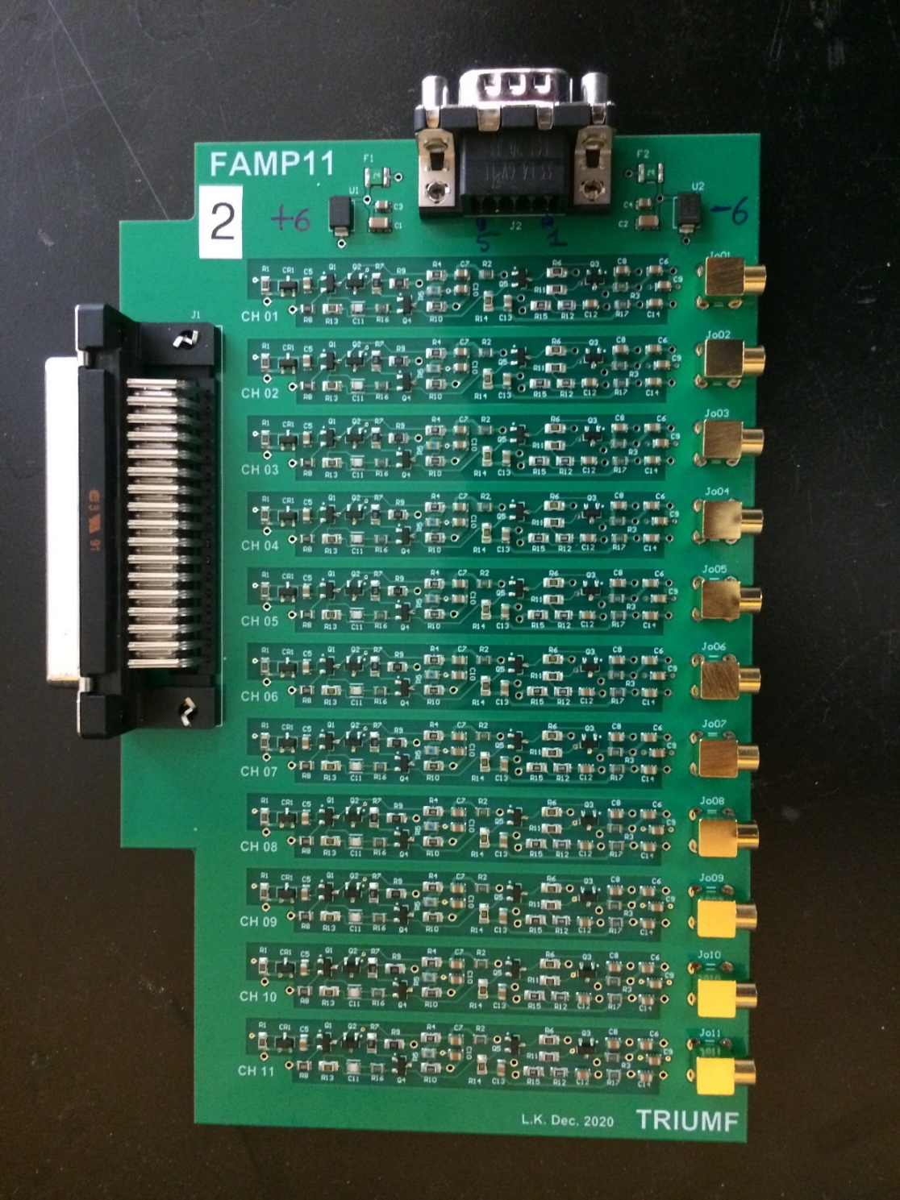
One of 5 boards shown here Each preamp board has 11 channels One channel is in the red box We need two boards Input on the left Output on the right ±6 V power at the top
FCalPulse Preamps

Slide 5
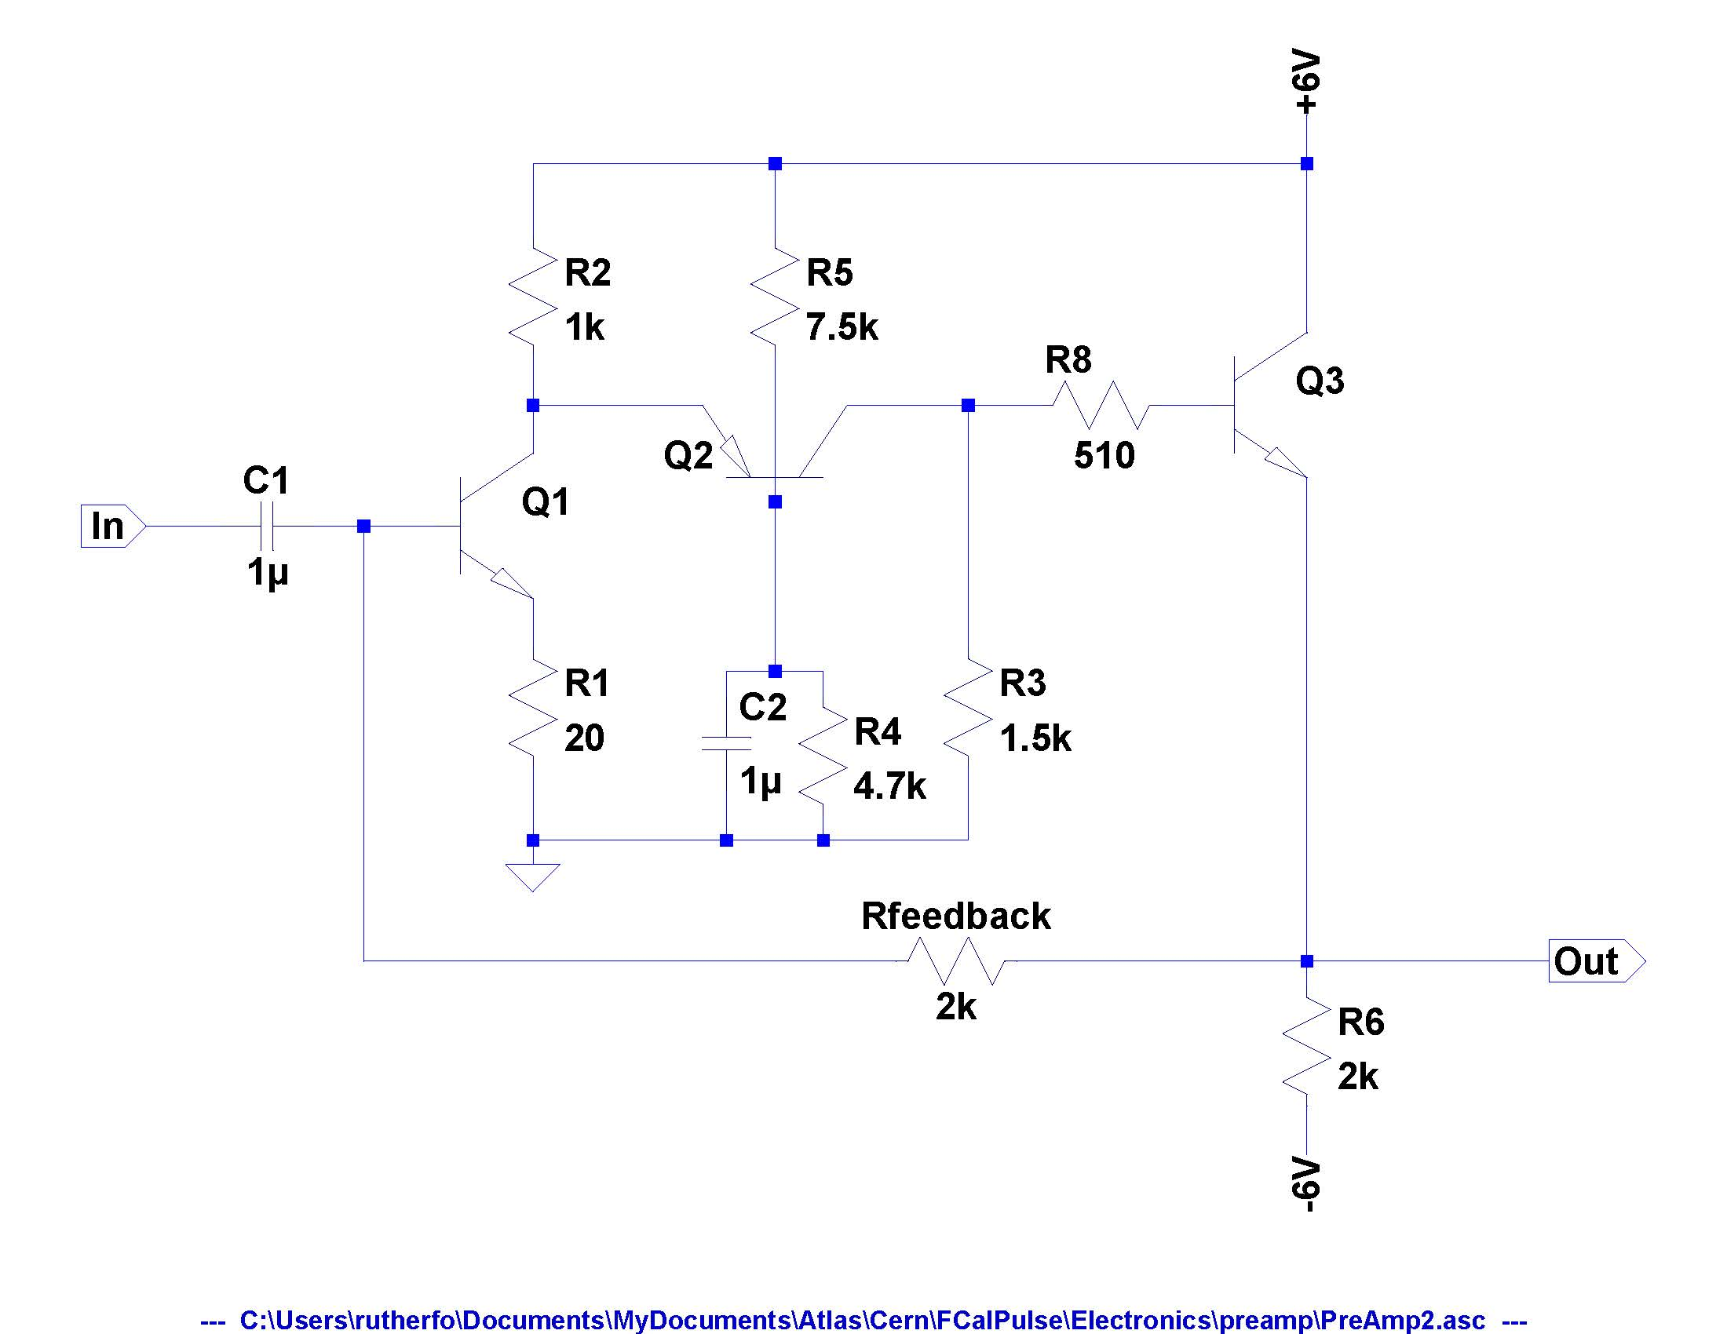
Emitter follower
Small load on previous stage
Current amplifier
Common emitter with emitter degeneration Low noise.
Cascode configuration
Good high frequency performance
Common base
Makes input look like ‘cold’ 50 Ω

