Slide 1
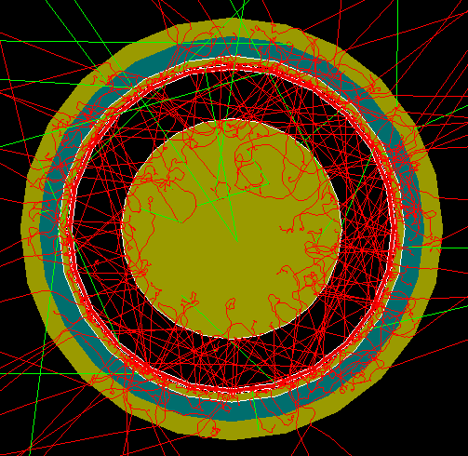
FCalPulse Local Mtg
J.Rutherfoord
25 March 2021
v1

Slide 2
Outline
New PreAmplifiers
Rob Walker report
Sticking the Strontium salt to the foil
Jobs in the shop
Sasha – Trigger scintillators and their PMTs
Justin Hink and Evan LaForge
Finding pair-production in geant EM showers
More on correlations in EM showers
Graham - update on “Adding Pulses”

Slide 3
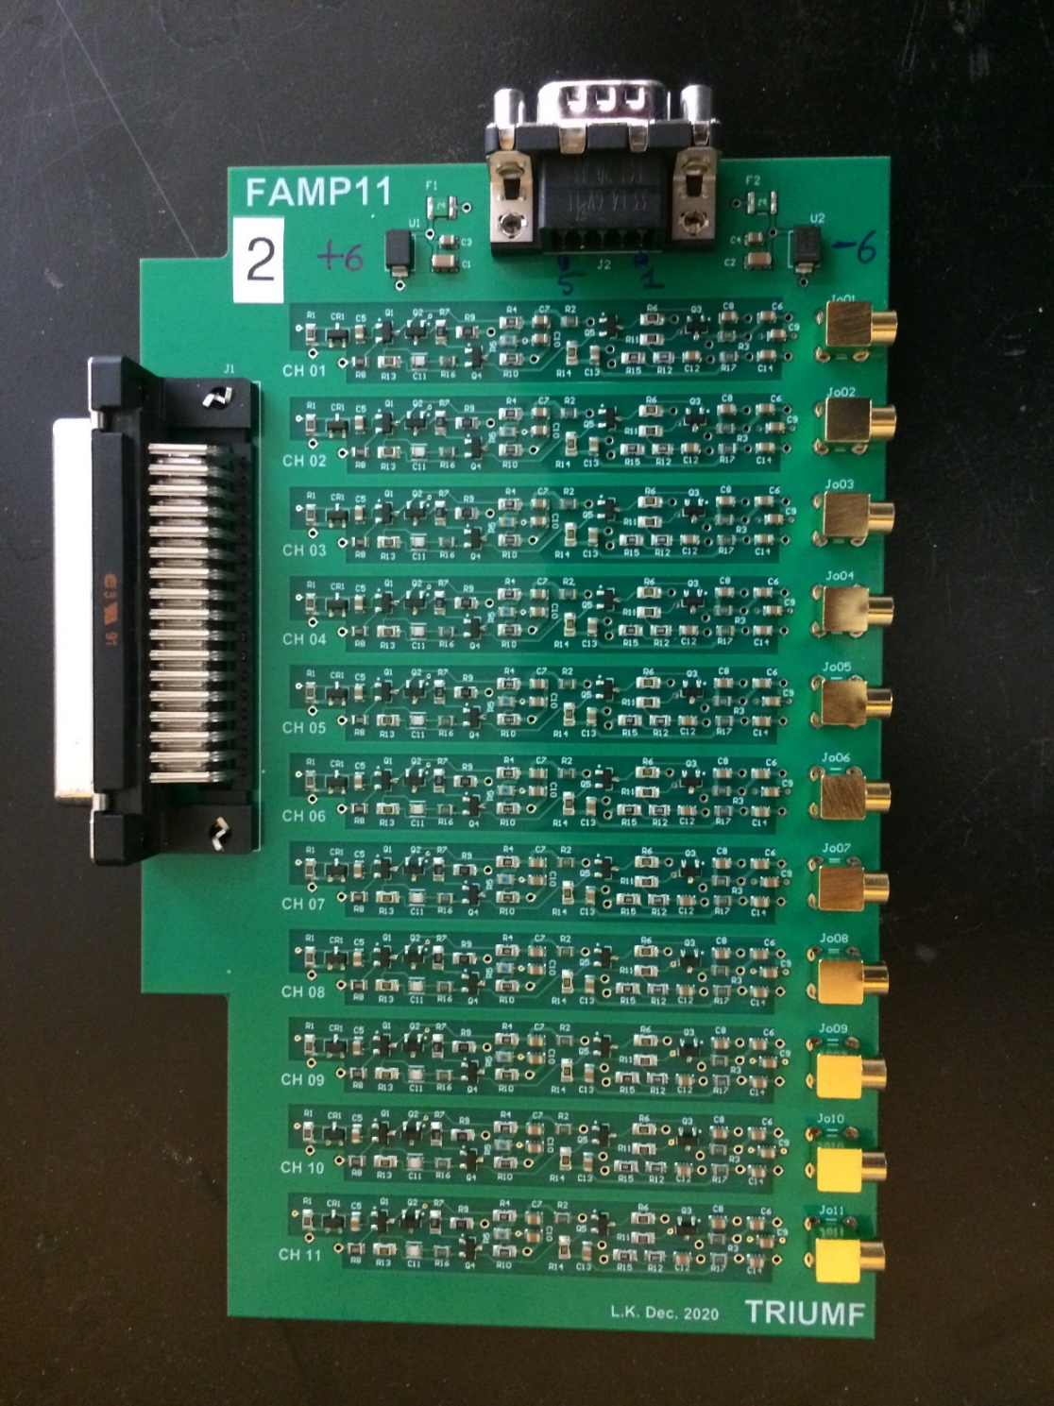
Leonid Kurchaninov shipped five preamp boards which arrived Tuesday Each preamp board has 11 channels We need two boards Input on the left Output on the right ±6 V power at the top
FCalPulse Preamps

