Slide 1
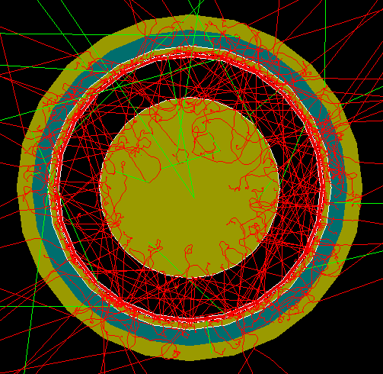
FCalPulse Local Mtg
J.Rutherfoord
18 March 2021
v1

Slide 2
Outline
Strontium-90 beta source
Updates – Rob Walker
Adding pulses to improve s/n – Graham Woolley
Correlations in the calorimeter signals from 350 GeV incident electrons – Justin Hink and Evan LaForge
If anyone has something to report please do so

Slide 3
Hot beta source - Background
Strontium-90 beta source
We want it deposited on a foil
Activity of 100 mCi
Beta emitter – betas ionize the liquid argon
We collect the ionization electrons
Source foil
10 mm
Shell

Slide 4
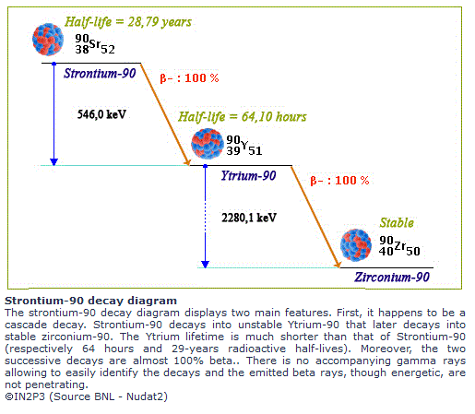
Strontium-90 Decay Chain

Slide 5
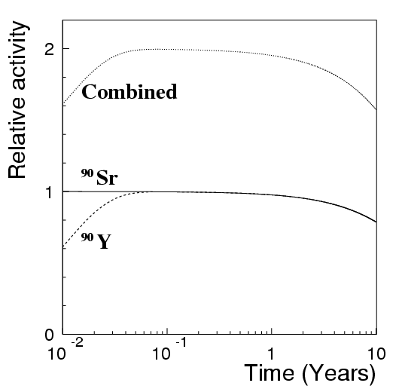
Activity vs time
When purchasing, the specified activity of the source applies to the Strontium-90 only.
The actual activity is twice the specified activity within a month after production.

Slide 6
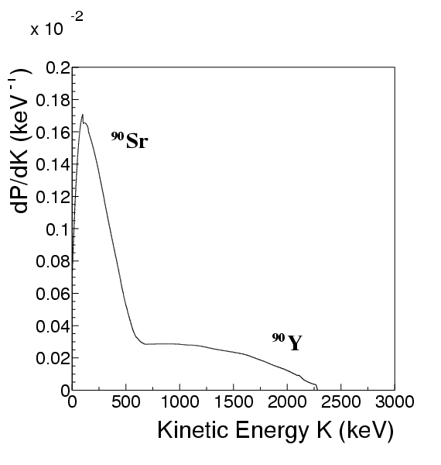
Beta Decay Spectrum
Endpoint KE
Sr-90: 0.55 MeV
Y-90: 2.28 MeV
The dip as KE → 0 is an artifact of the measurement.

Slide 7
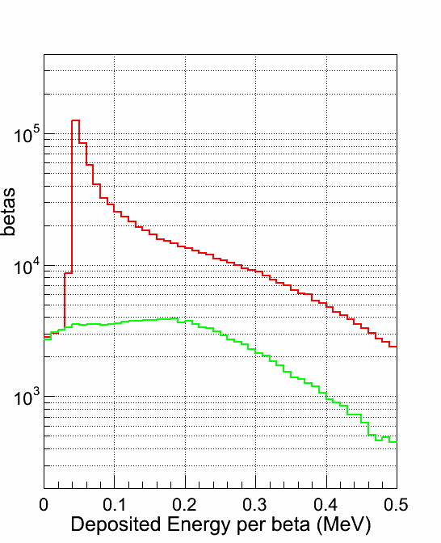
Energy deposited in the LAr gap by a single beta
One ionization electron from every 23.6 eV of deposited energy at E-field of 2.2 kV/mm
First arrow: Energy deposit by a beta of KE=1 MeV moving normal to the electrodes.
Second arrow: Average deposited energy by a beta.
Red: Any beta entering the LAr gap.
Green: Subset which do not cross the gap

Slide 8
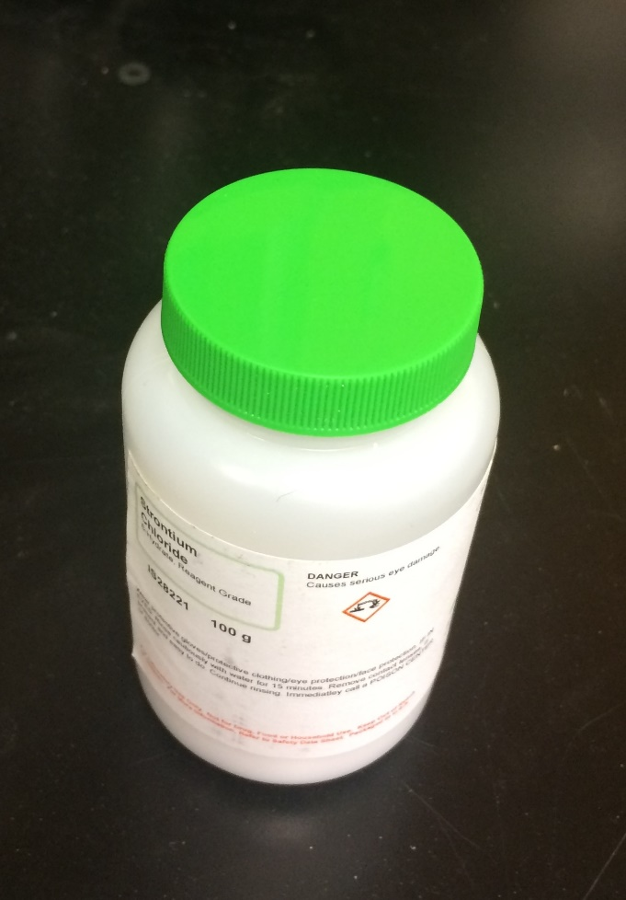
Strontium-90 Production
From U-235 and Pu-239 fission
Extracted from spent fuel rods
5.8% of all U-235 fissions produces Sr-90
Chemically combined with Chlorine
SrCl₂ is a hygroscopic salt
Analogous to CaCl₂
SrCl₂⋅6H₂O
ρ=1.93 g/cm³

