Slide 1
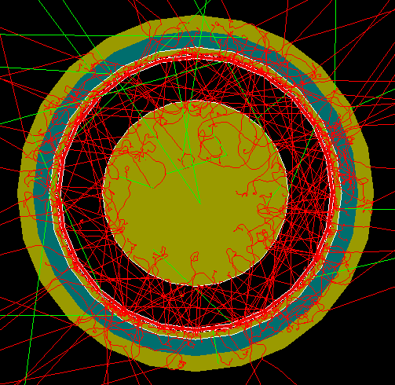
Local FCalPulse Mtg
J.Rutherfoord
11 March 2021
v1

Slide 2
Outline
Shower calorimeter tungsten plates
How to proceed with Sr-90 beta source - Rob
Simulating FCalPulse raw data and writing data analysis code – Graham Woolley
Off-axis 350 GeV electrons impinging on our test beam setup – Justin Hink
Energy deposits in the LAr from 350 GeV electrons – Evan LaForge

Slide 3
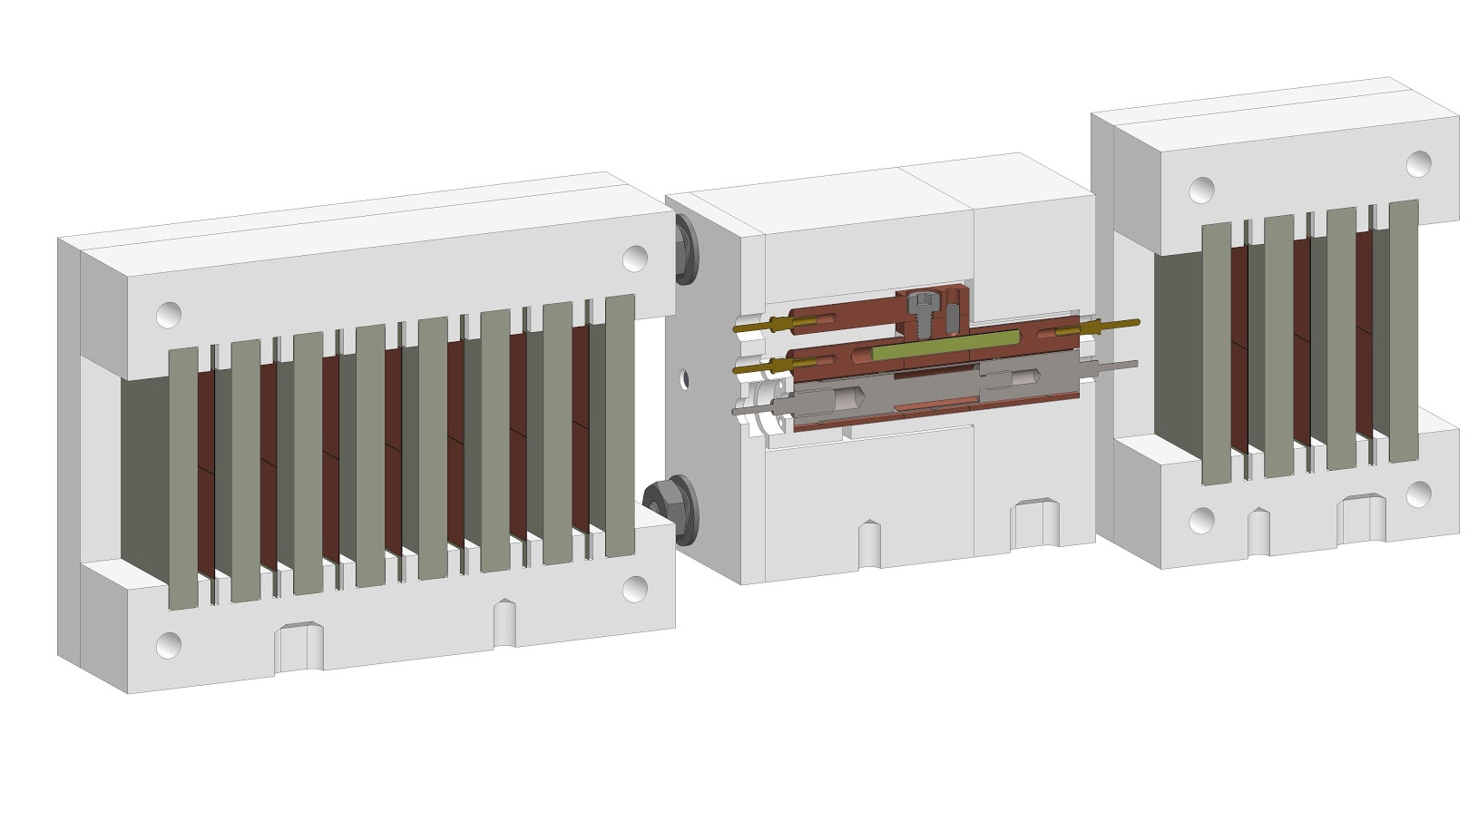
Shower Calorimeters on L/R

Slide 4
The Shower Calorimeters
IHEP/Protvino (Sergey Denisov) has produced 26 30×30×3.5 mm³ W plates
Will ship to MPI/Munich in early April
MPI (Sven Menke) will ship to us
We will make the shower calorimeters
For detailed data on the W plates see https://indico.cern.ch/event/1013221
For the parts drawings see (next slide)

Slide 5
Links to photos and drawings
For FCalPulse mechanicals see
https://goo.gl/photos/8f2G1mHXgcDtDAnX9 for drawings
https://photos.app.goo.gl/peQ1GosCpxrPe7N5A for pictures
Or
http://atlas.physics.arizona.edu/Arizona_Atlas_Downloads/walker/FCalPulse

Slide 6
Hot beta source - Status
Manufacturer: IPPE Obninsk
We asked them to pause production
Their proposal to enclose the SrCl₂ in 100 μm of Indium is unacceptable.
Indium is too dense and Z is too high
Defeats the point of the thin Titanium shell wall
Source foil
10 mm
Shell

Slide 7
