Slide 1
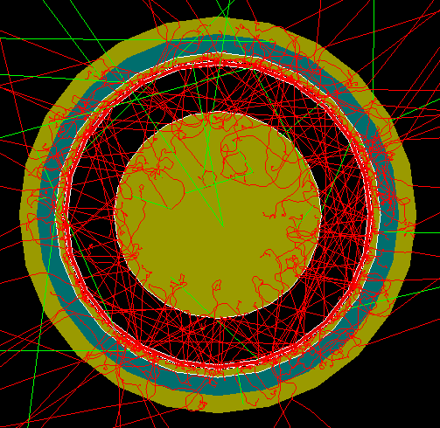
Local FCalPulse Mtg
J.Rutherfoord
4 March 2021
v1

Slide 2
Outline
PowerPoints from past Local Group Meetings
Status of preamps
Latest on the Sr-90 beta source
Fast trigger
Status of shower calorimeters
Analysis of simulated 350 GeV electrons impinging on our test beam setup

Slide 3
FCalPulse Local Group Meetings
Powerpoints of the talks of past meetings can be found at http://atlas.physics.arizona.edu/Arizona_Atlas_Downloads/FCalPulse/LocalTalks

Slide 4
FCalPulse Preamps
Amplifies the calorimeter signals
11 + 11 channels
Designed and built at TRIUMF (Leonid)
New, more robust design
Printed-circuit boards completed
Boards and components at assembly house
Expected to be returned in a week
Another week to test and certify

Slide 5
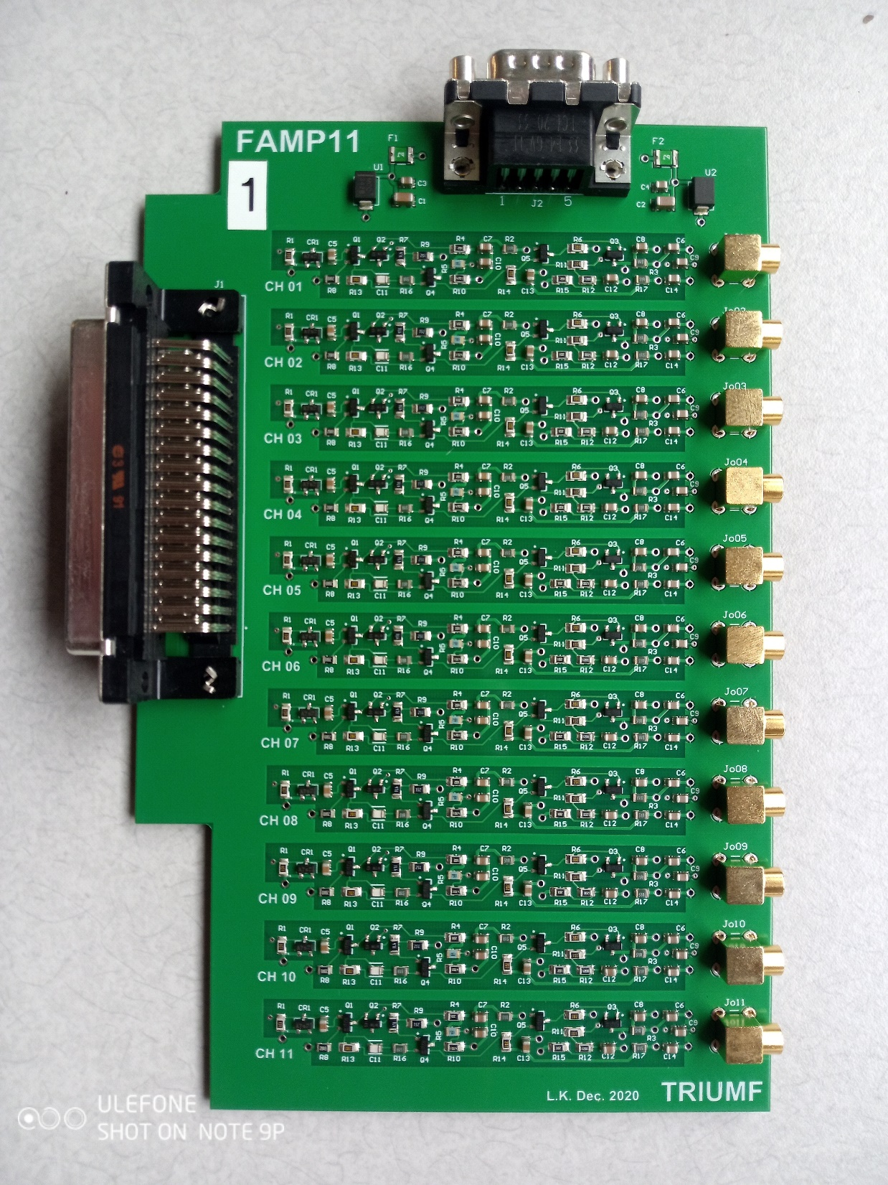
New PreAmps
Leonid Kurchaninov
Delivered to TRIUMF
Testing started – will extend into next week
We might receive them late next week or the following week.
Now 11 channels/board
♦ Need 22 channels in all
More space between channels for better isolation
Improved filtering on low voltage power

Slide 6
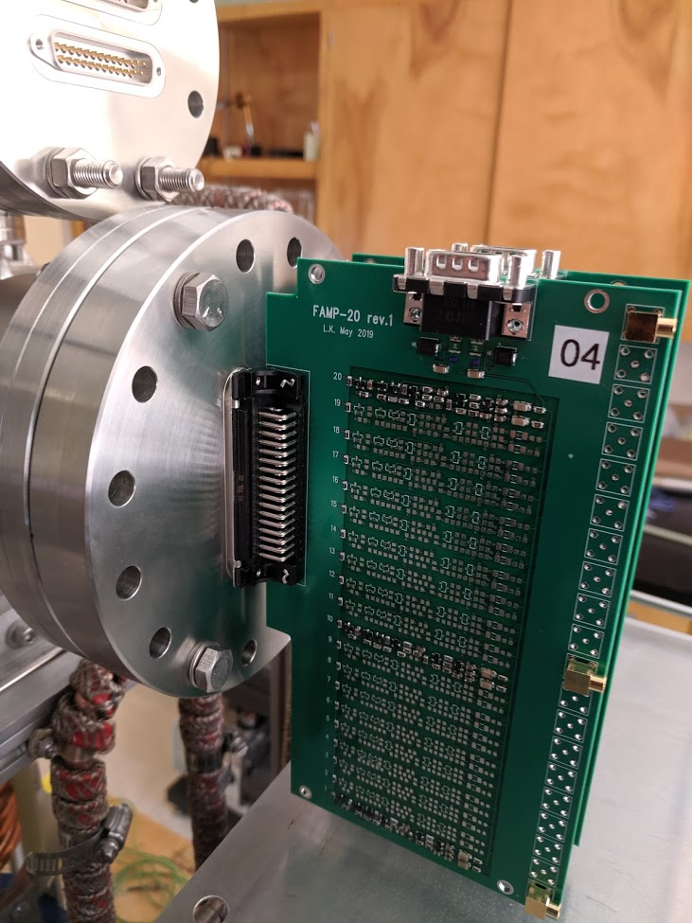

Slide 7
Hot beta source - Status
Manufacturer: IPPE Obninsk
We asked them to pause production
Their proposal to enclose the SrCl₂ in 100 μm of Indium is unacceptable.
Indium is too dense and Z is too high
Defeats the point of the thin Titanium shell wall
Source foil
Shell

Slide 8
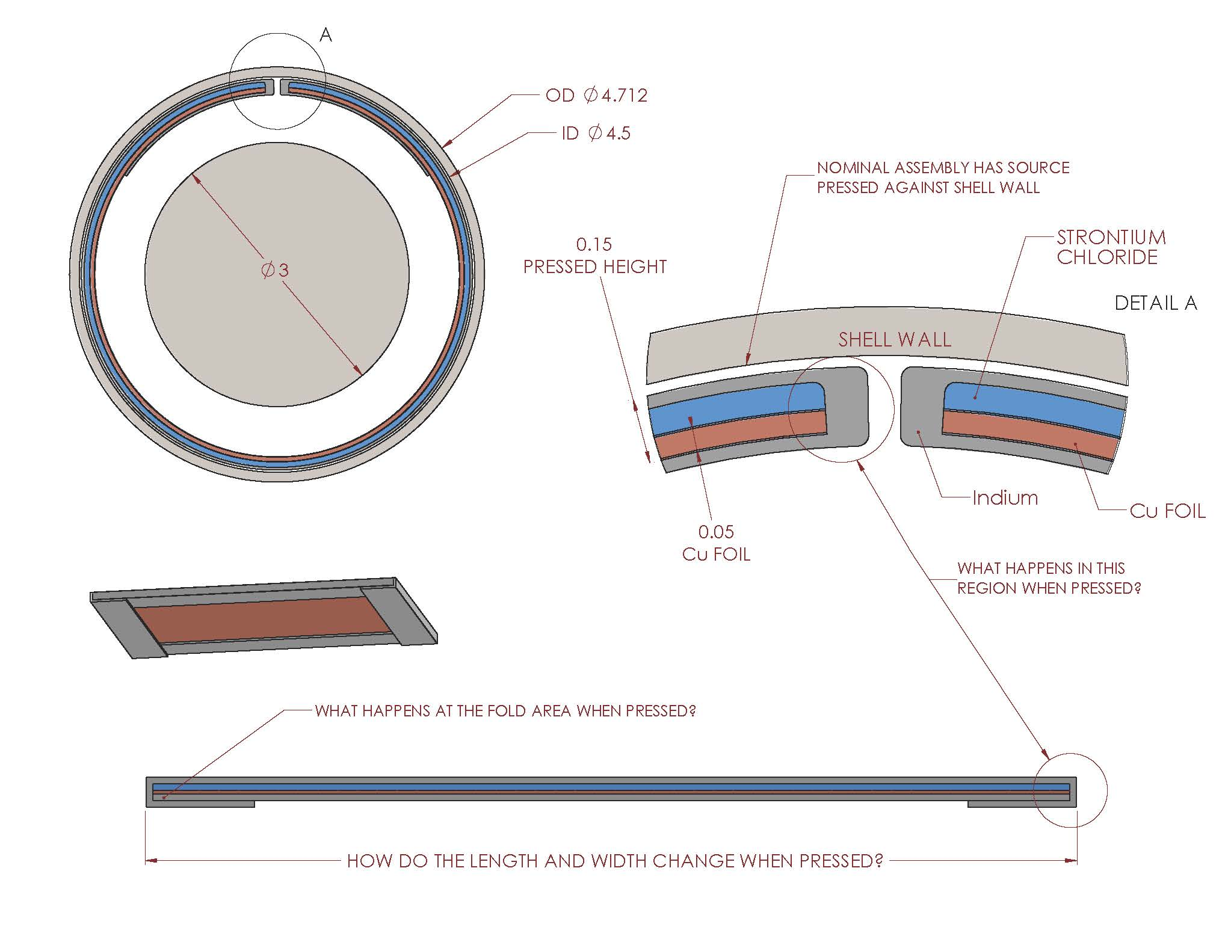

Slide 9
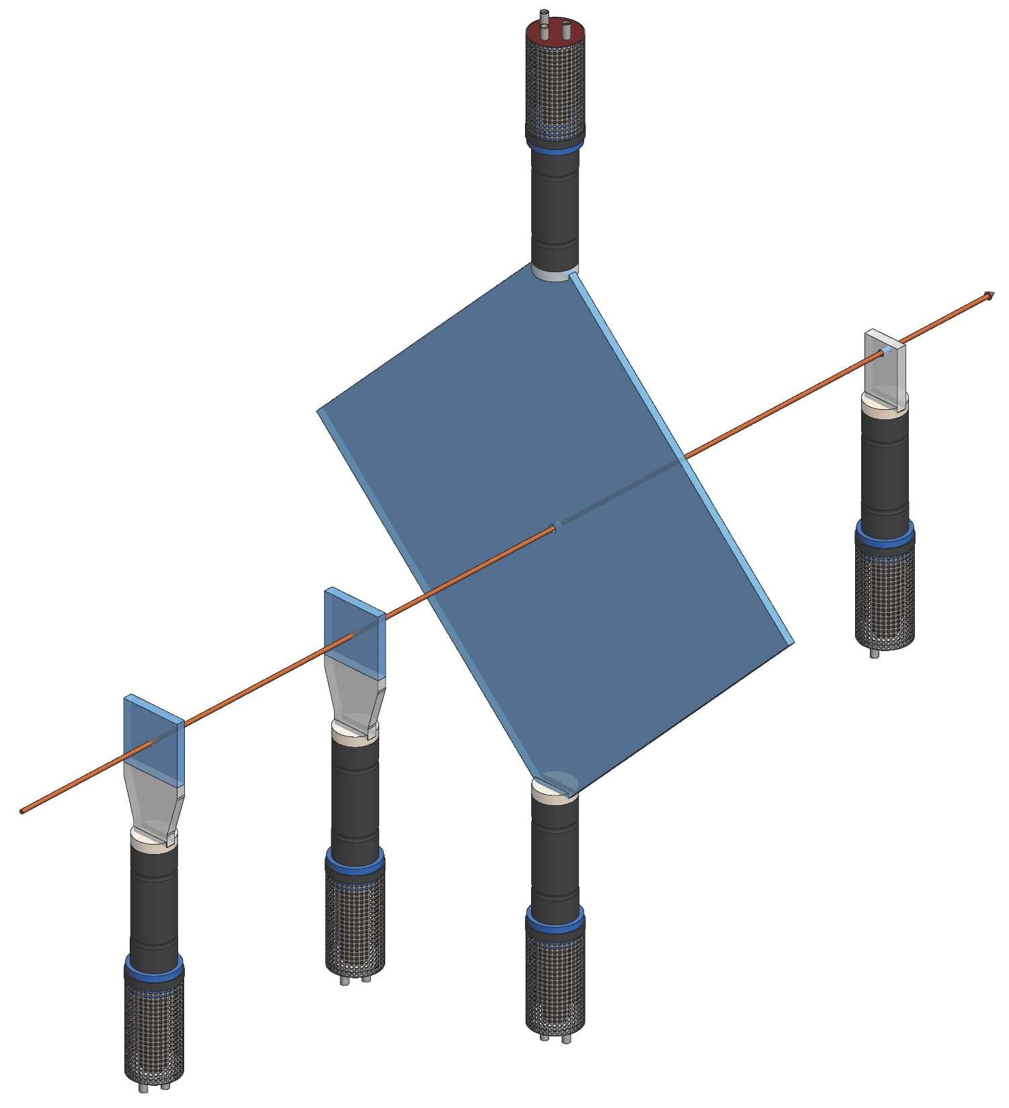
Trigger Scintillators
Ready to order scintillator plastic

Slide 10
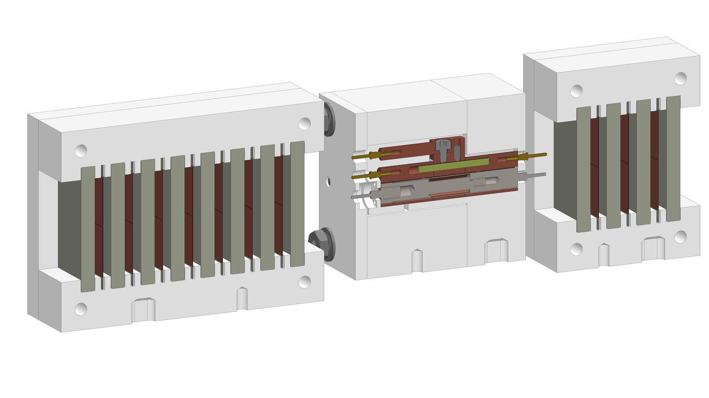
Shower Calorimeters on L/R

Slide 11
W-plate Shower Calorimeters
Purpose
Develop EM shower which is max at PEEK block
News from IHEP/Protvino (Sergey Denisov)
Tungsten plates are completed
Trouble drilling holes for ground pins

