Slide 1
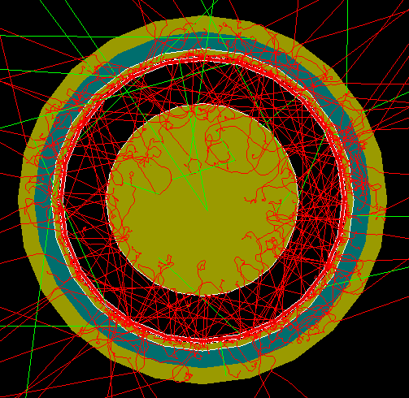
FCalPulse Local Mtg
J.Rutherfoord
25 February 2021
v1

Slide 2
FCalPulse Collaboration - Local
University of Arizona group
Prof John Rutherfoord
Prof Erich Varnes
Research engineer Alexandre (Sasha) Savin
Engineer Rob Walker
Engineer Dan Tompkins
Grad student Billie Lubis
Ugrad Nick Foo
Ugrad Graham Woolley
Ugrad Justin Hink
Ugrad Evan LaForge

Slide 3
FCalPulse International Collaborators
TRIUMF – Canada: Leonid Kurchaninov
IHEP – Protvino: Sergey Denisov
ITEP – Moscow: Petr Gorbounov and Pavel Shatalov
JINR – Dubna: Alexander (Sasha) Cheplakov and Victor Kukhtin
CERN – Switzerland: Martin Aleksa

Slide 4
Outline
Status of radioactive source
Status of preamps
Request for beam time
More on the H4 beam in the North Area
Keeping the noise at bay
Simulated test beam data and analysis of that data

Slide 5
Hot beta source - Status
100 mCi Sr-90 (28.8 yr half-life) β source
~ 3 betas enter the 8 mm long LAr gap per ns
Manufacturer: IPPE Obninsk
Delays due to covid
Technical difficulties – requested new rods
Arrived in Moscow last week
Unclear when the new rods will arrive in Obninsk

Slide 6
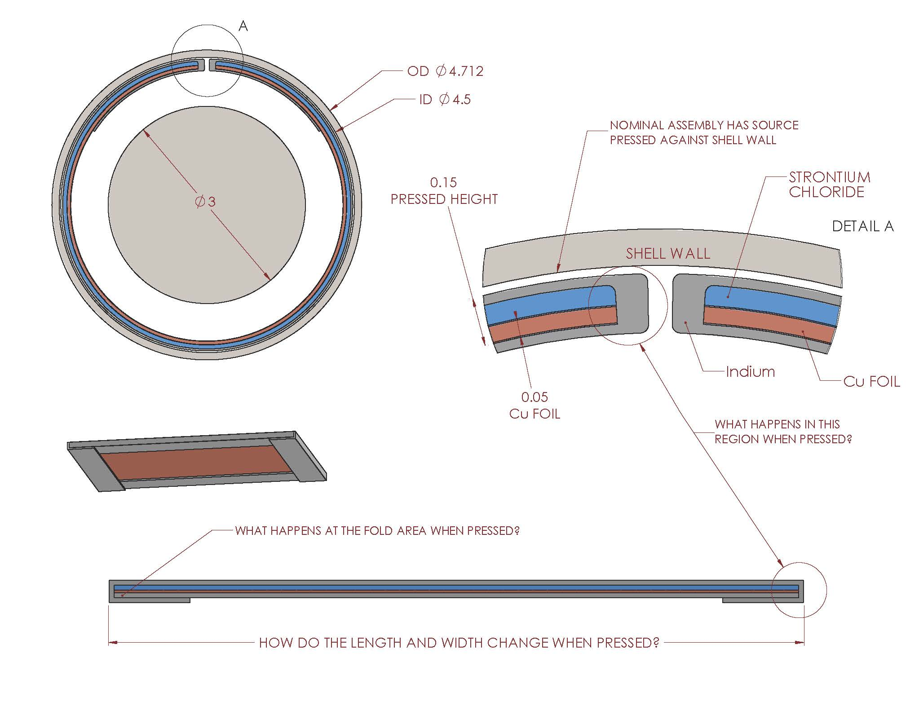

Slide 7
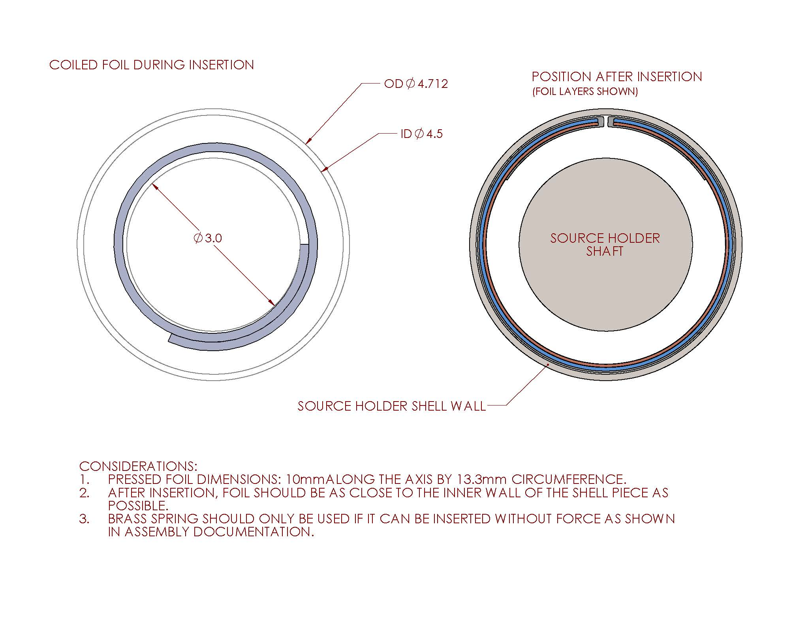

Slide 8
FCalPulse Preamps
Amplifies the calorimeter signals
11 + 11 channels
Designed and built at TRIUMF (Leonid)
New, more robust design
Printed-circuit boards completed
Boards and components at assembly house
Expected to be returned in a week
Another week to test and certify

Slide 9
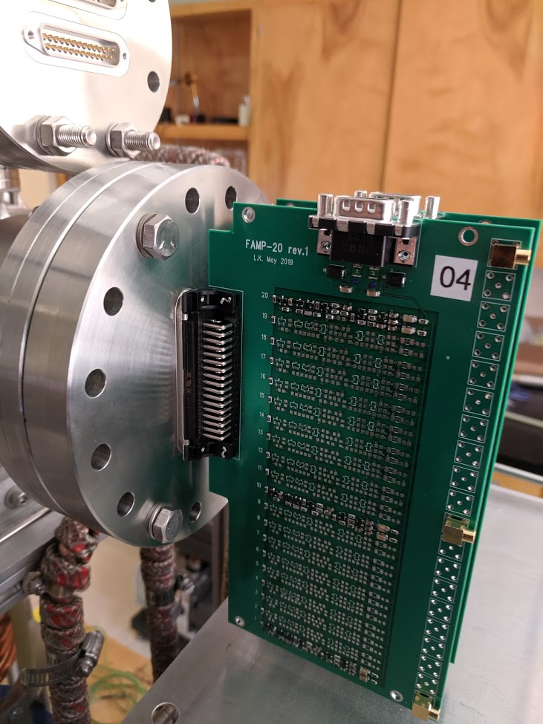

Slide 10
H4 beam line in the North Area
SPS protons are de-bunched so there is no synchronization with the RF
For adding middle segment pulses together we can use the other calorimeter signals and the scintillator signals to determine the relative phase.

Slide 11
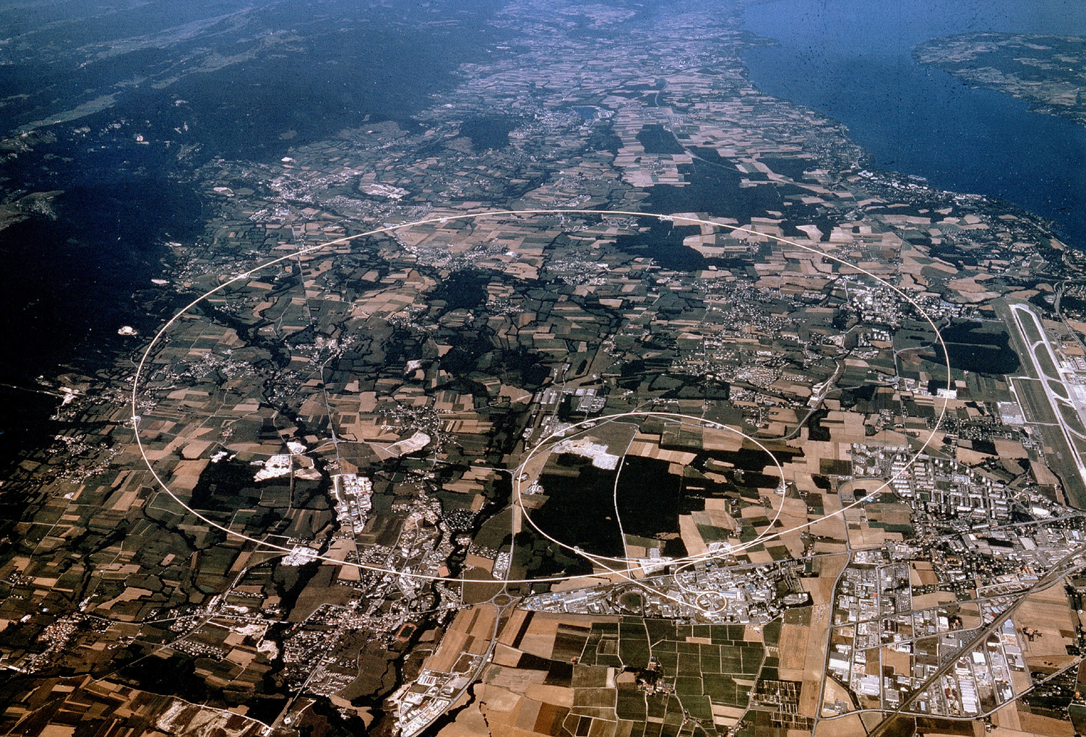
North Area
SPS
ATLAS

Slide 12
Request for beam
Officially the FCalPulse project is a part of the ATLAS Phase 2 Upgrade project
Schedule for the SuperProtonSynchrotron (SPS) shows beam available starting 15 July and ending sometime in November of this year
We have requested one week of beam
Request submitted in late January
No news yet.

